Slide 1

What if you could
ask your cameras?
// INTRODUCING HISTOR
Histor keeps a searchable memory of what your cameras see, so you can ask about it later in plain language and get answers that point to the frames.
Notes:
Histor is our video memory solution: it records everything a camera sees as searchable memory and lets you ask about it in plain language. This deck covers what it does, how it works, how it keeps footage private, and how to try it on your own video.

Slide 2
Your cameras see everything. Nobody watches everything.
// THE PROBLEM
01
02
03
Recorded, rarely watched
Searched by clock, not by content
Alerts only cover what you planned for
Most footage is only opened after something has gone wrong, and then someone has to find it.
A recorder lets you jump to a time. It can't tell you when the white van showed up.
Alerts react to the rules you set in advance. The question you have today was not one of them.
Notes:
Set up the pain, in the brochure's words: most sites have dozens of cameras and a few people watching screens, so most feeds go unseen and incidents are found hours later on the recording. Recorders search by time, not by what happened. Alerts only fire on rules set in advance.

Slide 3
ἵστωρ
// MEET HISTOR
Ancient Greek for witness, one who knows by having seen: the root of history.
Histor turns what your cameras see into a memory you can question: every tracked object, plus regular snapshots of each scene, searchable for as long as you choose to keep them.
Notes:
The name: Histor Panoptes, the hundred-eyed watchman of Greek myth, who never closed all his eyes at once. That is the product: a watchman for every camera.

Slide 4
Alerts watch for one thing. Histor remembers all of it.
// ALERTS AND MEMORY
ALERTS
MEMORY
Is it happening right now?
What happened?
Watch for a set event, like a zone being entered
React in seconds, by webhook or email
Rules decided in advance
Store every object and scene
Ask any question, any time later
No rules needed up front
Histor does both, on the same cameras: alerts for the rules you set, memory for everything else.
Notes:
Two ways to use the same cameras. Alerts answer "is X happening now?" for rules set in advance; memory answers "what happened?" afterwards, for any question. Histor runs both in one recorder, on the same detector, tracker and store.

Slide 5

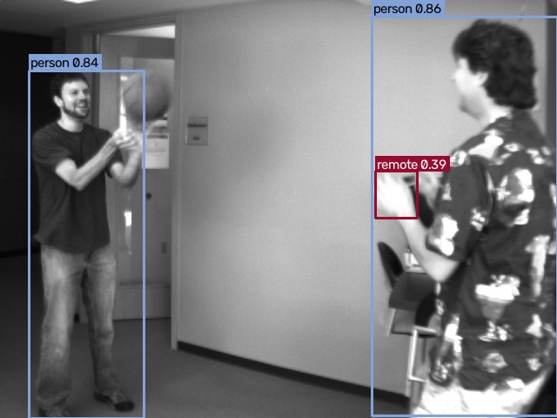



From camera to alert in four steps.
// HOW IT WATCHES
1 Connect
We plug into your existing IP cameras: Hikvision, Dahua, Reolink, Uniview, Axis or any RTSP camera.
2 Detect
AI spots people, vehicles, bags and plates in real time, and follows each one across the frame.
3 Decide
Your rules: which area, which hours, how long someone may stay before it counts.
4 Alert
The event with a snapshot: on the dashboard, by email or Telegram, or in your own security system.
Real detector output, sample video
Notes:
The watching side, as in the brochure: connect, detect, decide, alert. It is the same recorder that builds the memory, on the same cameras.
Connect: any IP camera with an RTSP stream; ONVIF discovery finds them on the network. Detect: YOLOX-S on the light sub-stream, and the tracker keeps one ID per person or vehicle. Decide: rules per area, line, hours and object type, set per site. Alert: the event with a snapshot on the dashboard, by email, Telegram or a webhook into the client's own system.
Picture: real detector output on a sample video (the brochure's picture).

Slide 6
Ask in plain language.
// WHAT IT FEELS LIKE
What, when, which camera
Was there a white van at the gate yesterday evening?
Your question is split into what to look for, the time range and the camera.
An answer, not a playlist
Yes, twice: a white van stopped at the gate camera around 18:42 for about 3 minutes, and again near 20:15. These are the frames I checked:
Histor replies in sentences: what it found, when, and where.
Evidence attached
Every answer lists the frames it checked, so you can see for yourself.
gate · 18:42
gate · 18:44
gate · 20:15
Illustrative mock-up
Notes:
Walk through the example. The operator types a question the way they would ask a colleague. Histor answers in a sentence and shows the frames it used, so the answer can be checked. This exchange is illustrative, not a recorded transcript.

Slide 7
Record, ask, answer.
// HOW IT WORKS
01
02
03
Record
Ask
Answer
Every object is detected, tracked and stored as searchable memory, across 80 everyday object types. Every few seconds the whole scene is stored too, so things without a label stay findable.
Your question is split into what, when and which camera. The "what" is matched against everything stored, and sightings of the same object merge into one visit.
A language model runs the lookups the question needs (up to six rounds), then answers in sentences and lists the frames it checked.
Notes:
Record: one recorder per camera detects and tracks every object (all 80 COCO classes), embeds each tracked object with CLIP, and every few seconds embeds the whole frame plus a 2x2 grid of tiles. Everything lands in one store per site. Ask: the question is parsed into what / when / which camera; the "what" is embedded with CLIP's text model and compared with stored vectors. Answer: an LLM gets the store as tools (objects, search, alerts, people by pose and colour, and faces when approved) and composes the answer with evidence thumbnails.

Slide 8
Questions you would ask a colleague.
// WHAT YOU CAN ASK
You ask | Histor looks up | Answer
What happened yesterday from 6pm to 9pm? | Everything tracked in that window, in time order, with counts | Exact
How many cars came in today? | Cars tracked today: one tracked car is one visit | Exact
Anyone with a dog this morning? | People seen on the same camera, at the same time, as a dog | Exact
A man in a red jacket near a car? | Visual search for "man in a red jacket", kept where a car was present | Ranked matches
Anyone lying on the floor last night? | Each person's posture from body points: seconds standing, sitting or lying | Exact
When did AB 123 CD come in? | Plates read on each vehicle, spaces and look-alikes ignored | Exact
Notes:
Time ranges can be in plain words (yesterday, this morning, last 2 hours) or exact times. "Together" means the same camera and overlapping in time, within about 15 seconds by default. Counts come straight from the tracker, so they are exact; descriptions such as clothing or colour are ranked visual matches.

Slide 9
Counted when it can be. Described when it can't.
// ANSWERS YOU CAN TRUST
#
Counted: exact
≈
Described: ranked
What, when and how many come straight from the detector and tracker. Counts are visits: each arrival is counted.
Descriptions like 'white van' or 'red jacket' are matched against what the cameras saw. Histor shows the closest matches with their frames, so you can confirm at a glance.
Either way, every answer lists the frames it looked at, so a person can check it in seconds.
Notes:
The language model has a few lookups; the two main ones are these. "objects" returns tracked objects by time, class and co-occurrence: exact, no guessing. "search" is CLIP visual similarity for descriptions: ranked guesses where low-ranked hits can be wrong. Body poses add a third kind, measured: posture and clothing colour per person (see the next slides). The model never sees the database, only the results, and the thumbnails it was shown are returned as evidence. Counts are visits, not unique people: someone who leaves and comes back is two visits. Telling people apart across visits would need face recognition, which stays off unless approved.

Slide 10
Tell me when it happens.
// ALERTS WHEN IT MATTERS
01
02
03
Areas and lines
Your objects, your rules
Sent where you need it
Draw areas and lines on each camera. An alert fires when something enters, leaves, stays too long, crosses a line, or too many gather.
Each rule picks what it watches: only people in the yard, only trucks at the gate. Every site gets its own rules.
By email, Telegram or straight into your own systems, with a snapshot of the moment. Repeats are held back, so nobody gets flooded.
Next: our own fire and smoke detector (in training now), and alerts from a description ("a white van at the gate").
Notes:
Alerts run inside the same recorder as the memory, on the same cameras. Tested with Histor's recorder on sample street footage: zone enter, exit and stay-too-long events and line crossings, limited to chosen object types. Delivery is by webhook (into the client's own systems), email or Telegram, with a snapshot and a cooldown between repeats; every alert also appears on the dashboard. Rules work on the 80 everyday object types today. Fire and smoke is our own detector, in training since 13 October 2026; weapons are not offered.

Slide 11
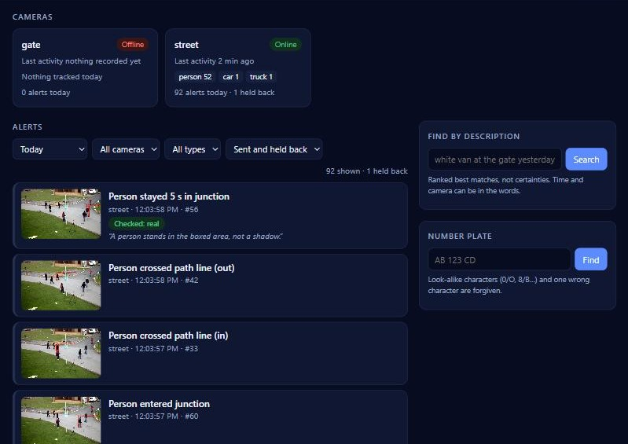
A second look before anyone is called.
// FEWER FALSE ALARMS
01
Stored at once
Every alert is saved with its snapshot the moment the rule fires.
02
Checked by a vision model
A local model looks at the snapshot and a close-up: a real person, or a shadow, poster or reflection?
03
Sent, or held back
A clear NO is held back but kept, so nothing is lost. If the check can't run, the alert goes out anyway.
Where it goes: the dashboard, Telegram, email, or a webhook into your own system.
Dashboard on a demo store, verdicts illustrative
Notes:
Alert checking (opt-in, built 10 October 2026): a local vision model, the same one behind the chat's look tool (Qwen3.5 4B on the site's server), gets the snapshot with the object boxed plus a close-up, and one question per event type: is there a real person in the box, not a shadow, reflection or poster? Is the person lying on the ground?
It answers YES, NO or UNSURE. In veto mode a NO is held back from the channels but stays in the store with its snapshot, so the chat and the dashboard can still show it. In tag mode everything is sent with the verdict, which is how a pilot measures it first. Never a silent loss: if the model is down or slow (60 s), the alert goes out unverified. The model can veto an alert, never raise one.
Dashboard: cameras online or offline, the live alert feed with snapshots and verdicts, search by description and by plate; one login token per site. Telegram: text by default; snapshots and clips only where the client agreed, because they leave the site.
Honest status: the false-alarm reduction is not measured yet. A week in tag mode at a pilot site gives the number to quote. The verdicts in the screenshot were set by hand for the picture.

Slide 12
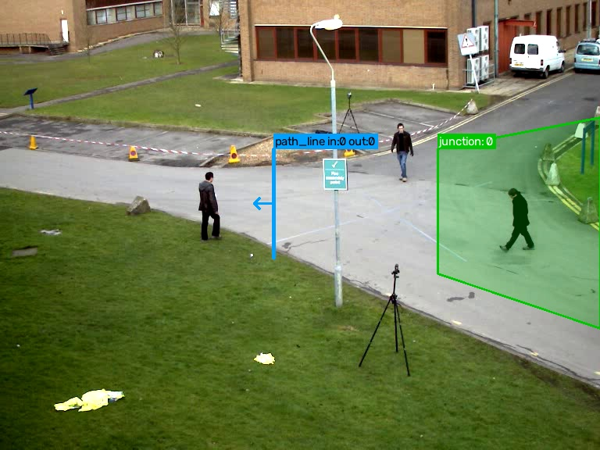
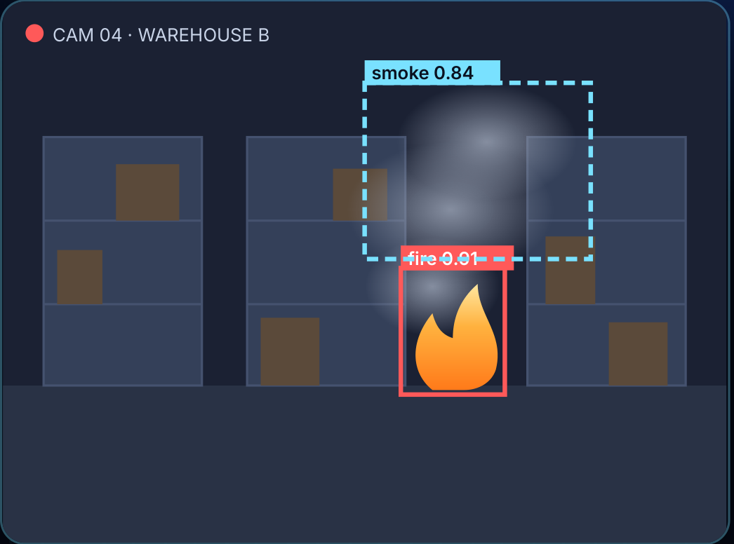
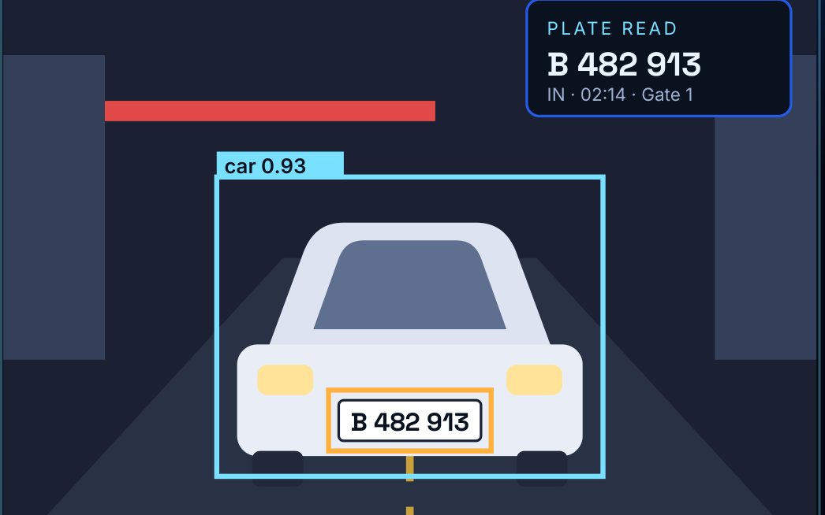
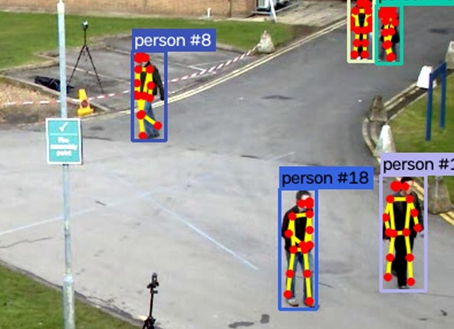
Four solutions, one system.
// OUR SOLUTIONS
SECURITY
SAFETY · IN TRAINING
ACCESS & TRAFFIC
SAFETY
Perimeter & Zone Watch
Fire & Smoke
Licence Plate Reading
Person Down & Activity
A line crossed, an area entered, or someone staying too long.
Flames and smoke on camera, often before a ceiling detector reacts.
Every vehicle at the gate, logged, searchable, with watchlist alerts.
An alert when someone stays down, and a record of what people were doing.
One system: each solution is a module on the same server. Add the next one without a new project.
Notes:
The brochure's lead solutions; each has its own one-page solution sheet in English, French and Arabic.
Perimeter & Zone Watch, plate reading and person-down run today. Fire and smoke is our own detector, in training since 13 October 2026: show it, but offer it as a pilot once it passes our tests, not as shipped.
Message: one system, many jobs. Fire detection today and car-park monitoring next year is the same system with a new module, no new hardware.

Slide 13
Know the moment someone crosses the line.
// PERIMETER & ZONE WATCH
Virtual tripwires
Restricted zones
Alert when a line is crossed, and in which direction: in or out.
Enter and exit alerts for any area you draw, any shape.
Stay-too-long timer
People or vehicles
A car parked over 60 s in a fire lane, someone lingering at a back door.
Choose what matters and ignore the rest, including animals and trees.
Counting
One intruder, one alert
How many people or cars went through a gate, in and out.
A cooldown stops the same event from flooding your team.
Real output: a line (blue), a zone (green)
Notes:
Running today. Areas and lines are drawn per camera in the visual editor; events are enter, exit, stay too long and line crossings with direction, filtered by object type and hours, with a cooldown per rule.
Why it beats motion sensors: it follows detected people and vehicles, so wind, shadows and animals do not trip it.
Good to know: works best with a clear view and decent light; at night IR cameras or lighting help a lot. We tune lines, zones and timers on the client's real footage during the pilot.

Slide 14
See smoke before the alarm goes off.
// FIRE & SMOKE
IN TRAINING · OUR OWN MODEL
Flames and smoke
Both, so you are warned in the early, smoky stage too.
Confirmed over several frames
An alert needs the detection to hold, not a single flash.
Covers open spaces
Yards, high roofs and car parks, where ceiling detectors struggle.
Works with your alarm
An extra early warning, never a replacement for a certified system.
Good to know: steam, fog and dust can look like smoke. We set thresholds on your site during the pilot.
Illustration of an alert, not a live run
Notes:
Status, said plainly: fire and smoke is our own detector, in training since 13 October 2026 (YOLOv9 with LibreYOLO, MIT; open datasets that allow commercial use: D-Fire CC0, CQU and an indoor set under CC BY 4.0). It is not shipped yet; we offer it as a pilot once it passes our tests.
Design: the detector runs about once a second next to the object detector; an alert needs the detection to hold over several frames, then goes through the same vision-model check and channels as every other alert.
It is an early-warning layer next to a certified fire alarm, never a replacement. Steam, fog and dust can look like smoke, and thin smoke is harder to see, so thresholds are set on site.
The picture is the brochure's illustration, not a live detection.

Slide 15
Measured from the body, not guessed.
// PERSON DOWN & ACTIVITY
Person down
Hands up
An alert when someone stays lying for 10 s, with a snapshot.
Both hands above the head for 3 s, at a till or a desk.
Posture history
What they wore
Seconds standing, sitting, crouching or lying, per person and visit.
Colour of the top and the trousers. "A red top and blue jeans?"
Honest limits: people must be at least 80 px tall, and colours are lost on infrared at night. Person-down is tested on staged falls at your site before it goes live.
Real output: 17 body points per person
Notes:
New since October 2026: body poses. About once a second, each tracked person's crop goes through a pose model (ViTPose-B: Apache-2.0, trained on COCO only) that finds 17 body points. Simple rules turn them into facts: posture (standing, sitting, crouching, lying), hands above the head, facing the camera, and the colour of the top and trousers from the clothes the body outlines. A row is stored only when something changes, plus every 10 s, so the chat gets exact seconds per posture. Person-down (lying 10 s) and hands-up (3 s) events go through the same alert channels. Honest limits: people must be at least 80 px tall; colours disappear at night (infrared); sitting and crouching can be confused; person-down has been checked with tests and sample footage, not yet on staged falls, so we validate it on site before it goes live. Pose costs about 0.1 s per person on a laptop CPU. Keypoints are not a face print, but they follow the same retention as the rest.

Slide 16
It reads plates, hears alarms and checks itself.
// NEW IN OCTOBER
01
02
03
04
05
Sharper search
A second look
Number plates
Sounds
Camera health
A better search model finds descriptions more reliably, at ~30 ms per object.
A local vision model looks at the evidence frames: counts, signs, a second opinion.
Every vehicle's plate is read and searchable. A plate on a watchlist raises an alert.
Smoke alarms, breaking glass, gunshots, screams and sirens, from the camera microphones.
Covered, dark, blurred, turned or frozen cameras raise an alert. So do bags left behind and crowds.
Same server, same rules: all of it runs on site with permissively licensed models. Plates and sounds stay off until the client approves them.
Notes:
October 2026 additions, each built and tested. Search: the CLIP model moved to LAION-2B weights (MIT), better on every benchmark we checked at the same cost. Look: a local vision model (Qwen3.5 4B via Ollama by default) reads the frames the chat already found. Plates: a plate finder plus fast-plate-ocr (MIT). The current finder is for trials only: our own YOLOX plate finder is the urgent next step. Sounds: YAMNet (Apache-2.0); audio is never stored. Camera health: picture checks with no model. Abandoned bags and crowding are rules on the tracker.

Slide 17

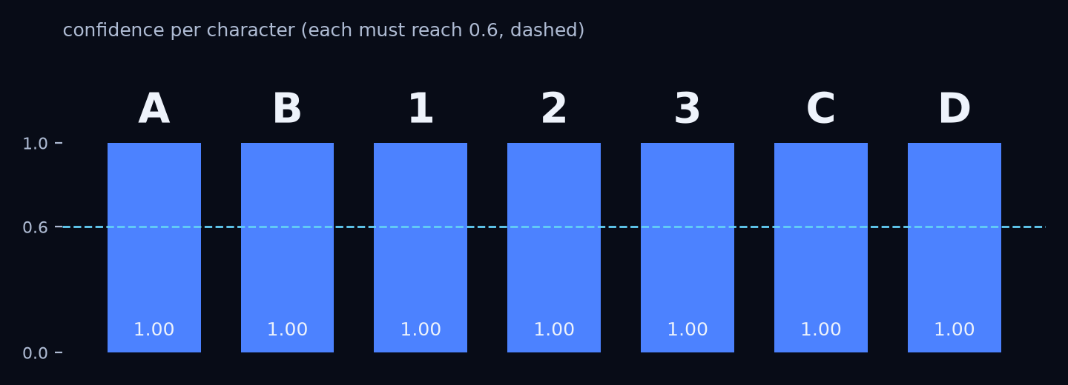
Which car was it? Ask for the plate.
// NUMBER PLATES
Find
A small model finds the plate on each tracked vehicle, about once a second.
Read
The reader turns it into text. Each character must be at least 60 % sure.
Vote
Several reads per vehicle are combined, so one bad frame never renames it.
Search and alert
"When did AB 123 CD come in?" Spaces and look-alikes (0/O, 8/B) don't matter. Watchlist plates raise an alert.
Real models on a synthetic plate
Notes:
Two small models, both on CPU: a plate finder (~11 ms per vehicle) and a reader (fast-plate-ocr, MIT, ~10 ms). Plates are read from the full-resolution main stream when it is recorded. Search forgives spaces, dashes, look-alike characters and one wrong character. Plates are personal data in many countries: off until the client agrees, with their own retention. Licence: the current finder's code is MIT but its weights were trained with a fork of the GPL-3.0 YOLOv9 repo, so it is for trials only; training our own YOLOX on Open Images plates (CC BY 4.0) is the urgent next step. Not yet measured on a real site camera.

Slide 18
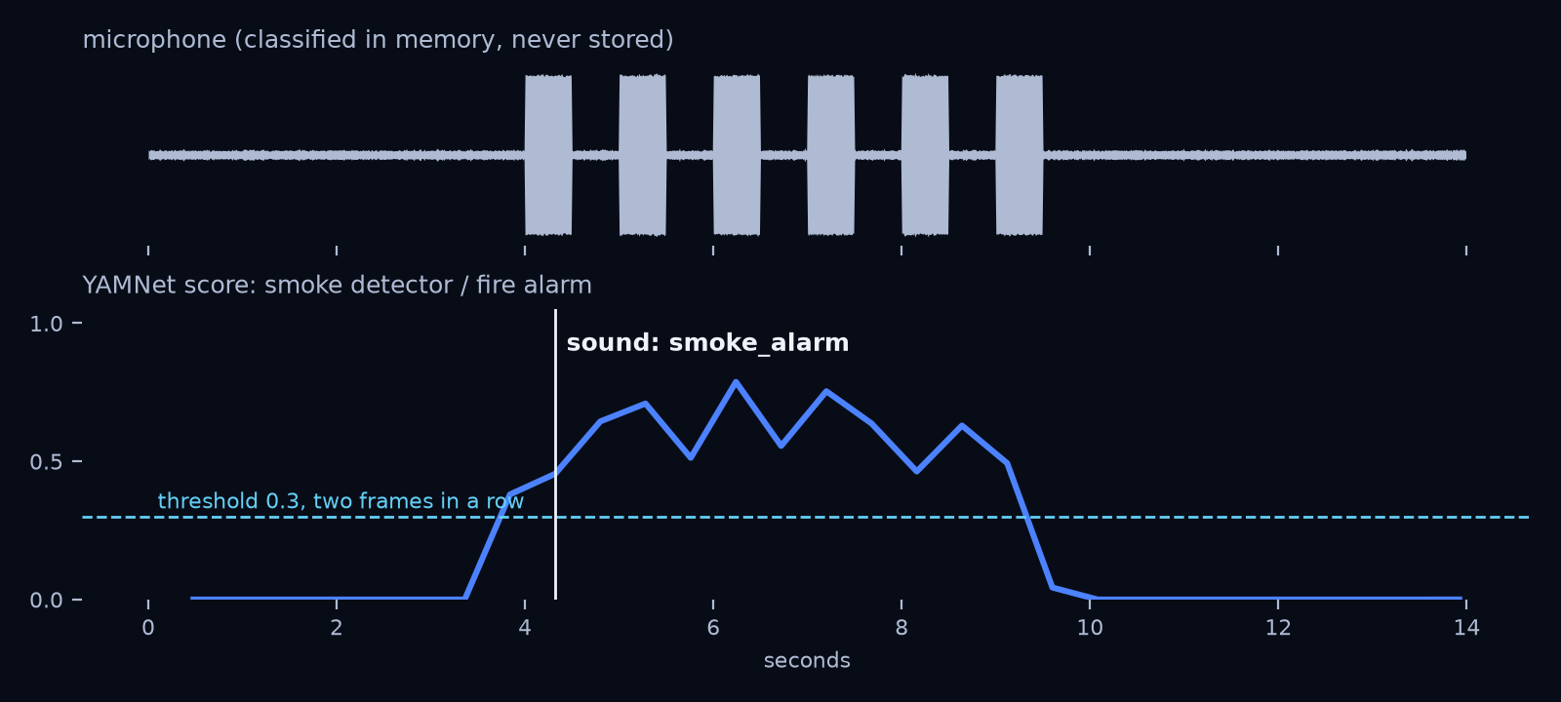
It hears the alarm, not the conversation.
// SOUNDS
What it hears
Smoke alarms, breaking glass, gunshots, explosions, screams, car alarms and sirens.
How it decides
A score above 0.3 for about a second, then 30 s of rest: one alert, not a flood.
What it keeps
Only the event and a snapshot. The audio is never stored. Off until the client and local law allow it.
Real model on a synthetic smoke-alarm pattern
Notes:
YAMNet (Google, Apache-2.0), trained on AudioSet's 521 sound classes, takes about 3 ms per 3 seconds of audio on one CPU thread. It reads the camera's audio track through ffmpeg. In the chart, a synthetic 3.1 kHz beep pattern starts at 4 s and the alert fires at about 4.3 s. Not yet checked on real camera microphones. Listening is often regulated more strictly than video, so this stays off by default.

Slide 19
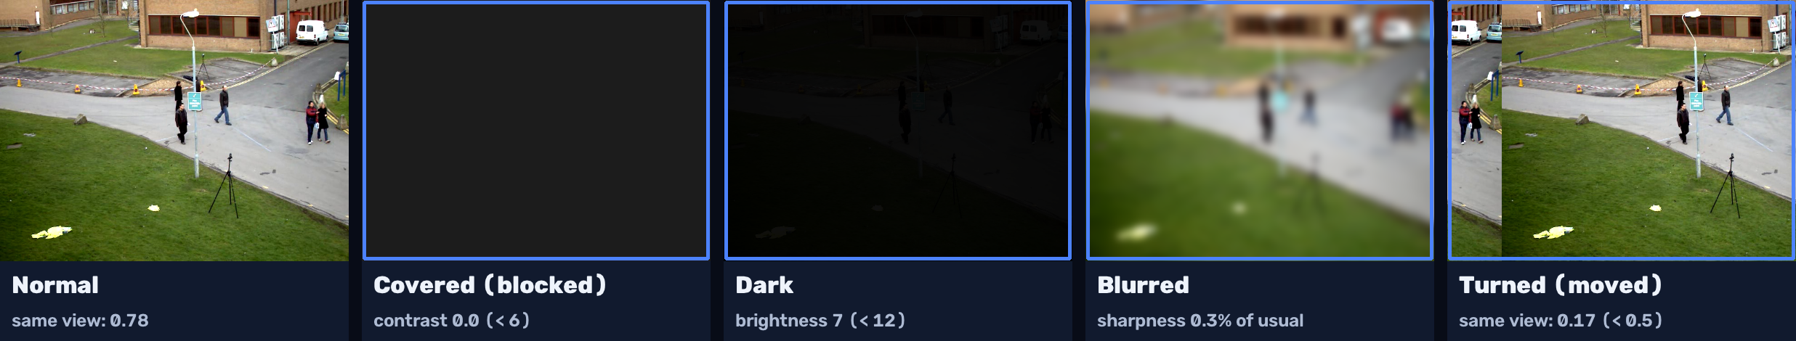
A camera that can't see raises its hand.
// CAMERA HEALTH
What it checks
How it decides
What it costs
Covered, too dark, out of focus, turned away, or a frozen picture.
Against the camera's own usual view, for 20 s, so people walking by or a cloud don't count.
No model: about 1 ms every 2 s per camera. On by default.
Notes:
Measured on the sample street video: the same view 35 s later scores 0.78 similarity, a camera turned by 40 px 0.40, a different view about 0.2; the threshold is 0.5. In 40 s of pedestrians nothing fires; a covered lens fires 'blocked'. Each problem must last 20 s and fires once until it clears. A site is never silently blind.

Slide 20
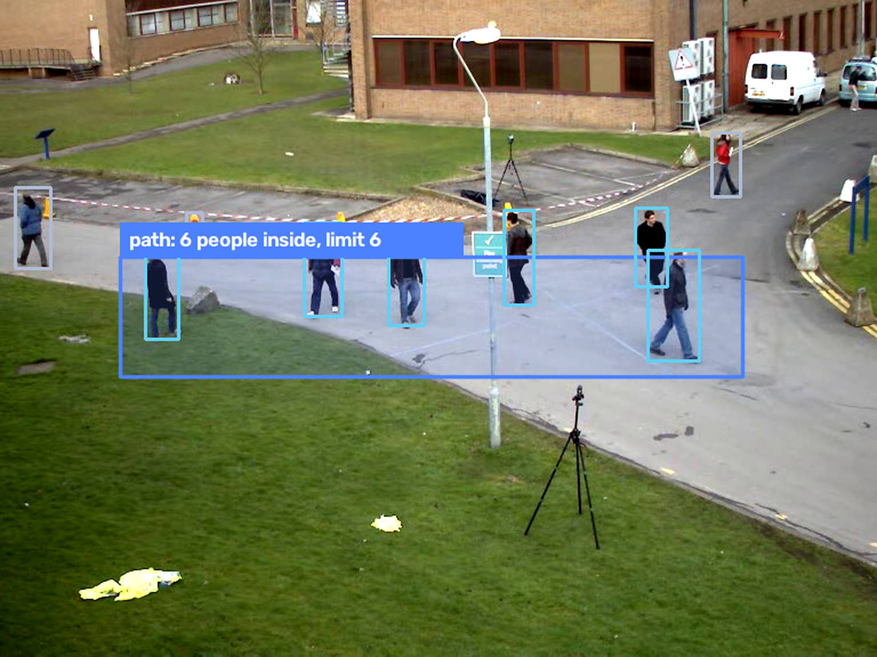
Bags left behind, crowds, wrong way.
// MORE RULES
Too many in one area
An area with a limit: 6 people for 30 s at the till or on a path raises an alert.
Bag left behind
A backpack, handbag or suitcase that stays still with nobody near it for 60 s.
Wrong way
A one-way line: anything crossing it in the forbidden direction raises an alert.
Real detections, sample street video
Notes:
Rules on the tracker, no new model. Crowding counts tracked objects of chosen classes inside an area, here 6 people on the path (real YOLOX detections on the sample video). Abandoned objects: still within a quarter of their size, with no person within 1.5 person-heights, for 60 s; a passer-by resets the clock. Wrong way: a line set to one direction only.

Slide 21
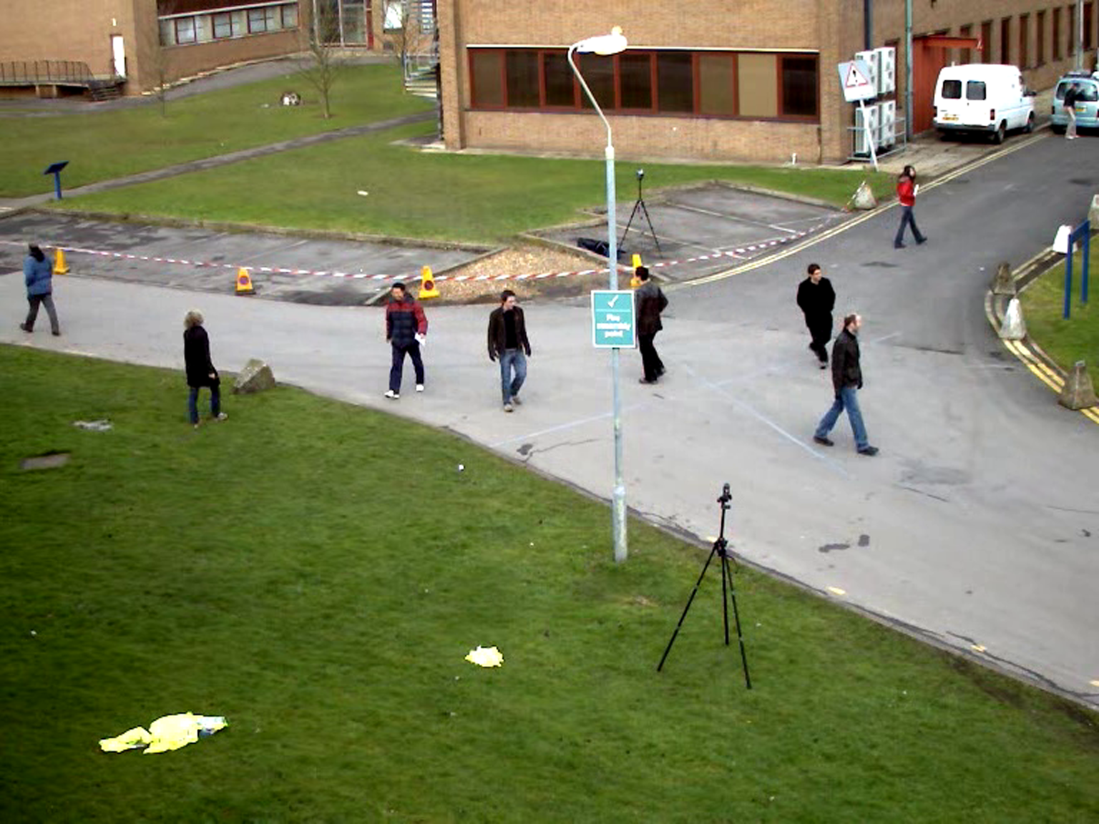
When counting needs eyes, it looks.
// A SECOND LOOK
Find the moment
How many people were on the path at 14:12?
Histor finds the right frames first, with the usual lookups.
Look at it
Six people on the path, walking in both directions. I looked at this frame:
A vision model reads those frames: counts, actions, signs.
Stays on site
It runs on your server, even with a cloud chat model. Images never leave.
Illustrative: the tool is built, this answer is not a live run
Notes:
CLIP ranks images but can't count or read. The chat model first finds the moment with its usual tools, then passes the 1 to 4 best frames to a local vision model (Qwen3.5 4B via Ollama by default, Apache-2.0) with a question. Only frames that earlier results listed can be opened. The images stay on site; only the text answer goes to the chat model. Seconds per image on a CPU. This exchange is illustrative: the tool is tested against a stand-in server, not yet a live model.

Slide 22





Same system, more jobs.
// BEYOND THE FIRST FOUR
28 of 37
Safety
Fall detection, loitering, left bags and packages, crowd size.
Workplace
ideas in our Use-Case Catalog are ready to deploy today.
Hard-hat and safety-vest checks, no-go zones around machines.
Retail
11
Ready out of the box
People counting, queue length, empty-shelf alerts.
17
Ready, set up on site
Traffic & parking
Vehicle counting and type, free spaces, helmet checks for riders.
9
In research: tested on your footage first
Outdoor & farms
Ask for the catalog: every idea with its readiness rating.
Animal intrusion, flood-level watch, illegal dumping.
Notes:
From the Use-Case Catalog 2026: 37 ideas across security, traffic, retail, industry and the outdoors, each with an honest readiness rating: 11 ready out of the box, 17 ready after setup on site (calibrated to the cameras, angles and lighting), 9 in research (we test them on the client's own footage before promising anything).
Every new use case is a new module on the system the client already has, not a new project. Hand out the catalog PDF (English, French, Arabic).
If a person can spot it on a camera, there is a good chance Histor can learn to spot it: ask what they want to watch for, and say honestly how ready it is.

Slide 23
Your footage stays in the building.
// PRIVATE BY DESIGN
Runs on your own server. Cameras stay on your network.
YOU CHOOSE THE MODEL
Local · default
One memory per site, on your machine. You set how long it is kept: 30 days by default.
Runs on the server's CPU. Nothing leaves the site.
The language model runs locally by default. Nothing leaves the site.
Local, larger
Better answers with about 20 GB of RAM or a GPU. Still on site.
Face search, plates and listening are off unless you approve them.
Cloud · only if you opt in
Sends the question and text search results. Never images or video.
Notes:
The first question every client asks: where does my footage go? Nowhere. Detection, search and the memory store run on the site's server. The default chat model is Qwen3 4B (Apache-2.0) through Ollama on CPU; a larger local option is Qwen3 30B-A3B. Any OpenAI-compatible server works (llama.cpp, LM Studio, vLLM). A cloud model such as Claude is an opt-in switch: it receives the question and the search results (times, cameras, labels, thumbnail paths), never images or video. Face prints are biometric data and stay off unless the client has approved them.

Slide 24
One server. No GPU required.
// ON SITE
SITE SERVER
IP cameras
Detect and track
Describe each sighting
Memory store
Your team
Light stream for analysis. Full-quality stream recorded untouched.
Asks in chat, sees the evidence.
Local language model: turns questions into lookups and writes the answer
~30 ms
2 KB
80
0
to describe one object on a laptop CPU
search vector per sighting, plus a small thumbnail
object types, plus the whole scene every few seconds
frames of video sent off site
Notes:
Detection uses YOLOX-S by default (about 76 ms a frame on a laptop CPU; YOLOX-M on a GPU server, Nano on weak machines) on ONNX Runtime and descriptions use CLIP, both on CPU. The detector reads the cheap sub stream; the main stream is saved as-is (about no CPU) in one-minute files, and full-resolution keyframes give sharp crops. On busy scenes the indexer samples more sparsely rather than lagging behind. Sizing note: 1080p at 4 Mbit/s is about 43 GB per camera per day of recording, 7 days kept by default. The 30 ms figure is a laptop CPU measurement for one CLIP crop (B/32 LAION-2B, October 2026).

Slide 25




Plugs into what you already have.
// FOR YOUR IT TEAM
Your cameras
Hikvision, Dahua, Reolink, Uniview, Axis or any RTSP camera, found on the network over ONVIF.
CLEAR EVENTS, NOT RAW VIDEO
{ "type": "cross",
"rule": "gate_line",
"direction": "in",
"label": "person",
"camera": "gate",
"time": "2026-10-02T02:14:07" }
CPU first
A standard Linux or Windows server. Add an NVIDIA GPU later for many cameras or heavier models.
One config per site
Cameras, zones, lines and thresholds in one simple file, drawn in a visual editor.
Built to keep running
Every event is plain JSON with a snapshot: easy to send to your dashboard, database or security system.
Cameras reconnect on their own, old frames are skipped so alerts never lag, and each object keeps its ID.
Notes:
From the technical sheet. Runs on site on a standard Linux or Windows server or VM; cloud hosting is possible on request. CPU first; an NVIDIA GPU is only for many cameras or heavier models.
Sizing: Nano for a few cameras on a low-power box, Tiny on a standard CPU, Small for busy scenes on a strong CPU or GPU, Medium/Large on an NVIDIA GPU. The cameras' low-resolution sub-stream is used for detection by default; the main stream is recorded untouched.
Models are permissively licensed (Apache-2.0 / MIT), safe for commercial use. Camera passwords stay out of config files and are masked in logs. Events: enter, exit, dwell, cross with direction, plus crowd, person down, plates and camera health. Hand out the technical sheet.

Slide 26



Keep your cameras. Add the intelligence.
// WHY HISTOR
Keep your cameras
No special hardware
Video stays on site
Fewer false alarms
Grows with you
No rip-and-replace: it works with the cameras you own.
Runs on a standard server, no graphics card to start.
Nothing has to leave your building.
Rules tuned to your site, and a second look before sending.
Add cameras, sites and detections any time.
BUILT FOR
Warehouses
Factories
Retail
Car parks
Schools
Hospitals
Residential compounds
Farms
Notes:
The five reasons from the brochure. Keep your cameras: no rip-and-replace. No special hardware to start: a standard server. Video stays on site: nothing has to leave the building. Fewer false alarms: rules tuned to the site, and alert checking by a local vision model before anything is sent. Grows with you: add cameras, sites and detections any time.
Built for: warehouses, factories, retail, car parks, schools, hospitals, residential compounds and farms.

Slide 27
Any site with cameras and questions.
// WHERE IT FITS
Gates and car parks
Warehouses and yards
"How many trucks came in this morning?"
"Was anyone at the loading bay camera yesterday evening?"
Campuses and public spaces
Construction sites
"When did a bag first appear by the bench?"
"Was there a white van at the gate yesterday evening?"
Notes:
Example questions per site type. Each maps onto what Histor does today: counts by object type and time, presence on a named camera in a time window, co-occurrence (bag with bench), and visual description search (white van).

Slide 28
Working now, and what comes next.
// WHERE HISTOR IS TODAY
Working now
Next
Recording, indexing and plain-language questions
Chat, local or cloud, with evidence frames
Alerts: areas, lines, crowds, bags, camera health
Alerts checked by a local vision model
Dashboard with live alerts, and Telegram
Person-down alerts; plates and sounds (opt-in)
Our own fire and smoke detector (in training now)
Our own plate finder (fully permissive licence)
Person-down, plates and sounds checked on a pilot site
False alarms per day measured at a pilot site
Following one visit across several cameras
Mobile push, WhatsApp and SMS alerts
Notes:
Be straightforward about maturity. Today Histor runs as a recorder per camera, a chat, a dashboard and a Telegram bot. Alert checking runs on a real local vision model; what is not measured yet is how many false alarms it removes at a real site, which is the first thing a pilot measures. Fire and smoke is our own detector, in training since 13 October 2026, not shipped. Plates and sounds are checked on synthetic input only; the plate finder is for trials until ours is trained.

Slide 29
Start with a pilot.
// GETTING STARTED
01
02
03
Talk
Pilot
Roll out
We walk your site with you, list the cameras and agree what counts as an alert.
A few cameras on your real footage. We count hits and false alarms together.
Add cameras, sites and new detections as you need them, on the same system.
WHAT THE PILOT GIVES YOU
WHAT WE NEED FROM YOU
Real results on your own site, not a demo video
Access to 2–5 cameras (address and login)
A clear count of hits and false alarms
A server or PC on the same network: we advise on the spec
Rules tuned to your cameras and hours
One contact who knows the site
Agreement on what should trigger an alert
Notes:
The brochure's getting-started path. Talk: walk the site, list the cameras, agree what counts as an alert. Pilot: a handful of cameras on the client's real footage; hits and false alarms are counted together, and alert checking runs in tag mode so we can quote a measured number. Roll out: more cameras, sites and detections on the same system.
What we need: access to 2–5 cameras, a server or PC on the same network, one contact who knows the site, and agreement on what triggers an alert.
For the memory side, the lighter option still stands: we index a sample of their recorded video and they ask their own questions.

Slide 30
See it on
your own footage.
// TRY IT
A short pilot on a few of your cameras, or on a sample of your recorded video: you ask your questions, and then you decide.
www.mobius-tensors.com · +961 3 004 362
Notes:
Close with the pilot offer: a demo on their own recorded footage. Fill in the contact line before sending.

