Slide 1
What if you could
ask your cameras?
// INTRODUCING ARGUS
Argus keeps a searchable memory of what your cameras see, so you can ask about it later in plain language and get answers that point to the frames.
Notes:
Argus is our video memory solution: it records everything a camera sees as searchable memory and lets you ask about it in plain language. This deck covers what it does, how it works, how it keeps footage private, and how to try it on your own video.

Slide 2
Cameras record everything. Finding one moment still means scrubbing through hours of video.
// THE PROBLEM
01
02
03
Recorded, rarely watched
Searched by clock, not by content
Alerts only cover what you planned for
Most footage is only opened after something has gone wrong, and then someone has to find it.
A recorder lets you jump to a time. It can't tell you when the white van showed up.
Alerts react to the rules you set in advance. The question you have today was not one of them.
Notes:
Set up the pain: sites record a lot of video, but searching it is slow and manual. Recorders search by time, not by what happened. Alerts only fire on rules set in advance.

Slide 3
Ἄργος
// MEET ARGUS
Greek myth’s hundred-eyed watchman, Argus Panoptes: the all-seeing.
Argus turns what your cameras see into a memory you can question: every tracked object, plus regular snapshots of each scene, searchable for as long as you choose to keep them.
Notes:
The name: Argus Panoptes, the hundred-eyed watchman of Greek myth, who never closed all his eyes at once. That is the product: a watchman for every camera.

Slide 4
Alerts watch for one thing. Argus remembers all of it.
// ALERTS AND MEMORY
ALERTS
MEMORY
Is it happening right now?
What happened?
Watch for a set event, like a zone being entered
React in seconds, by webhook or email
Rules decided in advance
Store every object and scene
Ask any question, any time later
No rules needed up front
Argus does both, on the same cameras: alerts for the rules you set, memory for everything else.
Notes:
Two ways to use the same cameras. Alerts answer "is X happening now?" for rules set in advance; memory answers "what happened?" afterwards, for any question. Argus runs both in one recorder, on the same detector, tracker and store.

Slide 5
Ask in plain language.
// WHAT IT FEELS LIKE
What, when, which camera
Was there a white van at the gate yesterday evening?
Your question is split into what to look for, the time range and the camera.
An answer, not a playlist
Yes, twice: a white van stopped at the gate camera around 18:42 for about 3 minutes, and again near 20:15. These are the frames I checked:
Argus replies in sentences: what it found, when, and where.
Evidence attached
Every answer lists the frames it checked, so you can see for yourself.
gate · 18:42
gate · 18:44
gate · 20:15
Illustrative mock-up
Notes:
Walk through the example. The operator types a question the way they would ask a colleague. Argus answers in a sentence and shows the frames it used, so the answer can be checked. This exchange is illustrative, not a recorded transcript.

Slide 6
Record, ask, answer.
// HOW IT WORKS
01
02
03
Record
Ask
Answer
Every object is detected, tracked and stored as searchable memory, across 80 everyday object types. Every few seconds the whole scene is stored too, so things without a label stay findable.
Your question is split into what, when and which camera. The "what" is matched against everything stored, and sightings of the same object merge into one visit.
A language model runs the lookups the question needs (up to six rounds), then answers in sentences and lists the frames it checked.
Notes:
Record: one recorder per camera detects and tracks every object (all 80 COCO classes), embeds each tracked object with CLIP, and every few seconds embeds the whole frame plus a 2x2 grid of tiles. Everything lands in one store per site. Ask: the question is parsed into what / when / which camera; the "what" is embedded with CLIP's text model and compared with stored vectors. Answer: an LLM gets the store as tools (objects, search, alerts, people by pose and colour, and faces when approved) and composes the answer with evidence thumbnails.

Slide 7
Questions you would ask a colleague.
// WHAT YOU CAN ASK
You ask | Argus looks up | Answer
What happened yesterday from 6pm to 9pm? | Everything tracked in that window, in time order, with counts | Exact
How many cars came in today? | Cars tracked today: one tracked car is one visit | Exact
Anyone with a dog this morning? | People seen on the same camera, at the same time, as a dog | Exact
A man in a red jacket near a car? | Visual search for "man in a red jacket", kept where a car was present | Ranked matches
Anyone lying on the floor last night? | Each person's posture from body points: seconds standing, sitting or lying | Exact
When did AB 123 CD come in? | Plates read on each vehicle, spaces and look-alikes ignored | Exact
Notes:
Time ranges can be in plain words (yesterday, this morning, last 2 hours) or exact times. "Together" means the same camera and overlapping in time, within about 15 seconds by default. Counts come straight from the tracker, so they are exact; descriptions such as clothing or colour are ranked visual matches.

Slide 8
Counted when it can be. Described when it can't.
// ANSWERS YOU CAN TRUST
#
Counted: exact
≈
Described: ranked
What, when and how many come straight from the detector and tracker. Counts are visits: each arrival is counted.
Descriptions like 'white van' or 'red jacket' are matched against what the cameras saw. Argus shows the closest matches with their frames, so you can confirm at a glance.
Either way, every answer lists the frames it looked at, so a person can check it in seconds.
Notes:
The language model has a few lookups; the two main ones are these. "objects" returns tracked objects by time, class and co-occurrence: exact, no guessing. "search" is CLIP visual similarity for descriptions: ranked guesses where low-ranked hits can be wrong. Body poses add a third kind, measured: posture and clothing colour per person (see the next slides). The model never sees the database, only the results, and the thumbnails it was shown are returned as evidence. Counts are visits, not unique people: someone who leaves and comes back is two visits. Telling people apart across visits would need face recognition, which stays off unless approved.

Slide 9
Tell me when it happens.
// ALERTS WHEN IT MATTERS
01
02
03
Areas and lines
Your objects, your rules
Sent where you need it
Draw areas and lines on each camera. An alert fires when something enters, leaves, stays too long, crosses a line, or too many gather.
Each rule picks what it watches: only people in the yard, only trucks at the gate. Every site gets its own rules.
By email or straight into your own systems, with a snapshot of the moment. Repeats are held back, so nobody gets flooded.
Next: detectors trained for each customer's needs, such as fire and smoke, and alerts from a description ("a white van at the gate").
Notes:
Alerts run inside the same recorder as the memory, on the same cameras. Tested with Argus's recorder on sample street footage: zone enter, exit and stay-too-long events and line crossings, limited to chosen object types. Delivery is by webhook (into the client's own systems) or email, with a snapshot and a cooldown between repeats. Rules work on the 80 everyday object types today. Fire, smoke or other new object types need a model trained for that customer; weapons are not offered.

Slide 10
Measured from the body, not guessed.
// WHAT PEOPLE WERE DOING
01
02
03
Posture
Hands up, someone down
What they wore
Standing, sitting, crouching or lying, with the seconds spent in each. "Did anyone fall in the warehouse last night?"
Hands raised above the head, and whether they faced the camera. Lying for 10 s, or both hands up for 3 s, can be an alert.
The colour of the top and of the trousers, read from the clothes the body outlines. "A red top and blue jeans this morning?"
How: 17 body points per person, about once a second, on the same server. Person-down is checked on staged falls at each site before it goes live.
Notes:
New since October 2026: body poses. About once a second, each tracked person's crop goes through a pose model (ViTPose-B: Apache-2.0, trained on COCO only) that finds 17 body points. Simple rules turn them into facts: posture (standing, sitting, crouching, lying), hands above the head, facing the camera, and the colour of the top and trousers from the clothes the body outlines. A row is stored only when something changes, plus every 10 s, so the chat gets exact seconds per posture. Person-down (lying 10 s) and hands-up (3 s) events go through the same alert channels. Honest limits: people must be at least 80 px tall; colours disappear at night (infrared); sitting and crouching can be confused; person-down has been checked with tests and sample footage, not yet on staged falls, so we validate it on site before it goes live. Pose costs about 0.1 s per person on a laptop CPU. Keypoints are not a face print, but they follow the same retention as the rest.

Slide 11
It reads plates, hears alarms and checks itself.
// NEW IN OCTOBER
01
02
03
04
05
Sharper search
A second look
Number plates
Sounds
Camera health
A better search model finds descriptions more reliably, at ~30 ms per object.
A local vision model looks at the evidence frames: counts, signs, a second opinion.
Every vehicle's plate is read and searchable. A plate on a watchlist raises an alert.
Smoke alarms, breaking glass, gunshots, screams and sirens, from the camera microphones.
Covered, dark, blurred, turned or frozen cameras raise an alert. So do bags left behind and crowds.
Same server, same rules: all of it runs on site with permissively licensed models. Plates and sounds stay off until the client approves them.
Notes:
October 2026 additions, each built and tested. Search: the CLIP model moved to LAION-2B weights (MIT), better on every benchmark we checked at the same cost. Look: a local vision model (Qwen3.5 4B via Ollama by default) reads the frames the chat already found. Plates: a plate finder plus fast-plate-ocr (MIT). The current finder is for trials only: our own YOLOX plate finder is the urgent next step. Sounds: YAMNet (Apache-2.0); audio is never stored. Camera health: picture checks with no model. Abandoned bags and crowding are rules on the tracker.

Slide 12

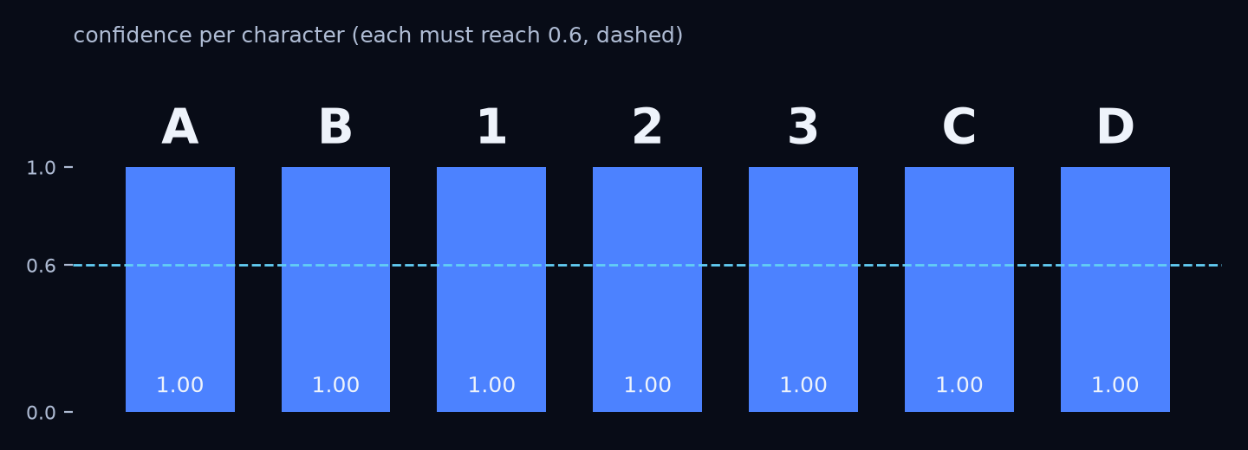
Which car was it? Ask for the plate.
// NUMBER PLATES
Find
A small model finds the plate on each tracked vehicle, about once a second.
Read
The reader turns it into text. Each character must be at least 60 % sure.
Vote
Several reads per vehicle are combined, so one bad frame never renames it.
Search and alert
"When did AB 123 CD come in?" Spaces and look-alikes (0/O, 8/B) don't matter. Watchlist plates raise an alert.
Real models on a synthetic plate
Notes:
Two small models, both on CPU: a plate finder (~11 ms per vehicle) and a reader (fast-plate-ocr, MIT, ~10 ms). Plates are read from the full-resolution main stream when it is recorded. Search forgives spaces, dashes, look-alike characters and one wrong character. Plates are personal data in many countries: off until the client agrees, with their own retention. Licence: the current finder's code is MIT but its weights were trained with a fork of the GPL-3.0 YOLOv9 repo, so it is for trials only; training our own YOLOX on Open Images plates (CC BY 4.0) is the urgent next step. Not yet measured on a real site camera.

Slide 13
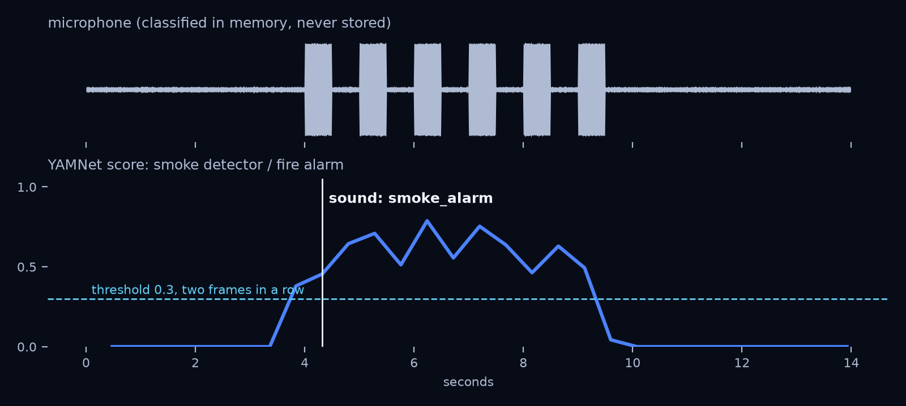
It hears the alarm, not the conversation.
// SOUNDS
What it hears
Smoke alarms, breaking glass, gunshots, explosions, screams, car alarms and sirens.
How it decides
A score above 0.3 for about a second, then 30 s of rest: one alert, not a flood.
What it keeps
Only the event and a snapshot. The audio is never stored. Off until the client and local law allow it.
Real model on a synthetic smoke-alarm pattern
Notes:
YAMNet (Google, Apache-2.0), trained on AudioSet's 521 sound classes, takes about 3 ms per 3 seconds of audio on one CPU thread. It reads the camera's audio track through ffmpeg. In the chart, a synthetic 3.1 kHz beep pattern starts at 4 s and the alert fires at about 4.3 s. Not yet checked on real camera microphones. Listening is often regulated more strictly than video, so this stays off by default.

Slide 14
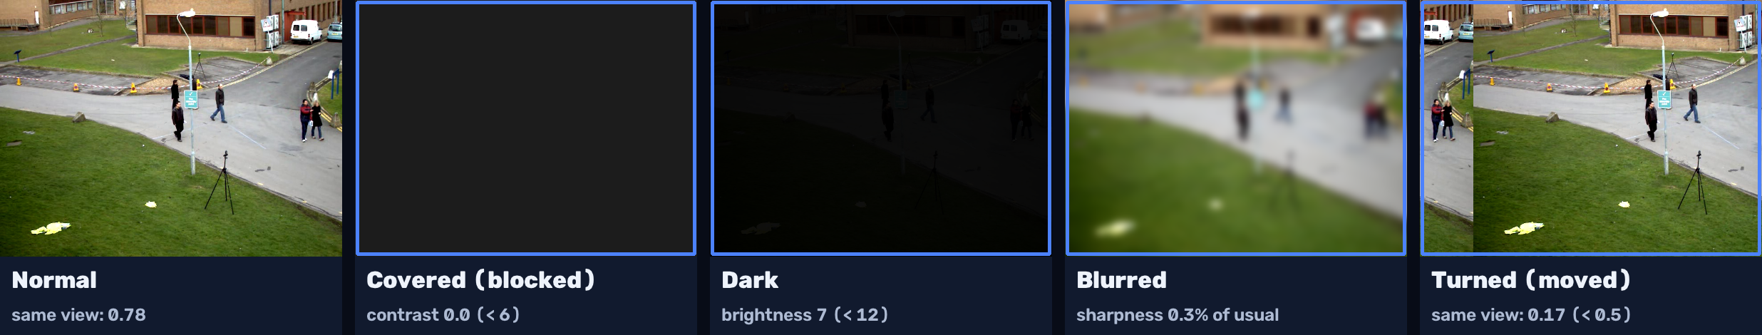
A camera that can't see raises its hand.
// CAMERA HEALTH
What it checks
How it decides
What it costs
Covered, too dark, out of focus, turned away, or a frozen picture.
Against the camera's own usual view, for 20 s, so people walking by or a cloud don't count.
No model: about 1 ms every 2 s per camera. On by default.
Notes:
Measured on the sample street video: the same view 35 s later scores 0.78 similarity, a camera turned by 40 px 0.40, a different view about 0.2; the threshold is 0.5. In 40 s of pedestrians nothing fires; a covered lens fires 'blocked'. Each problem must last 20 s and fires once until it clears. A site is never silently blind.

Slide 15
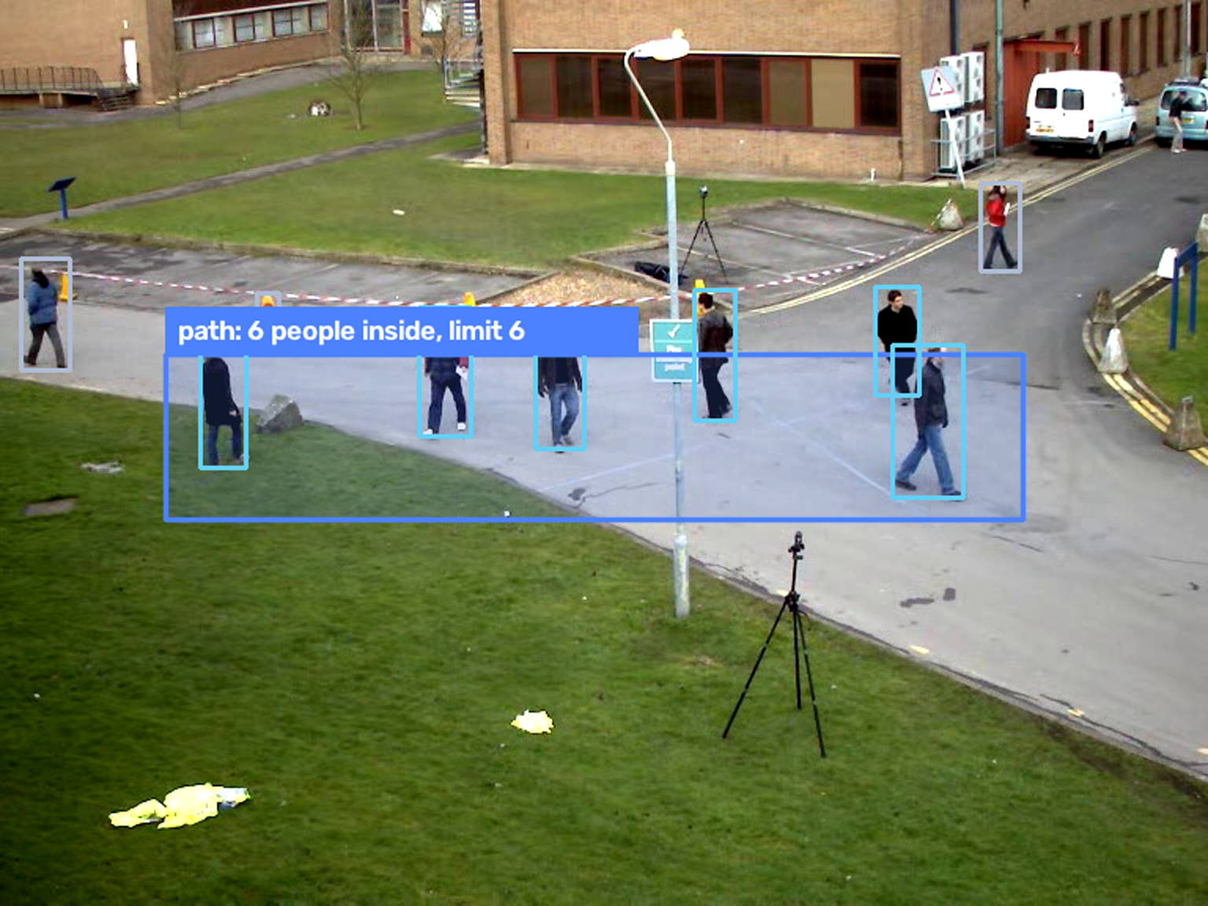
Bags left behind, crowds, wrong way.
// MORE RULES
Too many in one area
An area with a limit: 6 people for 30 s at the till or on a path raises an alert.
Bag left behind
A backpack, handbag or suitcase that stays still with nobody near it for 60 s.
Wrong way
A one-way line: anything crossing it in the forbidden direction raises an alert.
Real detections, sample street video
Notes:
Rules on the tracker, no new model. Crowding counts tracked objects of chosen classes inside an area, here 6 people on the path (real YOLOX detections on the sample video). Abandoned objects: still within a quarter of their size, with no person within 1.5 person-heights, for 60 s; a passer-by resets the clock. Wrong way: a line set to one direction only.

Slide 16
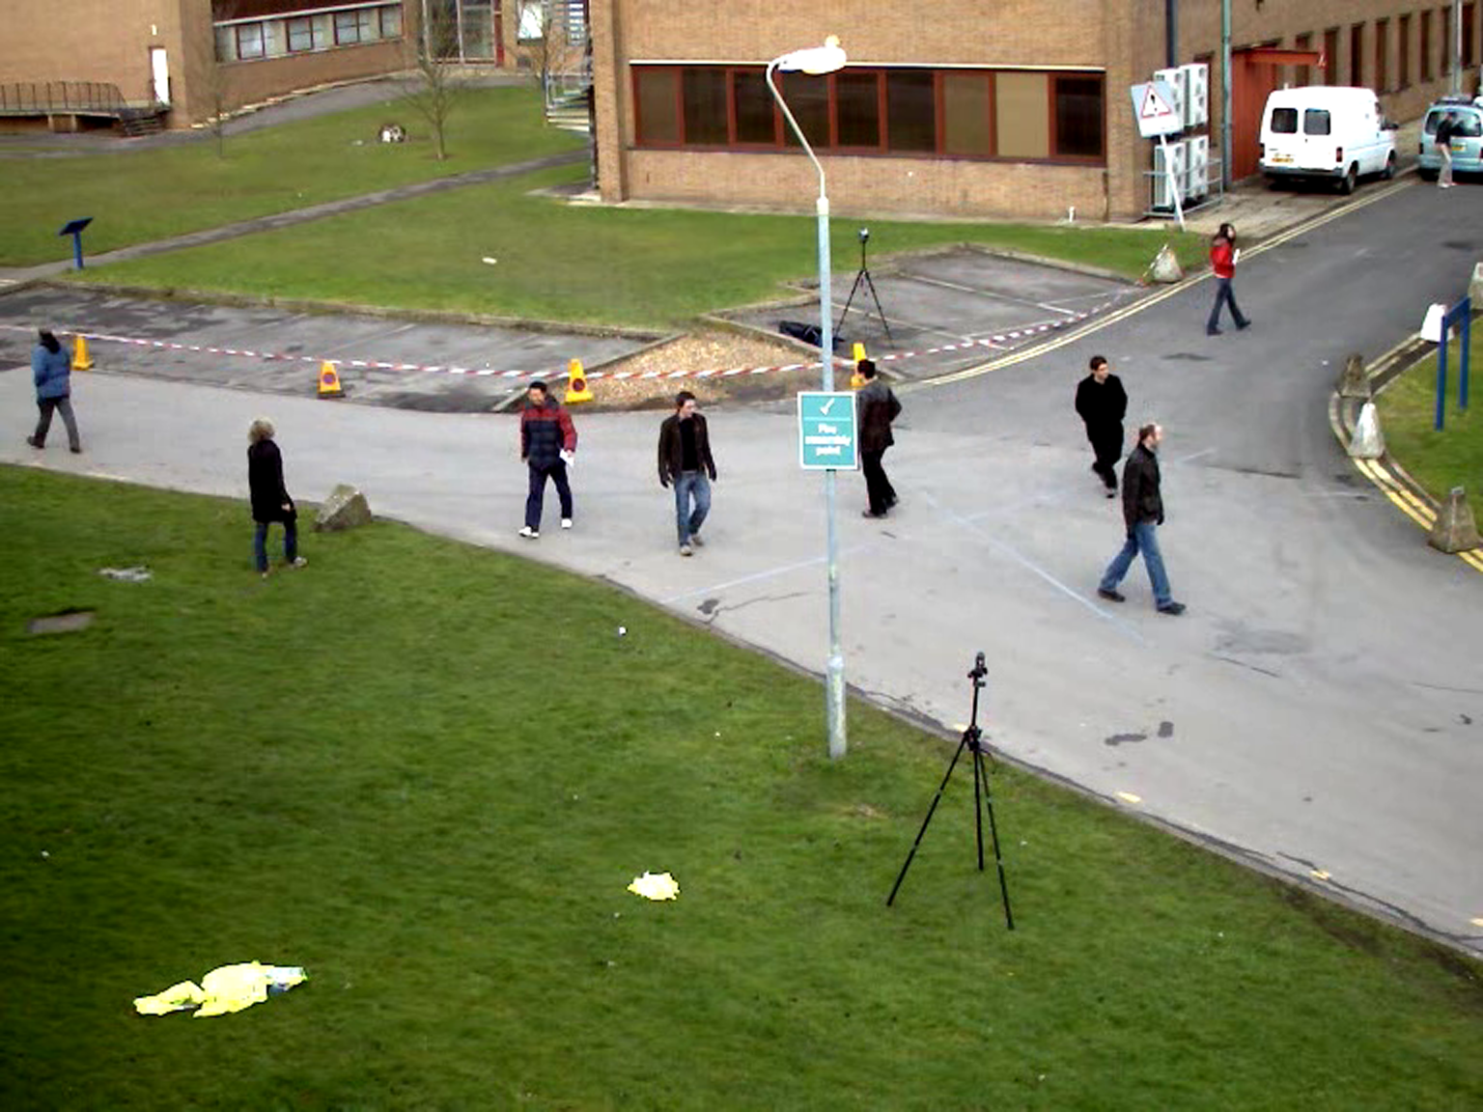
When counting needs eyes, it looks.
// A SECOND LOOK
Find the moment
How many people were on the path at 14:12?
Argus finds the right frames first, with the usual lookups.
Look at it
Six people on the path, walking in both directions. I looked at this frame:
A vision model reads those frames: counts, actions, signs.
Stays on site
It runs on your server, even with a cloud chat model. Images never leave.
Illustrative: the tool is built, this answer is not a live run
Notes:
CLIP ranks images but can't count or read. The chat model first finds the moment with its usual tools, then passes the 1 to 4 best frames to a local vision model (Qwen3.5 4B via Ollama by default, Apache-2.0) with a question. Only frames that earlier results listed can be opened. The images stay on site; only the text answer goes to the chat model. Seconds per image on a CPU. This exchange is illustrative: the tool is tested against a stand-in server, not yet a live model.

Slide 17
Your footage stays in the building.
// PRIVATE BY DESIGN
Runs on your own server. Cameras stay on your network.
YOU CHOOSE THE MODEL
Local · default
One memory per site, on your machine. You set how long it is kept: 30 days by default.
Runs on the server's CPU. Nothing leaves the site.
The language model runs locally by default. Nothing leaves the site.
Local, larger
Better answers with about 20 GB of RAM or a GPU. Still on site.
Face search, plates and listening are off unless you approve them.
Cloud · only if you opt in
Sends the question and text search results. Never images or video.
Notes:
The first question every client asks: where does my footage go? Nowhere. Detection, search and the memory store run on the site's server. The default chat model is Qwen3 4B (Apache-2.0) through Ollama on CPU; a larger local option is Qwen3 30B-A3B. Any OpenAI-compatible server works (llama.cpp, LM Studio, vLLM). A cloud model such as Claude is an opt-in switch: it receives the question and the search results (times, cameras, labels, thumbnail paths), never images or video. Face prints are biometric data and stay off unless the client has approved them.

Slide 18
One server. No GPU required.
// ON SITE
SITE SERVER
IP cameras
Detect and track
Describe each sighting
Memory store
Your team
Light stream for analysis. Full-quality stream recorded untouched.
Asks in chat, sees the evidence.
Local language model: turns questions into lookups and writes the answer
~30 ms
2 KB
80
0
to describe one object on a laptop CPU
search vector per sighting, plus a small thumbnail
object types, plus the whole scene every few seconds
frames of video sent off site
Notes:
Detection uses YOLOX-S by default (about 76 ms a frame on a laptop CPU; YOLOX-M on a GPU server, Nano on weak machines) on ONNX Runtime and descriptions use CLIP, both on CPU. The detector reads the cheap sub stream; the main stream is saved as-is (about no CPU) in one-minute files, and full-resolution keyframes give sharp crops. On busy scenes the indexer samples more sparsely rather than lagging behind. Sizing note: 1080p at 4 Mbit/s is about 43 GB per camera per day of recording, 7 days kept by default. The 30 ms figure is a laptop CPU measurement for one CLIP crop (B/32 LAION-2B, October 2026).

Slide 19
Any site with cameras and questions.
// WHERE IT FITS
Gates and car parks
Warehouses and yards
"How many trucks came in this morning?"
"Was anyone at the loading bay camera yesterday evening?"
Campuses and public spaces
Construction sites
"When did a bag first appear by the bench?"
"Was there a white van at the gate yesterday evening?"
Notes:
Example questions per site type. Each maps onto what Argus does today: counts by object type and time, presence on a named camera in a time window, co-occurrence (bag with bench), and visual description search (white van).

Slide 20
Working now, and what comes next.
// WHERE ARGUS IS TODAY
Working now
Next
Recording, indexing and plain-language questions
Chat with local or cloud models, evidence frames, and a second look by a vision model
Alerts: areas, lines, crowds, bags left behind, camera health
Body poses and person-down alerts
Number plates and sounds (opt-in)
Our own plate finder (urgent: fully permissive licence)
Plates, sounds and person-down checked on a pilot site
A fixed test set on recorded footage to compare models
Following one visit across several cameras
Detectors trained per customer, such as fire and smoke
Notes:
Be straightforward about maturity. Today Argus runs as a recorder per camera plus a chat. Counting and "what was he doing" questions are where CLIP alone is weakest, which is why scene captions from a small vision-language model are on the list.

Slide 21
See it on
your own footage.
// TRY IT
We set Argus up on a sample of your recorded video, you ask it your questions, and then you decide.
[email] · [website]
Notes:
Close with the pilot offer: a demo on their own recorded footage. Fill in the contact line before sending.

