Slide 1
New Market
Project week 3
Clemence and Rachad

Slide 2

Description of the dataset
Dataset to study a new market:
9 columns
2627 rows
Columns
Gender
Marital status
Age
Graduation status
Profession
Work Experience
Spending score
Family size
Categories

Slide 3
Process - created plan for data preparation
Python functions for data cleaning (Pandas library)
Change some characters : Capitalized some letters
Missing values : 6 out of 10 columns
Type of data : We changed the type of data in 2 columns
Duplicates : No duplicates in the rows or IDs
Low variance and outliers : No low variance columns and outliers were kept
Evaluate the incoherence between columns: "Age and Work experience", "Graduated and Profession".
MYSQL : export data from Python to Mysql using sqlalchemy
Applied analysis on the cleaned data

Slide 4
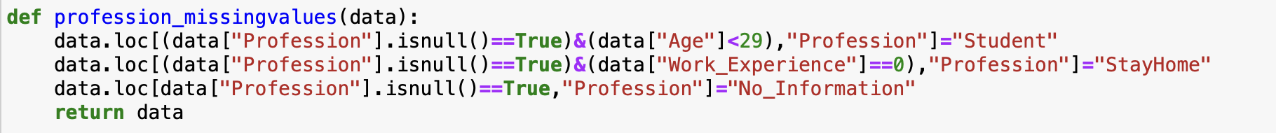
Challenges and Learnings
-> Managing the missing values (in the right order)
-> Identify and understand the incoherences : pivot table
-> Do SQL queries from Python Notebook :
sqlalchemy but SQL
Notes:
Clémence

Slide 5
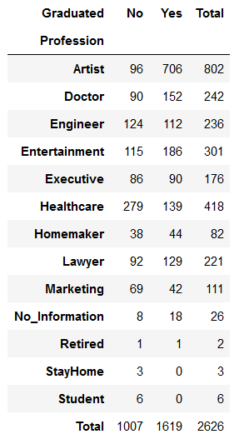
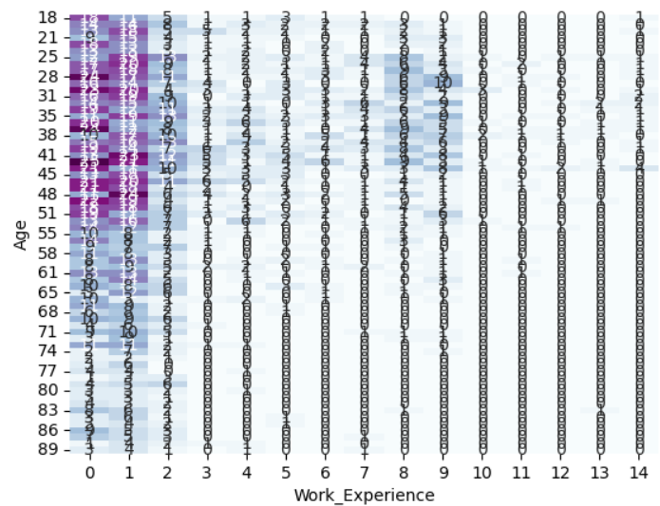
Incoherence in the data
Graduated and profession
age and work experience
Incoherent columns: Graduated and Work Experience
Not considered for the analysis

Slide 6
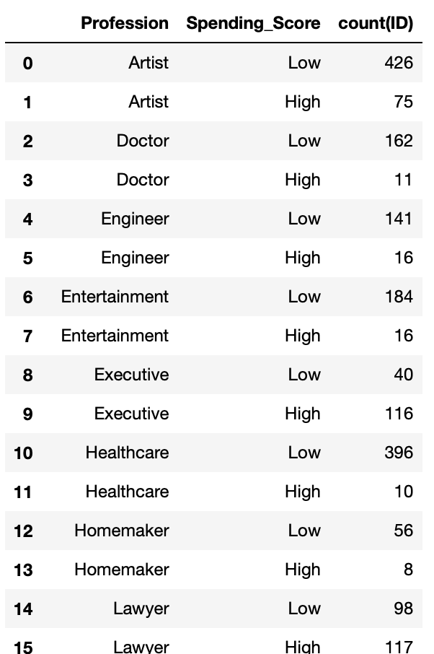
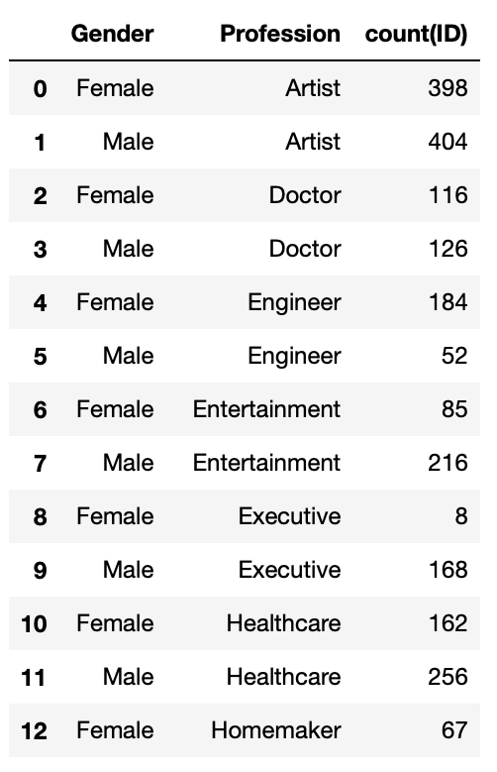
Results mysql analysis
What is the profession repartition in the extreme Spending_Score groups ?
What is the gender repartition for each profession?
…
…
Notes:
Clémence

Slide 7
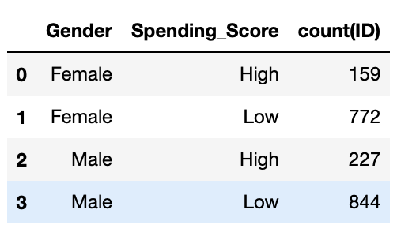
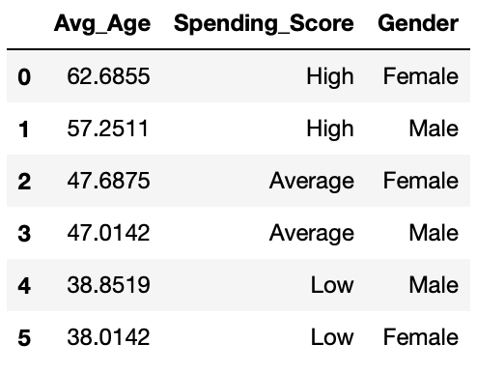
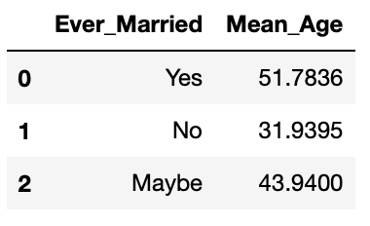
Results mysql analysis
What is the average age according to the Spending_Score and the Gender ?
What is the gender repartition depending on the Spending_Score ?
What is the average age according to the marital status ?

