Slide 1
Machine learning project
SGD classifier
ComplementNB
Voting Classifier
Kevin & Rachad

Slide 2
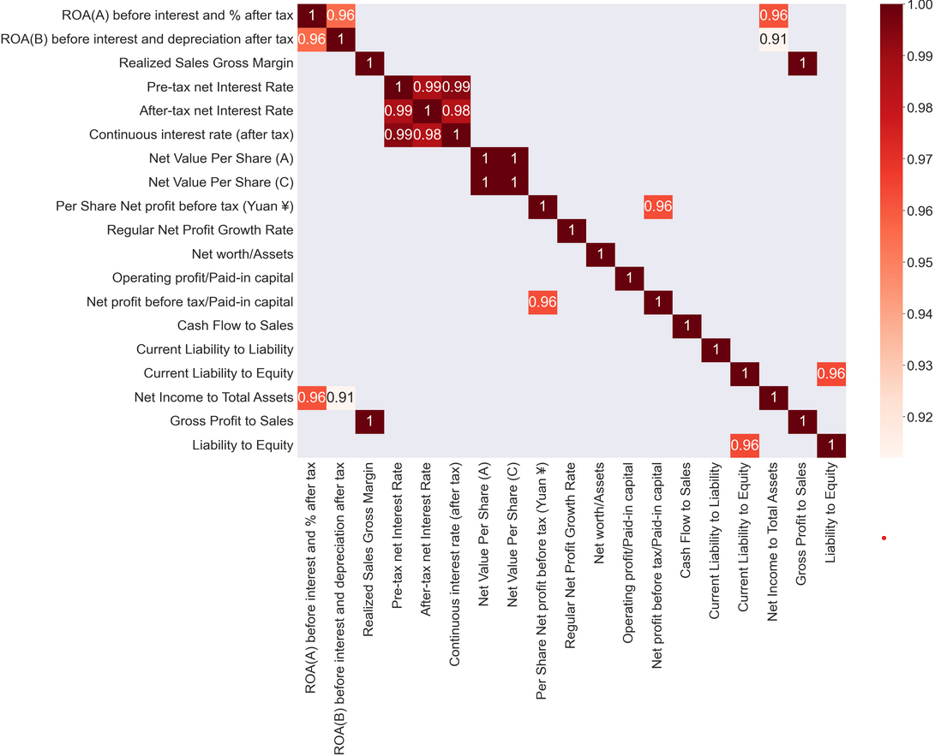
Exploratory analysis
Dropped columns:
2 low variance columns:
'Liability-Assets Flag''Net Income Flag'
We dropped 8 columns with high collinearity:
'ROA(B) before interest and depreciation after tax', 'Net Income to Total Assets', 'Realized Sales Gross Margin', 'Pre-tax net Interest Rate', 'Continuous interest rate (after tax)', 'Net Value Per Share (C)', 'Per Share Net profit before tax (Yuan ¥)','Current Liability to Equity'

Slide 3
SGD classifier - Model description
Stochastic Gradient Descent classifier:
Determining the linear model coefficients: that minimize the error between the prediction and the real value (loss function)
Initialize the model parameters Randomly.
selecting a small batch of data points from the training data set
For each small batch, compute the gradient of the loss function with respect to the model parameters.
Update the model parameters by taking a small step in the direction of the negative gradient.
Repeat steps 3 and 4 until convergence or for a fixed number of iterations.
Successfully applied to large-scale datasets because the update to the coefficients is performed for each training instance, rather than at the end of instances.

Slide 4
SGD classifier - HYPERPARAMETER AND SCALING
Hyperparameters:
Loss function: default = ‘hinge’ : linear SVM. I used ‘log’ − This loss will give us logistic regression i.e. a probabilistic classifier
Penalty: default = ‘l2’: Regularization is a technique used to prevent overfitting by adding a penalty term to the loss function.
‘l1’:can be useful when the dataset has a large number of features, and we want to identify the most important features for the prediction task
‘L2’: can be useful when we want to prevent the weights from becoming too large and potentially overfitting the model
alpha − float, default = 0.0001 : Alpha, the constant that multiplies the regularization term, is the tuning parameter that decides how much we want to penalize the model.
max_iter − int, optional, default = 1000. I used 1500. it represents the maximum number of passes over the training data.
Scaling:
StandardScaler()

Slide 5
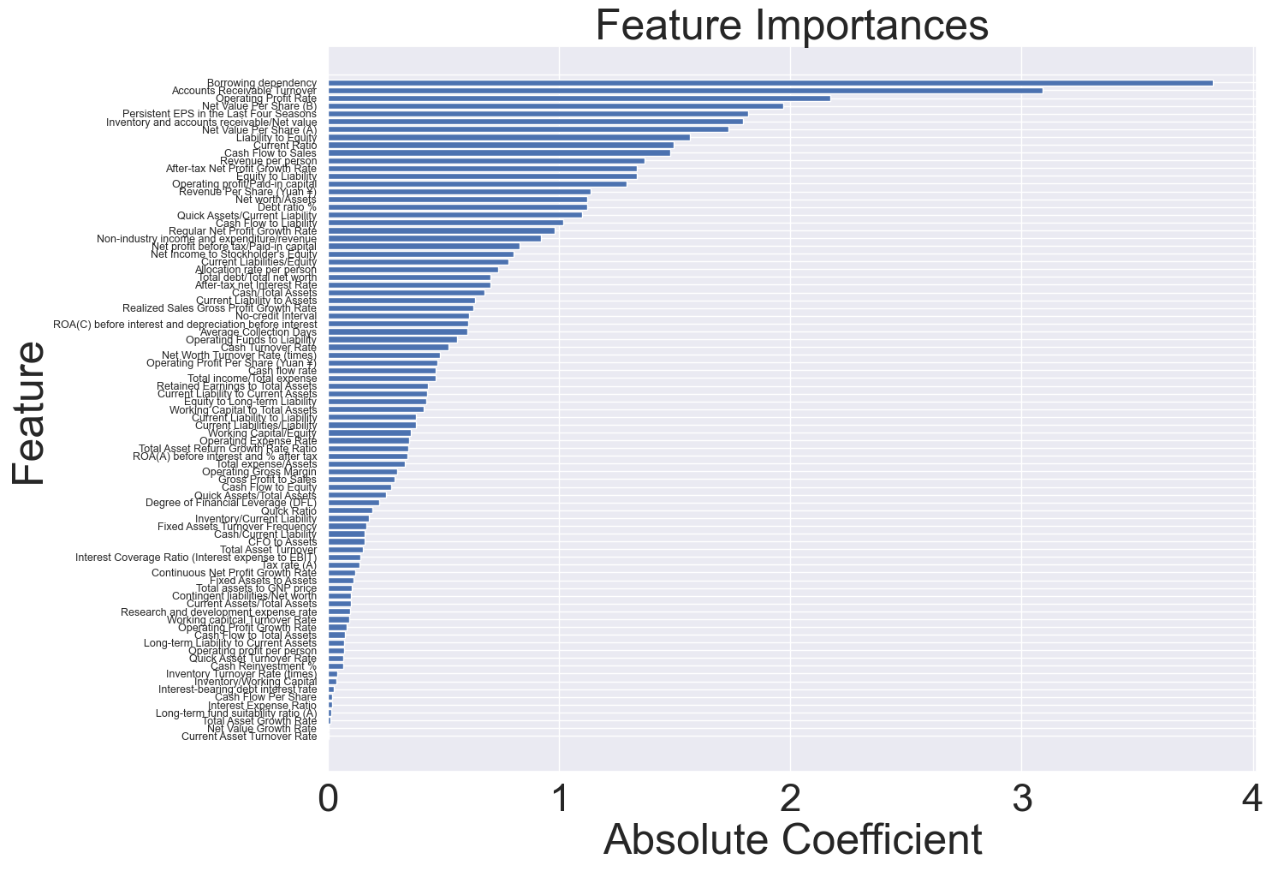
SGD classifier Feature selection
We selected features with coef > 1
20 columns left

Slide 6
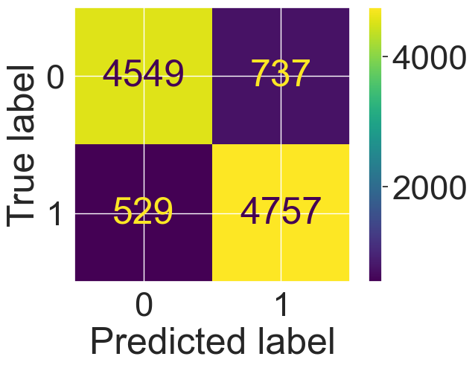
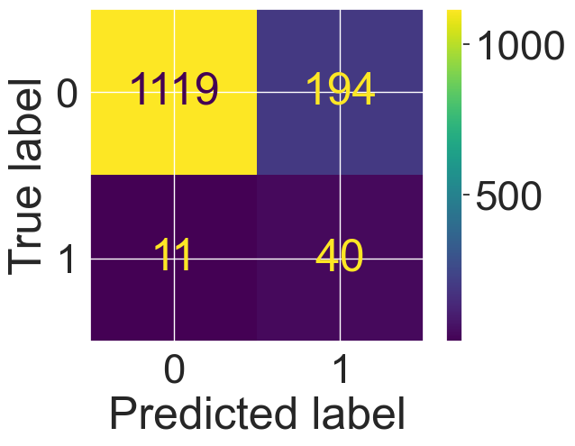
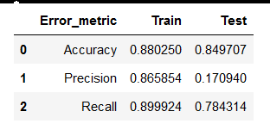
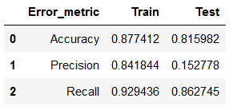
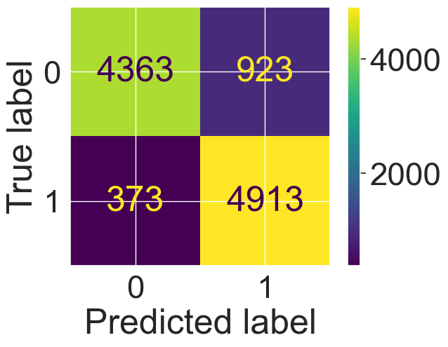
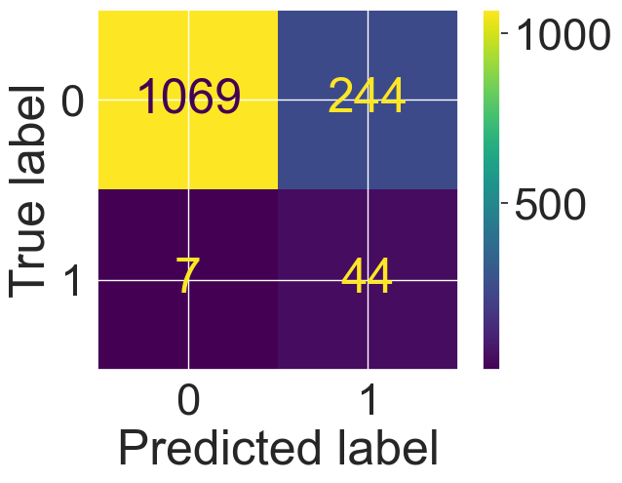
SGD classifier
Train
Test
No feature selection
With feature selection

Slide 7
Complement NB - Model description
ComplementNB is a variant of the Naive Bayes algorithm its supposed to be adapted to the case of class imbalance
Assume the features in a dataset are independent of each others
calculates the probability of each class given a set of features, and selects the class with the highest probability as the predicted class. This probability is calculated using Bayes theorem:
P(b|a) = P(a|b) * P(b) / P(a)
instead of modeling the probability of an instance belonging to a particular class, it models the probability of an instance not belonging to that class.
This approach is particularly useful when the negative class is dominant, as it allows the algorithm to focus on the positive class and improve its classification performance.

Slide 8
Complement NB- HYPERPARAMETER AND SCALING
Hyperparameters:
alpha: default = 1 : The smoothing parameter used to avoid zero probabilities when calculating likelihoods
Norm bool, default=False : Whether or not a second normalization of the weights is performed. I tried it with True nothing changed
Scaling:
MinMaxScaler() : Model don’t allow negative values after scaling

Slide 9
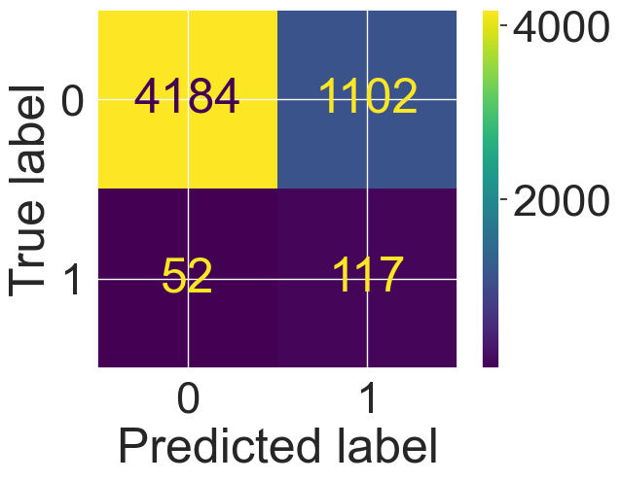
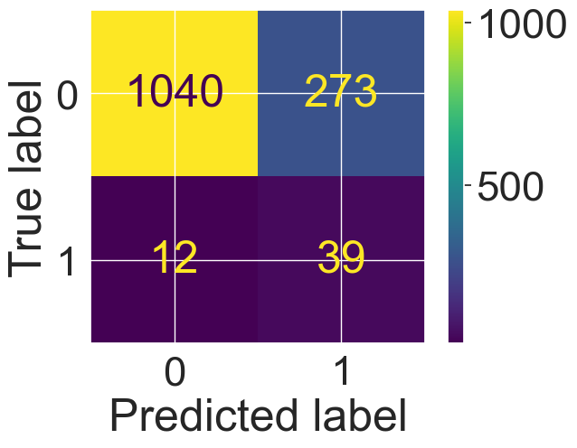
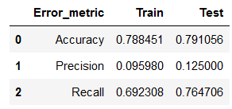
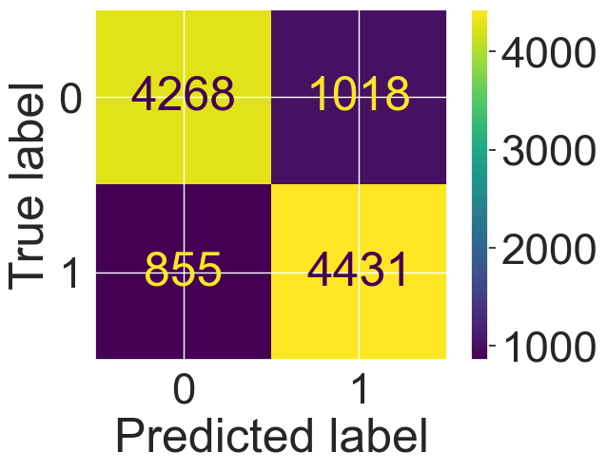

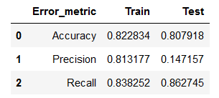
Complement NB
Train
Test
No oversampling
With oversampling

Slide 10
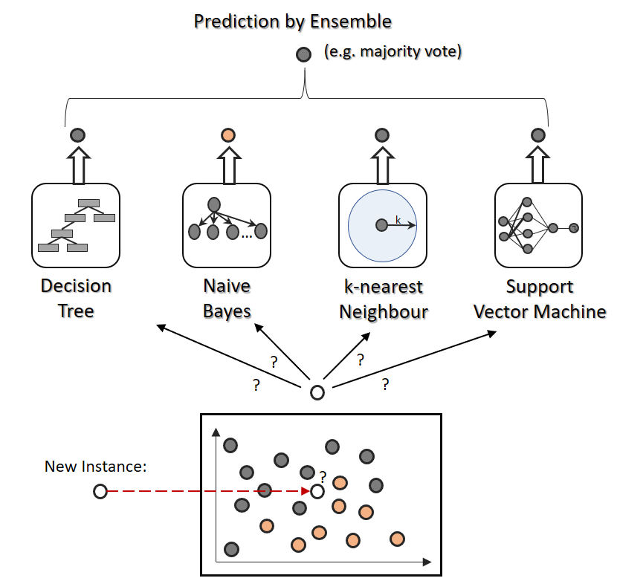
Voting Classifier- Model description
A voting classifier is like a committee of experts who make decisions together. Each expert (classifier) has their own opinion (prediction), and the committee (voting classifier) makes the final decision based on a vote.

Slide 11
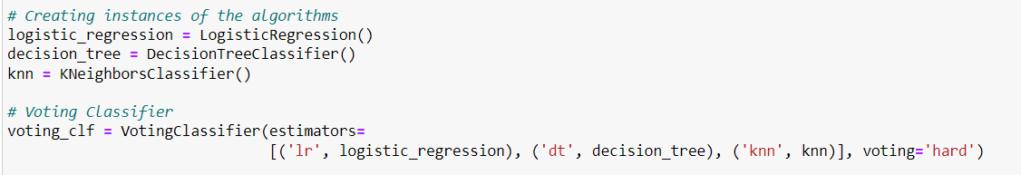
Voting Classifier - Syntax

Slide 12
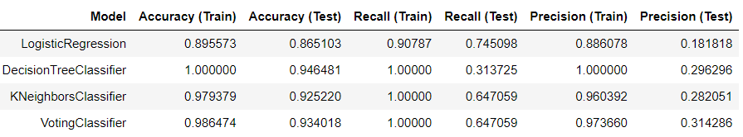
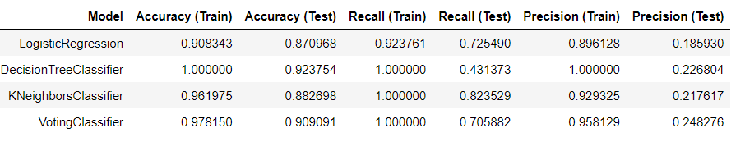
Voting Classifier
With PANDAS upsampling:
With SMOTE upsampling:

Slide 13



Voting Classifier – How to improve?
Cross-Validation as a way to reduce overfitting:
Without upsampling:
With upsampling:

