Slide 1
Unit Project 4
Predict the acceptance rate based on the independent variables
What are the correlations among the dependent and independent variables ?

Slide 2
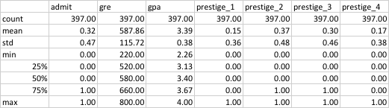
Description of your data and any cleaning that was completed.
Total of 400 observations in the dataset
Missing data in some observations
Dropped observations with missing data
Checked the distribution of the independent variables (boxplot, histogram, scatter plot)
Transformed the variables
Created dummy variables for prestige

Slide 3
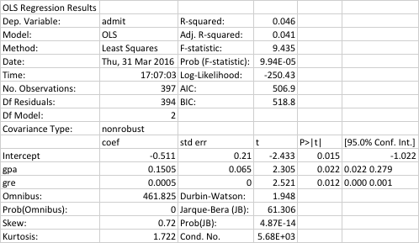
Write up the methods used in your analysis and Results
 | Not Admitted (0) | Admitted (1)
GPA | 3.35 | 3.49
GRE | 573.58 | 618.90
Prestige 1 | 46% | 54%
Prestige 2 | 64% | 36%
Prestige 3 | 77% | 23%
Prestige 4 | 82% | 18%
Regression analysis
GPA are GRE are good indicators to predict the acceptance rate
Logistic Regression
Prestige 1 has higher acceptance rate than the other three groups.
Need to do validation on the model (train vs. test)

Slide 4

Appendix: Provide a table or visualization of these results
Example for crosstab

