Slide 1
Cleaning Data & Feature Engineering
What is it?
Why is it important?
How do we implement it?
Presented by Rachael Phillips

Slide 2
Agenda
What is Cleaning Data & Feature Engineering and what are the different techniques?
Why are they important and what can we do with them?
Techniques and Explanations

Slide 3

What is Cleaning Data & Feature Engineering?
Feature Engineering is a methodology to choose better features for a given machine learning problem via data mining techniques. Techniques Include:
Removing Junk (Columns and Rows)
Imputation (Filling in Missing Data if Applicable)
Handling Outliers
Binning
Log Transformation
One-hot Encoding
Grouping Operations
Feature Split
Scaling
Extracting Date
Feature Importance
Extracting Synthetic Features From Text

Slide 4
Why is Cleaning Data & Feature Engineering Important?
Improve a model’s predictive performance
Reduce computational or data needs
Improve interpretability of the results
Cleaning Data and Feature Engineering are the MOST important part of Data Science and take the majority of time for a Data Science Project!
https://blog.ldodds.com/2020/01/31/do-data-scientists-spend-80-of-their-time-cleaning-data-turns-out-no/#:~:text=variant%20of%20it%3A-,Data%20scientists%20spend%2080%25%20of%20their%20time,data%20rather%20than%20creating%20insights.&text=Data%20scientists%20only%20spend%2020,data%20quality%2C%20standards%2C%20access.

Slide 5








Tools for Feature Engineering
Sri Satish Ambati
Kalyan Veeramachaneni
https://www.linkedin.com/in/kalyan-veeramachaneni-9861b821/
Max Kanter
https://www.linkedin.com/in/jmaxkanter/
Maximilian Christ (maximilianchrist.com, max.christ@me.com)
Nils Braun (nilslennartbraun@gmail.com)
Julius Neuffer (julius.neuffer@blue-yonder.com)
Antonia Mey* <antonia.mey@fu-berlin.de>
Christoph Wehmeyer* <christoph.wehmeyer@fu-berlin.de>
Fabian Paul
Hao Wu
Frank Noé
Group in Berlin
Franziska Horn, Robert Pack, Michael Rieger
Cornell University

Slide 6
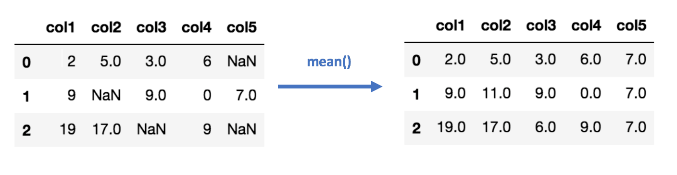
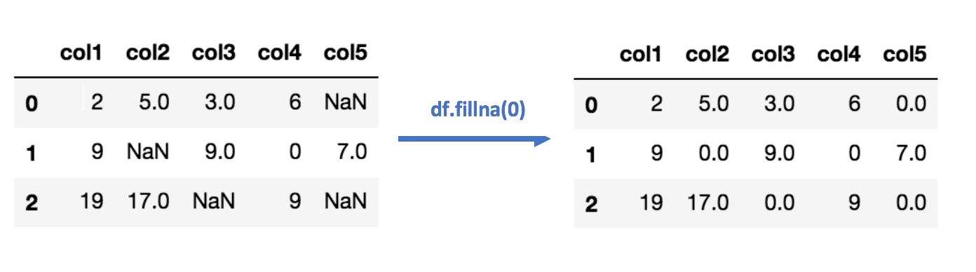
Removing Junk & Imputation
Removing Junk from Data Could Contain the Following Steps:
Removing columns and rows that have no information (all missing data)
Removing columns and rows that have all the same information (one value for each the entire column or row)
Removing features that are not useful
For Missing Data, we can Impute: Imputation is simply filling in missing data with various algorithms.
Impute the mean/median of the feature for missing values
Python code:
from sklearn.impute import SimpleImputer
imr = SimpleImputer(missing_values=np.nan, strategy='mean')
imr = imr.fit(df.values)
imputed_data = imr.transform(df.values)
Imputation using (Most Frequent) or (Zero/Constant) values
Python code:
df = df.fillna(0)

Slide 7
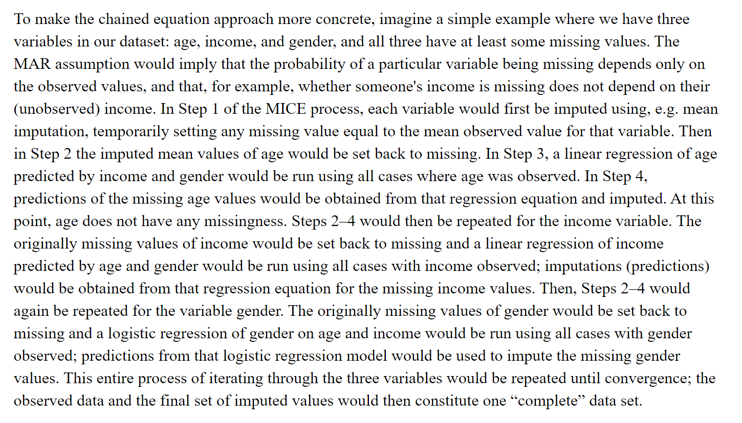
Imputation - MICE
Multivariate Imputation by Chained Equation (MICE):
Filling the missing data multiple times.
The chained equations approach is also very flexible and can handle different variables of different data types (i.e., continuous or binary) as well as complexities such as bounds, or survey skip patterns.
Age | Gender | Income
NA | F | 40000
50 | NA | 120000
25 | M | NA
Python code to implement MICE:
import numpy as np
from sklearn.experimental import enable_iterative_imputer
from sklearn.impute import IterativeImputer
imp = IterativeImputer(max_iter=10, random_state=0)
imp.fit([[1, 2], [3, 6], [4, 8], [np.nan, 3], [7, np.nan]])
X_test = [[np.nan, 2], [6, np.nan], [np.nan, 6]]
# the model learns that the second feature is double the first
print(np.round(imp.transform(X_test)))

Slide 8
Other Imputation Methods
K-NN:
This means that the new point is assigned a value based on how closely it resembles the points in the training set.
Stochastic regression imputation:
It is quite similar to regression imputation which tries to predict the missing values by regressing it from other related variables in the same dataset plus some random residual value.
Extrapolation and Interpolation:
It tries to estimate values from other observations within the range of a discrete set of known data points.
Hot-Deck imputation:
Works by randomly choosing the missing value from a set of related and similar variables.
K-NN:
import numpy as np
from sklearn.impute import KNNImputer
nan = np.nan
X = [[1, 2, nan], [3, 4, 3], [nan, 6, 5], [8, 8, 7]]
imputer = KNNImputer(n_neighbors=2, weights="uniform")
imputer.fit_transform(X)
Stochastic regression imputation:
imputer = IterativeImputer(BayesianRidge()) impute_data = pd.DataFrame(imputer.fit_transform(full_data))
Extrapolation and Interpolation:
import matplotlib.pyplot as plt
from scipy import interpolate
x = np.arange(0, 10)
y = np.exp(-x/3.0)
f = interpolate.interp1d(x, y)
Hot-Deck imputation:
df.fillna(method='ffill', inplace=True)

Slide 9
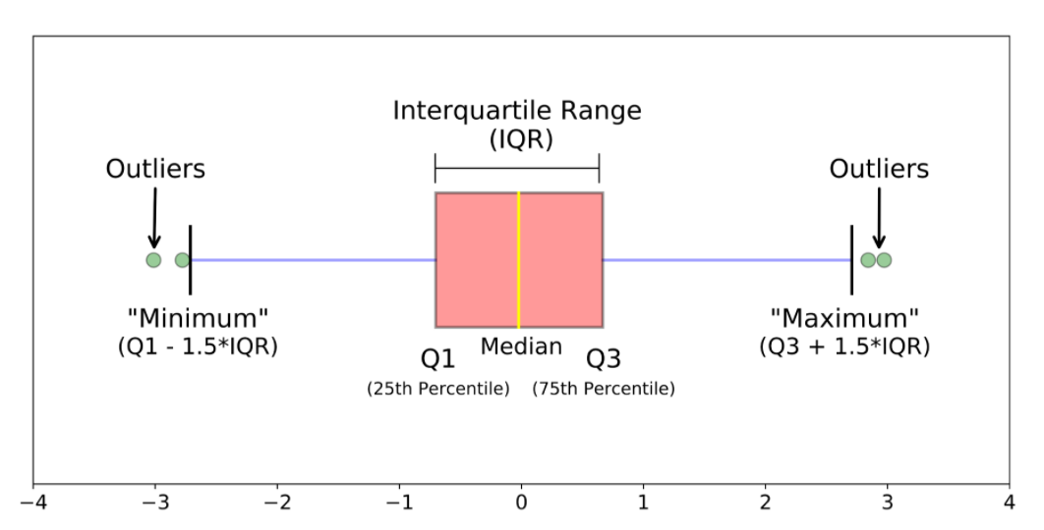
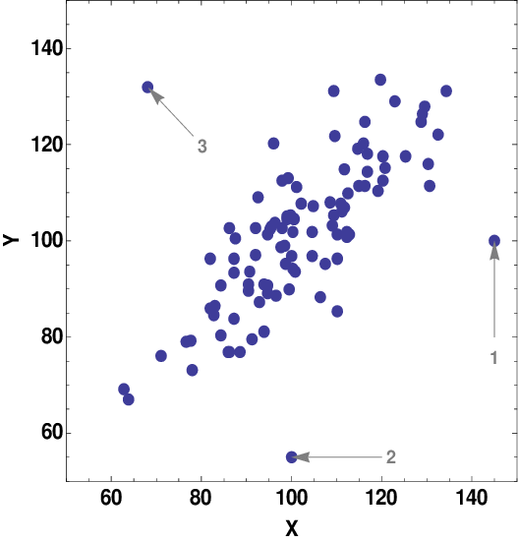
Outliers
What is an outlier?
An observation that lies an abnormal distance from a random sample in a population. Two kinds: mild and extreme outliers.
How can we detect outliers?
Basic methodologies include data visualization of boxplots and scatterplots:
Create a boxplot in python:
# Import libraries
import matplotlib.pyplot as plt
import numpy as np
# Creating dataset
np.random.seed(10)
data = np.random.normal(100, 20, 200)
fig = plt.figure(figsize =(10, 7))
# Creating plot
plt.boxplot(data)
# show plot
plt.show()
Create a scatterplot in Python:
x = np.linspace(0, 10, 30)
y = np.sin(x)
plt.plot(x, y, 'o', color='black')

Slide 10
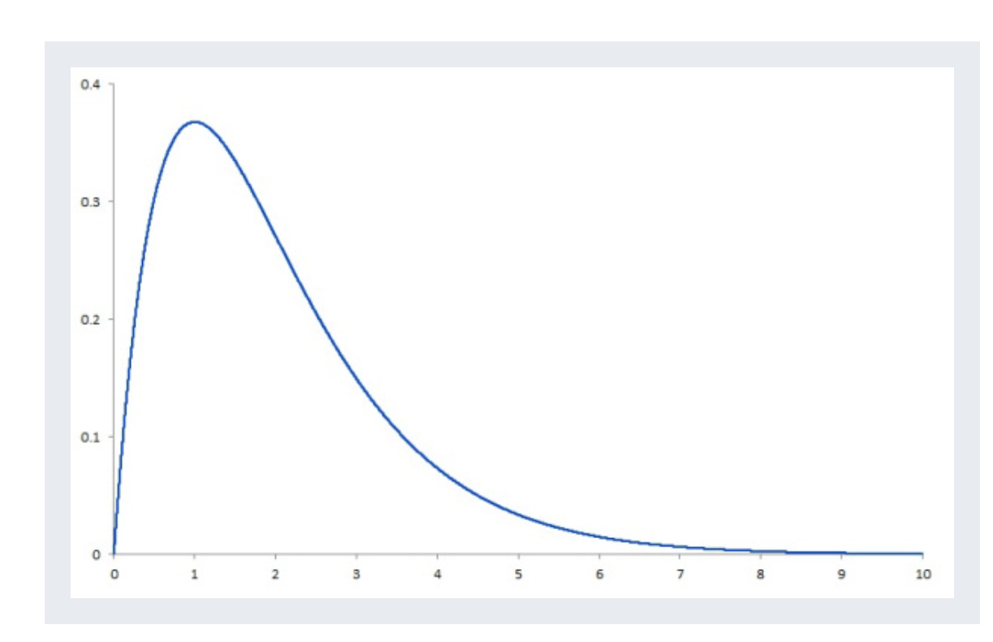
Handling Outliers
Methods to handle outliers include:
Filtering out the extreme outliers in pre-processing of data – if a feature is above or below a certain amount, filter out that observation
Remove or change outliers during post-test analysis – remove outliers or trim your data by a certain amount
Change outlier values – adjust the outliers so that they make sense
Consider the underlying distribution
Consider the mild outliers

Slide 11
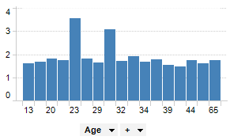
Binning
Also known as discrete binning or binning, is a technique to reduce the effects of minor observation errors.
Histograms are an example of binning.
Binning data is beneficial when your data is very noisy because it will reduce noise, however, this methodology does lose some information about the data.
Python code:
df[colname] = pd.qcut(df[column], 10)

Slide 12
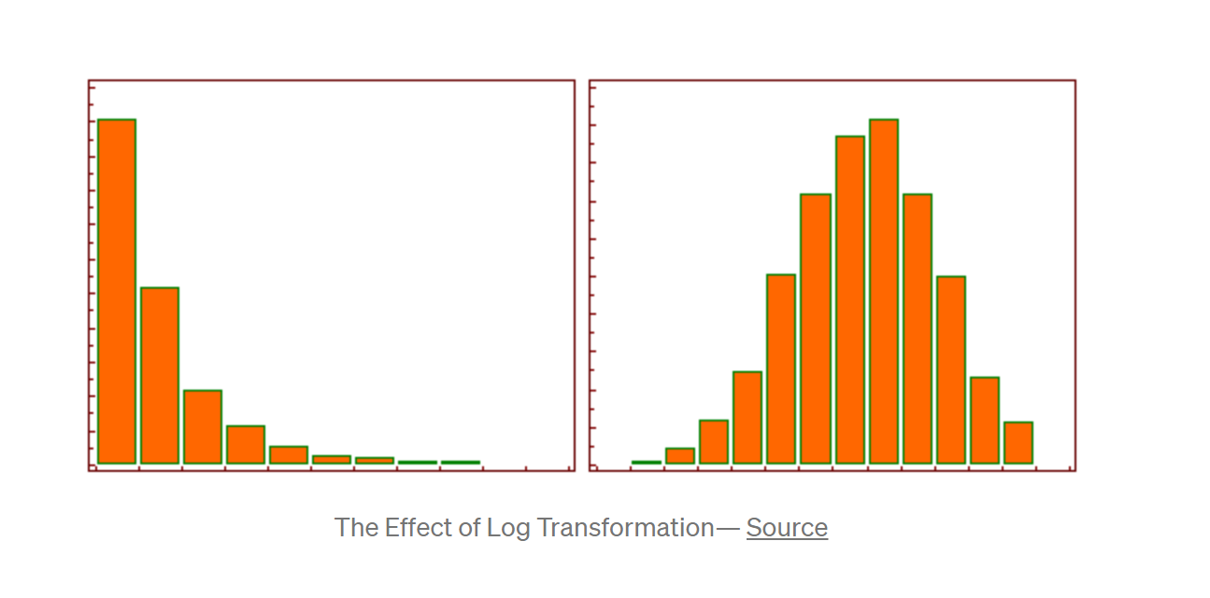
Log Transformation
This method replaces x values with log(x) values to make “non-normal” data into a normal distribution.
This should be used when the data is skewed in a way that it follows or approximately follows a natural log distribution.
Python code:
# Log transformation of negatively (left) skewed data in Python
df.insert(len(df.columns), 'D_log',
np.log(max(df.iloc[:, 2] + 1) - df.iloc[:, 2]))

Slide 13
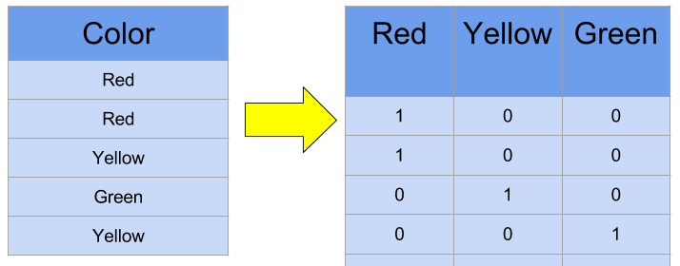
One-Hot Encoding
One-Hot Encoding is a method to make categorical or nominal variables into numerical representations.
Some algorithms can handle categorical variables such as a decision tree.
One-Hot Encoding
Python code:
data = pd.get_dummies(df,prefix=[column], columns = [column], drop_first=False)

Slide 14
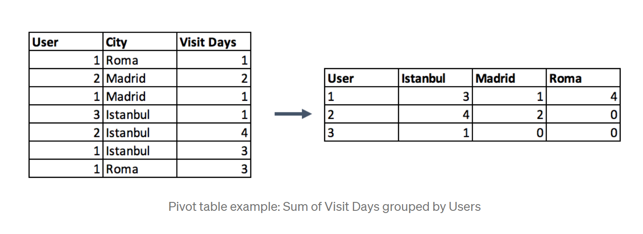
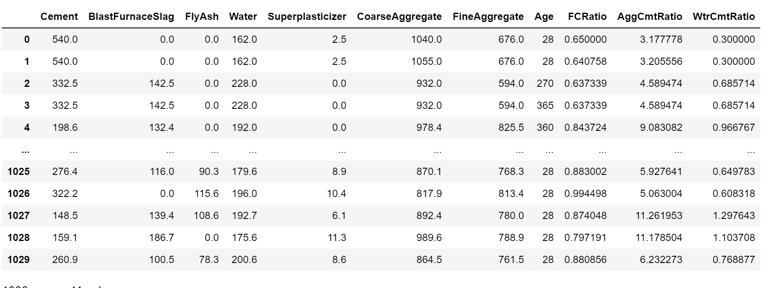
Grouping Operations
Numerical Grouping Methods:
Numerical columns are grouped using sum and mean functions in most of the cases. Both can be preferable according to the meaning of the feature. For example, if you want to obtain ratio columns, you can use the average of binary columns. In the same example, sum function can be used to obtain the total count either.
# Create synthetic features – python code
X["FCRatio"] = X["FineAggregate"] / X["CoarseAggregate"]
X["AggCmtRatio"] = (X["CoarseAggregate"] + X["FineAggregate"]) / X["Cement"]
X["WtrCmtRatio"] = X["Water"] / X["Cement"]
Categorical Grouping Methods:
Select the label with the highest frequency. In other words, this is the max operation for categorical columns.
Create a pivot table.
pivot = df.pivot_table(index=[‘User'], values=[‘Visit Days'], aggfunc='sum')
Apply a group by function after applying one-hot encoding. This method preserves all the data -in the first option you lose some-, and in addition, you transform the encoded column from categorical to numerical in the meantime.

Slide 15
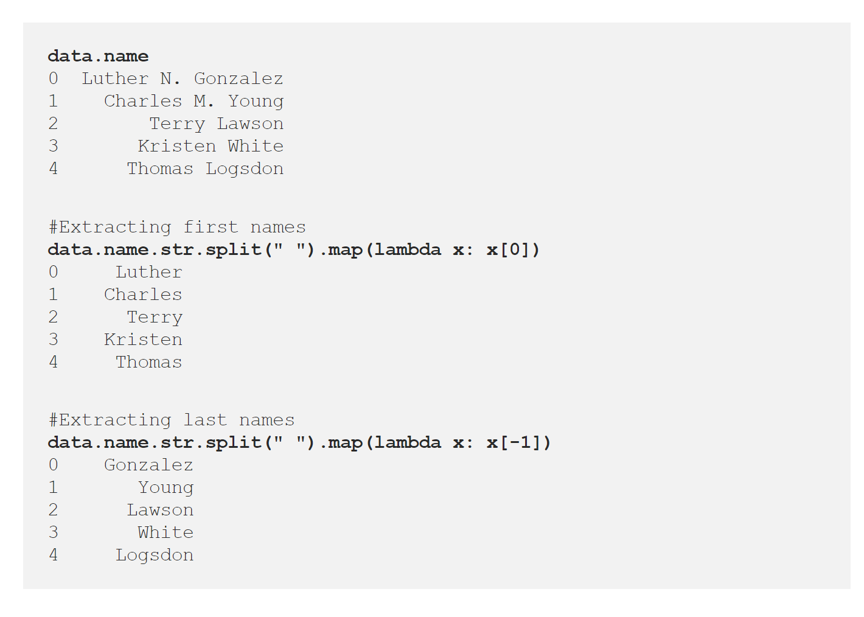
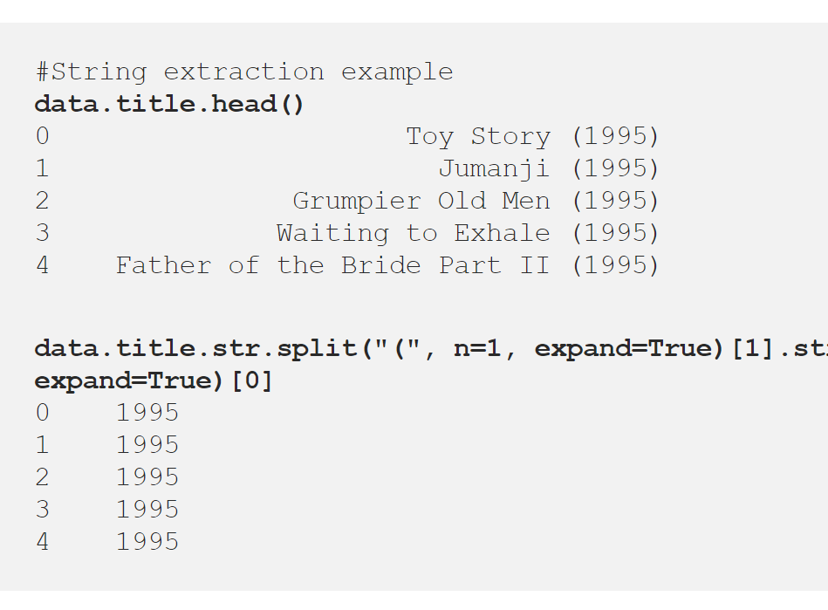
Feature Split
Some features, such as text, may not be useful on their own, but could possibly have some useful information inside. We can split this data up to extract usable features.

Slide 16
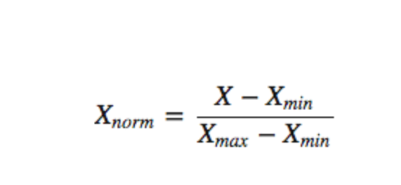
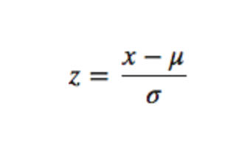
Scaling
When dealing with different features that have a different scaling – for example, income and age, we are unable to compare these two features. This is where scaling the data to have the same range is important. Algorithms based on distances need to have scaled data.
Two ways to scale: Normalization and Standardization
Normalization
from sklearn import preprocessing
import numpy as np
a = np.random.random((1, 4))
a = a*20
# normalize the data attributes
normalized = preprocessing.normalize(a)
print("Normalized Data = ", normalized)
Standardization
from sklearn import preprocessing
import numpy as np
X_train = np.array([[ 1., -1., 2.],
[ 2., 0., 0.],
[ 0., 1., -1.]])
scaler = preprocessing.StandardScaler().fit(X_train)
X_scaled = scaler.transform(X_train)

Slide 17
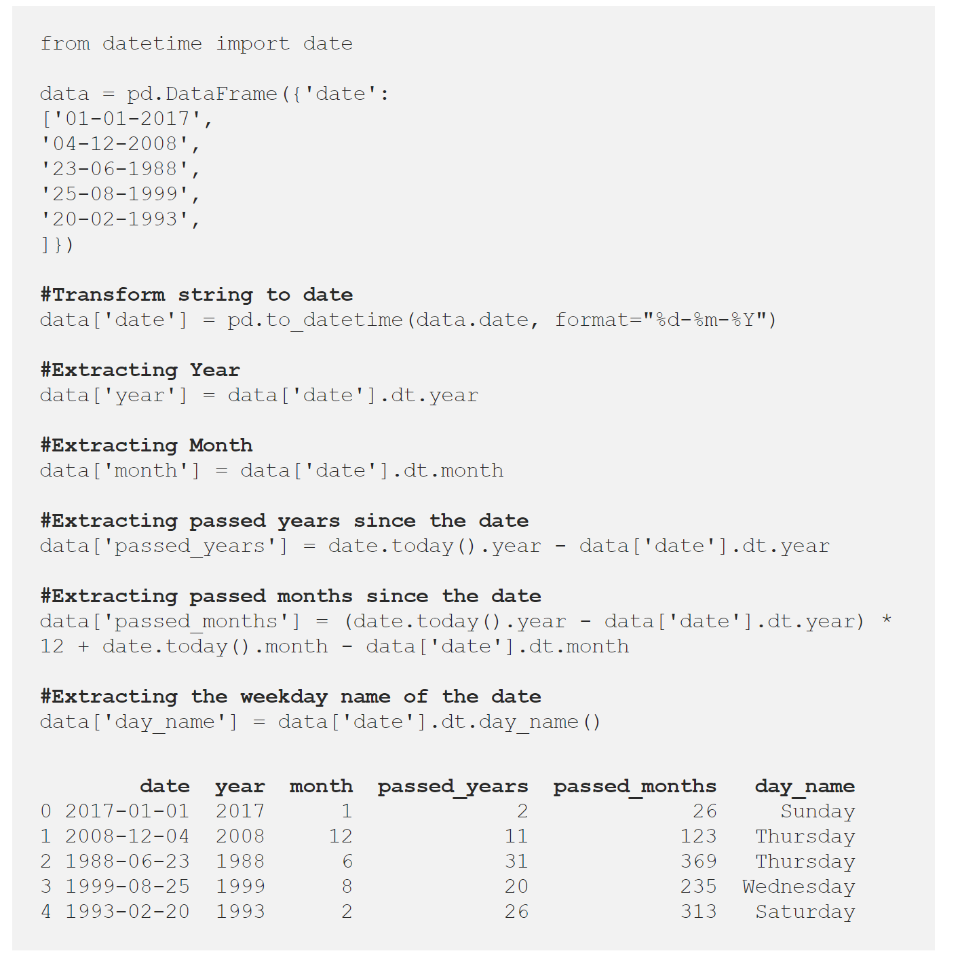
Extracting Date
We can utilize dates in data by extracting information that may be important out of them.
Examples of this include:
Day of the week
Month
Year
Day of the year
Quarter
Differences from other dates

Slide 18
Resources
https://stackoverflow.com/questions/65472200/when-should-data-binning-be-used-in-data-processing
https://docs.tibco.com/pub/spotfire/7.0.1/doc/html/bin/bin_what_is_binning.htm
https://cxl.com/blog/outliers/
https://en.wikipedia.org/wiki/Data_binning
https://www.simplypsychology.org/boxplots.html#:~:text=When%20reviewing%20a%20box%20plot,whiskers%20of%20the%20box%20plot.&text=For%20example%2C%20outside%201.5%20times,Q3%20%2B%201.5%20*%20IQR).
https://www.researchgate.net/figure/Examples-of-various-outliers-found-in-regression-analysis-Case-1-is-an-outlier-with_fig2_50946372
https://probabilityandstats.wordpress.com/2015/05/09/the-skewness-of-a-probability-distribution/
https://towardsdatascience.com/feature-engineering-for-machine-learning-3a5e293a5114
https://www.kaggle.com/ryanholbrook/what-is-feature-engineering
https://medium.com/@kyawsawhtoon/log-transformation-purpose-and-interpretation-9444b4b049c9#:~:text=Log%20transformation%20is%20a%20data,the%20purposes%20of%20statistical%20modeling.
https://machinelearningmastery.com/why-one-hot-encode-data-in-machine-learning/
https://www.kaggle.com/dansbecker/using-categorical-data-with-one-hot-encoding

