Slide 1
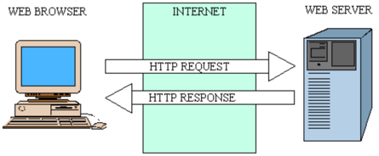
Basic Web Technologies
1995 – JavaScript - was developed by Brendan Eich for Netscape 2
<script type="text/javascript">
var rows = prompt("How many rows for your multiplication table?");
var cols = prompt("How many columns for your multiplication table?");
if(rows == "" || rows == null)
rows = 10;
if(cols== "" || cols== null)
cols = 10;
createTable(rows, cols);
function createTable(rows, cols)
{
var j=1;
var output = "<table border='1' width='500' cellspacing='0'cellpadding='5'>";
for(i=1;i<=rows;i++)
{
output = output + "<tr>";
while(j<=cols)
{
output = output + "<td>" + i*j + "</td>";
j = j+1;
}
output = output + "</tr>";
j = 1;
}
output = output + "</table>";
document.write(output);
}
</script>
1994 – web browser Netscape
HTML (HyperText Markup Language)
<!DOCTYPE html>
<html>
<head>
<meta charset="utf-8">
<title>My test page</title>
</head>
<body>
<p>Hello World!</p>
<img src="images/firefox-icon.png"
alt="My test image">
</body>
</html>
1996 – Cascading Style Sheets (CSS)
<style>
BODY, TD, TH, P, DIV, blockquote, li, ul
{FONT-FAMILY: verdana, arial, geneva, helvetica; FONT-SIZE: 10pt;}
A:hover { COLOR: #FF0000; background: #FFA; TEXT-DECORATION: underline }
</style>

Slide 2
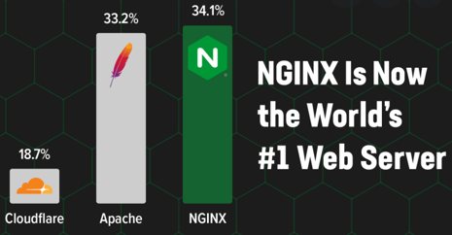
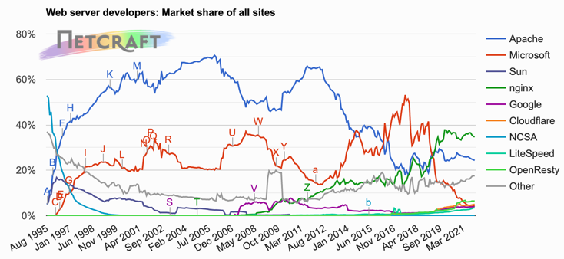
Web Servers
In 2021
In 2021 Nginx has become the most popular web server.
Apache moved to the 2nd place, and Microsoft IIS has very little popularity.
Nginx – very light, but very fast.
Typical Python Architectures:
Nginx – Gunicorn
Nginx – Gunicorn – Flask
Nginx – Gunicorn – Uvcorn – FastAPI
Nginx Units – FastAPI
Nginx – Django
Typical node.js (Javascript) Architecture:
Nginx – Node

Slide 3
Serving Active Content
For active content you will need
an App. Server behind the Web Server.
Typically python app. servers use either WSGI or ASGI protocols.
CGI = Common Gateway Interface
WSGI = Web Server Gateway Interface (most common)
ASGI = Asynchronous Server Gateway Interface
Look at the list of different WSGI compatible app servers here:
- https://en.wikipedia.org/wiki/Web_Server_Gateway_Interface
Good for prototyping: uWSGI + Flask:
- https://en.wikipedia.org/wiki/UWSGI
- https://en.wikipedia.org/wiki/Flask_(web_framework)
Static content
HTML, CSS, JS, Images
Client
(Browser or mobile apps)
HTTP Web
Server
Active content
Python, Perl, PHP, .NET, etc.
Static content
HTML, CSS, JS, Images
Browser
or app
Nginx HTTP Web
Server
WSGI Server
(Gunicorn)
Flask Python App Server
CGI script (Perl)
WSGI script (Python, Gunicorn)
#!/usr/bin/perl print "Content-type:text/html\n\n"; print "<html>Hello</html>\n";
1;
# myapp.py
# python gunicorn -c myconfig.cfg myapp:app
def app(environ, start_response):
data = b"Hello, World!\n"
start_response("200 OK", [
("Content-Type", "text/plain"),
("Content-Length", str(len(data)))
])
return iter([data])
# myconfig.cfg
import multiprocessing bind = "127.0.0.1:8010"
workers = 4
reload = True

Slide 4
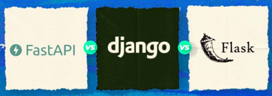
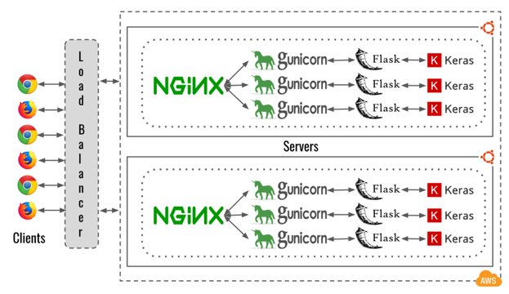

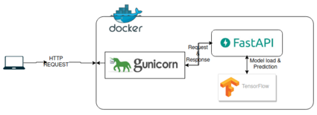


WebApps
Serving pages and APIs using Python
For active content you will need an App. Server behind the Web Server.
Typically python app. servers use either WSGI or ASGI protocols.
CGI = Common Gateway Interface
WSGI = Web Server Gateway Interface (most common)
ASGI = Asynchronous Server Gateway Interface
Look at the list of different WSGI compatible app servers here:
- https://en.wikipedia.org/wiki/Web_Server_Gateway_Interface
Good for prototyping: uWSGI + Flask:
- https://en.wikipedia.org/wiki/UWSGI
- https://en.wikipedia.org/wiki/Flask_(web_framework)
Note:
Azure, AWS, and Google cloud
offer Load Balancing solutions
You can scale using multiple servers, or multiple docker containers managed by kubernetes
Two ways to use ASGI with FastAPI:

Slide 5

FastAPI
fast web framework for building APIs with Python 3.6+
Documentation: https://fastapi.tiangolo.com
Source Code: https://github.com/tiangolo/fastapi
Modern (since 2018)
Fast: Very high performance, on par with NodeJS and Go
Uses Pydantic for type hints checks - https://pydantic-docs.helpmanual.io
Uses Starlette, but provides more features - https://www.starlette.io
Fast to code
Fewer bugs, reduce developer errors
Intuitive: Great editor support, auti-completion, fast debugging
Easy to use and learn
Short: Minimize code duplication. Multiple features from each parameter declaration. Fewer bugs.
Robust: Get production-ready code. With automatic interactive documentation.
Standards-based: Based on OpenAPI (previously known as Swagger) and JSON Schema.
Uses Uvicorn - The lightning-fast ASGI server. - https://www.uvicorn.org
Implements ASGI (Asynchronous Server Gateway Interface) - https://asgi.readthedocs.io
Uses uvloops - fast, drop-in replacement of the built-in asyncio event loop. uvloop is implemented in Cython and uses libuv under the hood. - https://github.com/MagicStack/uvloop
Uses httptools - a Python binding for the nodejs HTTP parser. - https://github.com/MagicStack/httptools
Comparing with Flask
https://towardsdatascience.com/understanding-flask-vs-fastapi-web-framework-fe12bb58ee75
Flask (since 2010) is a micro web framework written in python.
minimal amount of coding required
easy to setup, flexible, fast to deploy
built on WSGI (Python Web Server Gateway Interface) whereby the server will tie up a worker for each request.
FastAPI (since 2018) – similar to Flask, but:
is faster than Flask because it is built on ASGI (Asynchronous Server Gateway Interface), whereby it supports concurrency / asynchronous code.
generates documentation
creates interactive GUI (Swagger UI) for testing

Slide 6








Javascript
Links:
ajax - https://en.wikipedia.org/wiki/Ajax_(programming) -
jQuery - https://jquery.com -
node.js - https://nodejs.org -
AngularJS - https://en.wikipedia.org/wiki/AngularJS - https://angularjs.org
React - https://en.wikipedia.org/wiki/React_(JavaScript_library) - https://reactjs.org
npm - https://www.npmjs.com - https://en.wikipedia.org/wiki/Npm_(software)
Vue.js - https://en.wikipedia.org/wiki/Vue.js - https://vuejs.org - https://cli.vuejs.org -
Redux - https://en.wikipedia.org/wiki/Redux_(JavaScript_library)
Typescript - https://en.wikipedia.org/wiki/TypeScript
NativeScript - https://nativescript.org – mobile apps
More links:
Loopback.io - https://loopback.io/ - node.js + typescript
form.io - https://www.form.io/ - create forms and APIs, very good, uses mongo.db, opensource
heroku - https://www.heroku.com/ - container-based cloud platform
Swagger.io - https://swagger.io – build API, open source
expressJS - https://expressjs.com - Node Express
Yeoman.io - https://yeoman.io – tools for JS development
Mustache - https://github.com/mustache - templates
Joe Orr - https://kaleguy.github.io/ -
Fiddler – web debugger tool - https://en.wikipedia.org/wiki/Fiddler_(software) -
lodash JS library - https://en.wikipedia.org/wiki/Lodash
RxJS - reactive library - https://rxjs-dev.firebaseapp.com/ -
Svelte - https://en.wikipedia.org/wiki/Svelte – frontend
Vercel - https://vercel.com - platform for frontend frameworks
GitPod.io - https://www.gitpod.io - VS Code or JetBrains in browser
1996 – AJAX (Asynchronous JavaScript And XML)
2006 – jQuery
2009 – Node.js (server-side)
2010 – AngularJS (Google) JavaScript MVC framework
2013 – React (Facebook)
2014 – npm registry
repository for frontend packages
2014 – Vue.js
2014 – NativeScript (mobile apps)
2015 – Redux Library (maange state,
used with React or Angular)

Slide 7

Web Technologies – continued ...
Web Server Frameworks:
- Python-based (Django, Flask, gunicorn, FastAPI, etc.)
- node.js + TypeScript
- Flutter (widgets) - https://en.wikipedia.org/wiki/Flutter_(software)
Load Balancers
In front of your web application you may have a load balancer.
All three major clouds provide load balancers:
AWS - https://docs.aws.amazon.com/AmazonECS/latest/developerguide/load-balancer-types.html
Azure - https://docs.microsoft.com/en-us/azure/load-balancer/load-balancer-overview
GCP - https://cloud.google.com/load-balancing
You may also use Nginx to route requests to application servers and to serve static html pages:
https://en.wikipedia.org/wiki/Nginx
Django/Python provides authentication, sessions, and caching out-of-the-box:
- https://en.wikipedia.org/wiki/Django_(web_framework) -
- https://www.django-rest-framework.org -
All major clouds provide tools for Authentication/Authorization
AWS Single Sign-On - https://docs.aws.amazon.com/singlesignon/latest/userguide/what-is.html -
Azure Active Directory SSO - https://docs.microsoft.com/en-us/azure/active-directory/hybrid/how-to-connect-sso -
Google: OpenID Connect - https://developers.google.com/identity/protocols/oauth2/openid-connect -
Templates:
Responsive HTML templates (top menu changes to hamburger for narrow screen)
You can google for something like this:
mobile compatible website template free download
mobile html templates
responsive website templates
shopify templates
Example of good template for Jekyll (static site generator):
- https://mademistakes.com/work/minimal-mistakes-jekyll-theme/

Slide 8
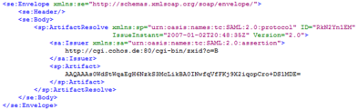
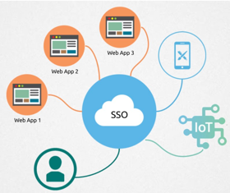
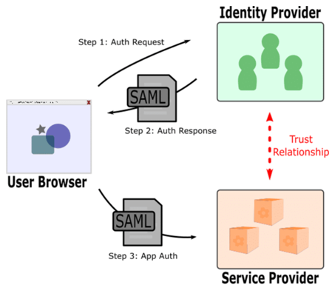
Web Security
SAML
Data security
Access
SSO = Single Sign-On
SAML (Security Assertion Markup Language (XML))
OAuth2 (Open Authorization) - open standard for access delegation, commonly used as a way for Internet users to grant websites or applications access to their information on other websites but without giving them the passwords
3-legged vs 2-legged OAuth. Typical 3-legged OAuth flow involves three parties: - the end-user (or resource owner), - the client (the third-party application), - and the server (or authorization server). The term 2-legged is used to describe an OAuth-authenticated request without the end-user involved. Client credentials (identifier and secret) are used to calculate a request signature. 2-legged request don't include an access token or access token secret. These two values are basically empty strings.
Resources:
https://en.wikipedia.org/wiki/Single_sign-on
https://en.wikipedia.org/wiki/Security_Assertion_Markup_Language (SAML)
https://oauth.net/2/
https://stackoverflow.com/questions/13369516/why-is-there-3-legged-oauth2-when-2-legged-works-so-well

