Slide 1
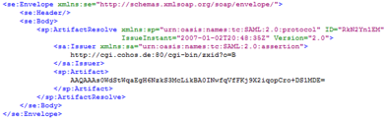
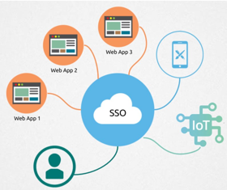
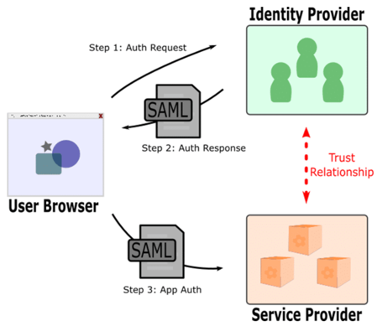
Security
SAML
Data security
Access
SSO = Single Sign-On
SAML (Security Assertion Markup Language (XML))
OAuth2 (Open Authorization) - open standard for access delegation, commonly used as a way for Internet users to grant websites or applications access to their information on other websites but without giving them the passwords
3-legged vs 2-legged OAuth. Typical 3-legged OAuth flow involves three parties: - the end-user (or resource owner), - the client (the third-party application), - and the server (or authorization server). The term 2-legged is used to describe an OAuth-authenticated request without the end-user involved. Client credentials (identifier and secret) are used to calculate a request signature. 2-legged request don't include an access token or access token secret. These two values are basically empty strings.
Resources:
https://en.wikipedia.org/wiki/Single_sign-on
https://en.wikipedia.org/wiki/Security_Assertion_Markup_Language (SAML)
https://oauth.net/2/
https://stackoverflow.com/questions/13369516/why-is-there-3-legged-oauth2-when-2-legged-works-so-well

Slide 2
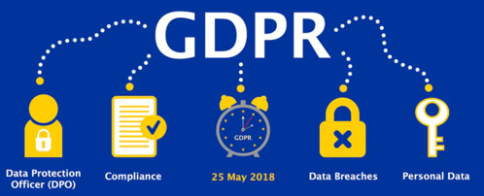
Privacy
Data Privacy, GDPR = General Data Protection Regulation - a European Union privacy law that came into effect on May 25, 2018.
Differential Privacy (DP) An algorithm is DP (Differentially Private) if an observer seeing its output cannot tell if a particular individual's information was used in the computation. """Differential privacy is a system for publicly sharing information about a dataset by describing the patterns of groups within the dataset while withholding information about individuals in the dataset."""
Resources:
https://en.wikipedia.org/wiki/General_Data_Protection_Regulation (GDPR)
https://en.wikipedia.org/wiki/Differential_privacy

Slide 3


SSH, SSL, Single Sign-On, Authorization, Token, etc.
Authentication – prove identity of the user or server (user name + password, cards, retina scans, voice recognition, fingerprints, secure certificates, tokens, etc.)
Authorization – check if user/server is allowed (authorized) to do something
Encryption - transforming the data so that it is unreadable without decryption key.
One-way encryption - hash function, hard to reverse, different for different strings
Symmetric encryption (symmetric cipher - uses same key to encrypt and decrypt).
Asymmetric encryption (public key / private key).
PGP = Pretty Good Privacy, since 1991, uses both symmetric an asymmetric encryption, the de facto standard for email security.
AES = Advanced Encryption Standard, symmetric encryption, fast, used in databases
SSH = Secure Shell protocol (SSH-2 : terminal, sending files, SecureFTP, etc.)
SSL = Secure Socket Layer protocol (https://...), 1995 – 2015, deprecated
TLS = Transport Layer Security, a successor of SSL 3.0, 1999, https://www.ssl2buy.com/wiki/ssl-vs-tls
SSL certificate (a.k.a. “digital certificate”) is installed on a web server and has two functions: It authenticates the identity of the website to visitors, and it is used for data encryption.
ssh-keygen = command to manually generate a pair of keys as files in .ssh hidden directory
ssh.com = SSH Communications Security, Inc. , proprietary SSH solutions
ssh UKM (Universal Key Management) - https://www.ssh.com/products/universal-ssh-key-manager -
OpenSSH – Open-source SSH implementation - https://www.openssh.com/
Single Sign-On - https://en.wikipedia.org/wiki/Single_sign-on - authentication scheme that allows a user to log in once - and access multiple services without re-authenticating. User authenticates with an Identity Server which issues a token. User uses this token to access services. A service verifies the token with Identity Server before giving access.
Token = a collection of data about the user which is passed between systems for getting access. Tokens must be digitally signed for the token receiver to verify that the token is coming from a trusted source. The certificate that is used for this digital signature is exchanged during the initial configuration process.
https://jwt.io/ - JSON Web Tokens , http://www.passportjs.org/ - authentication middleware
https://firebase.google.com/ - platform from Google for creating mobile and web applications. Includes authentication and tokens.
Oauth 2.0 - https://oauth.net/2/ - open standard for access delegation, commonly used as a way for Internet users to grant websites or applications access to their information on other websites but without giving them the passwords.
YubiKey - a small USB device used to authenticate logins - https://www.yubico.com/products/ . On touch it sends a string containing it's public_id and AES-encrypted OTP (One-Time Password).
Taher Elgamal
"Father of SSL"
Netscape 1995-98
Tatu Ylönen,
in 1995 invented the SSH protocol and founded ssh.com
(SSH Communications Security, Inc.)
SSL was deprecated in 2015

Slide 4

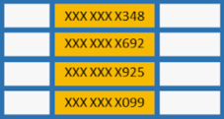
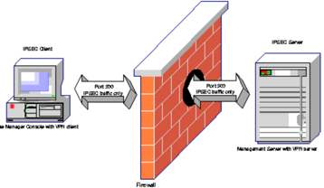
SQL Server Data Security
Encrypted communication over SSL/TLS
Windows Data Protection API (DPAPI) to encrypt data at rest
IAM (Identity Access Management),
Authentication and authorization, strong password policy, security keys, monitor login failures
Roles, conditional access, grant extra permissions only as needed,
Use certificates to sign stored procedures or use impersonation, only for the duration of the task
Prevent SQL injection, sanitize all database inputs
Dynamic Data Masking (DDM)
Run regular audits
Monitor/audit transaction logs
Monitoring
Row-Level Security (RLS) and Column-Level Security (CLS)
Protect error messages and logs
Firewall, VPN
Use leverage DDoS protection services to deflect Denial of Service (DoS) attacks
Regular security updates
Azure Defender for SQL
Regular vulnerabiltiy scans / assessment
DDM

