Slide 1



Asteroid Dataset
Group 08:
Aneela Gannarapu
Preetham Garre
Rachana Goli
Sai Rithwik Reddy Bolla
Susmitha Dalli

Slide 2
BUSINESS OPPURTUNITY
The asteroid dataset offers valuable insights and opportunities for multiple domains, including astronomy and space exploration. It contains information on the materialistic characteristics and the orbital details of more than 17,000 asteroids. Moreover, detecting and monitoring potentially dangerous asteroids can help avert catastrophic incidents, such as an asteroid collision with Earth. The dataset also facilitates the identification of valuable resources, like water and metals, on asteroids, which can pave the way for future asteroid mining expeditions. Consequently, the asteroid dataset provides critical data for diverse scientific and commercial use cases in the field of space exploration.
Notes:
The asteroid dataset offers valuable insights and opportunities for multiple domains, including astronomy and space exploration. It contains information on the materialistic characteristics and the orbital details of more than 17,000 asteroids. Moreover, detecting and monitoring potentially dangerous asteroids can help avert catastrophic incidents, such as an asteroid collision with Earth. The dataset also facilitates the identification of valuable resources, like water and metals, on asteroids, which can pave the way for future asteroid mining expeditions. Consequently, the asteroid dataset provides critical data for diverse scientific and commercial use cases in the field of space exploration.

Slide 3
RESEARCH OBJECTIVES
Evaluating the performance of different machine learning algorithms for predicting whether an asteroid is potentially hazardous or not.
Identify any patterns or trends in the probability of an asteroid colliding with the Earth based on its orbit and eccentricity.
Investigate the potential impacts of asteroids that are bound to the solar system
Examine the distribution of asteroids amongst the planets.
Get clear insights into the asteroid classification surrounding the earth.
Identify attributes that interrelate to the diameter of an asteroid in the solar system.
Notes:
The main aim was to provide a follow-up based on demand and assist in reaching the business goals. To carry out the solution, we decided to use AWS technologies. We planned to execute relevant designs and algorithms to find out the flow in demand that was most appropriate in examining the dataset. Evaluating the performance of different machine learning algorithms for predicting whether an asteroid is potentially hazardous or not.
Identify any patterns or trends in the probability of an asteroid colliding with the Earth based on its orbit and eccentricity.
Investigate the potential impacts of asteroids that are bound to the solar system
Examine the distribution of asteroids amongst the planets.
Get clear insights into the asteroid classification surrounding the earth.
Identify attributes that interrelate to the diameter of an asteroid in the solar system.

Slide 4


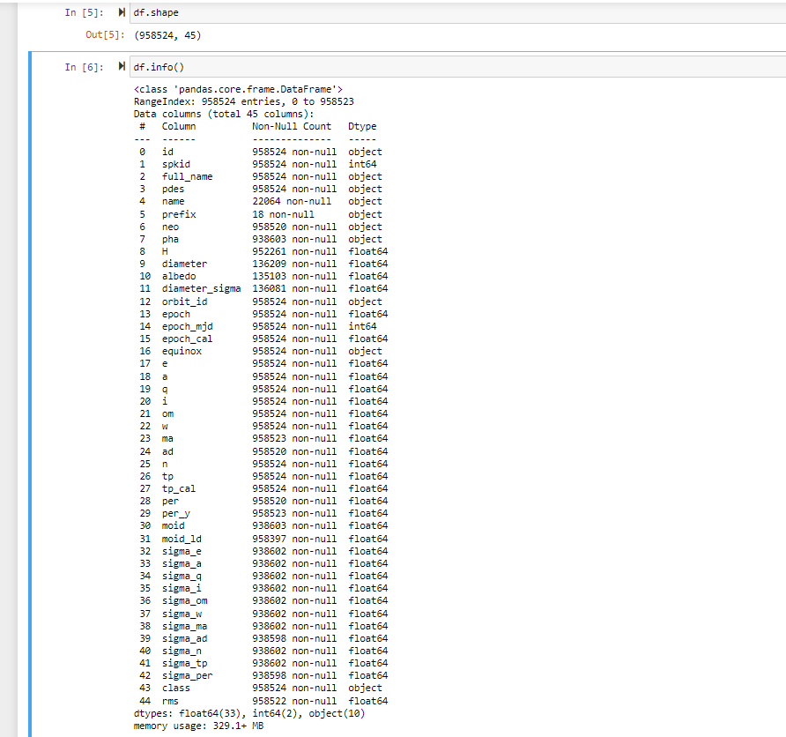
DATA SELECTION
We selected the data set from Kaggle active competitions officially maintained by Jet Propulsion Laboratory of California Institute of Technology which is an organization under NASA. In this Dataset all kinds of Data related to Asteroid is included for analyze.
Notes:
9,80,000 records and 45 columns: The major attributes implemented to perform analysis within the dataset are detailed as below:
SPK-ID: Object primary SPK-ID
Object ID: Object internal database ID
Object fullname: Object full name/designation
pdes: Object primary designation
name: Object IAU name
NEO: Near-Earth Object (NEO) flag
PHA: Potentially Hazardous Asteroid (PHA) flag
H: Absolute magnitude parameter
Diameter: object diameter (from equivalent sphere) km Unit
Albedo: Geometric albedo
Diameter_sigma: 1-sigma uncertainty in object diameter km Unit
Orbit_id: Orbit solution ID
Epoch: Epoch of osculation in modified Julian day form
Equinox: Equinox of reference frame
e: Eccentricity
a: Semi-major axis au Unit
q: perihelion distance au Unit
i: inclination; angle with respect to x-y ecliptic plane
tp: Time of perihelion passage TDB Unit
moid_ld: Earth Minimum Orbit Intersection Distance au Unit

Slide 5
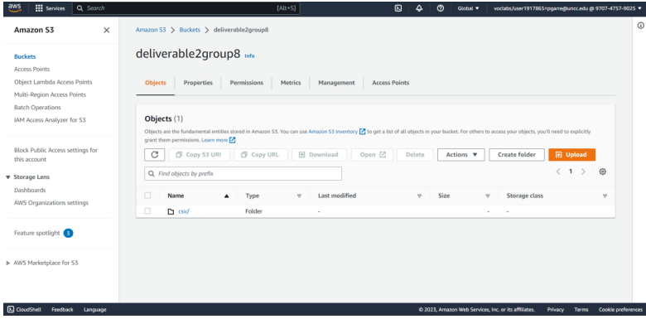
DATA UNDERSTANDING The data was first uploaded to an S3 bucket, and then the AWS S3 copy command was used to load it into a Jupyter notebook instance

Slide 6
CONNECTING TO DATABASE After the dataset was loaded in the terminal, it was loaded into a data frame thereby proving the established connection. This makes it easy processing in the models.

Slide 7

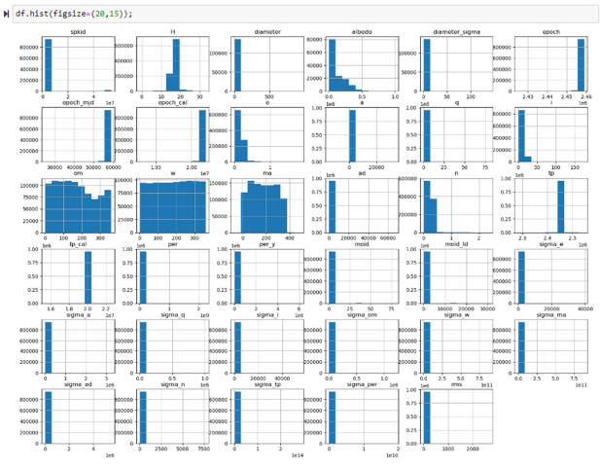
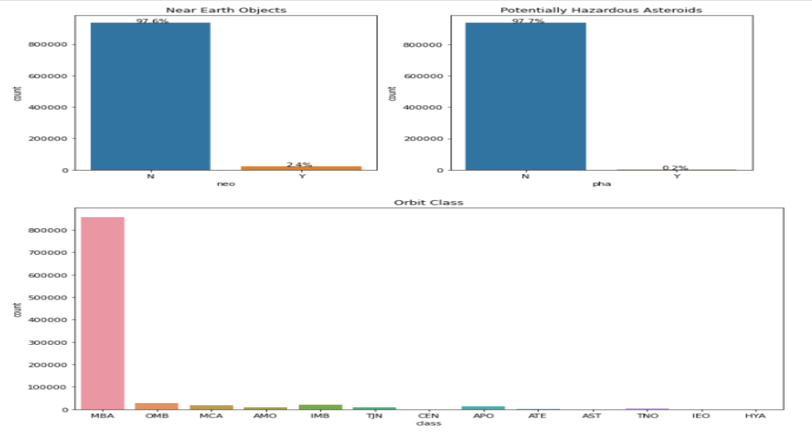
EXPLORATORY DATA ANALYSIS
This indicates clear column data distribution.
Also, the dimension distribution of significant attributes.

Slide 8
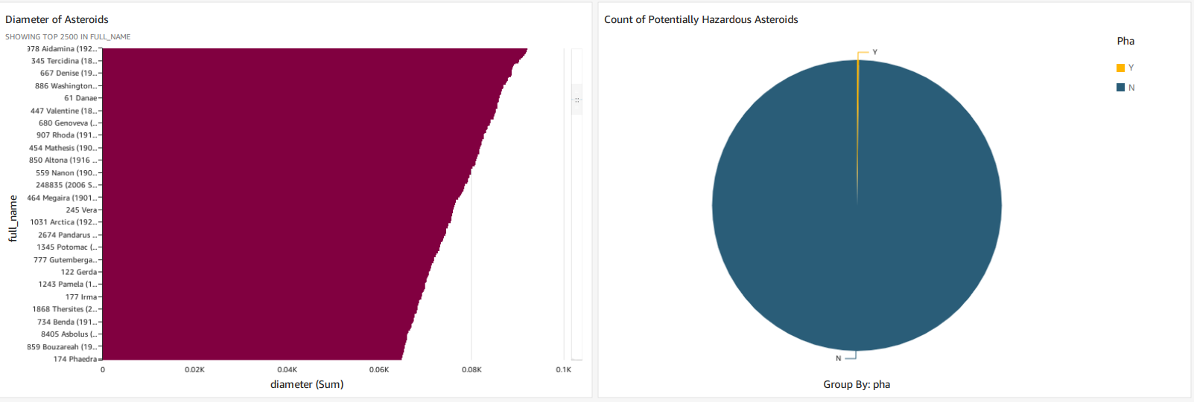
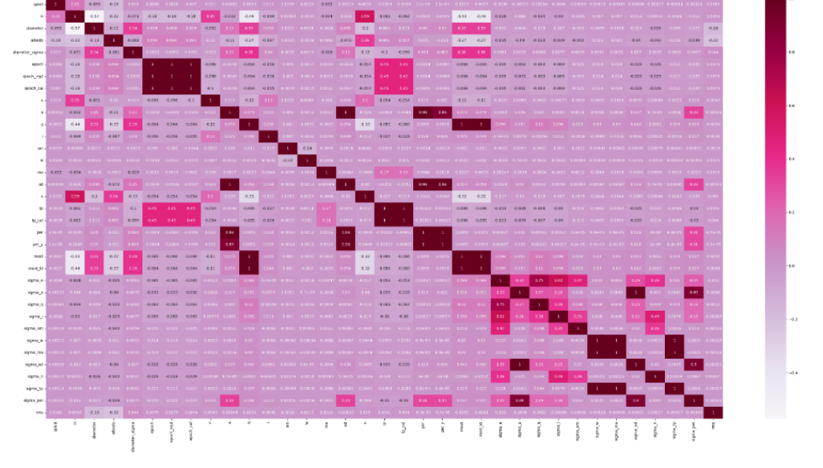
Contd..
Correlation Matrix
Analysis of decision attributes

Slide 9
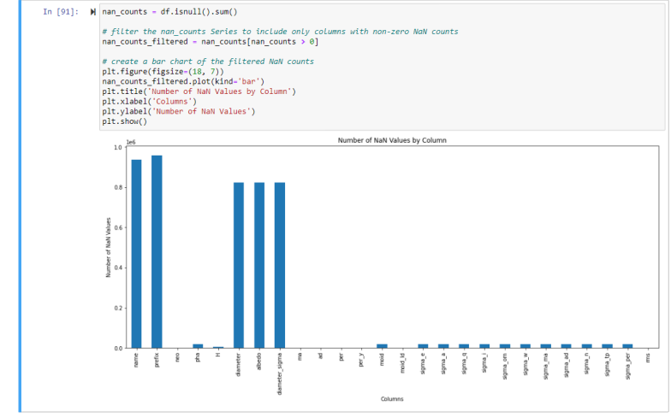
DATA PREPARATION
The null values have been identified and processed to clean the data

Slide 10
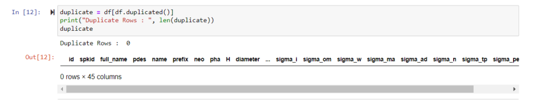
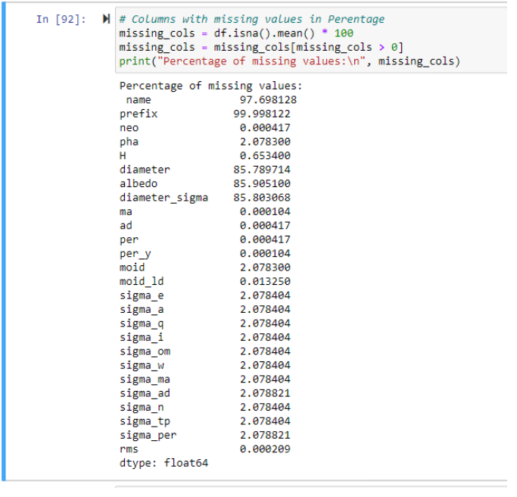
The duplicate values have been searched but found none.
The missing values found maximum in the respective columns have been searched to drop accordingly since the columns with huge proportions of missing values are insignificant in performing analysis.

Slide 11
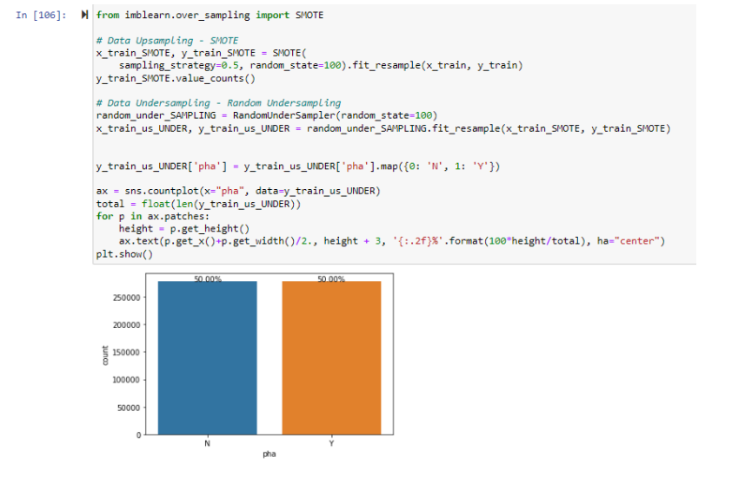
Resampling the data using SMOTE
Notes:
SMOTE (Synthetic Minority Over-sampling Technique) resampling is performed on the dataset to address the class imbalance problem. SMOTE resampling generates synthetic examples for the minority class by creating new instances that are combinations of existing minority class instances. This helps to balance the dataset and improve the performance of the machine learning model in predicting both classes. By oversampling the minority class in this way, the model is exposed to more diverse examples of that class and is less likely to miss important patterns in the data that are specific to that class.After this we obtain uniformly classified data values.

Slide 12
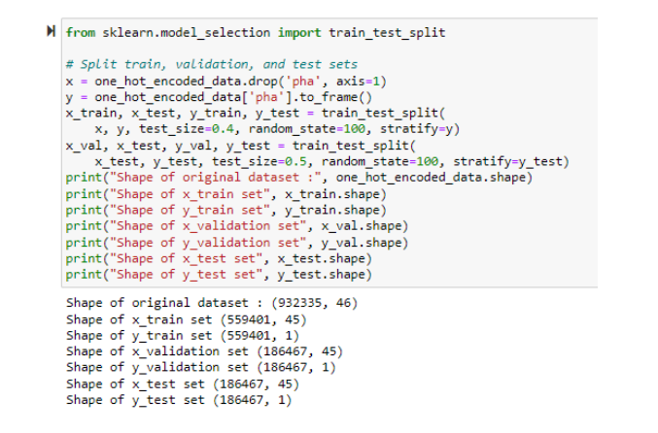
Splitting the data into test and train subsets

Slide 13
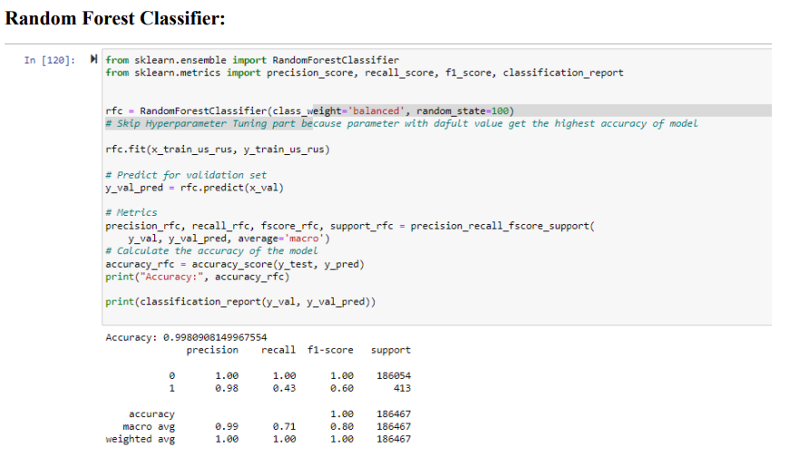
Analytics & Machine Learning

Slide 14
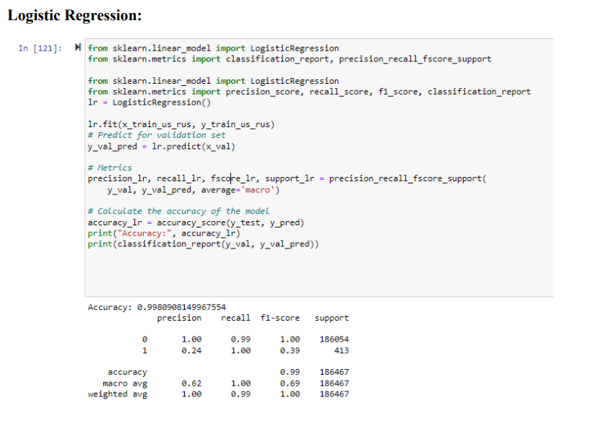

Slide 15
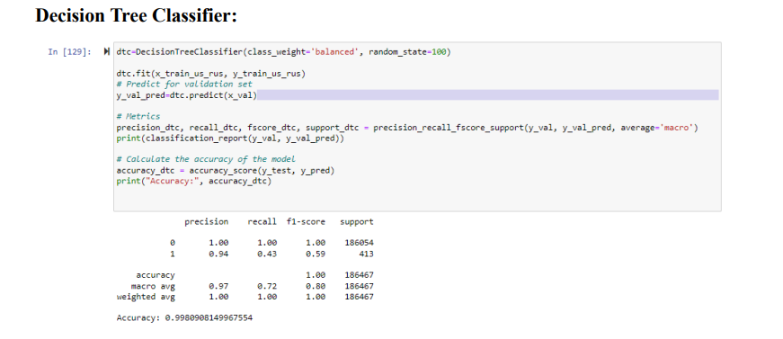

Slide 16
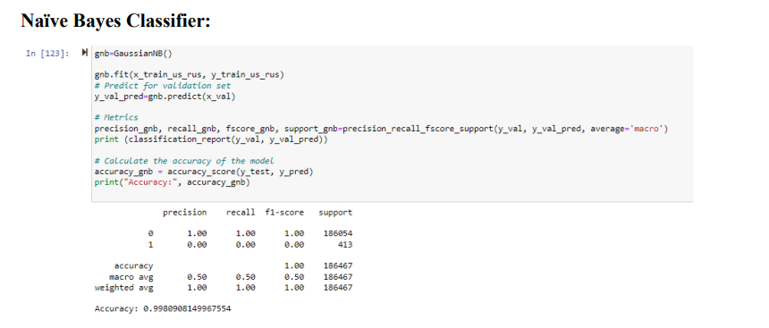

Slide 17
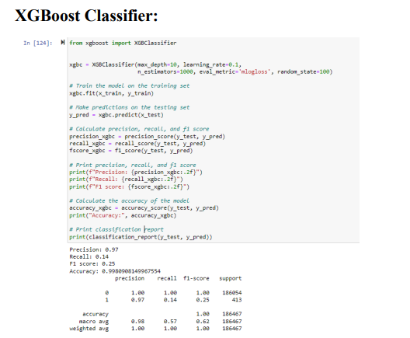

Slide 18
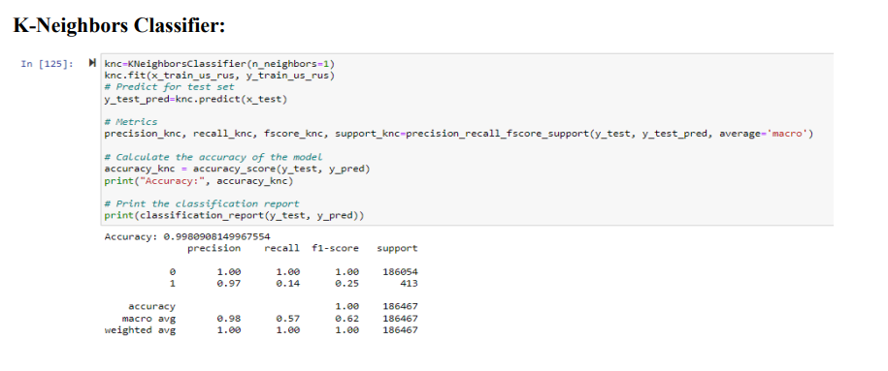

Slide 19
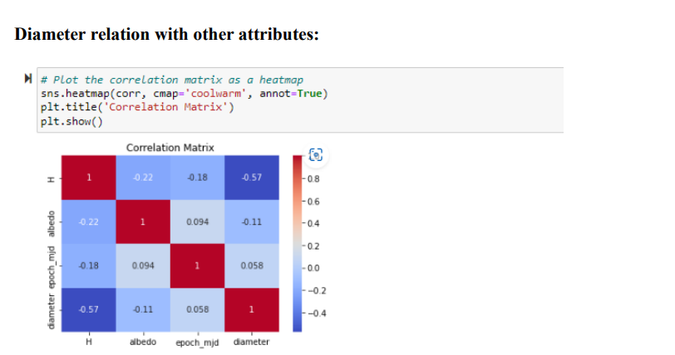

Slide 20
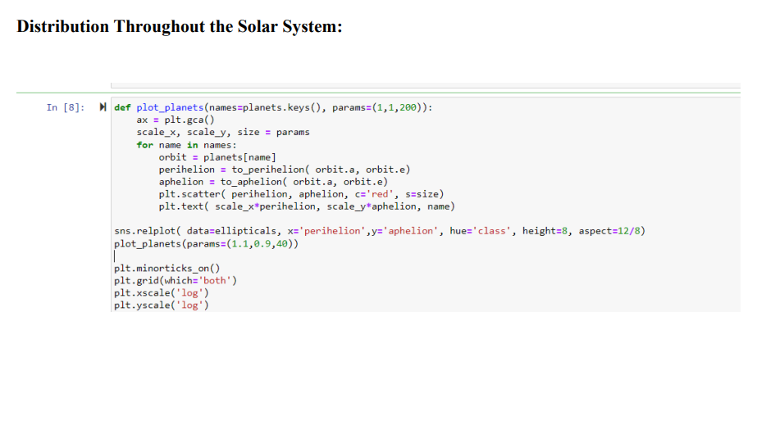

Slide 21
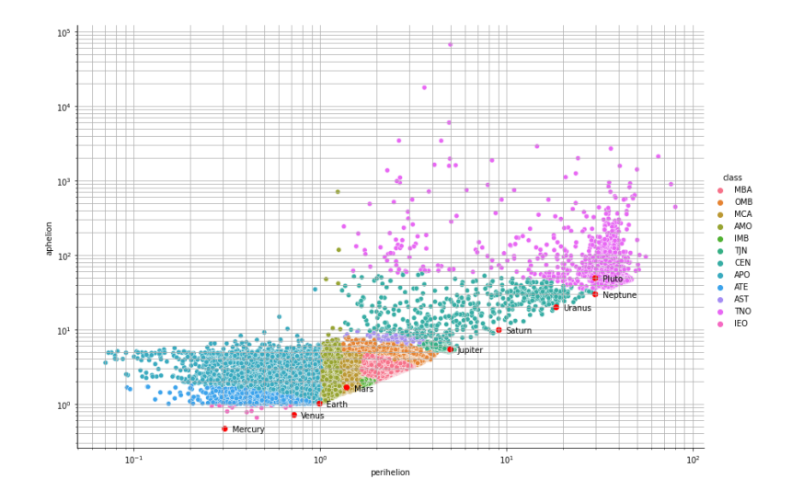

Slide 22
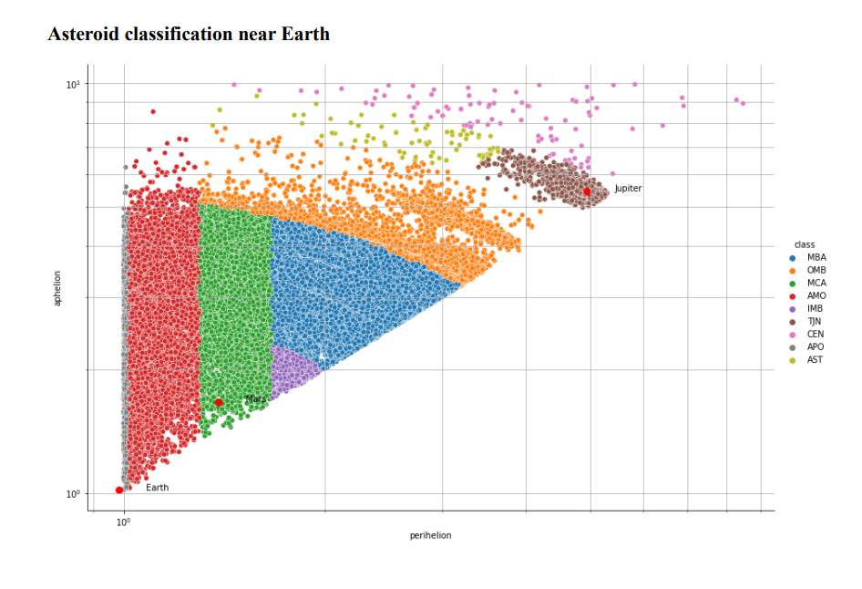

Slide 23
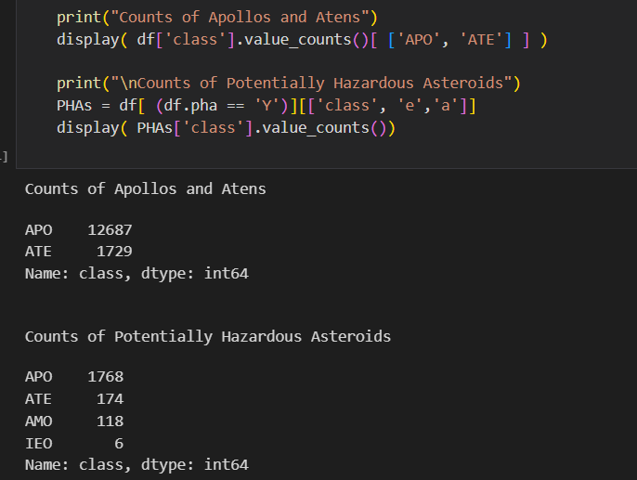
Number of asteroids near earth

Slide 24
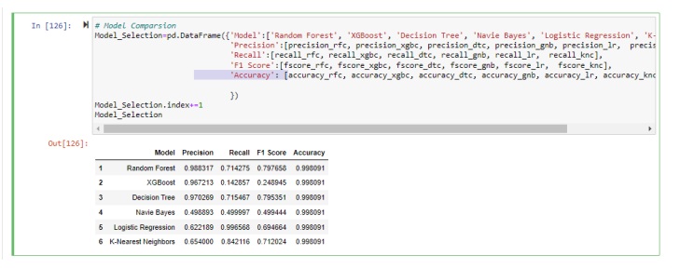
EVALUATION AND OPTIMIZATION
Notes:
F1 score and accuracy metrics are used to evaluate the performance of classification models. F1 score is a harmonic mean of precision and recall, which means it considers both false positives and false negatives. On the other hand, accuracy measures the proportion of correctly classified instances among all instances. While accuracy is a good metric for balanced datasets, it can be misleading when dealing with imbalanced datasets like ours, where one class is much more prevalent than the other. In such cases, a model that always predicts the majority class can still achieve high accuracy but fails to detect instances of the minority class. Therefore, F1 score, and accuracy are combinedly used to determine model efficiency to get a more complete picture of a model's performance. A good model should have high accuracy and an F1 score, indicating that it is able to classify instances correctly while also considering false positives and false negatives. However, if a model performs well in terms of accuracy but poorly in terms of F1 score, it may indicate that the model is not good at detecting instances of the minority class, which is an important consideration in imbalanced datasets.

Slide 25
RESULTS
Based on Accuracy, all the models perform very well, with an almost similar accuracy score for all the models. So, accuracy alone is not sufficient to differentiate between the models. Based on F1 Score, the Random Forest model performs the best with an F1 score of 0.797658, followed closely by the Decision Tree model with an F1 score of 0.795351. The other models have lower F1 scores, with the XGBoost model having the lowest F1 score of 0.248945. The diameter of the asteroid is closely related to the H, albedo, epoch_mjd The orbit class attribute i.e a three-character code is used to understand the distribution of asteroids in the solar system and the clear classification near the earth. Firstly, full set of bound orbits we are interested in understanding the likelihood of planetary collisions. full set of bound orbits and later those whose perihelion lies inside of the Earth's orbit. Based on the eccentricity of the each of the asteroid a visualization is developed that clearly shows number of asteroids near the earth along with their classification based on their class value.

Slide 26
THANK YOU

