Slide 1

Unlocking Insights for Mitron Bank's New Credit Card Line
(Codebasics resume challenge 8)
Domain: Banking Function: Strategy

Slide 2
Agenda
Problem Statement
Purpose
• Data Overview
• Key Findings & recommendations
Demographic
Customer spending behaviour
High value customer segment
• Conclusion

Slide 3


Problem Statement
• Mitron Bank in Hyderabad.
• New credit cards planned.
• AtliQ Data Services proposed project.
• Pilot project requested by Bashnir.
• Sample data of 4,000 customers.
• To analyze data.
Please check the notes section for detailed information for all slides
Notes:
Mitron Bank is a legacy financial institution headquartered in Hyderabad. They want to introduce a new line of credit cards, aiming to broaden its product offerings and reach in the financial market. AtliQ Data Services came to know about this through an internal link and approached Mitron Bank with a proposal to implement this project. However, strategy director of Mitron Bank, Mr.Bashnir Rover is skeptical and asked them to do a pilot project with the sample data before handing them the full project. They provided a sample dataset of 4000 customers across five cities on their online spend and other details.

Slide 4
Purpose
• Broaden Product Offerings
• Market Reach
• Customer Insight
• Tailor Products
• Informed Strategy
Notes:
The purpose of this project is to analyze the provided sample data and report key findings to the strategy team of Mitron Bank. This analysis is expected to guide them in tailoring the credit cards to customer needs and market trends.

Slide 5
Data Overview
1.) dim_customers
• customer_id
• gender
• age_group
• marital_status
• city
• occupation
• average_income
Notes:
Column Description for dim_customers:
- customer_id: This column represents the Unique ID assigned to each customer.
- gender: This column represents the gender of the customer. (Male, Female)
- age_group: This column categorizes the customer into different age groups. (21-24, 25-34, 35-45, 45+)
- marital_status: This column indicates the marital status of the customer (single, married).
- city: This column represents the city of residence for the customer. (Mumbai, Delhi-NCR, Chennai, Hyderabad, Bengaluru)
- occupation: This column denotes the occupation or profession of the customer. (Salaried IT Employees, Salaried Other Employees, Business Owners, Freelancers, Government Employees)
- average_income: This column indicates the monthly average income of the customer, in INR currency.

Slide 6
Data overview
2.) fact_spends
• customer_id
• month
• category
• payment_type
• spends
Notes:
Column Description for fact_spends:
- customer_id: This column represents the Unique ID of each customer, linking to the dim_customer table.
- month: This column indicates the month in which the spending was recorded. (May, June, July, August, September, October)
- category: This column describes the category of spending (Entertainment, Apparel, Electronics, etc).
- payment_type: This column specifies the type of payment used by the customer (Debit Card, Credit Card, UPI, Net Banking).
- spends: This column shows the total amount spent by the customer in the specified month, category and payment_type.

Slide 7
Demographic Classification

Slide 8
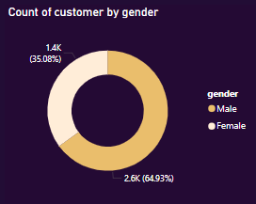
Demographic classification
Gender
Higher Male Credit card users
Notes:
Analyzing the data on credit card users by gender reveals the following insights: There are more male credit card users (2597) compared to female credit card users (1403). This suggests that there might be differences in the propensity or access to credit cards between genders.

Slide 9
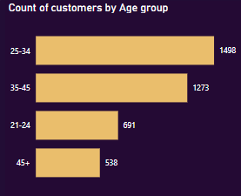
Demographic classification
Age
• Largest Age Group: 25-34
• Second-Largest Group: 35-45
• 21-24 Age Group
• 45+ Age Group: have different card usage pattern
Notes:
Analyzing the data on credit card users by age reveals the following insights:
Age Distribution: The largest age group of credit card users falls within the range of 25-34, with 1498 individuals. This suggests that young adults and early professionals are the most significant demographic segment utilizing credit cards.
35-45 Age Group: The second-largest group consists of individuals aged between 35 and 45, with 1273 users. This indicates that middle-aged individuals also heavily rely on credit cards for their financial transactions and needs.
21-24 Age Group: The age group of 21-24 follows, with 691 individuals. This demographic likely includes young adults who have recently entered the workforce or are still in university, suggesting that credit card usage starts at an early age for many individuals.
45+ Age Group: Lastly, individuals aged 45 and above represent the smallest group of credit card users, with 538 individuals. This could indicate that older individuals might rely more on other forms of payment or have different financial habits compared to younger generations.

Slide 10
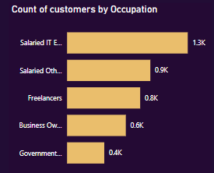
Demographic classification
Occupation
• Salaried IT Employees: Largest segment, significant usage.
Salaried Other Employees
Freelancers
Business Owners
• Government Employees: Smallest group
Notes:
Analyzing the data on credit card users by occupation reveals the following insights:
Salaried IT Employees: With 1294 individuals, salaried IT employees represent the largest occupational segment among credit card users. This suggests that individuals employed in the IT sector are significant users of credit cards, possibly due to the convenience of electronic transactions and the nature of their work.
Salaried Other Employees: The category of salaried other employees follows, with 893 individuals. This group likely includes individuals employed in various industries outside of IT, indicating that credit card usage is prevalent across different sectors of the economy.
Freelancers: Freelancers comprise 784 credit card users. This demographic includes self-employed individuals who work on a project basis, and their reliance on credit cards may stem from the flexibility and ease of managing finances offered by credit card transactions.
Business Owners: Business owners represent 630 credit card users. This group likely includes entrepreneurs and small business owners who utilize credit cards for business-related expenses, such as purchasing inventory, managing cash flow, or covering operational costs.
Government Employees: The smallest group among credit card users consists of government employees, with 399 individuals. This suggests that while credit card usage is prevalent across various occupations, it may not be as common among government employees compared to those in the private sector.

Slide 11
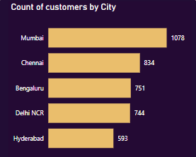
Demographic classification
City
• Mumbai: Financial hub, high activity.
• Chennai, Bengaluru, Delhi NCR
• Hyderabad: Thriving IT industry.
Notes:
Analyzing the data on credit card users by city reveals the following insights:
Mumbai: Mumbai has the highest number of credit card users, with 1078 individuals. This indicates that Mumbai residents are significant users of credit cards, possibly due to the city's status as a major financial and commercial hub, as well as its large population and high levels of economic activity.
Chennai: Chennai follows closely behind, with 834 credit card users. This suggests that credit card usage is prevalent among residents of Chennai, reflecting the city's status as a prominent center for industries such as information technology, manufacturing, and healthcare.
Bengaluru: Bengaluru ranks third in terms of credit card users, with 751 individuals. As a leading technology and innovation hub in India, Bengaluru attracts a large population of professionals and entrepreneurs who likely rely on credit cards for various financial transactions and expenses.
Delhi NCR: The Delhi National Capital Region (NCR) has 744 credit card users. This includes residents of Delhi as well as surrounding areas such as Noida, Gurugram, and Ghaziabad. The high number of credit card users in this region is indicative of the metropolitan area's economic significance and diverse population.
Hyderabad: Hyderabad rounds out the list with 593 credit card users. Known for its thriving IT industry, Hyderabad attracts a significant population of tech professionals and entrepreneurs who may rely on credit cards for their financial needs.

Slide 12
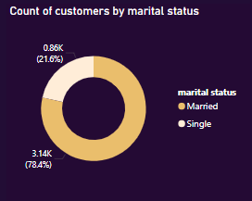
Demographic classification
Marital status
Married Individuals:
Majority, household, joint expenses.
• Single Individuals:
Personal, entertainment, travel expenses.
Notes:
Analyzing the data on credit card users by marital status reveals the following insights:
Married Individuals: Married individuals constitute the majority of credit card users, with 3136 individuals. This suggests that married couples often rely on credit cards for various financial transactions and expenses, including household expenses, joint purchases, and managing family finances.
Single Individuals: Single individuals represent a smaller portion of credit card users, with 864 individuals. While they make up a smaller segment, single individuals still significantly contribute to the credit card user base, likely using credit cards for personal expenses, entertainment, travel, and other individual purchases.

Slide 13
Spending Behaviour

Slide 14
Key metric
Average income utilization:
Definition: Proportion of income spent versus saved/invested.
High Utilization: Larger share of income used for expenses.
Low Utilization: More income saved or invested.
Purpose: Assesses spending behavior and financial health.
Income Utilization=(Total Income Spent on Expenses​/Total Income)×100
Notes:
Average income utilization refers to the proportion of an individual's or household's income that is spent on various expenses, as opposed to being saved or invested. It provides insight into spending behavior and financial health. High utilization indicates a larger share of income is being used for consumption, while low utilization suggests more income is being saved or invested. This metric can be useful for budgeting, financial planning, and understanding economic trends at both personal and macroeconomic levels.

Slide 15
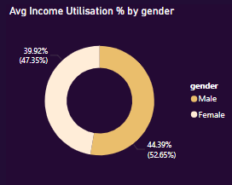
Customer spending behavior
Gender
Significant spending by both genders.
• Gender Differences: Males utilize higher percentage.
Indicates differing spending habits.
Notes:
Both males and females are utilizing a significant portion of their income, with males utilizing a slightly higher percentage (44.39%) compared to females (39.92%). This suggests that both genders are actively spending a substantial part of their income.

Slide 16
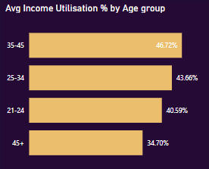
Customer spending behavior
Age:
35-45 Age Group:
Highest spending, larger income usage.
45+ Age Group:
Lowest spending, more conservative.
Trend: Decreasing utilization with age.
Notes:
35-45: Highest at 46.72%, indicating significant spending.
25-34: Close behind at 43.66%, also demonstrating high spending.
21-24: Slightly lower at 40.59%, active spenders but less than older age groups.
45+: Lowest at 34.70%, showing conservative spending habits.
Age Group Differences: Trend of decreasing income utilization with increasing age. Younger groups spend more, likely due to lifestyle and financial habits.

Slide 17
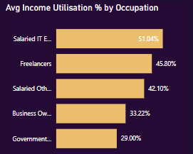
Customer spending behavior
Occupation
• Salaried IT Employees: Highest spending
• Government Employees:
Lowest spending, conservative habits.
• IT and freelancers spend more.
• Business owners and government employees spend less.
Notes:
Salaried IT Employees: This group demonstrates the highest average income utilization percentage at 51.04%. Salaried IT employees seem to spend the largest portion of their income compared to other occupational groups, indicating potentially higher disposable income or different spending priorities.
Freelancers: Freelancers exhibit a relatively high average income utilization percentage at 45.80%. This suggests that freelancers, despite having variable income streams, are actively spending a significant portion of their earnings.
Salaried Other Employees: Individuals categorized as salaried other employees have an average income utilization percentage of 42.10%. While slightly lower than IT employees and freelancers, this group still shows a propensity for spending a considerable portion of their income.
Business Owners: Business owners have a lower average income utilization percentage at 33.22%, indicating a more conservative spending behavior compared to salaried employees and freelancers. This could be due to the need to reinvest profits into their businesses or a desire to maintain liquidity.
Government Employees: Individuals employed by the government have the lowest average income utilization percentage at 29.00%. Government employees appear to be the most conservative spenders among the occupational groups analyzed.
Occupational Differences: There is a notable disparity in income utilization across different occupational groups. Salaried IT employees and freelancers tend to spend a larger portion of their income, possibly due to higher earnings or different lifestyle preferences. On the other hand, business owners and government employees exhibit more conservative spending habits, possibly influenced by factors such as financial responsibilities or job stability.

Slide 18
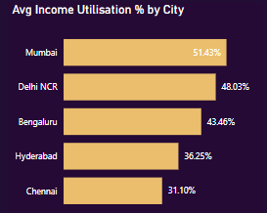
Customer spending behavior
City
Mumbai: Highest spending, high cost of living.
Chennai: Lowest spending, restrained pattern.
Variation: Significant differences across cities.
Mumbai and Delhi NCR spend more.
Notes:
Mumbai: Mumbai residents exhibit the highest average income utilization percentage at 51.43%. This suggests that individuals in Mumbai tend to spend a significant portion of their income, possibly reflecting the high cost of living and vibrant consumer culture in the city.
Delhi NCR: Residents in the Delhi National Capital Region (NCR) demonstrate a relatively high average income utilization percentage at 48.03%. Similar to Mumbai, this may be attributed to the bustling urban lifestyle and economic activity in the region.
Bengaluru: Bengaluru residents have an average income utilization percentage of 43.46%, indicating a propensity for spending but at a slightly lower level compared to Mumbai and Delhi NCR. Hyderabad: Individuals in Hyderabad exhibit a lower average income utilization percentage at 36.25%, suggesting a more conservative spending behavior compared to the aforementioned cities. Chennai: Chennai residents have the lowest average income utilization percentage at 31.10%. This indicates a more restrained spending pattern among Chennai residents, possibly influenced by cultural factors or economic conditions specific to the city.
City Differences: There is a notable variation in income utilization across different cities, with Mumbai and Delhi NCR residents allocating a larger portion of their income towards spending compared to Bengaluru, Hyderabad, and Chennai residents. Factors such as cost of living, income levels, cultural preferences, and economic opportunities likely contribute to the observed differences in spending behavior among cities.

Slide 19
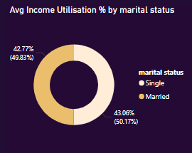
Customer spending behavior
Marital status
Single:
Significant spending, personal interests.
Married:
Slightly more conservative spending.
Similarities: Both groups spend substantially.
Notes:
Single: Single Individuals have an average income utilization percentage of 43.06%. This suggests that single individuals tend to spend a significant portion of their income on various expenses, possibly including personal interests, lifestyle choices, or immediate needs.
Married: Married individuals exhibit a slightly lower average income utilization percentage at 42.77%. This indicates that married couples, as a unit, may have a slightly more conservative spending behavior compared to their single counterparts.
Marital Status Differences: While there is a slight difference in the average income utilization between single and married individuals, both groups allocate a substantial portion of their income towards spending. However, the gap between the two groups is relatively small, indicating similarities in spending habits despite marital status.

Slide 20
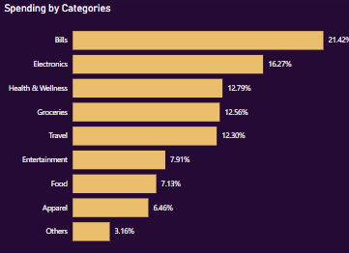

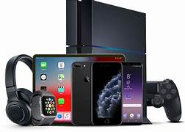



Spending insights
Notes:
The data shows that all segments spend the most on bills, followed by electronics, health & wellness, groceries, and travel. These categories dominate the spending patterns across different demographics and occupational groups.

Slide 21
High value customer segment

Slide 22
High Value users
High-Value Customer Profile:
Age Group: 25-34, 35-45
Gender: Male
Occupation: Salaried IT Employees (followed by Salaried Other Employees, Business Owners)
City: Mumbai (followed by Delhi NCR Bengaluru)
Marital Status: Married
Notes:
1. Tech-Savvy Young Professionals
Age: 25-34
Gender: Predominantly Male
Occupation: Salaried IT Employees
Marital Status: Single or Married
Spending Categories:
High: Bills, Electronics, Travel, Entertainment
Moderate: Groceries, Food, Apparel
Characteristics: High disposable income, early adopters of technology, frequent travelers, and entertainment enthusiasts.
Marketing Strategies:
Highlight new tech products and gadgets.
Offer travel-related discounts and packages.
Promote entertainment subscriptions and events.

Slide 23


Recommendations
1. Rewards and Cashbacks
Cashback on Essentials
Accelerated Rewards for IT and Salaried Employees
2. Exclusive Benefits and Privileges
Travel and Lifestyle Benefits
Lifestyle Discounts
3. Flexible Payment Options
EMI Conversion
Credit Limit Enhancement
Notes:
1. Rewards and Cashbacks
Cashback on Essentials: Offer higher cashback percentages on groceries, fuel, and utility bill payments, which cater to the everyday needs of young professionals and married individuals.
Accelerated Rewards for IT and Salaried Employees: Introduce higher reward points for transactions related to technology, gadgets, online shopping, and dining, appealing to the lifestyle of IT employees and urban professionals.
2. Exclusive Benefits and Privileges
Travel and Lifestyle Benefits: Provide travel insurance, and discounts on flight and hotel bookings, appealing to business owners and frequent travelers.
Lifestyle Discounts: Offer discounts on dining, entertainment, and health club memberships, catering to urban professionals and high spenders in cities like Mumbai, Delhi NCR, and Bengaluru.
3. Flexible Payment Options
EMI Conversion: Enable easy conversion of large purchases into Equated Monthly Installments (EMIs) at low interest rates, attracting high-spending age groups and salaried employees.
Credit Limit Enhancement: Offer periodic reviews and increases in credit limits for users with good payment histories, encouraging higher usage among affluent segments.

Slide 24




Recommendations
4. Financial Management Tools
Expense Tracking and Budgeting
Personalized Offers
5. Loyalty Programs
Tiered Loyalty Program
6. Promotions and Offers
Welcome Bonuses
Referral Programs
7. Digital Integration
Mobile Wallet Integration
Contactless Payments
Notes:
4. Financial Management Tools
Expense Tracking and Budgeting: Provide tools and apps to help users track their spending, set budgets, and receive alerts, aiding married individuals and professionals in better financial management.
Personalized Offers: Use spending data to offer personalized discounts and offers, ensuring relevance and higher engagement with the card.
5. Loyalty Programs
Tiered Loyalty Program: Introduce a loyalty program with tiers based on spending levels, offering increasing benefits as users move up the tiers, incentivizing higher spending and long-term loyalty.
6. Promotions and Offers
Welcome Bonuses: Attractive sign-up bonuses such as bonus reward points, cashback, or fee waivers for the first year to entice new users.
Referral Programs: Incentivize existing customers to refer friends and family by offering rewards for successful referrals.
7. Digital Integration
Mobile Wallet Integration: Ensure compatibility with popular mobile wallets and payment platforms, facilitating easy and seamless transactions.
Contactless Payments: Promote the use of contactless payments for convenience and speed, appealing to urban professionals.
Implementing these features tailored to the needs and preferences of the identified high-value customer segments can significantly enhance the likelihood of credit card usage and customer satisfaction.

Slide 25
Thankyou
Notes:
This analysis is expected to guide them in tailoring the credit cards to customer needs and market trends. By segmenting customers in this manner, businesses can effectively align their marketing strategies, product development, and customer engagement efforts to meet the distinct needs of each group, thereby driving growth and customer satisfaction.

