Slide 1
Inheritance
Inheritance in java is a mechanism in which one object acquires all the properties and behaviors of parent object.
The idea behind inheritance in java is that you can create new classes that are built upon existing classes. When you inherit from an existing class, you can reuse methods and fields of parent class, and you can add new methods and fields also.

Slide 2
Why use inheritance in java
For Method Overriding (so runtime polymorphism can be achieved).
For Code Reusability.
Syntax of Java Inheritance
class Subclass-name extends Superclass-name
{
//methods and fields
}
The extends keyword indicates that you are making a new class that derives from an existing class. The meaning of "extends" is to increase the functionality.
In the terminology of Java, a class which is inherited is called parent or super class and the new class is called child or subclass.

Slide 3
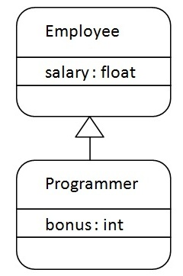
Java Inheritance Example
As displayed in the above figure, Programmer is the subclass and Employee is the superclass. Relationship between two classes is Programmer IS-A Employee.It means that Programmer is a type of Employee.

Slide 4
class Employee{
float salary=40000;
}
class Programmer extends Employee{
int bonus=10000;
public static void main(String args[]){
Programmer p=new Programmer();
System.out.println("Programmer salary is:"+p.salary);
System.out.println("Bonus of Programmer i"+p.bonus);
}
}
Programmer salary is:40000.0
Bonus of programmer is:10000

Slide 5
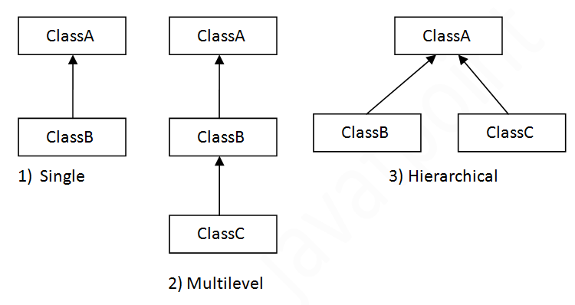
Types of inheritance in java
On the basis of class, there can be three types of inheritance in java: single, multilevel and hierarchical.
In java programming, multiple and hybrid inheritance is supported through interface only. We will learn about interfaces later.

Slide 6
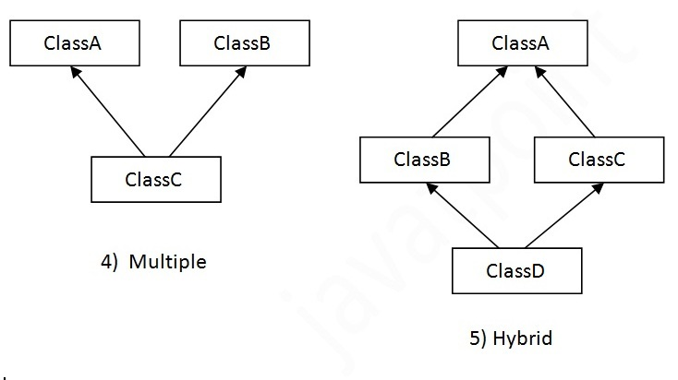
Single inheritance is damn easy to understand. When a class extends another one class only then we call it a single inheritance.
“Multiple Inheritance” refers to the concept of one class extending (Or inherits) more than one base class.
Multilevel inheritance refers to a mechanism in OO technology where one can inherit from a derived class, thereby making this derived class the base class for the new class.
In hierarchical inheritance one class is inherited by many sub classes
Hybrid Inheritance In simple terms you can say that Hybrid inheritance is a combination of Single and Multipleinheritance.

Slide 7
Disadvantages of Inheritance
Main disadvantage of using inheritance is that the two classes (parent and child class) gets tightly coupled.
This means that if we change code of parent class, it will affect to all the child classes which is inheriting/deriving the parent class, and hence, it cannot be independent of each other.

