Slide 1


Slide 2



KEY DETERMINATIONS:
Are Magist customers happy?
Do they deliver quickly?
Is Magist a good partner for ENICA & our high-end Apple accessories?
KEY INDICATORS:
All Magist customers
Customers within the ‘Computer Accessories’ category

Slide 3
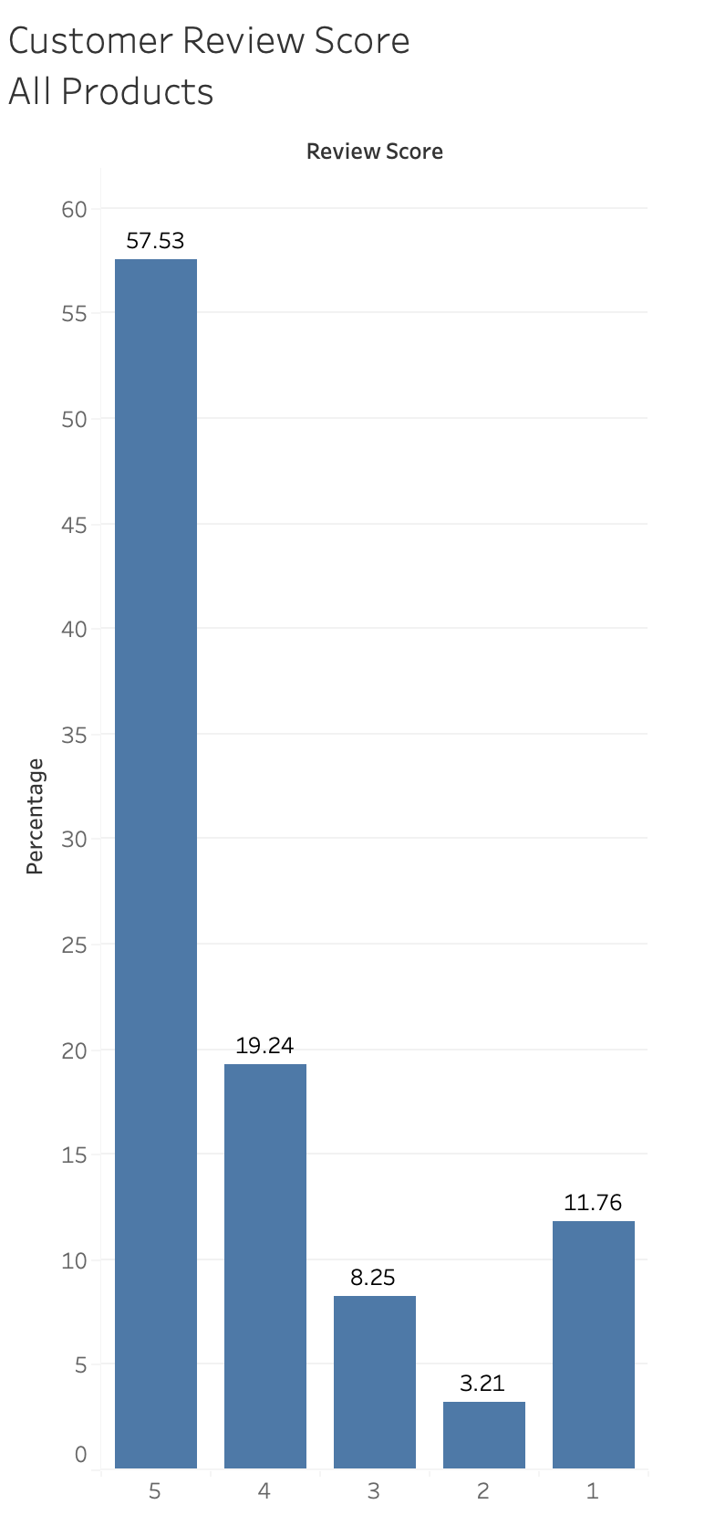
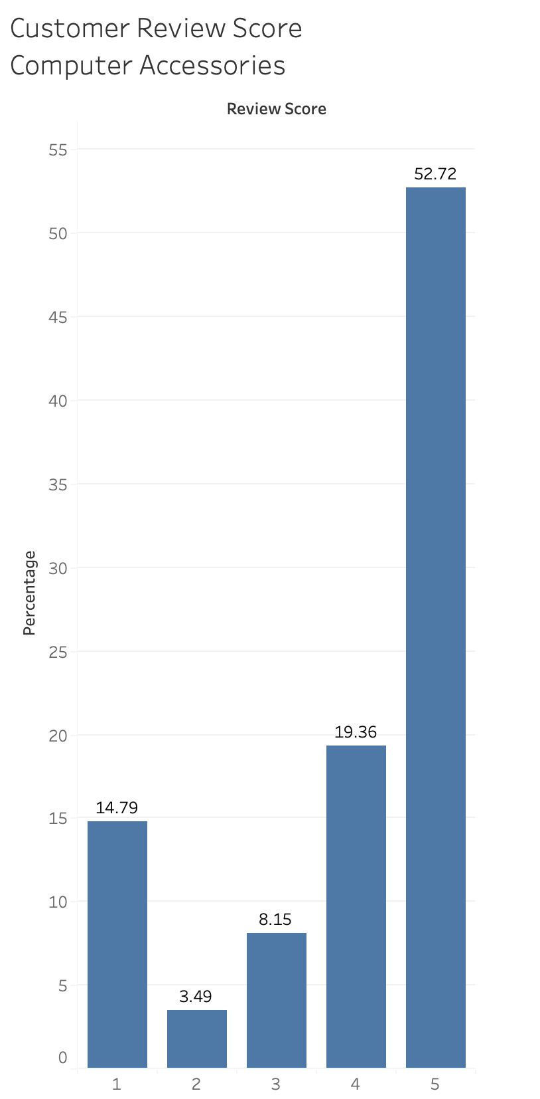

CUSTOMER SATISFACTION
All Products
An average review score of 4.05
Only 57% with 5 stars
Computer Accessories
An average review score of 3.90
Only 52% with 5 stars

Slide 4
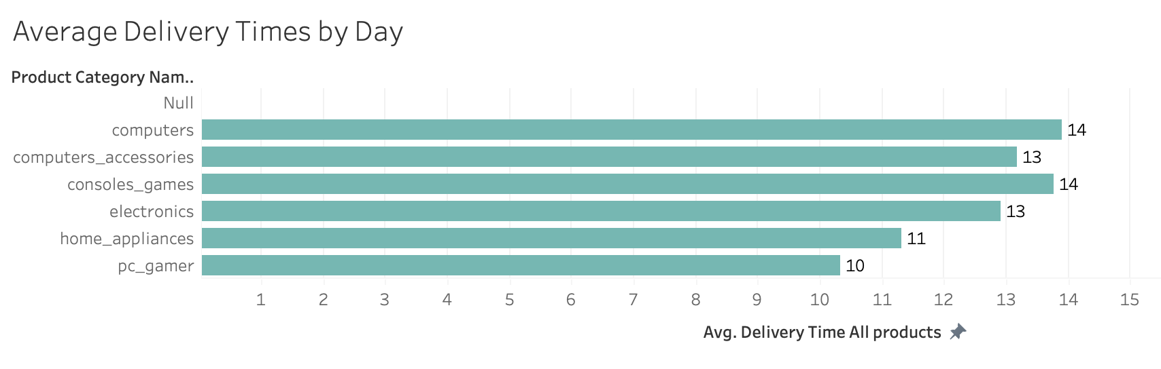
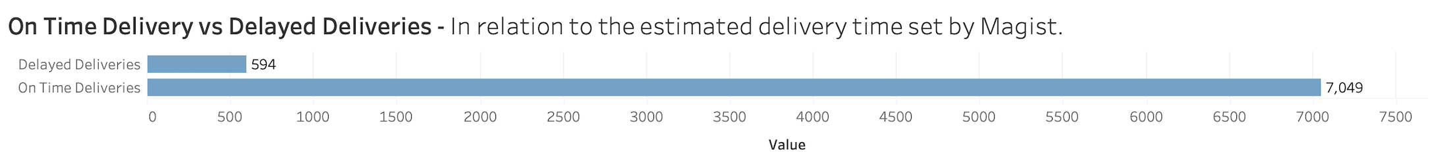
DELIVERY ANALYSIS
12 Days delivery time - ALL
13 Days delivery time – ACCESSORIES
92%

Slide 5
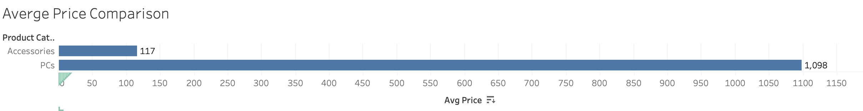
PARTNERSHIP RISK
The quality of good sold by MAGIST sellers does not align
ENICA’s average item place is €540 vs €117 for a comparable product
CONCLUSIONS
Delivery times are too slow
Customer Satisfaction is middle of road
The offerings of their sellers is lower quality

