Slide 1
Big Data Analytics Midterm Presentation
Team:
Rachan Hegde Balamanikandan Gopalakrishnan

Slide 2
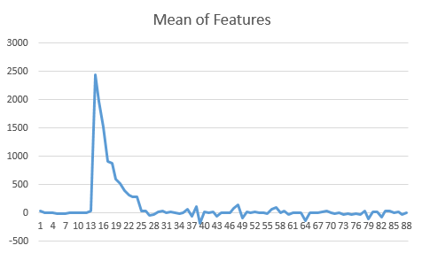
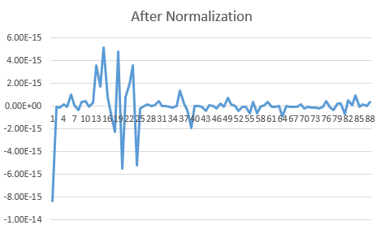
Case 1 – Predicting Movie Year
Pre Processing
Data Exploration: Stratified Sampling with duplicates was used to increase the occurrences of #movies before 1965.
Feature Scaling: Scalar normalization was chosen to normalize the data
Feature Selection: PCA – Using MLIB Features
Techniques Explored
Chi-Sq Selector: A column with more than 10000 unique values was found in the data set which caused Chi-Sq selector to crash
SVD

Slide 3
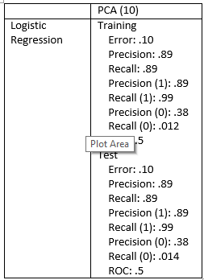
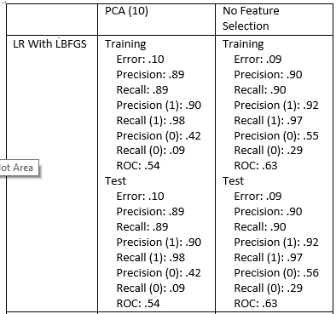
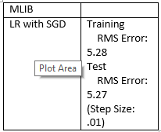
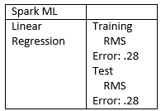
Case 1 – Predicting Movie Year - Classification
ML
MLIB

Slide 4
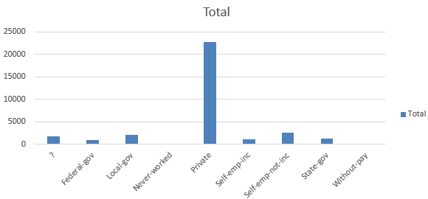
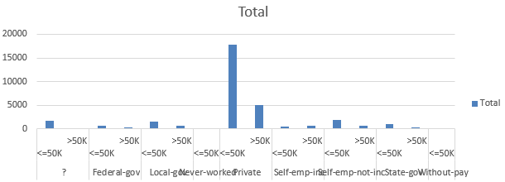
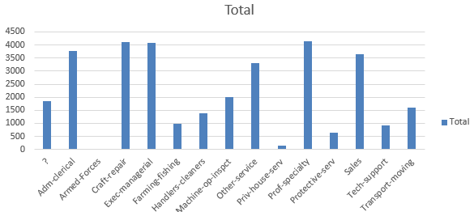
Case 2 – Determine Income
Pre Processing
The data was analyzed for missing/ invalid data and the following columns had missing values
Country, Work Class. Occupation

Slide 5
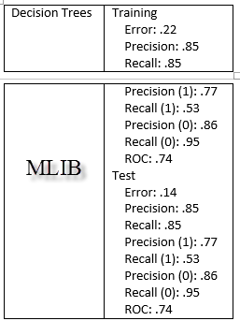
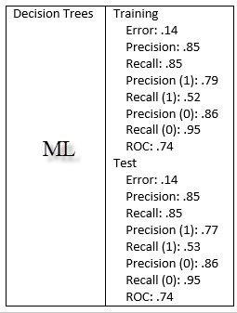
Case 2 – Determine Income
Pre Processing
Feature Selection: The categorical variables were indexed using map functions and categorical information was passed to the decision trees which handled the transformation of categorical data into columns for prediction

Slide 6
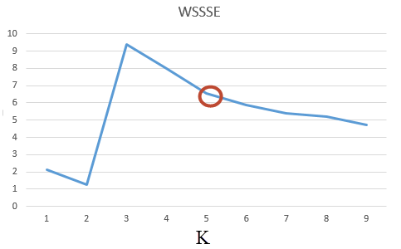

Case 3 – Clustering
Pre Processing
The data from different sources were aggregated into a single RDD in LIBSVM format
There were some missing data but the data type (LIBSVM) automatically handles null values
Summarization
K-Means clustering algorithm was used on the consolidated data for clusters. The number of clusters was initially set to 2 and was iteratively increased till 10 and the corresponding WSSSE values were observed.
Techniques Explored
Guassian Mixture

Slide 7


