Slide 1
Transient Sprinkler Dynamics Update
January 2026

Slide 2

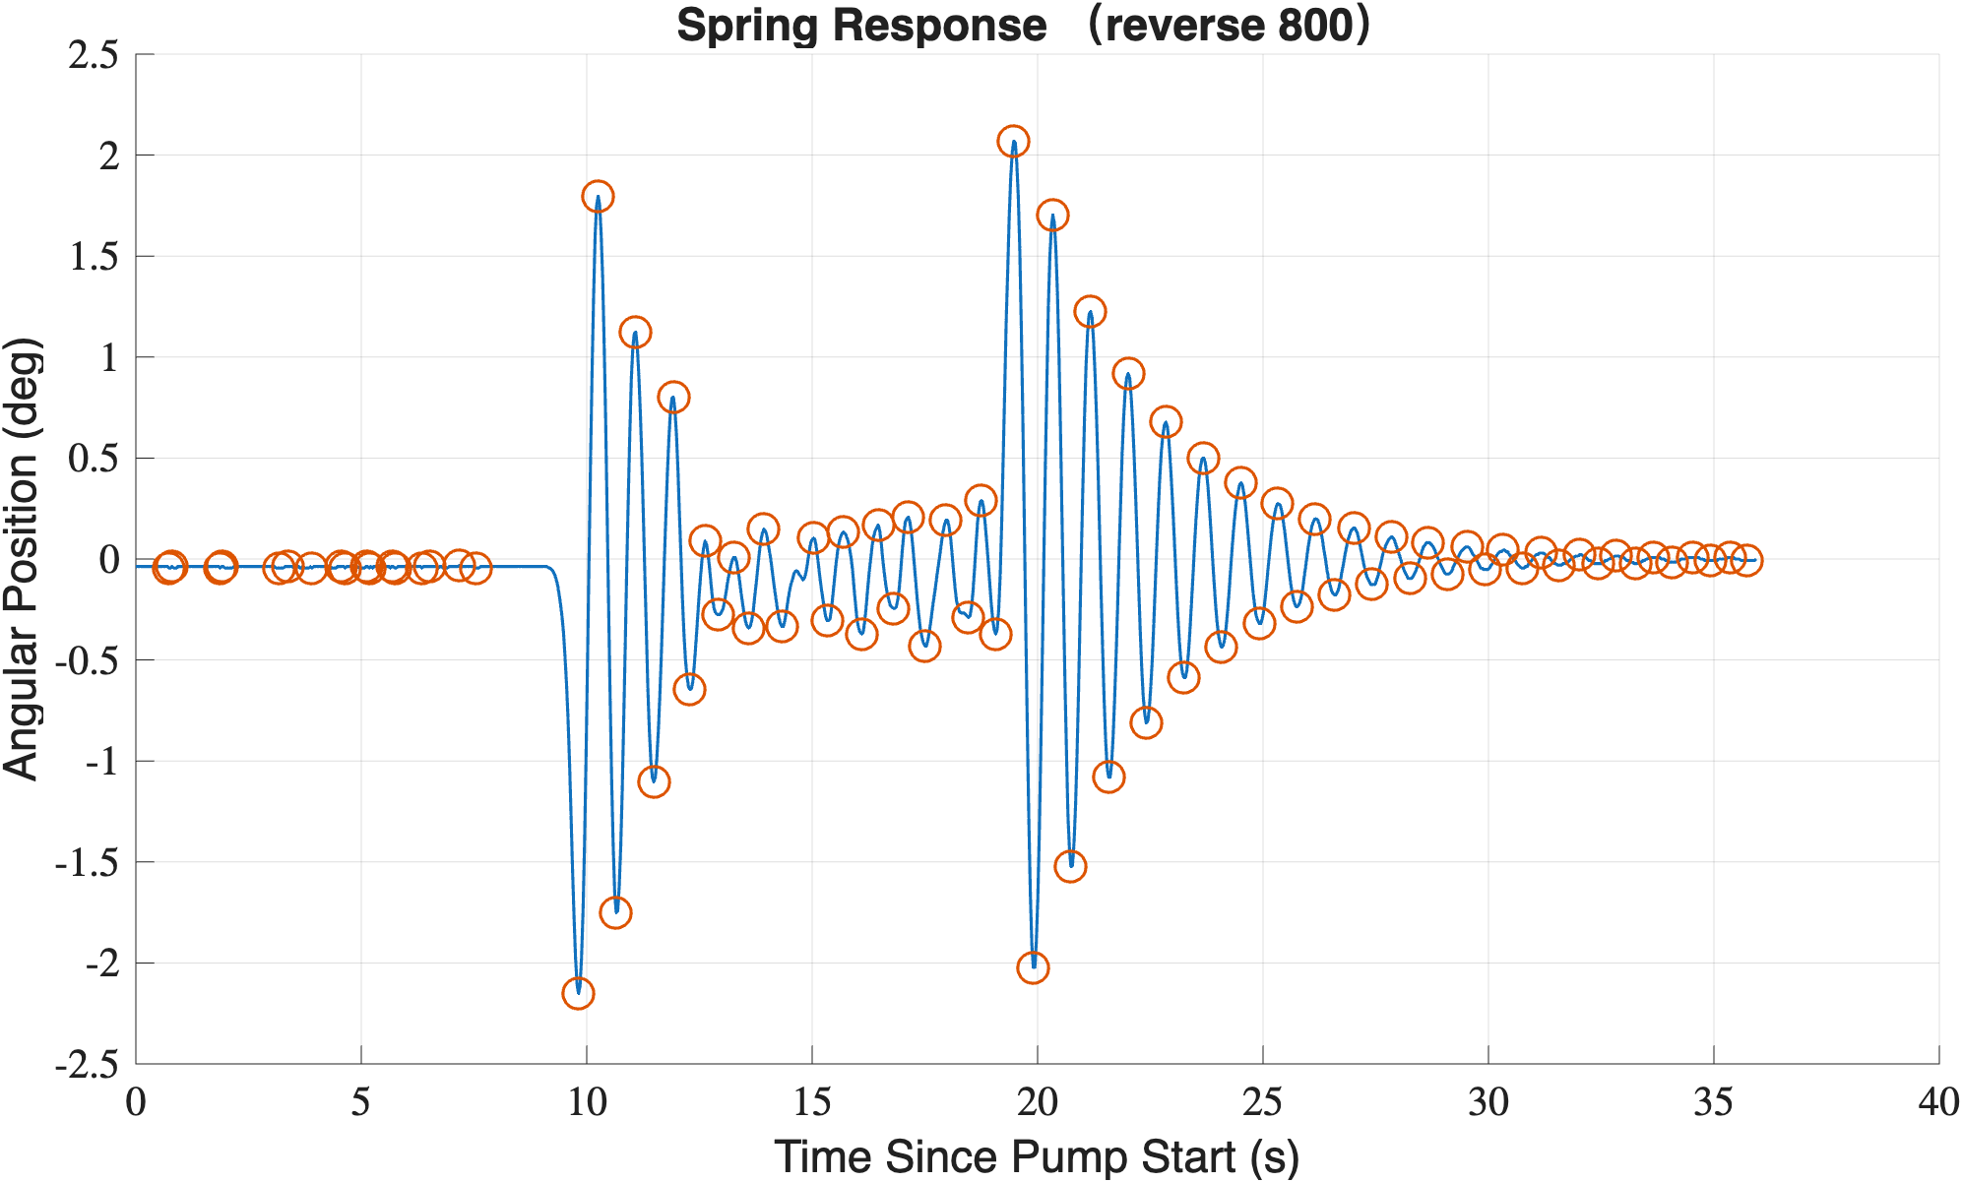

Necessary Equations
Want to fit tail to the ODE:
$\ddot{ϕ} + 2γ\dot{ϕ} + ω^{2}ϕ = 0$. (1)
  Overall goal is to solve for $γ$ and $ω$.
General Solution to ODE:
$Φ\left(t\right)=e^{−γt}\left[C_{1}cos\left(Ωt\right)+C_{2}sin\left(Ωt\right)\right],$ (2)
where $Ω=\sqrt{ω^{2}−γ^{2}}$ and $C_{1},C_{2}$ are constants.
By picking a $ϕ(t)$ such that $\dot{ϕ}(t) =0$ (at a peak/orange point) and given $γ, ω$, we can solve for $C_{1},C_{2}$.
Tail region
Blue, solid curve is spring response of sprinkler. Orange, circular data points are where peaks occur (change in direction of curve).
Excellent data shown was provided by Kelly and Jesse, Dec. 2025

Slide 3
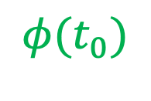
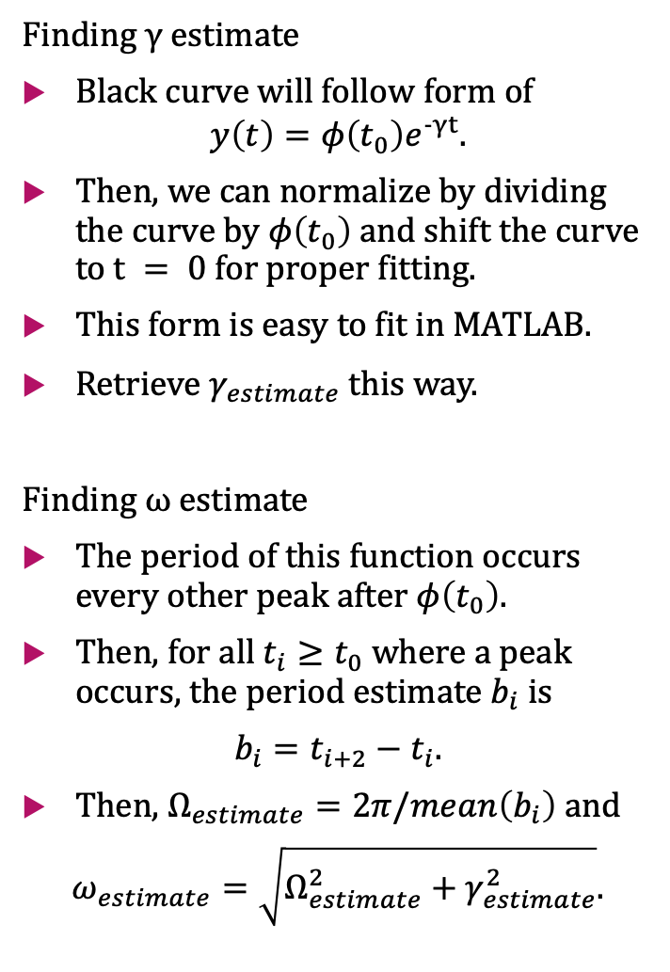
$$φ(t_{0})$$
Finding $γ estimate$
Black curve will follow form of
$$y\left(t\right)=φ\left(t_{0}\right)e^{−γt}.$$
Then, we can normalize by dividing the curve by $φ\left(t_{0}\right)$ and shift the curve to $t = 0$ for proper fitting.
This form is easy to fit in MATLAB.
Retrieve $γ_{estimate}$ this way.
Finding $ω$ estimate
The period of this function occurs every other peak after $φ\left(t_{0}\right)$.
Then, for all $t_{i}≥t_{0}$ where a peak occurs, the period estimate $b_{i}$ is
$b_{i}=t_{i+2}−t_{i}$.
Then, $Ω_{estimate}=2π/mean\left(b_{i}\right)$ and
$ω_{estimate}=\sqrt{Ω_{estimate}^{2}+γ_{estimate}^{2}}$.
Tail region

Slide 4
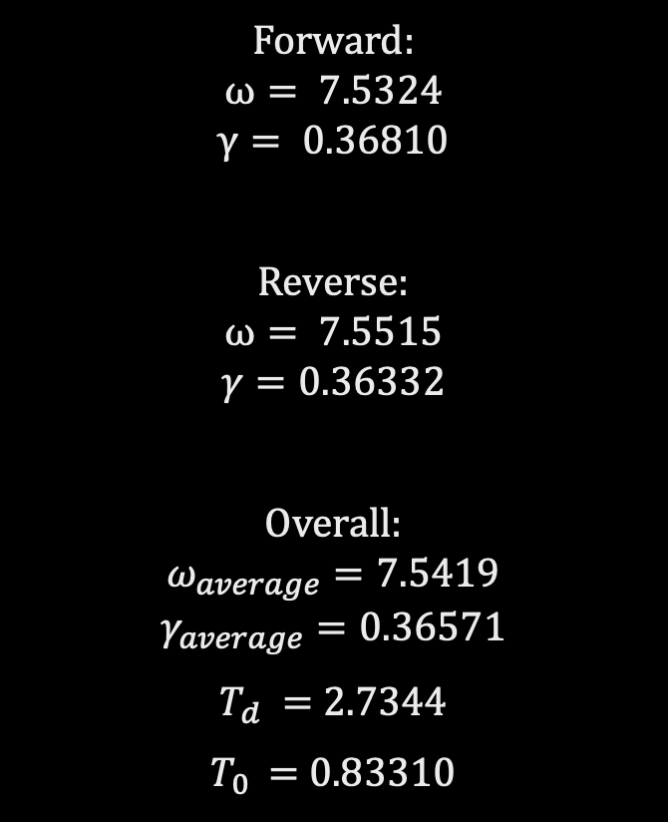
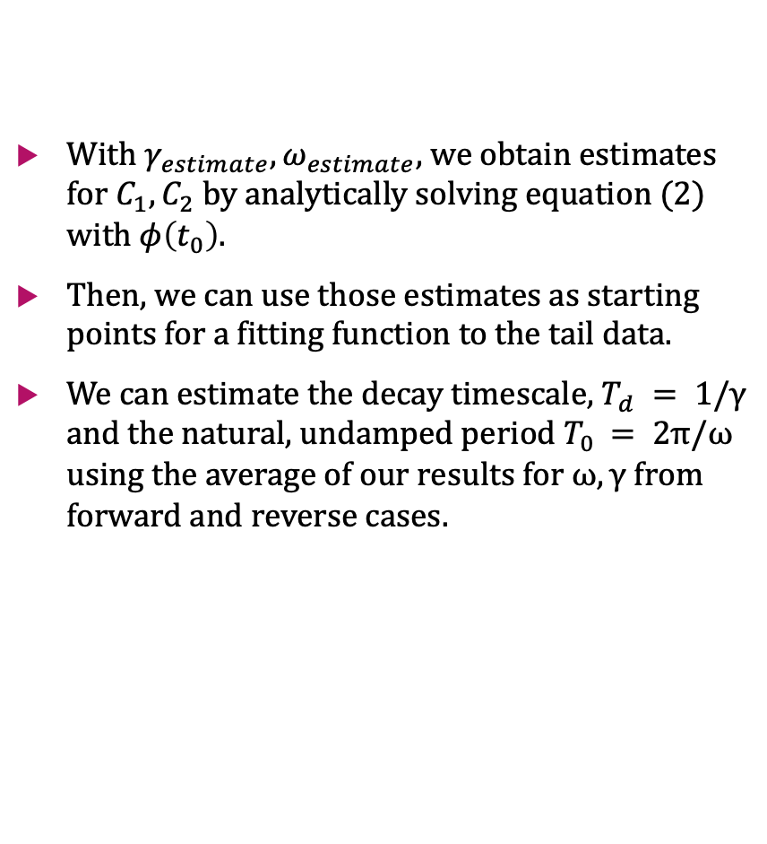
Results
With $γ_{estimate},ω_{estimate}$, we obtain estimates for $C_{1},C_{2}$ by analytically solving equation (2) with $φ\left(t_{0}\right).$
Then, we can use those estimates as starting points for a fitting function to the tail data.
We can estimate the decay timescale, $T_{d} = 1/γ$ and the natural, undamped period $T_{0 }= 2π/ω$ using the average of our results for $ω,γ$ from forward and reverse cases.
Forward:
$$ω= 7.5324$$
$$γ= 0.36810$$
Reverse:
$$ω= 7.5515$$
$$γ=0.36332$$
Overall:
$$ω_{average}=7.5419$$
$$γ_{average}=0.36571$$
$T_{d} =$2.7344
$T_{0 }=$0.83310

Slide 5
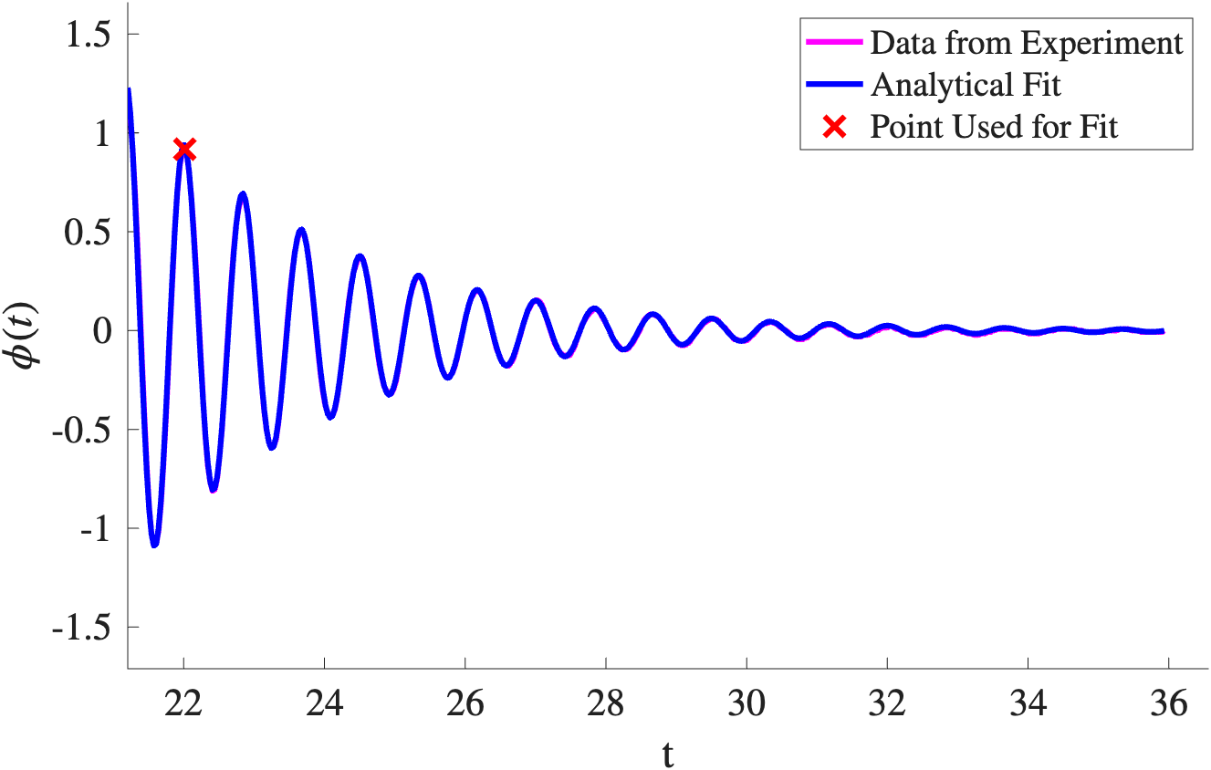
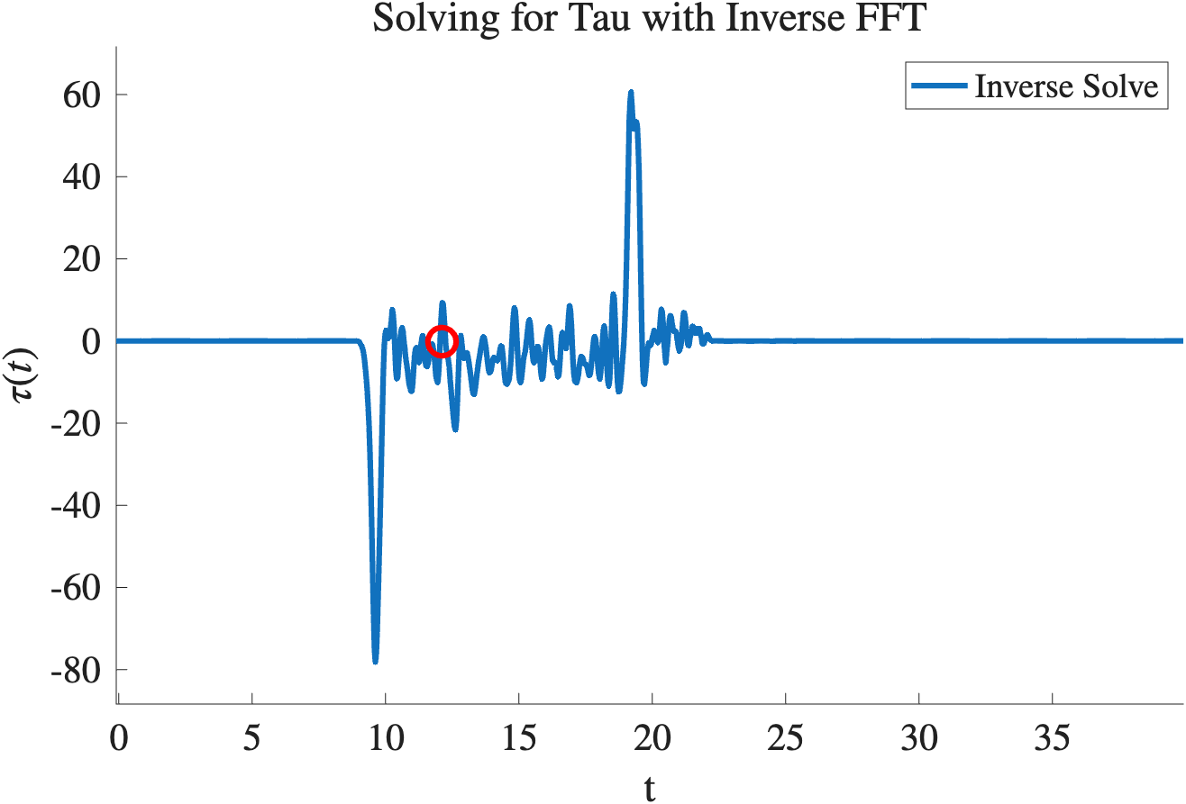
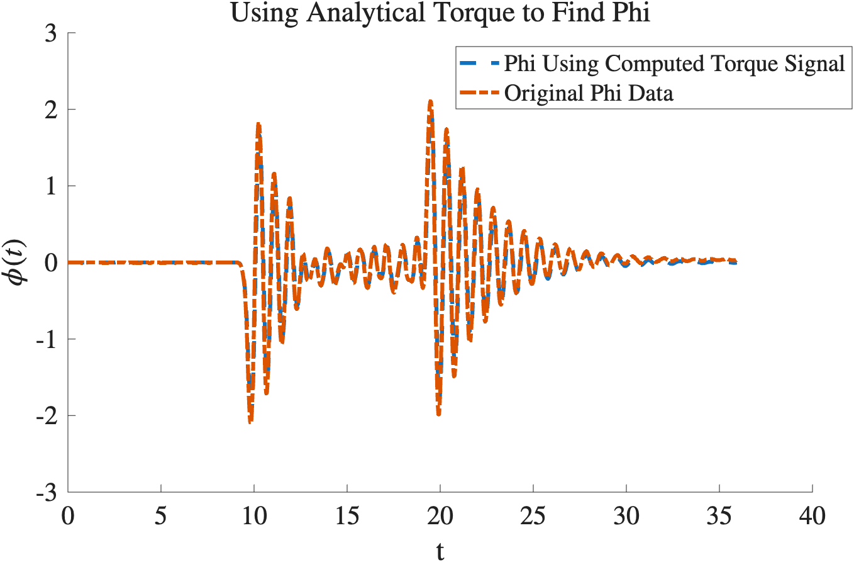
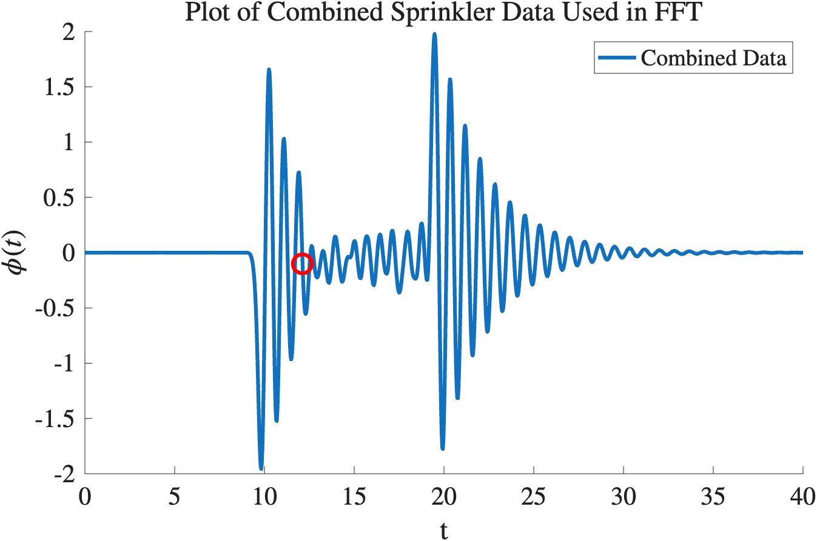
REVERSE

Slide 6
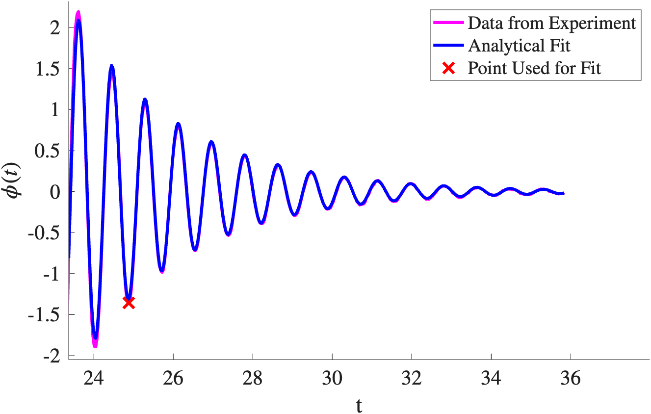
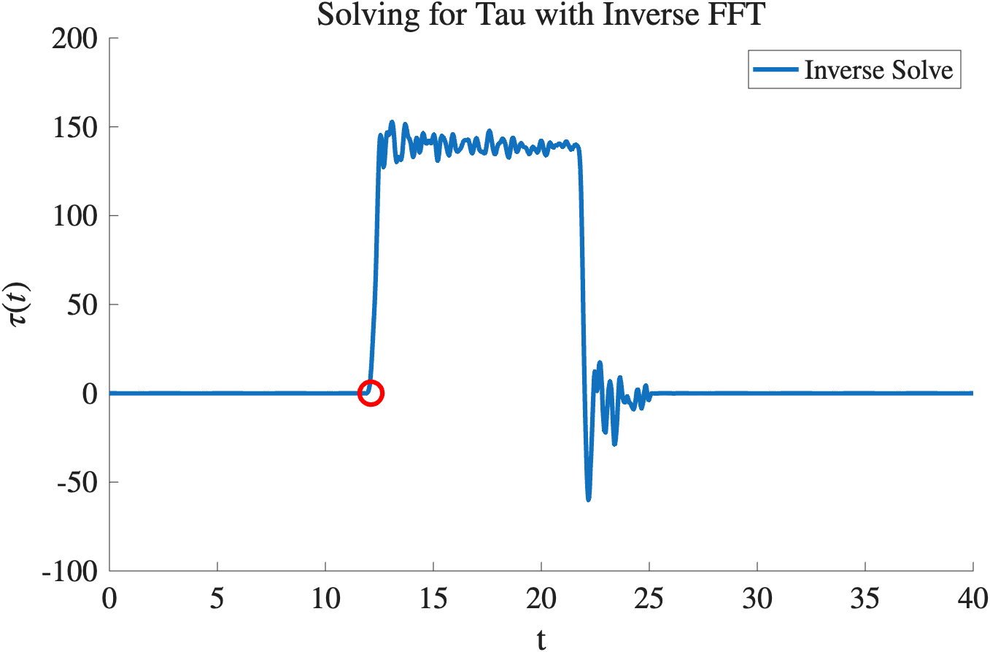
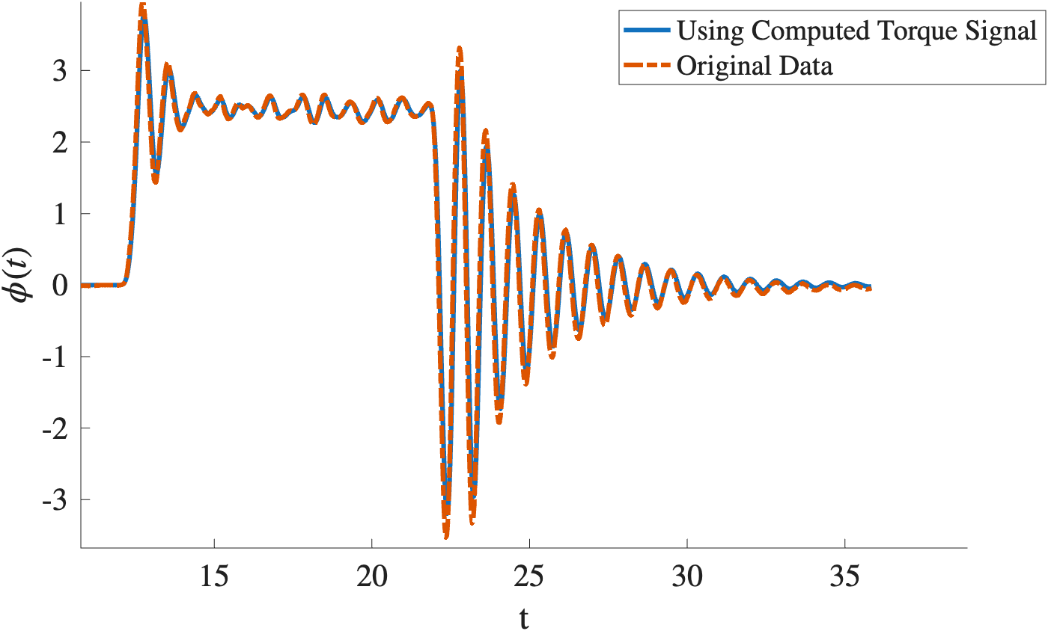
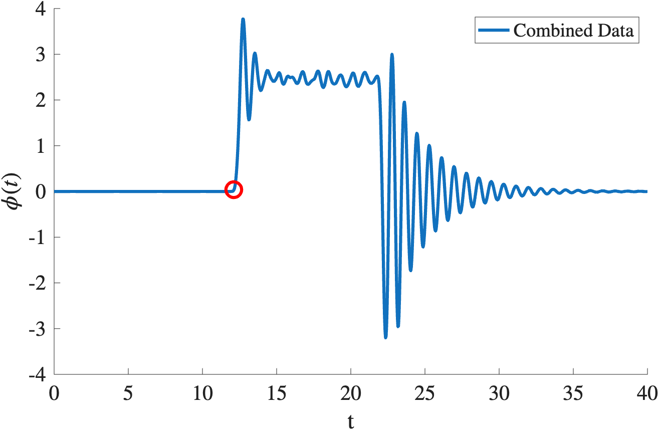
FORWARD

Slide 7
Error Analysis
Forward
norm two error between data and analytical fit: 4.3667e-02
norm two error from smoothing phi: 4.5624e-02
norm two error of original data and output using solved torque: 1.0750e-01
Reverse
norm two error of data and analytical fit: 2.7083e-02
norm two error from smoothing phi: 2.8165e-02
norm two error of original data and output using solved torque: 2.2769e-01

