Slide 1
forward

Slide 2
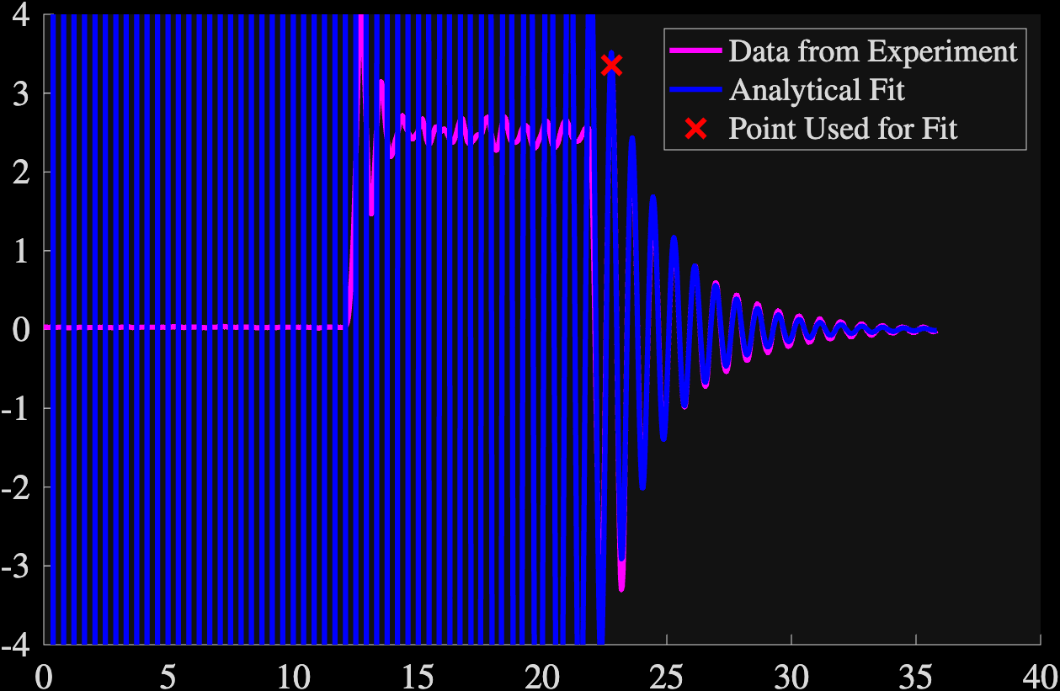
Found using fit for all four – fit eq below
Gamma = 0.4388
Omega_0 = 7.5151
C1 = 23,139
C2 = 73,508
Relative Error after red point = 9.567239e-02

Slide 3
