Slide 1
ANGULAR WORKSHOP
16 de Noviembre de 2.018

Slide 2


Best practices in Angular
Angular CLI
Automatic Documentation
Reactive Programming

Slide 3
Best Practices for Writing Angular Apps
Use of Angular CLI
Develop apps in modular fashion using core, shared and feature modules
Lazy loading a feature module
Use of smart vs presentational
Proper use of dependency injection
Aliases for imports.
Make use of lint rules
....

Slide 4

2. Angular CLI

Slide 5
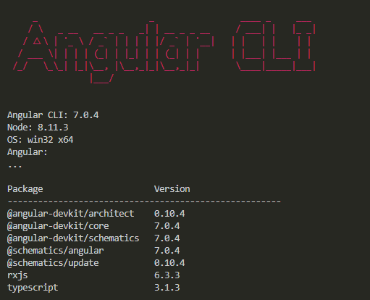
Angular CLI
What Is
The Angular CLI creates, manages, builds and test your Angular projects. It's built on top of the Angular DevKit.

Slide 6
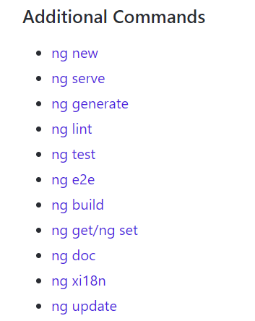
Angular CLI
Commands
Command syntax is shown as follows:
ng commandNameOrAlias requiredArg [optionalArg] [options]
https://github.com/angular/angular-cli/wiki

Slide 7
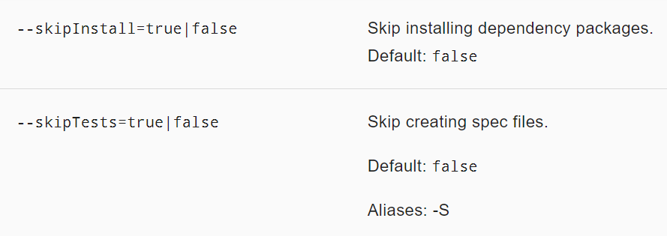
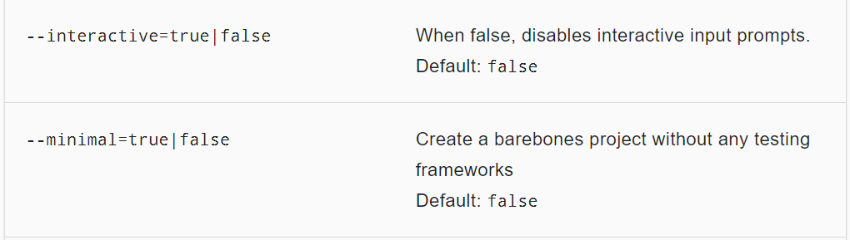
Commands
ng-new
Creates a new workspace and an initial Angular app.
ng new <name> [options]
default interactive = true -> Angular 7

Slide 8
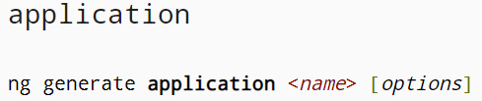
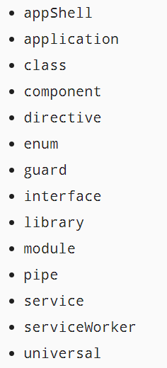
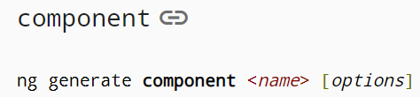
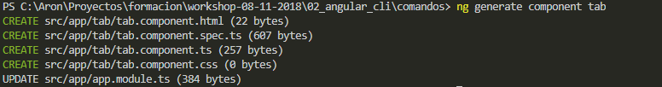
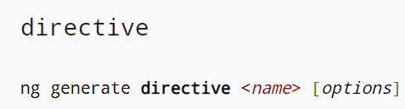
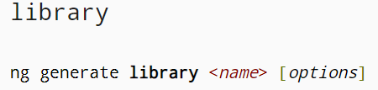
Commands
ng-generate
Generates and/or modifies files based on a schematic.
ng generate <schematic> [options]

Slide 9
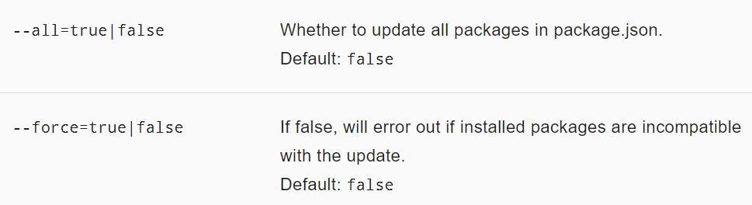
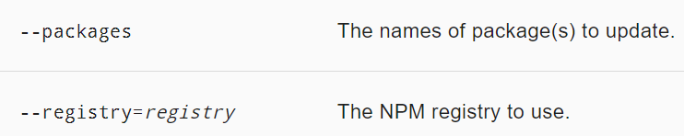
Commands
ng-update
Updates your application and its dependencies
ng update [options]

Slide 10
Commands
Exercise
Getting Familiar with Angular commands
Generate new workpace- Skip
Add new component
Add new module
Add new component to last module
git clone https://github.com/rached193/AngularWorkshop-20181116/tree/master/02_angular_cli/comandos

Slide 11
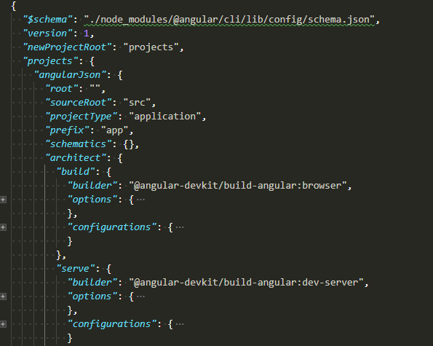
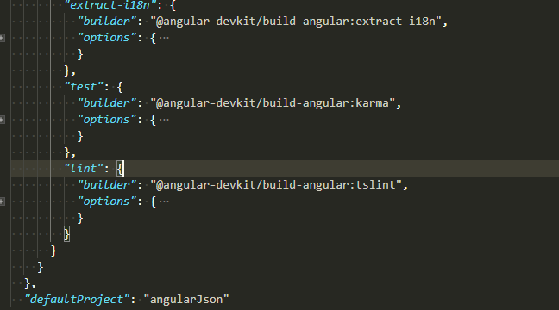
angular.json
What is
This file is used as the configuration schema for the whole project and manipulated by the CLI.
Including managing of different environments, testing, proxy, third-party resources and plenty of built-in tools and capabilities for developing our application.

Slide 12

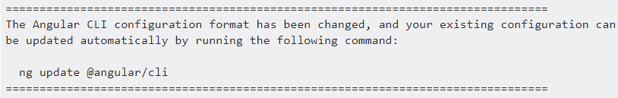
angular.json
migration
Angular ^6.*
Migration Angular 5 to Angular 6

Slide 13
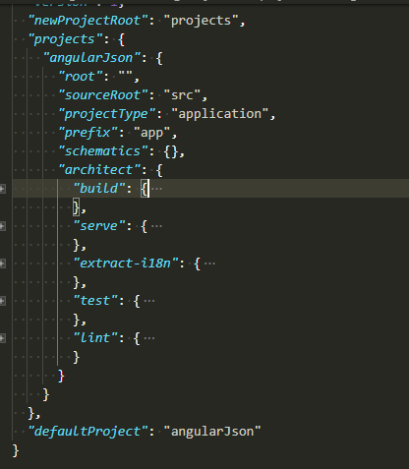
angular.json
Configurations
Any project in a workspace able to contain and customize automatic task commands.
build
serve
extract-i18n
test
lint
karma
app-shell
...

Slide 14
Commands
ng build
Compiles an Angular app into an output directory named dist/ at the given output path. Must be executed from within a workspace directory.
Uses the Webpack build tool, with environment and build options specified in the CLI configuration file.
https://github.com/angular/angular-cli/wiki/build

Slide 15
angular.json
Exercise
Configure angular.json
Change ouput dist
Add new asset
Add new enviroment
Add new build options

Slide 16

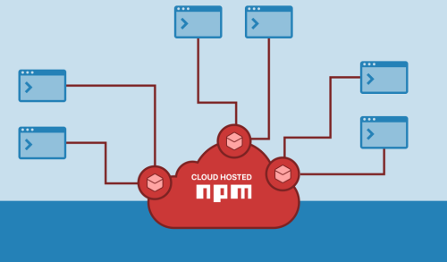
Npm
What is
npm is the package manager for JavaScript and the world’s largest software registry. Discover packages of reusable code — and assemble them in powerful new ways.

Slide 17
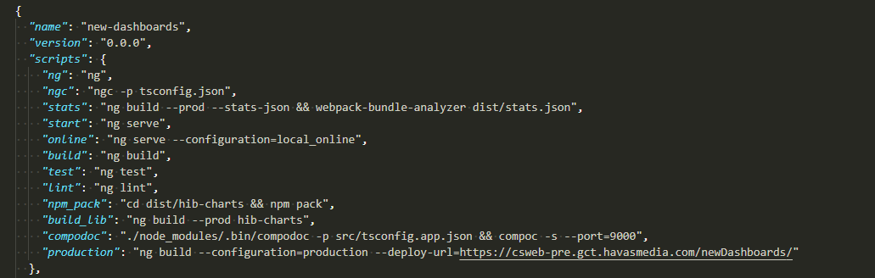
Npm
Task-Runner
A task runner is exactly what it sounds like, a program that can execute tasks based on specific criteria.

Slide 18
Angular-CLI
Workshop
Generate library
ng generate libraty [name]
add to paths in tsconfig.json

Slide 19

¿quieres crecer con nosotros?
La información comprendida en esta presentación es confidencial y pertenece a Hiberus Tecnología.
Cualquier forma de divulgación, reproducción, copia o distribución total o parcial de la misma queda prohibida, no pudiendo ser utilizado su contenido para otros fines sin la autorización expresa por escrito de Hiberus Tecnología.
Contacto
+34 902 877 392
www.hiberus.com

