Slide 1
ANGULAR WORKSHOP
16 de Noviembre de 2.018

Slide 2


Best practices in Angular
Angular CLI
Documentacion automatizada de proyectos
Flow Events

Slide 3

1. Best practices in Angular

Slide 4
Best Practices for Writing Angular Apps
Use of Angular CLI
Develop apps in modular fashion using core, shared and feature modules.
Lazy loading a feature module.
Use of smart vs presentational
Proper use of dependency injection
Aliases for imports.
Make use of lint rules
....

Slide 5
Make use of lint rules
Having lint rules in place means that you will get a nice error when you are doing something that you should not be. This will enforce consistency in your application and readability.

Slide 6
Style Guide
Ru
The purpose of this style guide is to provide guidance on building Angular applications by showing the conventions I use and, more importantly, why I choose them.
Jonh Papa

Slide 7
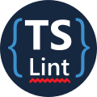
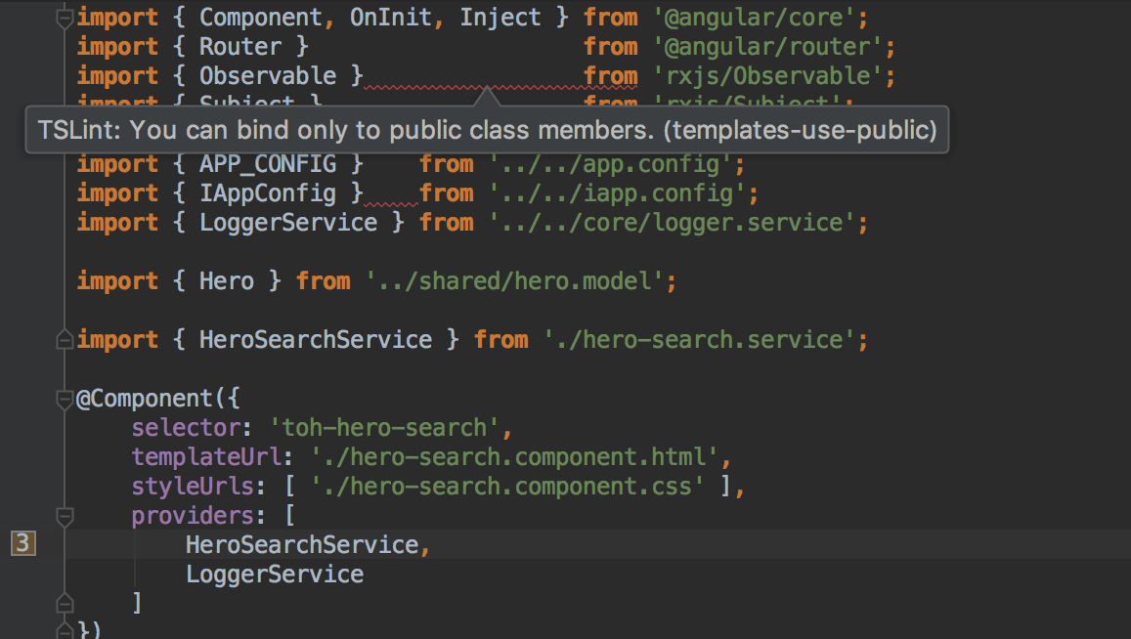
TsLint
What its
TSLint is an extensible static analysis tool that checks TypeScript code for readability, maintainability, and functionality errors.
Rules:
https://palantir.github.io/tslint/rules/

Slide 8
Apariencia

Slide 9
TsLint
Rule: indent
Enforces indentation with tabs or spaces.
Using only one of tabs or spaces for indentation leads to more consistent editor behavior, cleaner diffs in version control, and easier programmatic manipulation.

Slide 10
TsLint
Rule: max-line-length
Requires lines to be under a certain max length.
Limiting the length of a line of code improves code readability. It also makes comparing code side-by-side easier and improves compatibility with various editors, IDEs, and diff viewers.

Slide 11
Funcionalidad

Slide 12
TsLint
Rule: curly
Enforces braces for if/for/do/while statements
if (foo === bar)
foo++;
bar++;
In the code above, the author almost certainly meant for both foo++ and bar++ to be executed only if foo === bar. However, they forgot braces and bar++ will be executed no matter what. This rule could prevent such a mistake.

Slide 13
TsLint
Rule: import-blacklist
Disallows importing the specified modules directly via import and require. Instead only sub modules may be imported from that module.
Some libraries allow importing their submodules instead of the entire module. This is good practise as it avoids loading unused modules.

Slide 14
Diseño

Slide 15
TsLint
Rule: max-file-line-count
Requires files to remain under a certain number of lines
Limiting the number of lines allowed in a file allows files to remain small, single purpose, and maintainable.

Slide 16
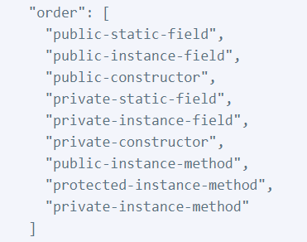
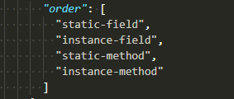
TsLint
Rule: member-ordering
Enforces member ordering.
A consistent ordering for class members can make classes easier to read, navigate, and edit.
A common opposite practice to member-ordering is to keep related groups of classes together. Instead of creating classes with multiple separate groups, consider splitting class responsibilities apart across multiple single-responsibility classes.

Slide 17
Ejercicio Tslint

Slide 18

Codelyzer
A set of tslint rules for static code analysis of Angular TypeScript projects.

Slide 19
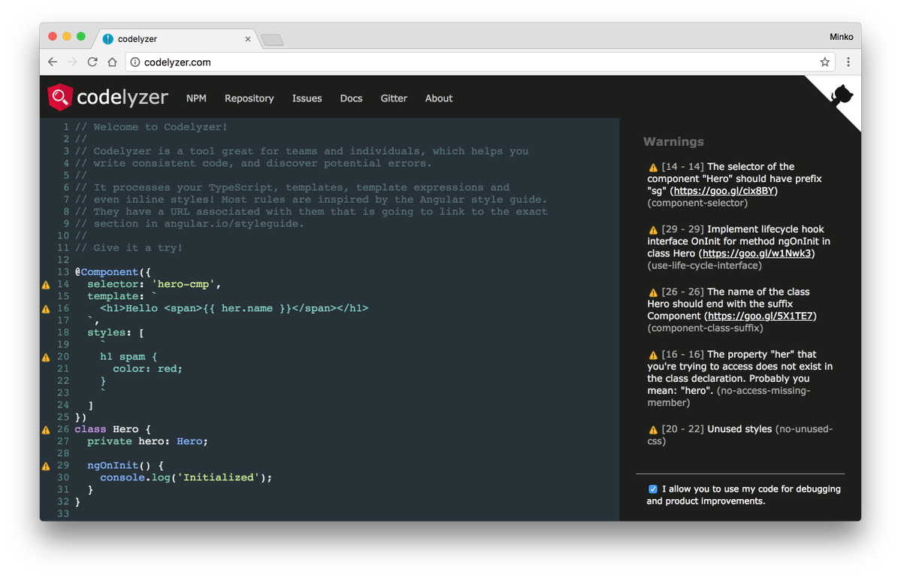
Codelyzer
What is
Rules:
http://codelyzer.com/rules/

Slide 20
Codelyzer
Rule 1

Slide 21
Codelyzer
Rule 2

Slide 22
Codelyzer
Rule 3

Slide 23
Ejercicio Codelyzer

Slide 24
Workshop

Slide 25

¿quieres crecer con nosotros?
La información comprendida en esta presentación es confidencial y pertenece a Hiberus Tecnología.
Cualquier forma de divulgación, reproducción, copia o distribución total o parcial de la misma queda prohibida, no pudiendo ser utilizado su contenido para otros fines sin la autorización expresa por escrito de Hiberus Tecnología.
Contacto
+34 902 877 392
www.hiberus.com

