Slide 1
ANGULAR WORKSHOP
16 de Noviembre de 2.018

Slide 2


Best practices in Angular
Angular CLI
Automatic Documentation
Reactive Programming

Slide 3

4. Reactive Programming

Slide 4
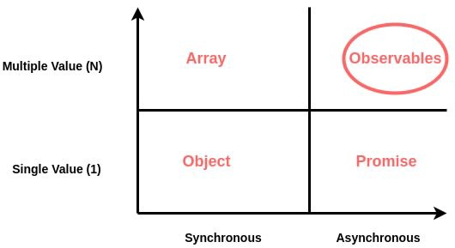
Reactive Programming
What Is
Reactive Programming is a declarative programming paradigm concerned with data streams and the propagation of change. .
A different way of building software applications which will “react” to changes that happen instead of the typical way of writing software where we explicitly write code to handle those changes.

Slide 5
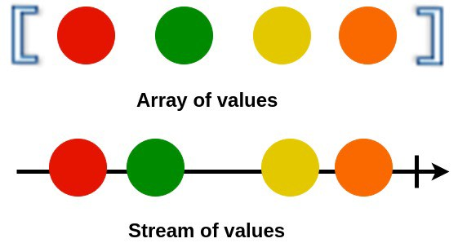
Reactive Programming
Data Streams
A stream is a sequence of ongoing events ordered in time. It can be anything like user inputs, button clicks or data structures.
You can listen to a stream and react to it accordingly. You can use functions to combine, filter or map streams.

Slide 6

Reactive Programming
RxJS
REACTIVE EXTENSIONS LIBRARY FOR JAVASCRIPT
RxJS is a library for reactive programming using Observables, to make it easier to compose asynchronous or callback-based code.
https://rxjs-dev.firebaseapp.com/

Slide 7
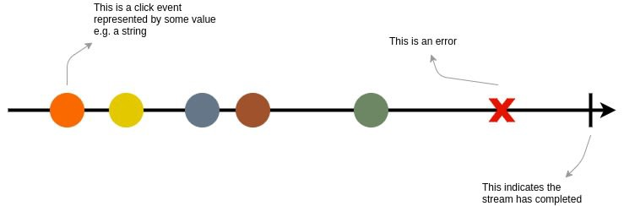
Rxjs
Observables
Observables provide support for passing messages between publishers and subscribers in your application.
Observables offer significant benefits over other techniques for event handling, asynchronous programming, and handling multiple values.
Observables are lazy. It doesn’t start producing data untill you subscribe to it.

Slide 8
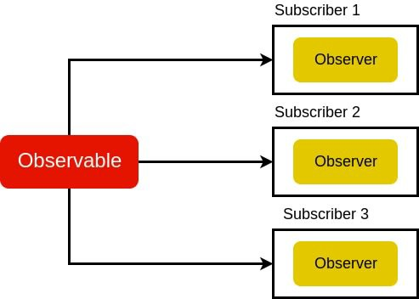
Rxjs
Observer
An observer is object literal with next(), error() and complete()functions. In the above example, the observer is the object literal we pass into our .subscribe() method.
When we subscribe to an Observable, it will keep passing values to an observer until the complete signal.

Slide 9
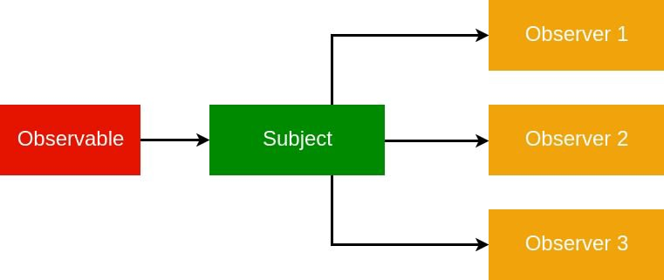
RxJS
Subject
A Subject is like an Observable, but can multicast to many Observers. Subjects are like EventEmitters: they maintain a registry of many listeners.

Slide 10
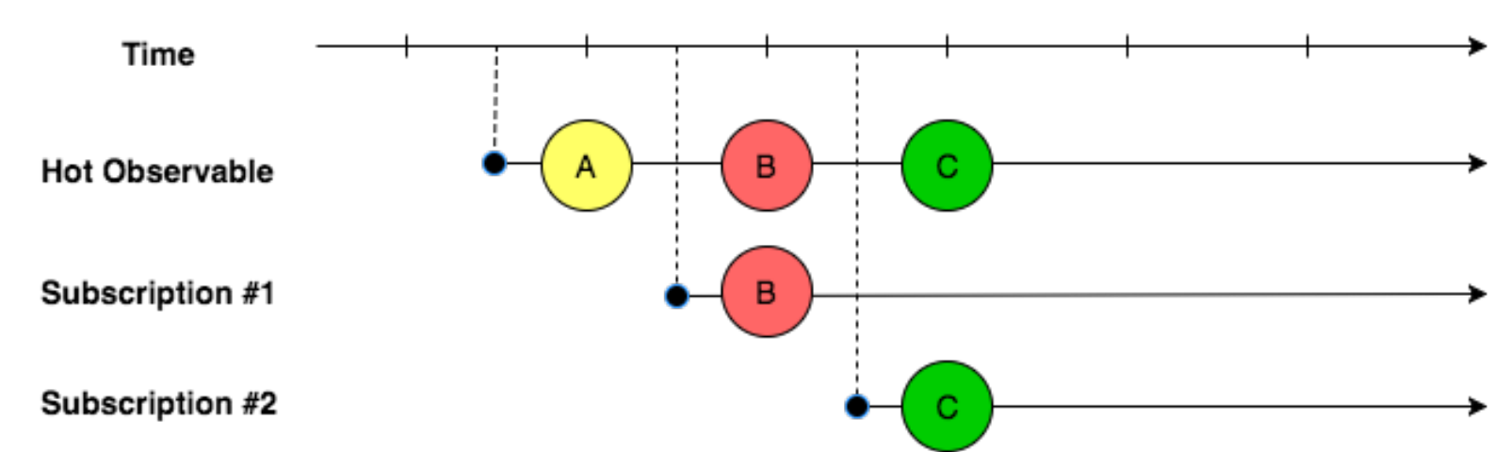
RxJS
Multicasted Observables
A multicasted Observable uses a Subject under the hood to make multiple Observers see the same Observable execution.

Slide 11
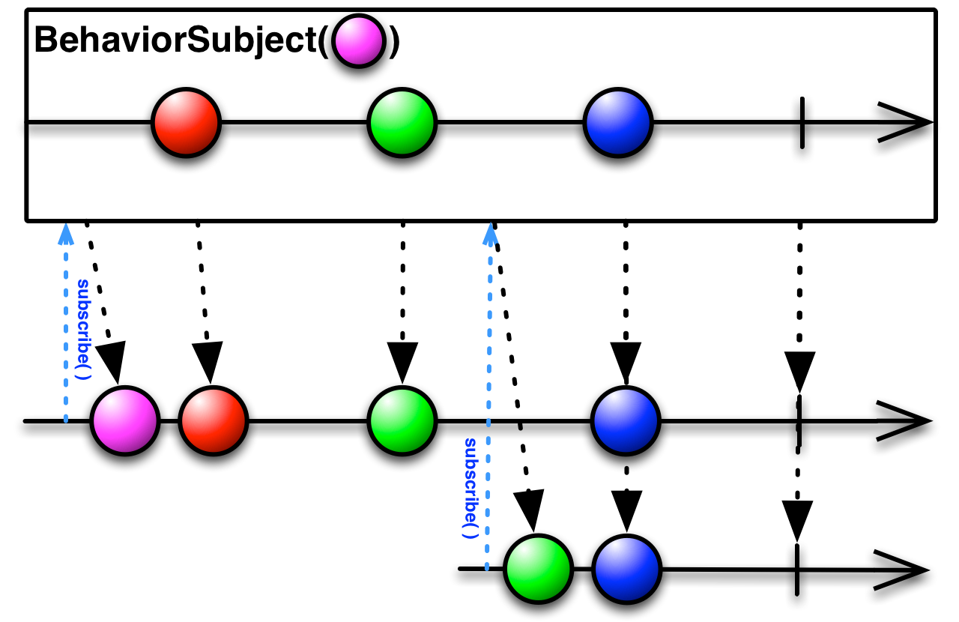
RxJS
BehaviorSubject
BehaviorSubjects are useful for representing "values over time". For instance, an event stream of birthdays is a Subject, but the stream of a person's age would be a BehaviorSubject.

Slide 12
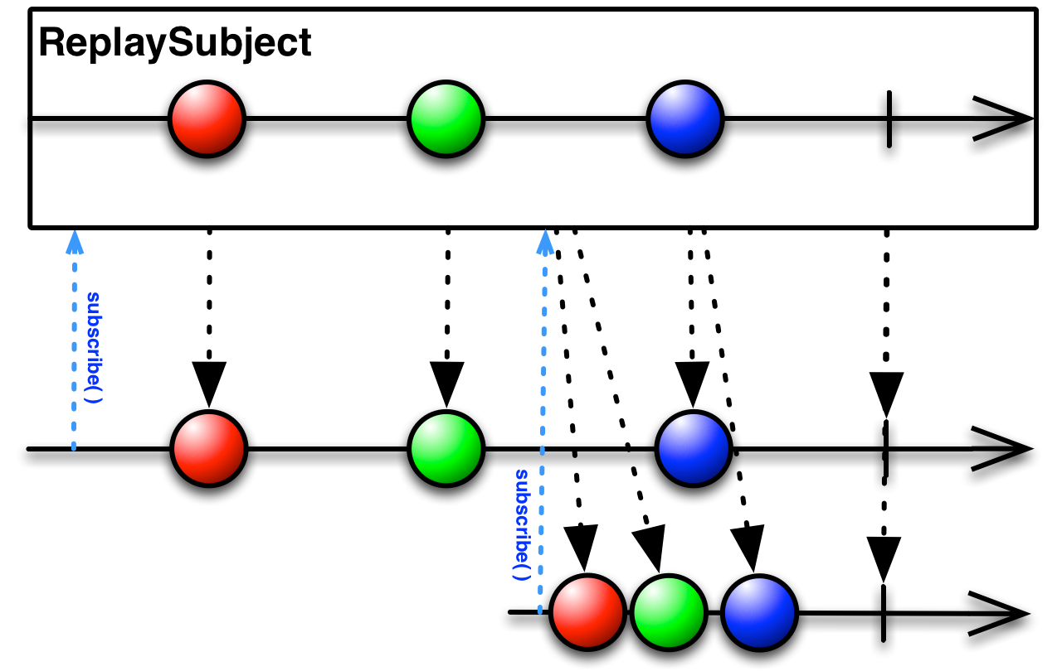
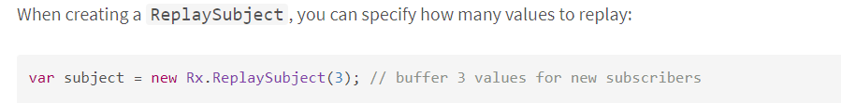
RxJS
ReplaySubject
A ReplaySubject records multiple values from the Observable execution and replays them to new subscribers.

Slide 13
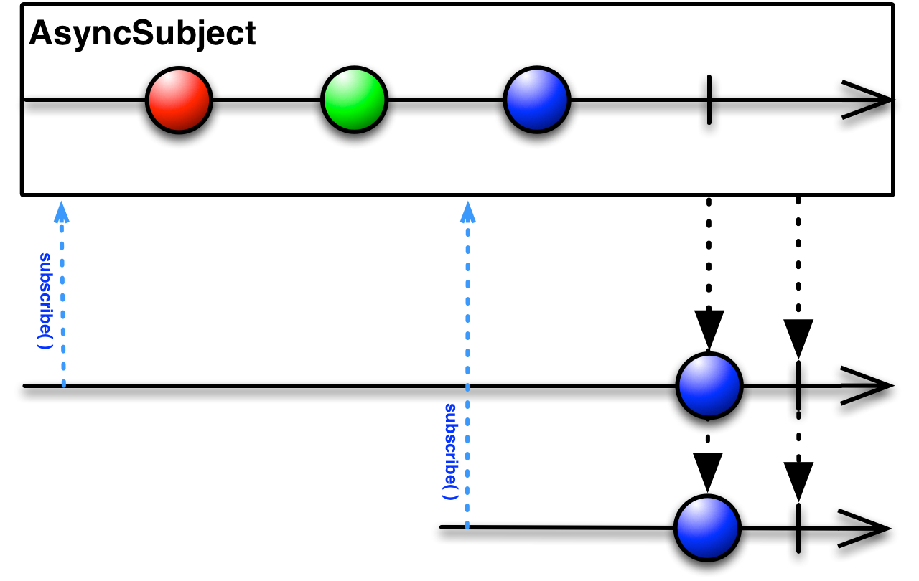
RxJS
AsyncSubject
The AsyncSubject is a variant where only the last value of the Observable execution is sent to its observers, and only when the execution completes.

Slide 14
Rxjs
Exercise
git clone https://github.com/rached193/AngularWorkshop-20181116/tree/master/01_best_practices/tslint
tsc [name] -> compile the file
node [name] -> execute file

Slide 15
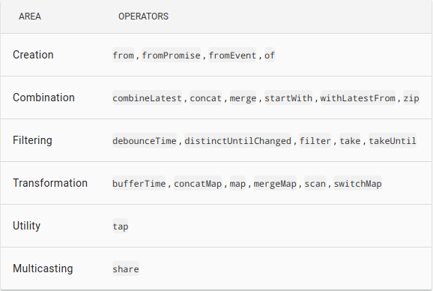
RxJS
Operators
An Operator is essentially a pure function which takes one Observable as input and generates another Observable as output.

Slide 16
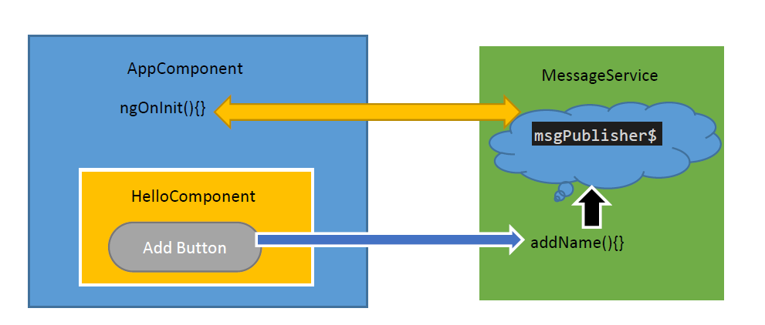
RxJS
Angular
Angular makes use of observables as an interface to handle a variety of common asynchronous operations.

Slide 17
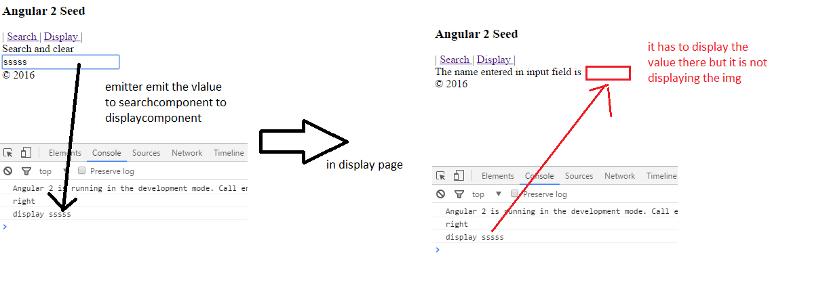
Angular
EventEmitter
Angular provides an EventEmitter class that is used when publishing values from a component through the @Output() decorator. EventEmitter extends Observable, adding an emit() method so it can send arbitrary values.

Slide 18
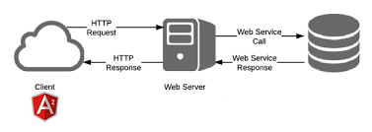
Angular
HTTP
Angular’s HttpClient returns observables from HTTP method calls. For instance, http.get(‘/api’) returns an observable.

Slide 19
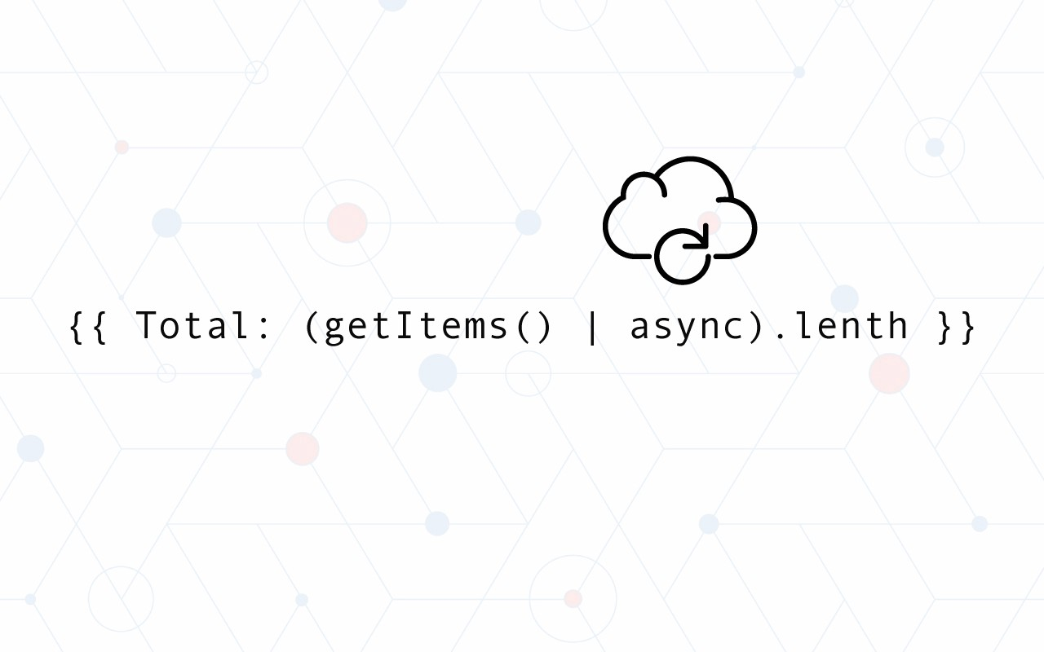
Angular
Async pipe
The AsyncPipe subscribes to an observable or promise and returns the latest value it has emitted. When a new value is emitted, the pipe marks the component to be checked for changes.

Slide 20
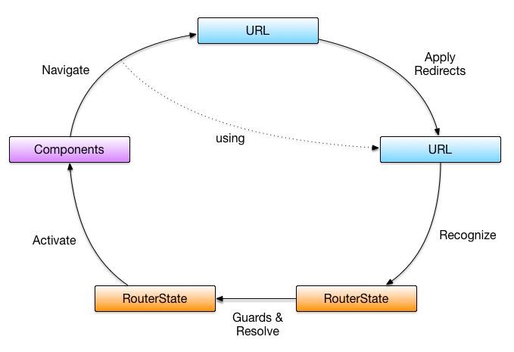
Angular
Router
Router.events provides events as observables. You can use the filter() operator from RxJS to look for events of interest, and subscribe to them in order to make decisions based on the sequence of events in the navigation process.

Slide 21
Angular
Practical usage
Listen for data from an input.
Trim the value (remove whitespace) and make sure it’s a minimum length.
Debounce (so as not to send off API requests for every keystroke, but instead wait for a break in keystrokes).
Don’t send a request if the value stays the same (rapidly hit a character, then backspace, for instance).
Cancel ongoing AJAX requests if their results will be invalidated by the updated results.

Slide 22

¿quieres crecer con nosotros?
La información comprendida en esta presentación es confidencial y pertenece a Hiberus Tecnología.
Cualquier forma de divulgación, reproducción, copia o distribución total o parcial de la misma queda prohibida, no pudiendo ser utilizado su contenido para otros fines sin la autorización expresa por escrito de Hiberus Tecnología.
Contacto
+34 902 877 392
www.hiberus.com

