Slide 1
ANGULAR WORKSHOP
16 de Noviembre de 2.018

Slide 2


Best practices in Angular
Angular CLI
Automatic Documentation
Reactive Programming

Slide 3
Best Practices for Writing Angular Apps
Use of Angular CLI
Develop apps in modular fashion using core, shared and feature modules
Lazy loading a feature module
Use of smart vs presentational
Proper use of dependency injection
Aliases for imports.
Make use of lint rules
....

Slide 4

2. Angular CLI

Slide 5
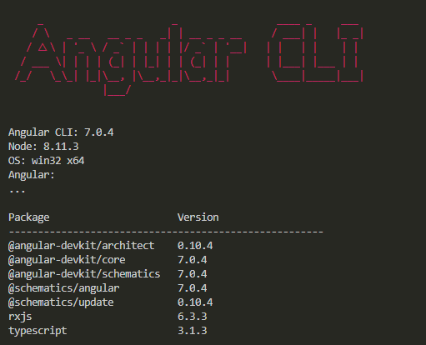
Angular CLI
What Is
The Angular CLI creates, manages, builds and test your Angular projects. It's built on top of the Angular DevKit.

Slide 6
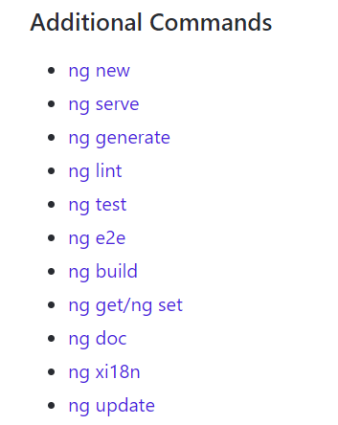
Angular CLI
Commands
Command syntax is shown as follows:
ng commandNameOrAlias requiredArg [optionalArg] [options]
https://github.com/angular/angular-cli/wiki

Slide 7
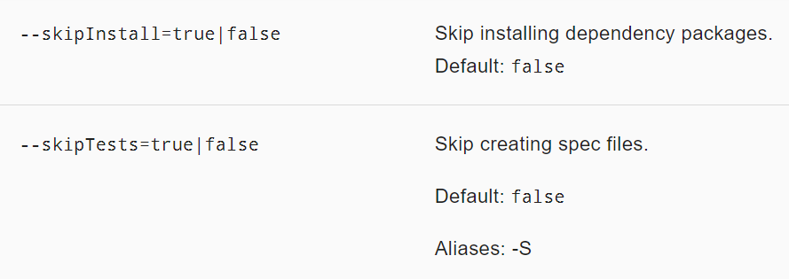
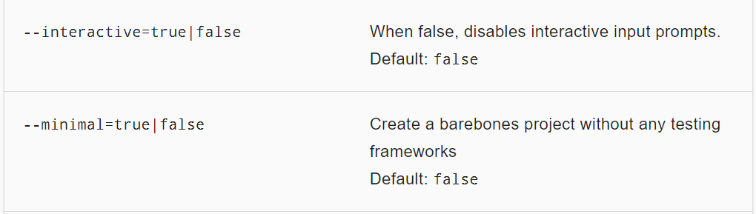
Commands
ng-new
Creates a new workspace and an initial Angular app.
ng new <name> [options]
default interactive = true -> Angular 7

Slide 8
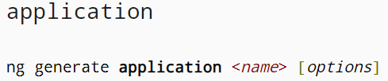
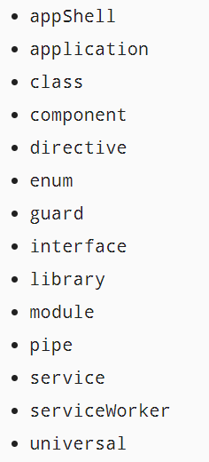
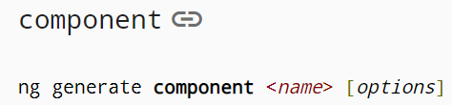
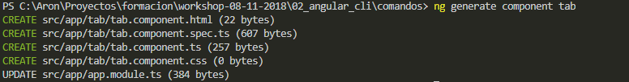
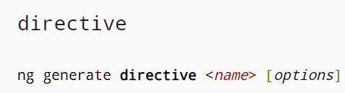
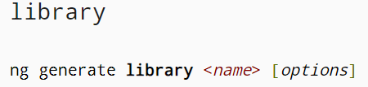
Commands
ng-generate
Generates and/or modifies files based on a schematic.
ng generate <schematic> [options]

Slide 9
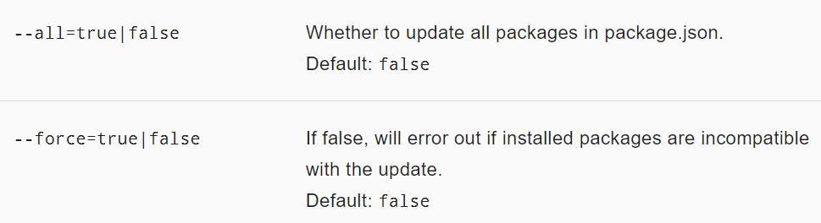
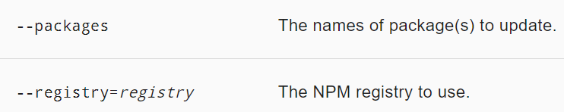
Commands
ng-update
Updates your application and its dependencies
ng update [options]

Slide 10
Ejercio comandos

Slide 11
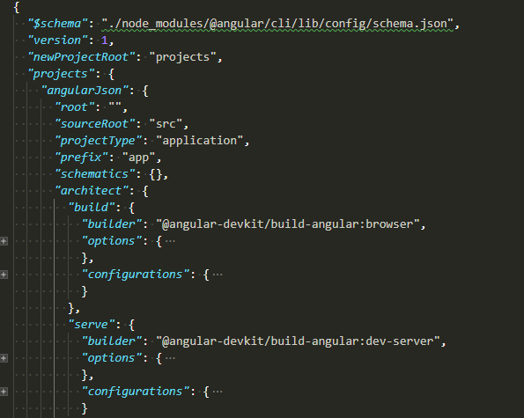
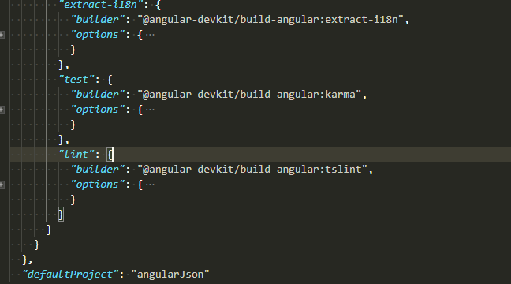
angular.json
What is
This file is used as the configuration schema for the whole project and manipulated by the CLI.
Including managing of different environments, testing, proxy, third-party resources and plenty of built-in tools and capabilities for developing our application.

Slide 12

angular.json
migration
Migracion

Slide 13
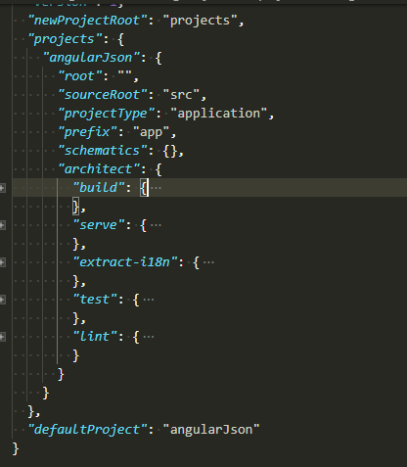
angular.json
Configurations
Any project in a workspace able to contain and customize automatic task commands.
build
serve
extract-i18n
test
lint
karma
app-shell
...

Slide 14
Angular CLI
angular.json
Multiples proyectos??

Slide 15
Commands
ng build
Compiles an Angular app into an output directory named dist/ at the given output path. Must be executed from within a workspace directory.
Uses the Webpack build tool, with environment and build options specified in the CLI configuration file.

Slide 16
Angular CLI
Ejercicio Enviroments

Slide 17
Npm
What is

Slide 18
Npm
Task-Runner

Slide 19
Workshop Generar una libreria

Slide 20
XXXXXXXX

