Slide 1
ANGULAR WORKSHOP
16 de Noviembre de 2.018

Slide 2


Best practices in Angular
Angular CLI
Automatic Documentation
Reactive Programming

Slide 3

4. Reactive Programming

Slide 4
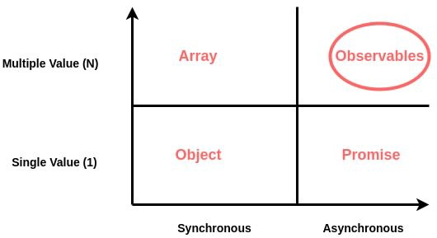
Reactive Programming
What Is
Reactive Programming is a declarative programming paradigm concerned with data streams and the propagation of change. .
A different way of building software applications which will “react” to changes that happen instead of the typical way of writing software where we explicitly write code to handle those changes.

Slide 5
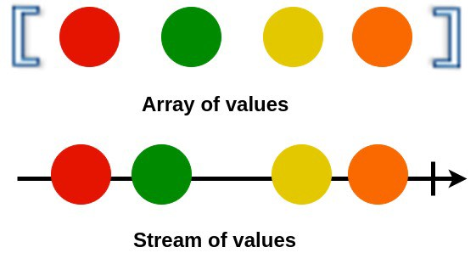
Reactive Programming
Data Streams
A stream is a sequence of ongoing events ordered in time. It can be anything like user inputs, button clicks or data structures.
You can listen to a stream and react to it accordingly. You can use functions to combine, filter or map streams.

Slide 6

Reactive Programming
RxJS
REACTIVE EXTENSIONS LIBRARY FOR JAVASCRIPT
RxJS is a library for reactive programming using Observables, to make it easier to compose asynchronous or callback-based code.
https://rxjs-dev.firebaseapp.com/

Slide 7
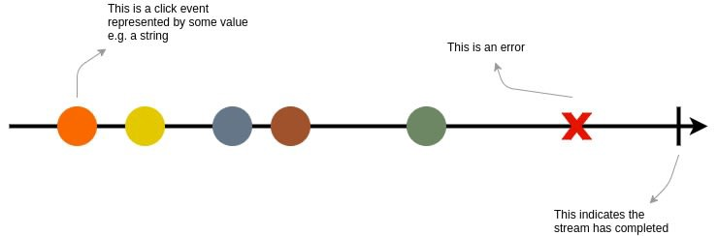
Rxjs
Observables
Observables provide support for passing messages between publishers and subscribers in your application.
Observables offer significant benefits over other techniques for event handling, asynchronous programming, and handling multiple values.
Observables are lazy. It doesn’t start producing data untill you subscribe to it.

Slide 8
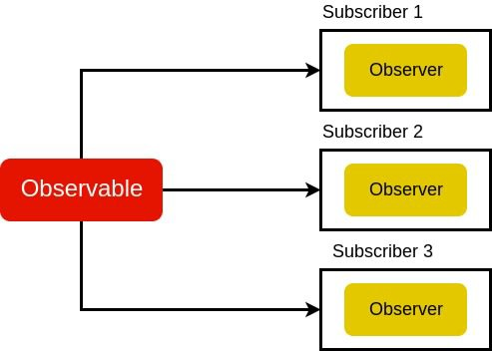
Rxjs
Observer
An observer is object literal with next(), error() and complete()functions. In the above example, the observer is the object literal we pass into our .subscribe() method.
When we subscribe to an Observable, it will keep passing values to an observer until the complete signal.

Slide 9
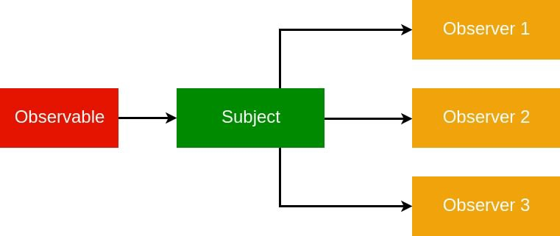
RxJS
Subject
Subjetcs
BehaviourSubcjet
MultiCast

Slide 10
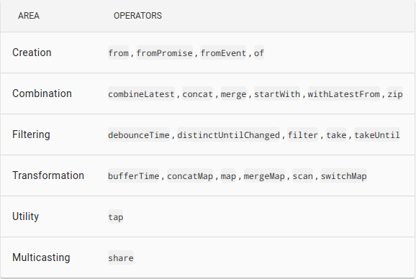
RxJS
Operators
An Operator is essentially a pure function which takes one Observable as input and generates another Observable as output.

Slide 11
Ejercicios Observables

Slide 12
Communication
Subscribe
HttpRequest
EventEmmiter
AsyncPipe

Slide 13

¿quieres crecer con nosotros?
La información comprendida en esta presentación es confidencial y pertenece a Hiberus Tecnología.
Cualquier forma de divulgación, reproducción, copia o distribución total o parcial de la misma queda prohibida, no pudiendo ser utilizado su contenido para otros fines sin la autorización expresa por escrito de Hiberus Tecnología.
Contacto
+34 902 877 392
www.hiberus.com

