Slide 1
ANGULAR WORKSHOP
16 de Noviembre de 2.018

Slide 2


Index
Best practices in Angular
Angular CLI
Documentacion automatizada de proyectos
Observables

Slide 3

1. Best practices in Angular

Slide 5
StyleGuide
Ru
Guia de estilos ofical de Angular
.

Slide 6
TsLint
Best practices in Angular
Angular CLI
Documentacion automatizada de proyectos
Observables

Slide 8
Apariencia

Slide 9
TsLint
Rule: indent
Enforces indentation with tabs or spaces.
Using only one of tabs or spaces for indentation leads to more consistent editor behavior, cleaner diffs in version control, and easier programmatic manipulation.

Slide 10
TsLint
Rule: max-line-length
Requires lines to be under a certain max length.
Limiting the length of a line of code improves code readability. It also makes comparing code side-by-side easier and improves compatibility with various editors, IDEs, and diff viewers.

Slide 11
Funcionalidad

Slide 12
TsLint
Rule: curly
Enforces braces for if/for/do/while statements
if (foo === bar)
foo++;
bar++;
In the code above, the author almost certainly meant for both foo++ and bar++ to be executed only if foo === bar. However, they forgot braces and bar++ will be executed no matter what. This rule could prevent such a mistake.

Slide 13
TsLint
Rule: import-blacklist
Disallows importing the specified modules directly via import and require. Instead only sub modules may be imported from that module.
Some libraries allow importing their submodules instead of the entire module. This is good practise as it avoids loading unused modules.

Slide 14
Diseño

Slide 15
TsLint
Rule: max-file-line-count
Requires files to remain under a certain number of lines
Limiting the number of lines allowed in a file allows files to remain small, single purpose, and maintainable.

Slide 16
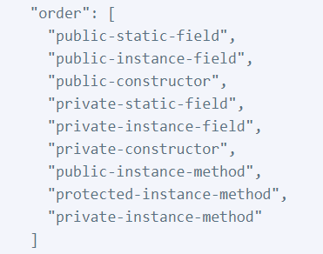
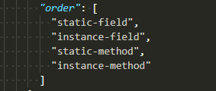
TsLint
Rule: member-ordering
Enforces member ordering.
A consistent ordering for class members can make classes easier to read, navigate, and edit.
A common opposite practice to member-ordering is to keep related groups of classes together. Instead of creating classes with multiple separate groups, consider splitting class responsibilities apart across multiple single-responsibility classes.

Slide 17
Codelyzer

Slide 18
Codelyzer
What is
Explicacion

Slide 19
Codelyzer
Rule 1

Slide 20
Codelyzer
Rule 2

Slide 21
Codelyzer
Rule 3

Slide 22
xxxxxxxxx

Slide 23

¿quieres crecer con nosotros?
La información comprendida en esta presentación es confidencial y pertenece a Hiberus Tecnología.
Cualquier forma de divulgación, reproducción, copia o distribución total o parcial de la misma queda prohibida, no pudiendo ser utilizado su contenido para otros fines sin la autorización expresa por escrito de Hiberus Tecnología.
Contacto
+34 902 877 392
www.hiberus.com

