Slide 1
ANGULAR WORKSHOP
16 de Noviembre de 2.018

Slide 2


Best practices in Angular
Angular CLI
Documentacion automatizada de proyectos
Flow Events

Slide 3
Best Practices for Writing Angular Apps
Use of Angular CLI
Develop apps in modular fashion using core, shared and feature modules.
Lazy loading a feature module.
Use of smart vs presentational
Proper use of dependency injection
Aliases for imports.
Make use of lint rules
....

Slide 4

2. Angular CLI

Slide 5
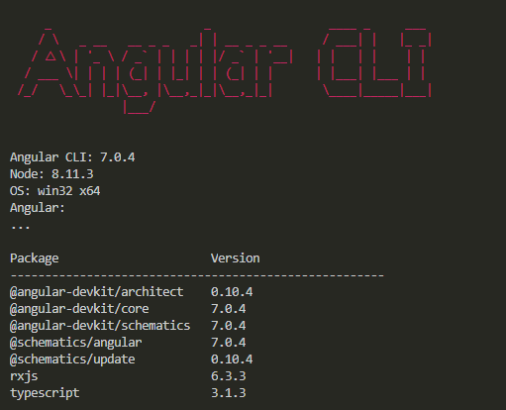
Angular CLI
What Is
The Angular CLI creates, manages, builds and test your Angular projects. It's built on top of the Angular DevKit.

Slide 6
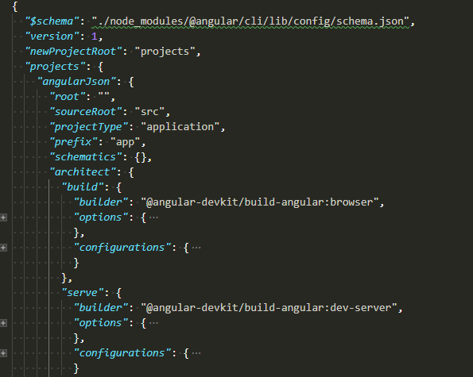
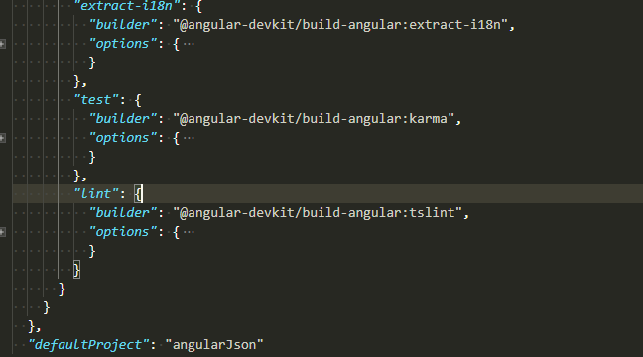
Angular CLI
angular.json
This file is used as the configuration schema for the whole project and manipulated by the CLI.
Including managing of different environments, testing, proxy, third-party resources and plenty of built-in tools and capabilities for developing our application.

Slide 7

Angular CLI
angular.json

Slide 8
XXXXXXXX

