Slide 1
HeliBoy
Presentation done by:
Mohamed Rached Waly

Slide 2
Summary
Concept
Demo
Implementation
Evaluation

Slide 3
01
Concept

Slide 4
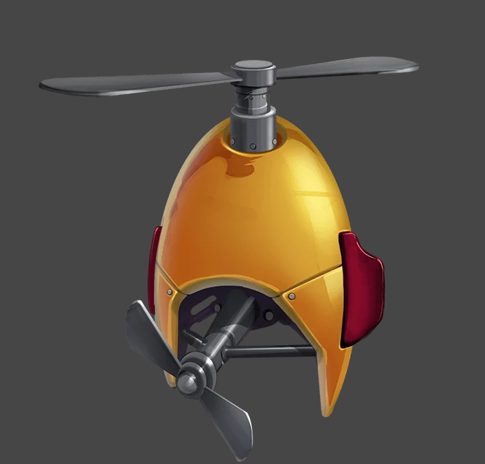

First Idea
Notes:
The first idea was to combine a character with a helmet that has one or multiple fans

Slide 5
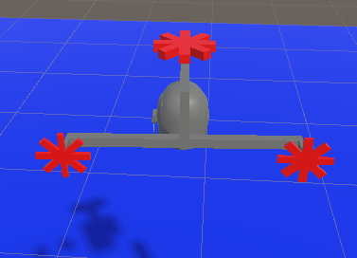
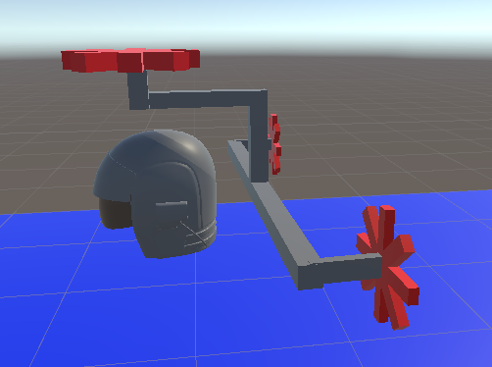
Final 3d model of the system
Notes:
After a good time of reflexion, here is the final 3d model that I designed.
So I found this helmet in a free asset in the unity’ store and I made all other parts by myself.
The fans will move accordingly to the movement, meaning if you want to make a sharp right ,only the left fan will work and vice versa
If you are moving forward both of them will work. I called theses fans the steering fans.
The Third fan which resides on top of the helmet is called the elevation fan, this fan will work constantly and tilt according to the direction of elevation that the user chose.

Slide 6
02
Demo

Slide 7
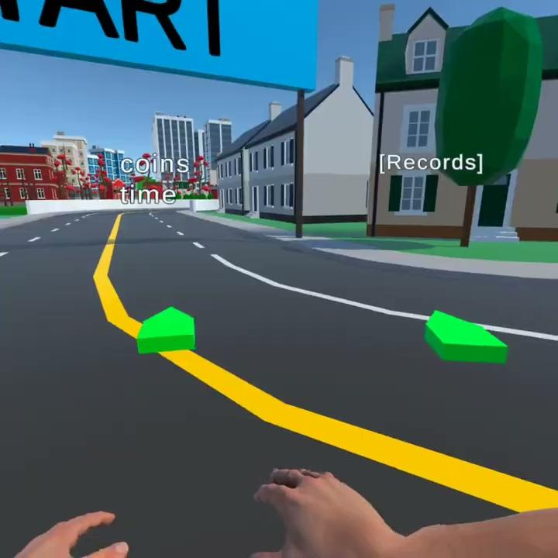

Slide 8
03
Implementation

Slide 9
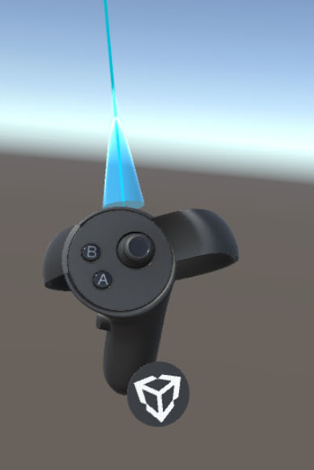
Go backwards
Go forward
Left controller
Right controller
Notes:
Loosing the control factor, replacing the 2 degrees of freedom of the left controller by the two buttons gives the user less control of the heliboy

Slide 10
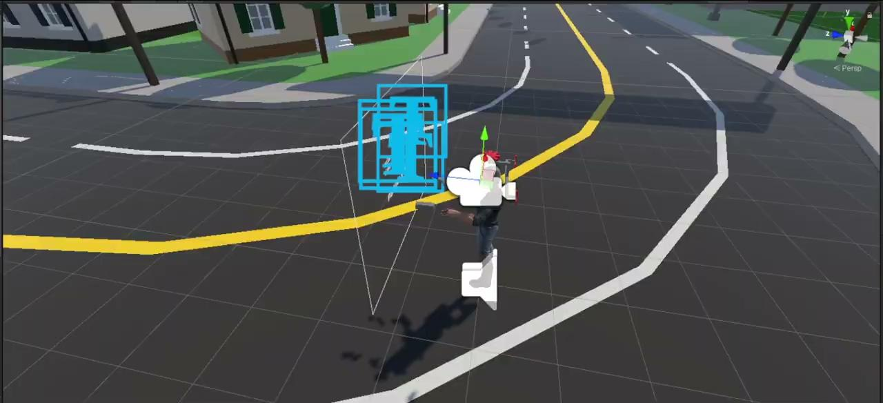
Notes:
I mapped the desired rotations of the oculus’ controllers to two virtual 3d objects in the scene. The gray squares in this video

Slide 11
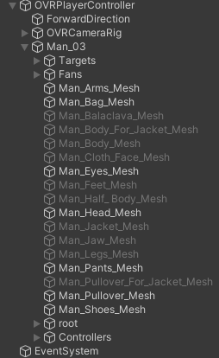
transform.parent.position = Vector3.Lerp(transform.parent.position, transform.parent.position - rightController.forward*speedCoefficientb, Time.deltaTime);
transform.parent.rotation = Quaternion.Slerp(transform.parent.rotation, leftController.rotation, Time.deltaTime);
Notes:
Here is the full hierarchy of the OVRPlayerController. All the scripts that create a movement is attached to the Man03 object. Then I change the transform of the parent OVRPlayerController using LERP for translations and SLERP for rotations.

Slide 12
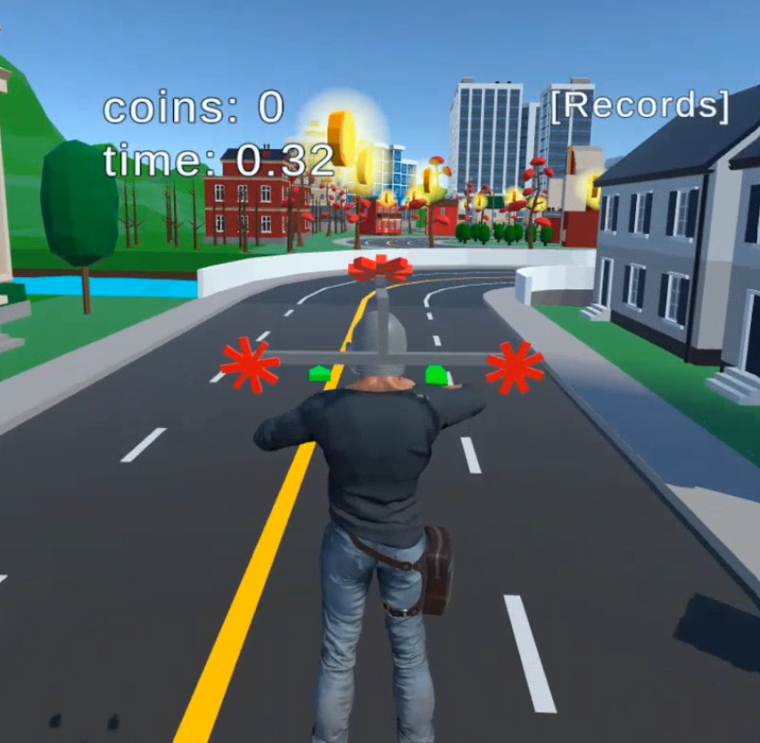
Cool features
3d model of the character
Inverse kinematic applied on hands
The head movement of the character will follow the HMD
The background music is the sound of fans.
With increasing volume when the user moves.
Switching between First Person mode and Third person mode with a press of a button

Slide 13
04
Evaluation

Slide 14
Metrics considered in the beginning
simulator sickness
speed
Accuracy
Notes:
In my first presentation of this locomotion technique, I said that this type of locomotion is more fit for the speed metric than the accuracy and the simulator sickness.
In the next slides, I ‘ll discuss the results of all locomotion techniques that we implemented in classe, in order to check whether my goals are achieved or not.

Slide 15
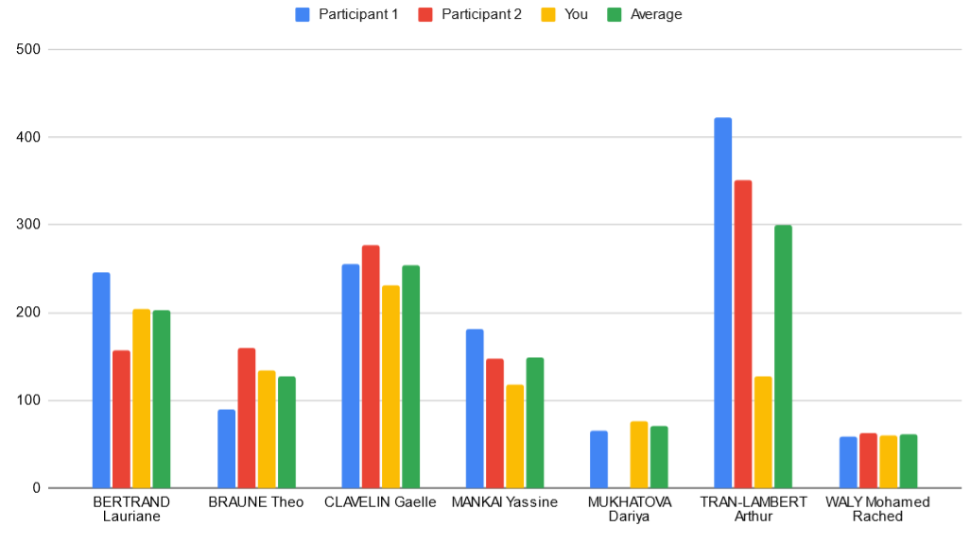
Speed evaluation
Notes:
So for the speed evaluation, I would say that the technique, comparing to other projects that we had here, has tendency to boost the speed metric

Slide 16
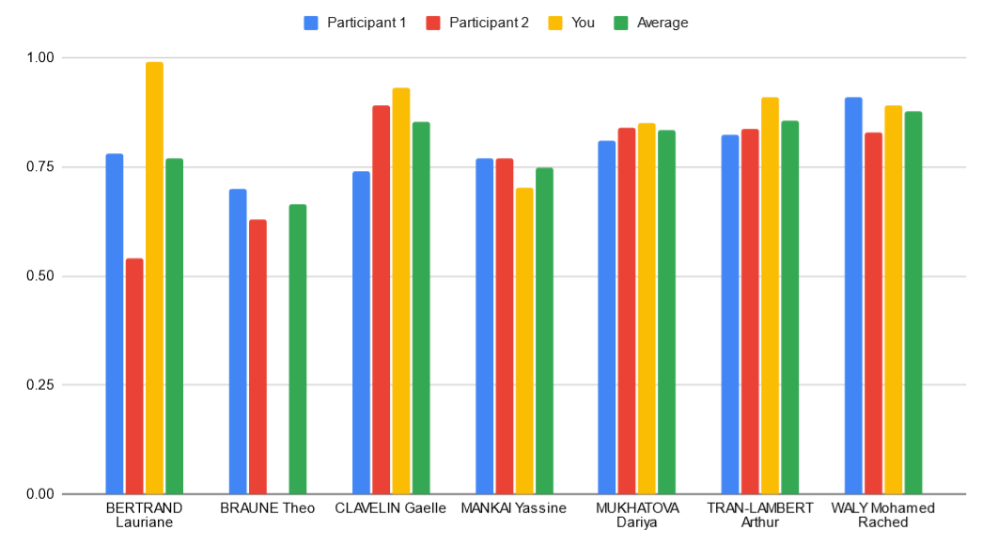
Accuracy evaluation
Notes:
For the accuracy part, I don’t think that this diagram reflects truly the accuracy of our locomotion techniques because there are not very big variations in the diagram even with different types of locomotions.
In spite of this idea, I found that my locomotion technique have a decent accuracy score.

Slide 17
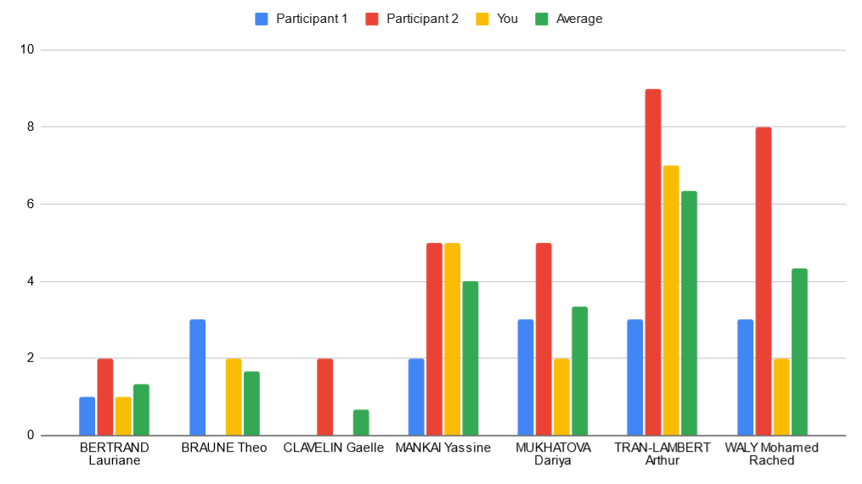
Motion sickness
Notes:
Unfortunately, my locomotion technique induced motion sickness in most of the players. Actually, some of my close friends couldn’t finish the track. The only one that felt less motion sickness is Arthur and that’s maybe because both of our locomotion technique belong to the same category.

Slide 18
Conclusion
Evaluate the accuracy using an another way
The use of the two controllers at the same time is not very intuitive
The size of the character’s hand is bigger than reality → might break presence.
Suggestion about how to evaluate the accuracy and the speed metrics
Notes:
I find that evaluating the speed and the accuracy metrics cannot be done separately. There is always a tradeoff between these two concepts.
Maybe design an experiment where there is a limited time to finish the parkour and each collectible will increase the remaining time?

Slide 19
THANKS FOR YOUR ATTENTION

