Slide 1
Module Dive
Three modules
Tennis Regression ANOVA
Baseball injuries and Time Series
Softball merging data

Slide 2
Tennis module
https://modules.scorenetwork.org/tennis/Teaching_ANOVA_Through_Aces/

Slide 3

Tennis module

Slide 4
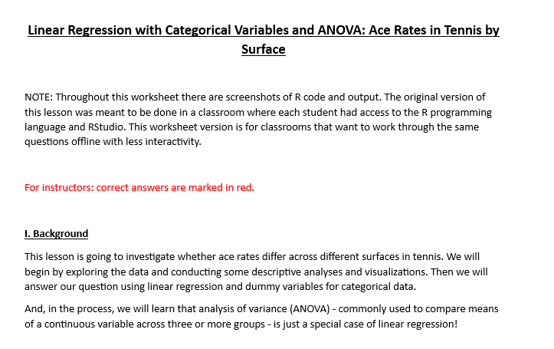
Tennis module

Slide 5
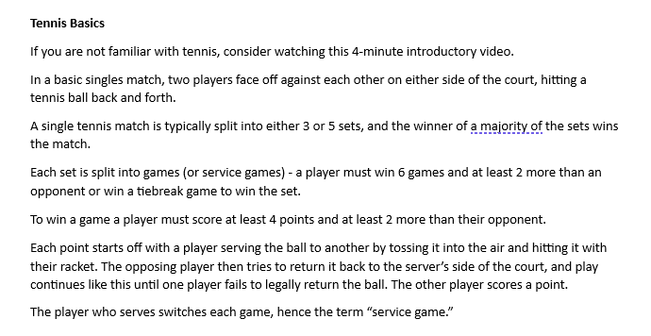
Tennis module

Slide 6
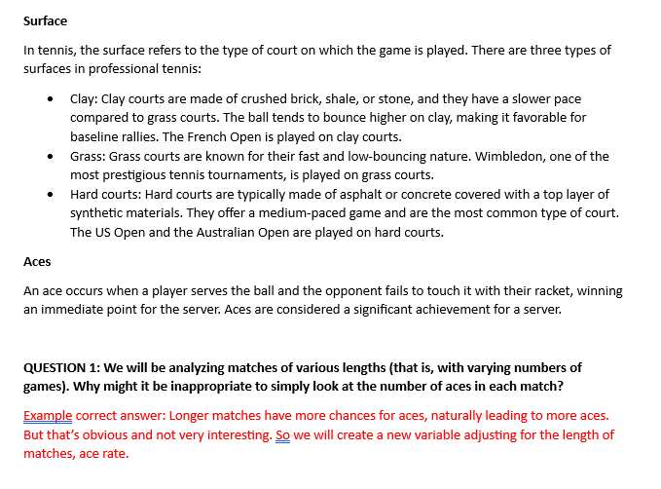
Tennis module

Slide 7
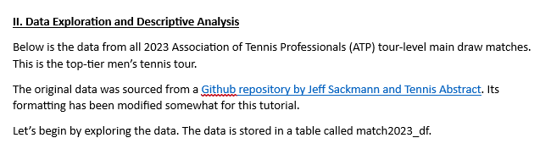
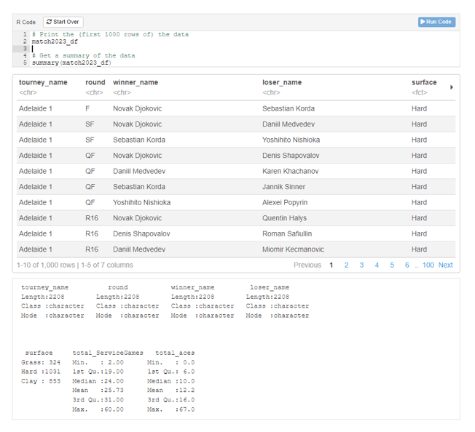
Tennis module

Slide 8
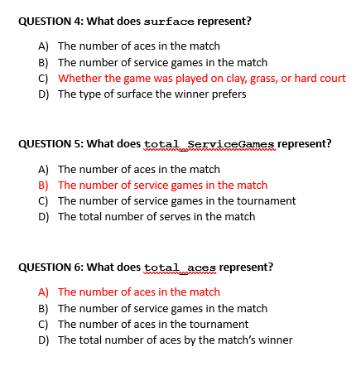
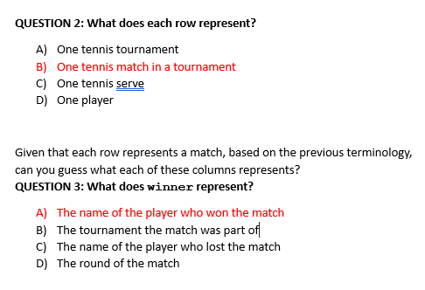
Tennis module

Slide 9
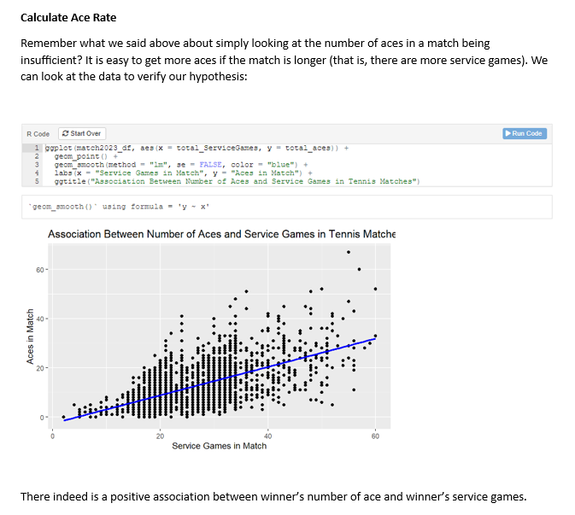
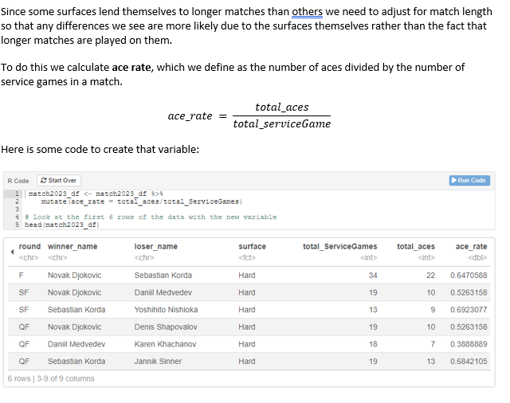
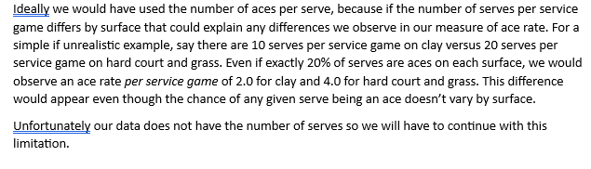
Tennis module

Slide 10
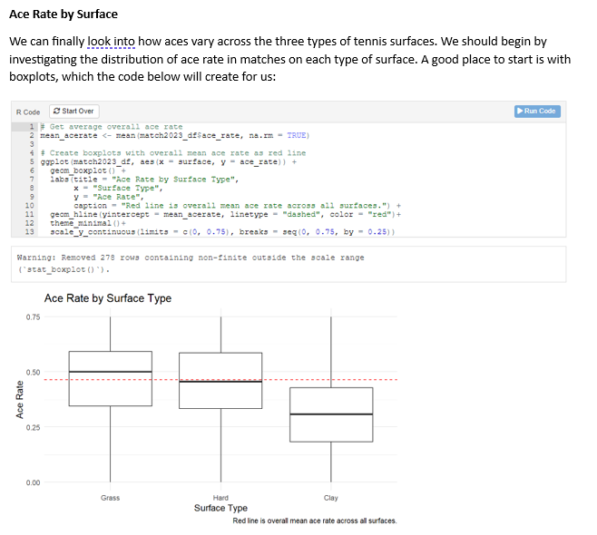
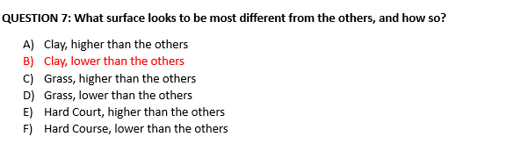
Tennis module

Slide 11
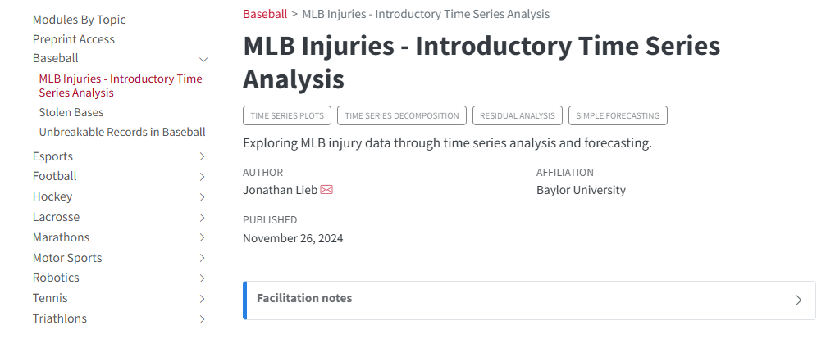
Baseball injuries and Time Series
https://modules.scorenetwork.org/baseball/mlb_injuries/

Slide 12
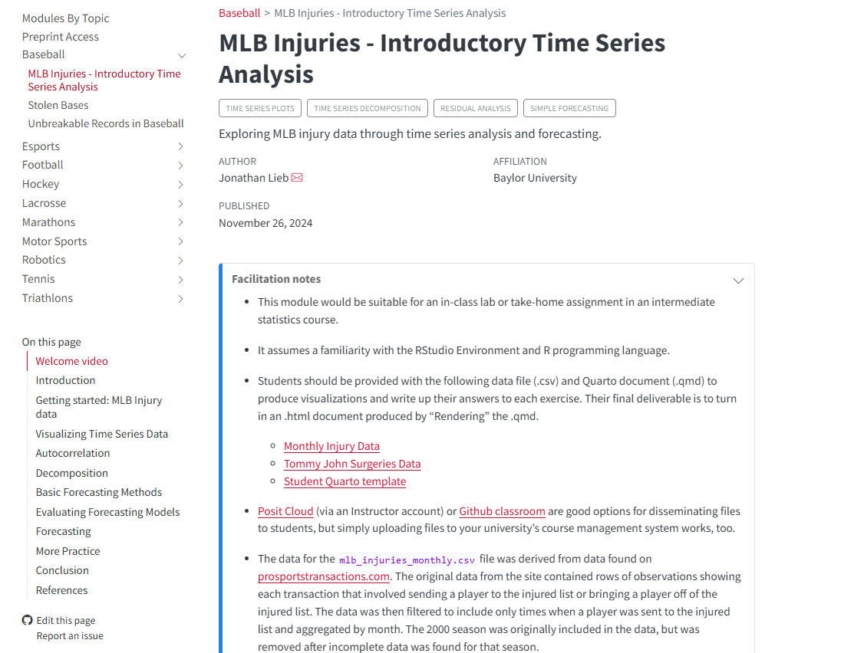
Baseball injuries and Time Series

Slide 13
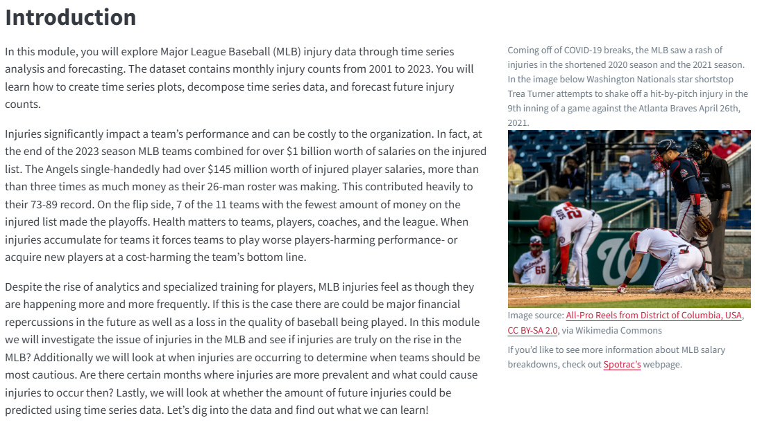
Baseball injuries and Time Series

Slide 14
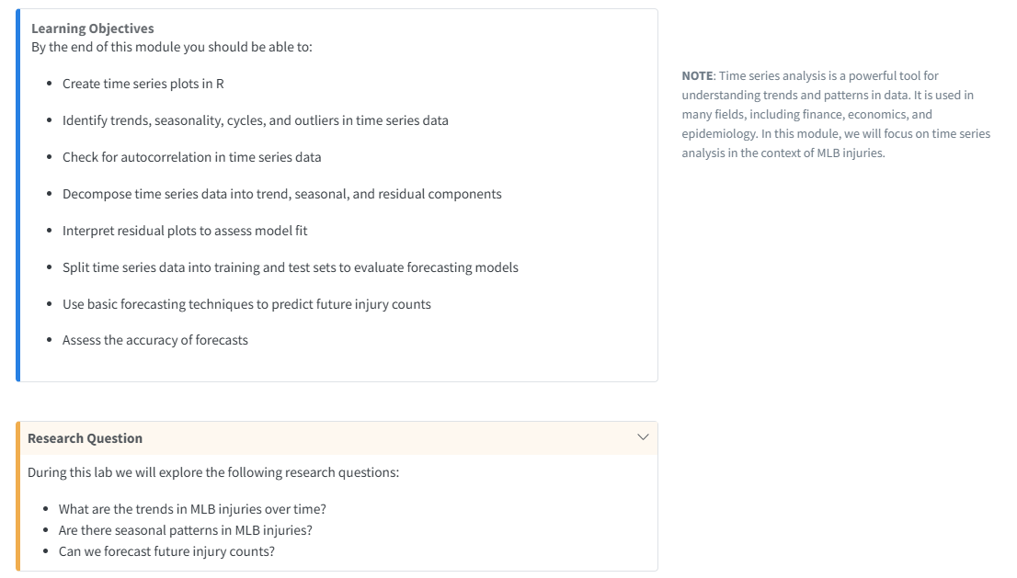
Baseball injuries and Time Series

Slide 15
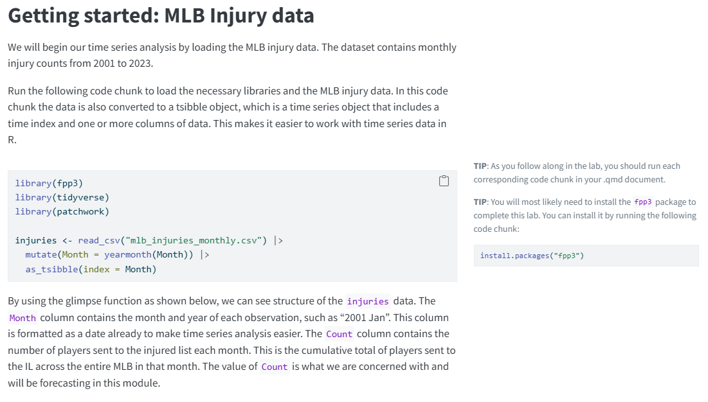
Baseball injuries and Time Series

Slide 16
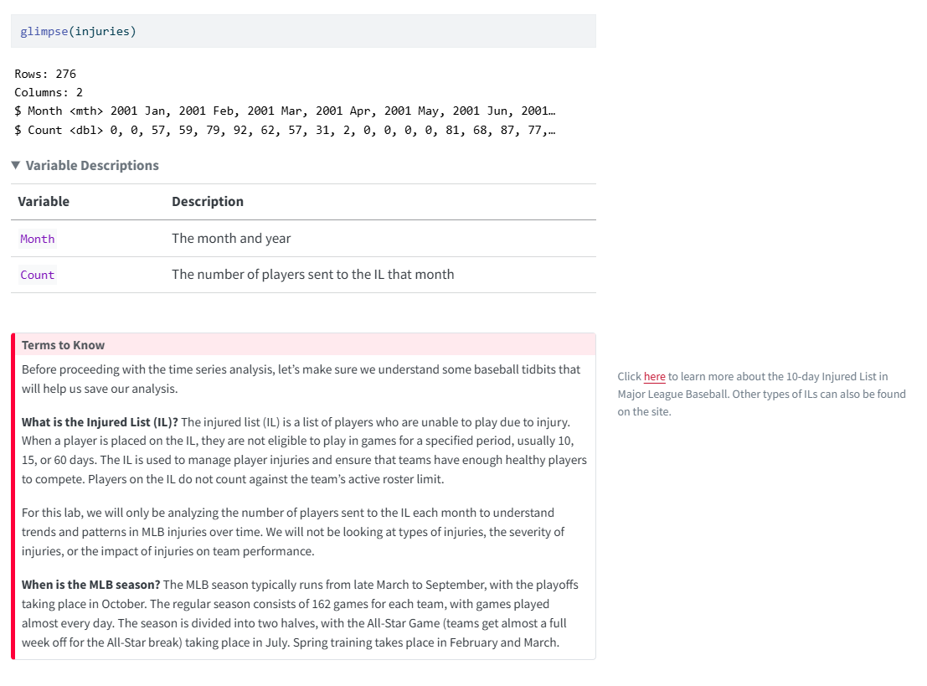
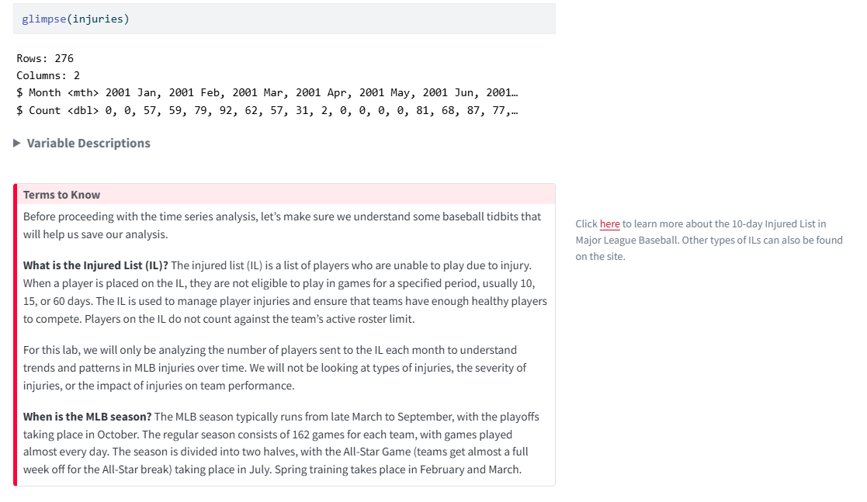
Baseball injuries and Time Series

Slide 17
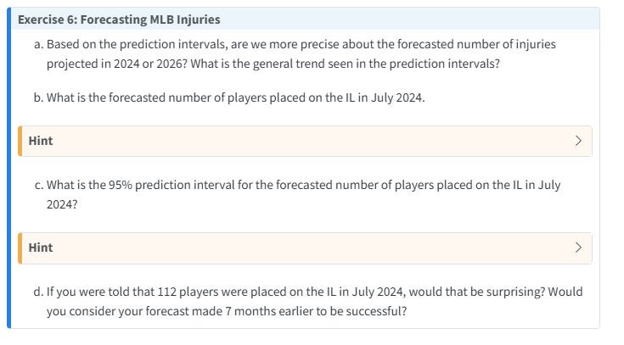
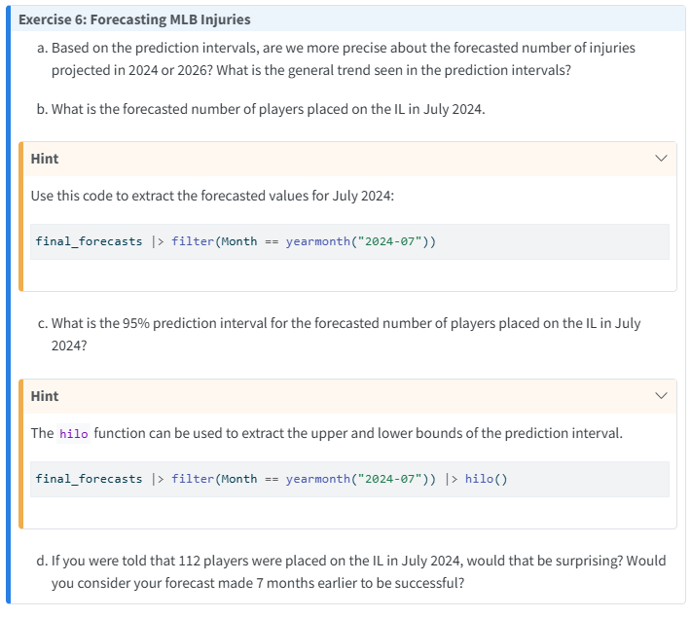
Baseball injuries and Time Series

Slide 18
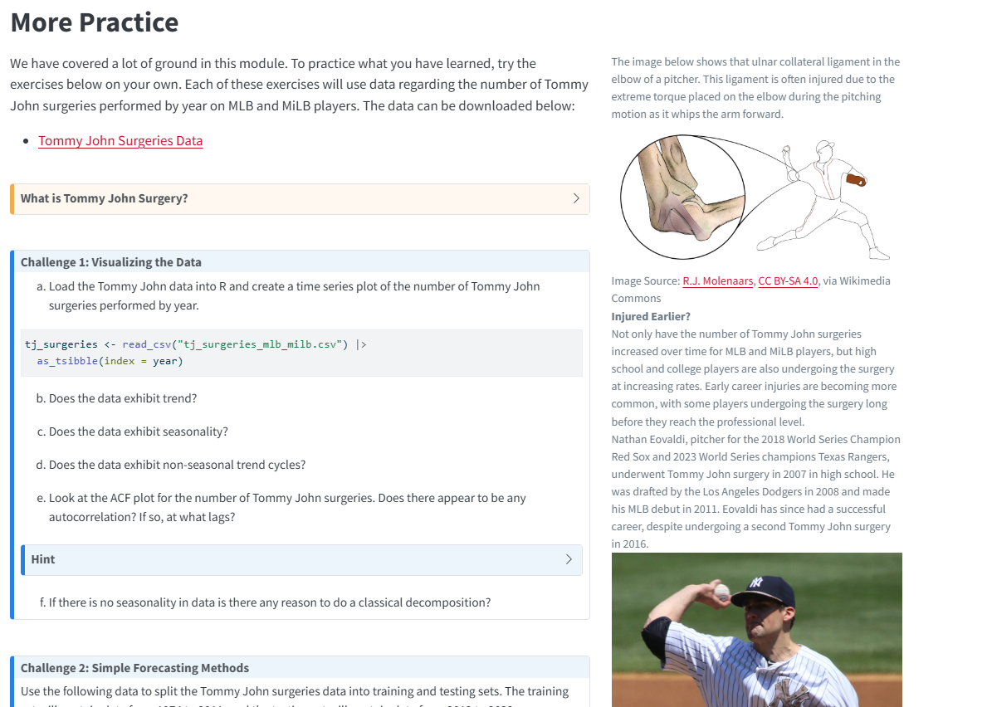
Baseball injuries and Time Series

Slide 19
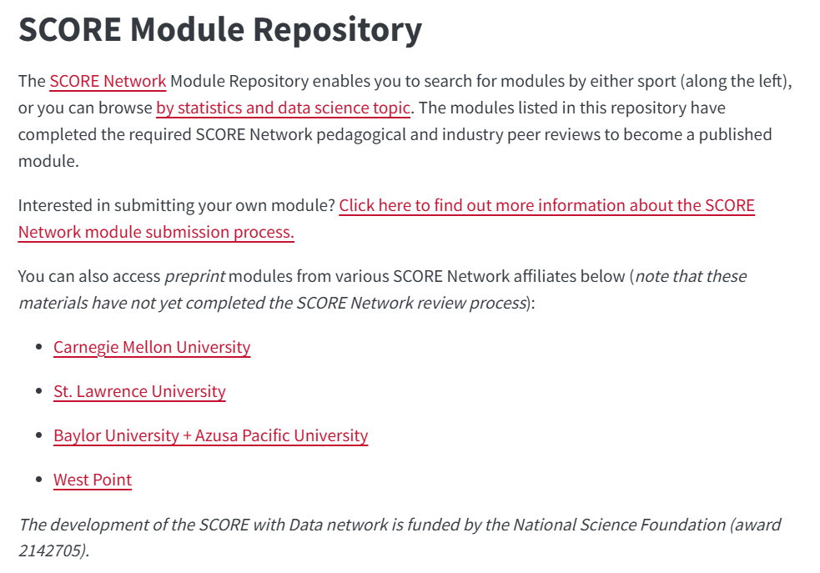
Softball merging data
https://iramler.github.io/slu_score_preprints/softball/softball_div1/

Slide 20
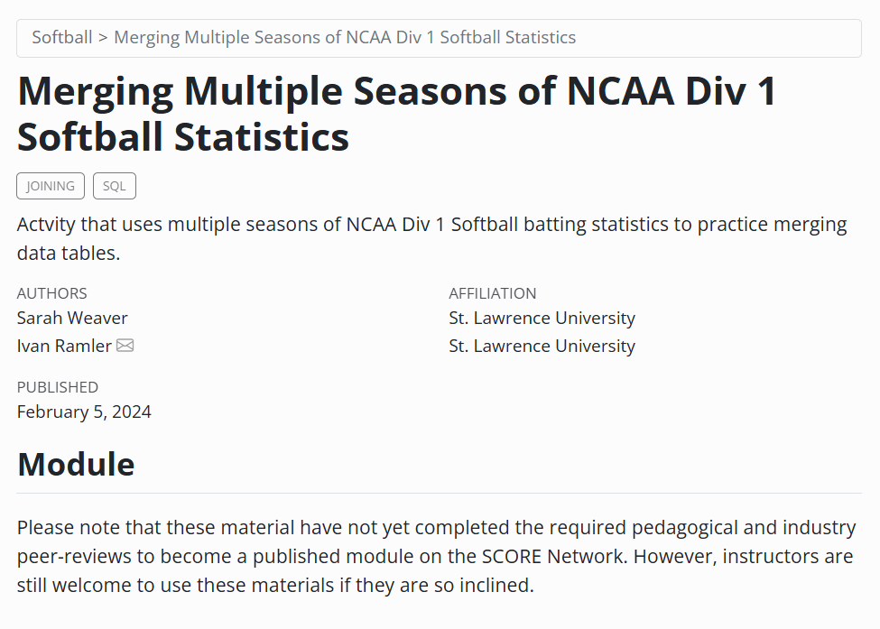

Slide 21
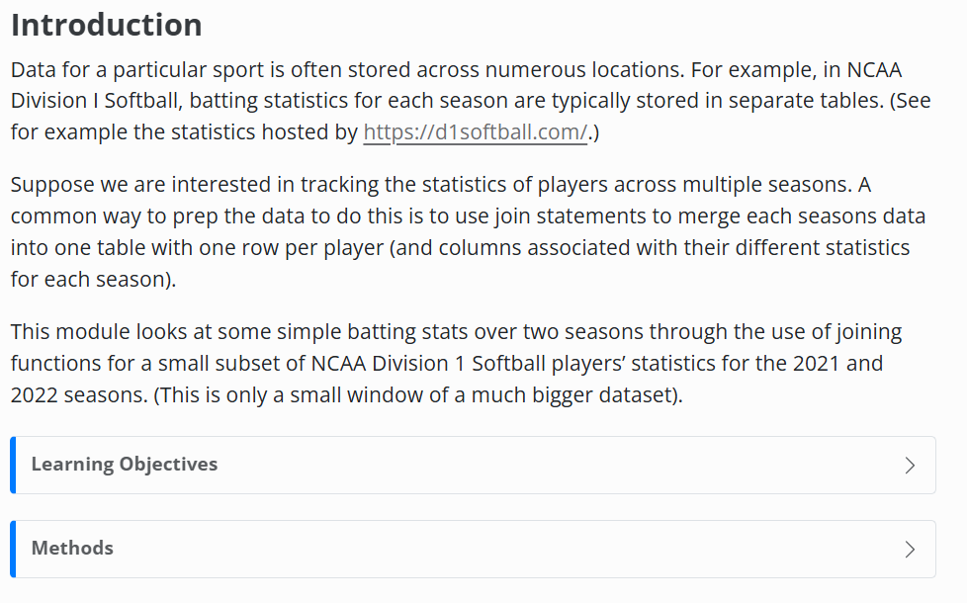
Softball merging data

Slide 22
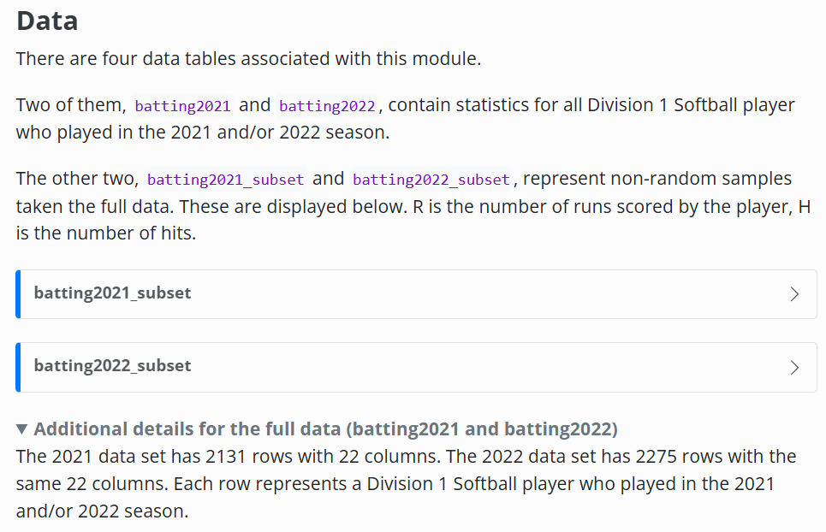
Softball merging data

Slide 23
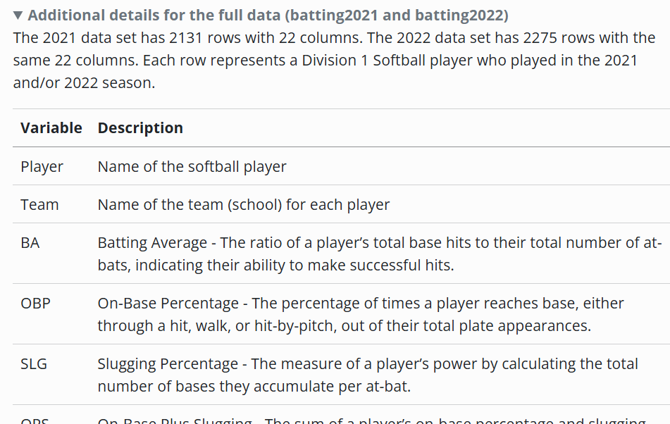
Softball merging data

Slide 24
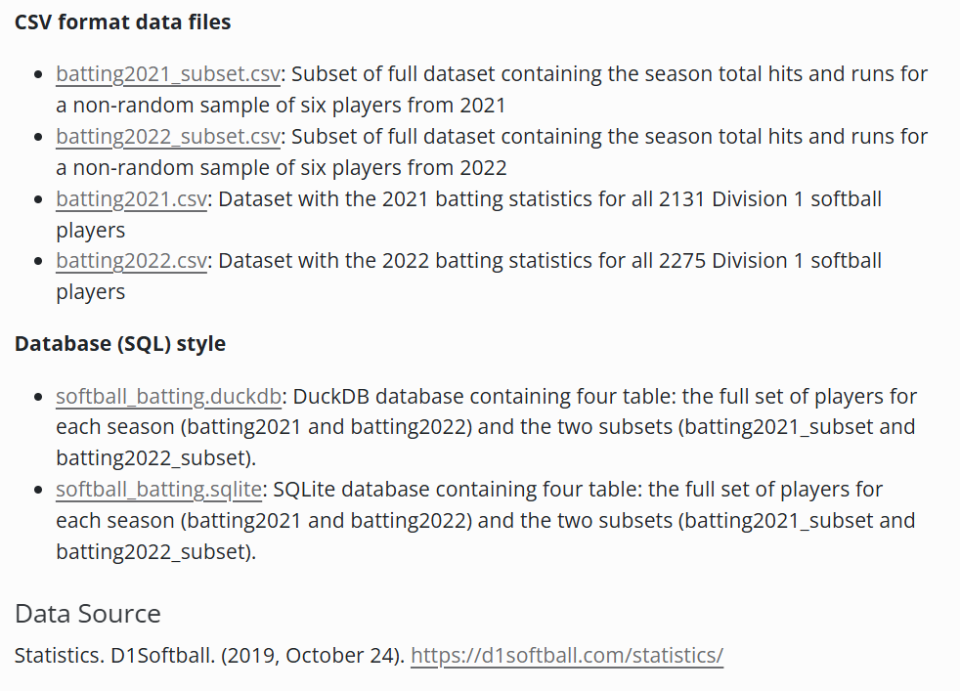
Softball merging data

Slide 25
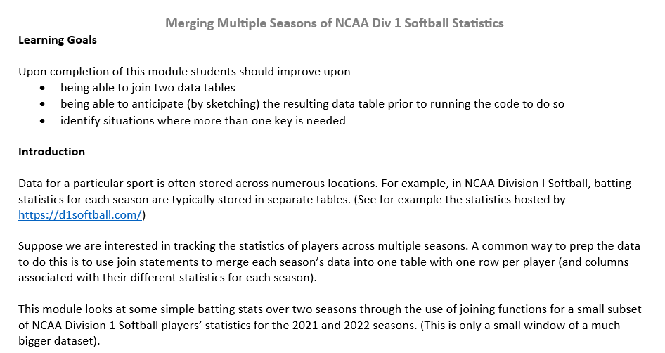
Softball merging data

Slide 26
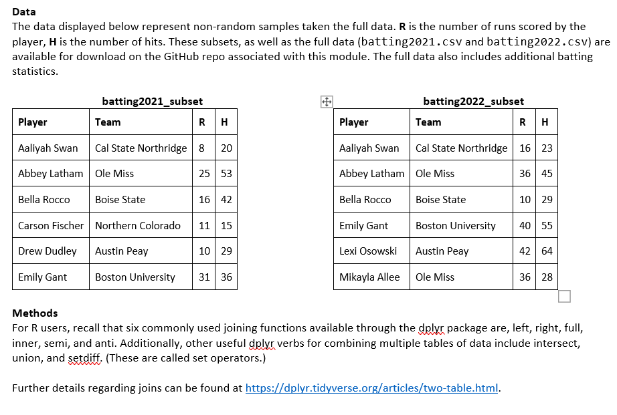
Softball merging data

Slide 27
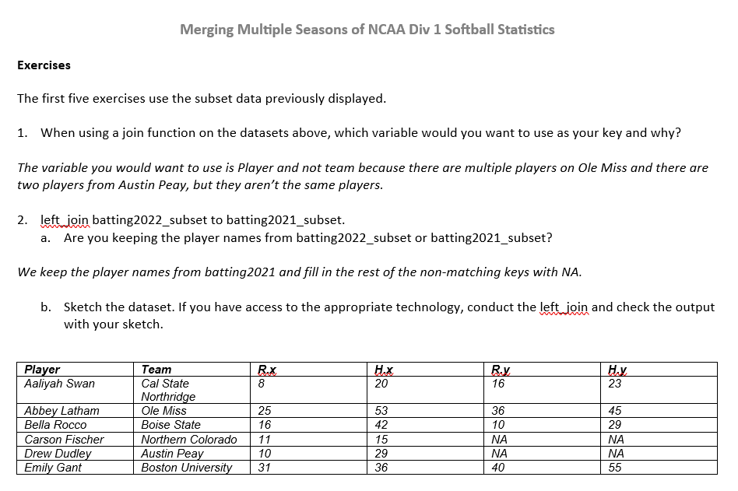
Softball merging data

Slide 28

Browse SCORE Network modules
Find two you might use in class and one useful dataset from the data repository
Dig into one of them and evaluate whether it is appropriate for your class
QR code for modules.scorenetwork.org

