Slide 1
SCORE Network Review Process
Michael Schuckers, Sam Nielsen,
Rebecca Nugent, Nick Clark

Slide 2
Module Submission & Review Process
Module Components and Choices
Submission Types
Idea vs Completed Module
Role of Associate Editors and Editors
Reviews and Review Types
Miscellaneous Comments and Support

Slide 3
Developing Modules
Goal: relevant, self-contained, plug and play
Introductory motivation videos/content from sports professionals (athletes, analysts, management)
Learning Objectives
Data sets
Lecture notes, handouts, activities, slides
Multiple formats, languages: interactive/no code (ISLE, Excel, Minitab), R, Python, etc
Modules can be downloaded or directly accessed through the SCORE website (e.g., can do data analysis online)
Support research on how people engage with and collaborate on data science
Use metrics available for educators/creators. Citations supported
Notes:
Move the developing content later

Slide 4
Module Choices
Sport(s)
Topic = Stat or Data Sci Content
Level (including Pre reqs)
Language
Learning Goals
Data and Data Glossary
Methods
Activities
Conclusions

Slide 5
Submission Types
Idea
Complete or Nearly Complete Module

Slide 6
Developing Content
Review process goal: use the diverse experiences and skills of the network to provide feedback from multiple perspectives to ensure
Industry relevance
Statistical and educational best practices
Standardization
Non-adversarial

Slide 7
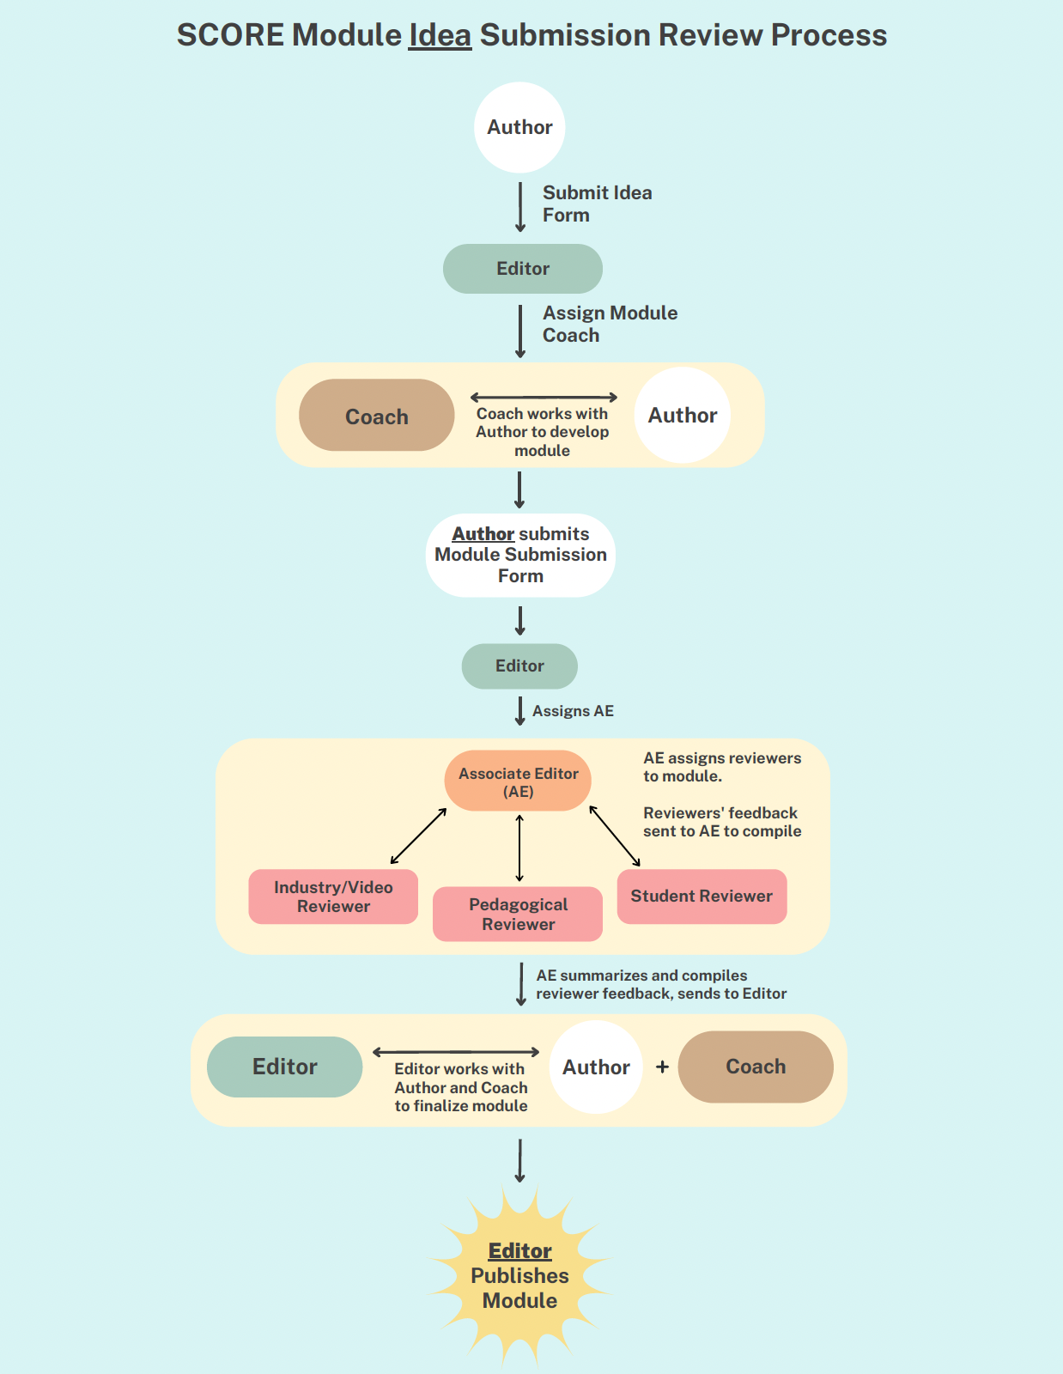
Developing Content
Can start with an idea, not a full module, and can be assigned a coach

Slide 8
Module Idea

Slide 9
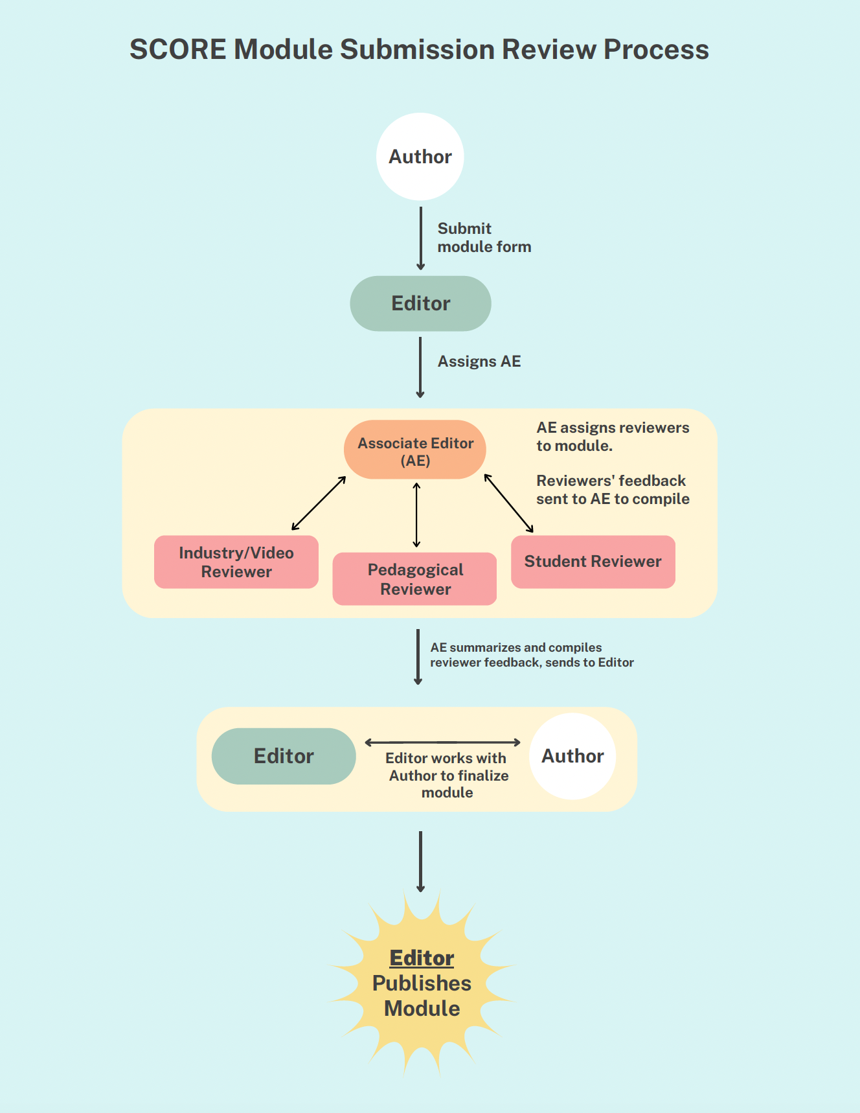
Completed Module

Slide 10
Reviewer Types
Pedagogical
Learning Objectives, Alignment with Content, Motivation, Best Practices, Data and Documentation, Terminology, Inclusivity
Industry
Connection and Application to Sports, Sports Question and/or Motivation, Video Review, Terminology/Clarity
Student (optional)
Knowledge needed, Clarity, Time Taken, Connection to Sports, Tone, Interest, Engagement

Slide 11
Associate Editor Role
Evaluate module submission for appropriateness
Find Reviewers
Pedagogical
Industry
Student (optional)
…
Make recommendation to Editor based upon Reviews

Slide 12
Editor Role
Evaluate submission initially for
Completeness
Appropriateness
Find an AE
…
Assess AE & Reviewer recommendations
Make Decision on Publication
Work with Authors to get to publishable
GOAL: Publish as much as we can

Slide 13
Published Modules
Video release form for any third parties (e.g. coach/player)
Data sets must be able to be posted publicly
Author must attest during the submission process
Author(s) will be given public attribution
Citations will be promoted and encouraged
Metrics will be available regarding use, downloads, etc
DOI for publications going forward

Slide 14
In groups of 2 or 3, talk about a possible module you might be able to create
What statistics/data science topic?
What sport will you use?
What is the approach of the module to introduce a new concept or to reinforce/practice material?
At what level (FY, Senior, etc) will you target the module?
What will be the learning goals?
(Optional) who would be good for making the introductory video?

Slide 15
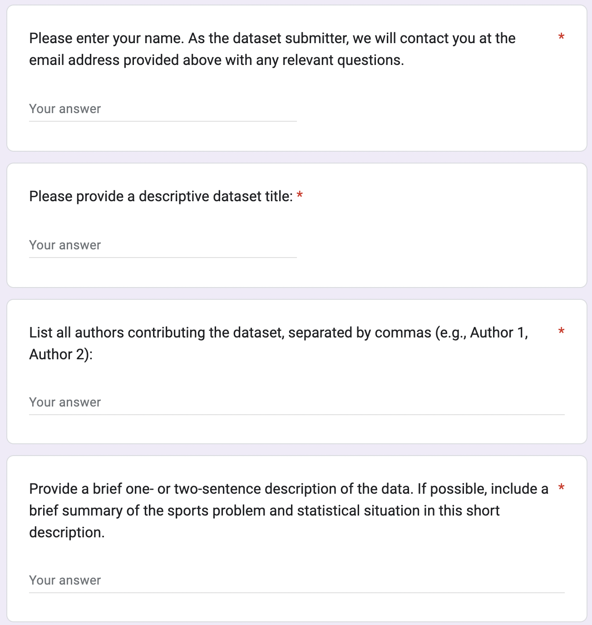
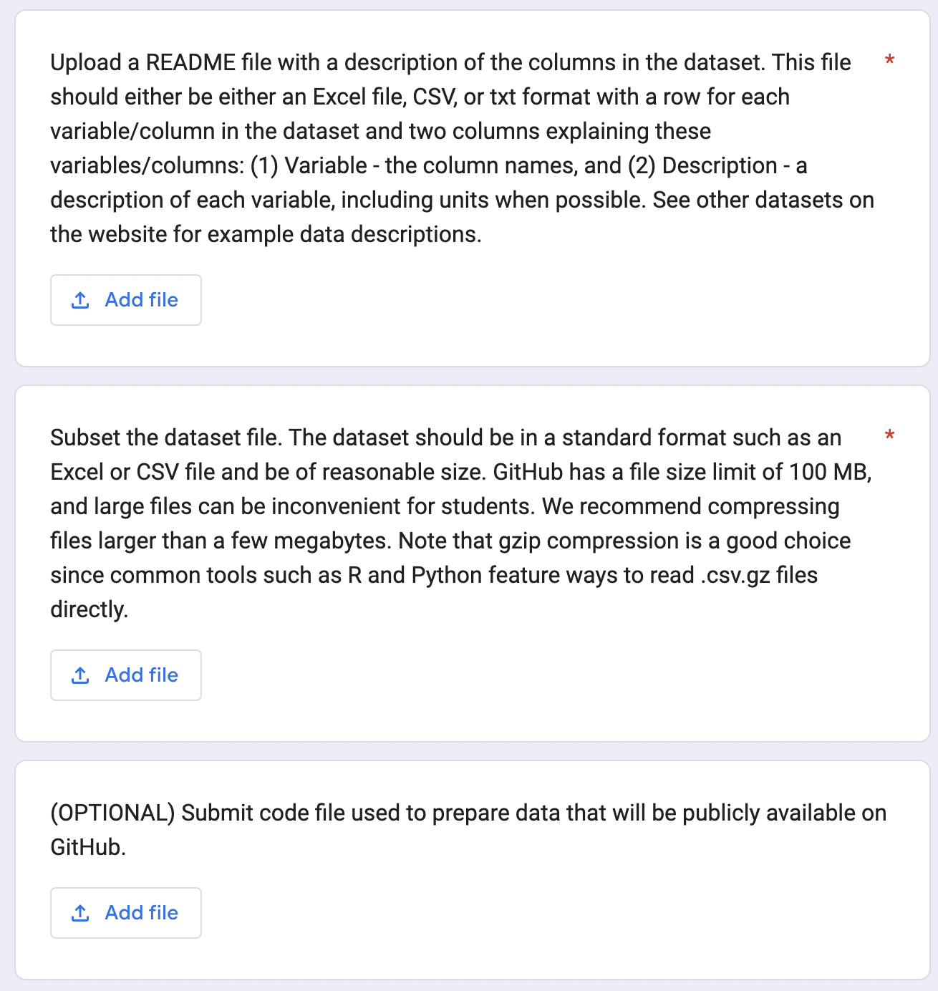
How to submit? (1) Google form

Slide 16
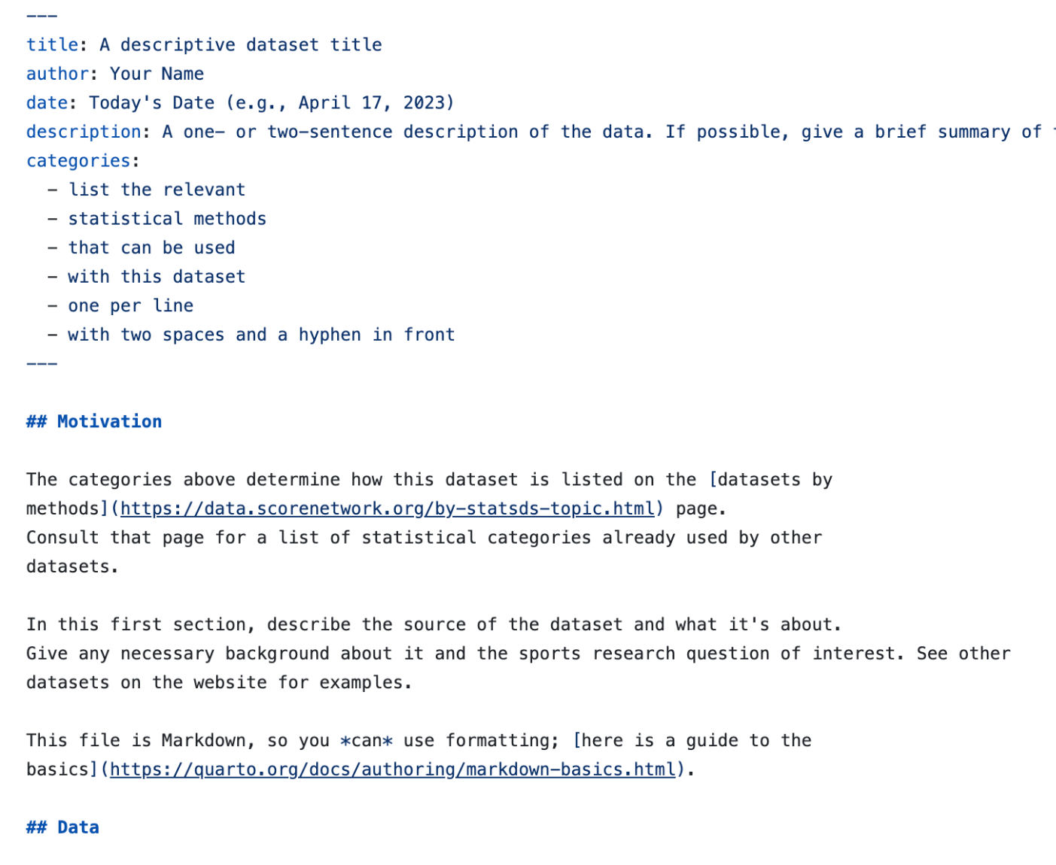
How to submit? (2) Quarto template
This data repository is built using quarto and rendered into a website. You can get the template file in two ways:
Copy the _dataset-template.qmd file from our GitHub repository and save it on your computer. Once you’re done, you can email us the file and the data.
Fork our GitHub repository into your own GitHub account and edit it like any other Git repository. Once you’re done, you can submit a pull request.

Slide 17

Thanks for your attention, any questions?
Building a sustainable national network for developing and disseminating Sports Content for Outreach, Research, Education in data science
Email scorenetworkorg@gmail.com to join d-list, get more info, etc
Workshops, trainings, network events for educators
Data sets and educational materials available
Connecting students with statistics & data science through sports and sports analytics
Researching how students engage with data science
https://scorenetwork.org/

Slide 18

SCORE Network
Please Join Us:

