Slide 1

Introduction to python
IS 201
Jin Chang

Slide 2
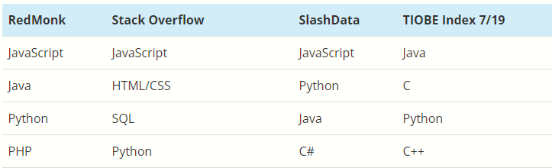
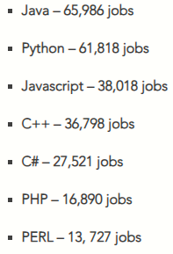
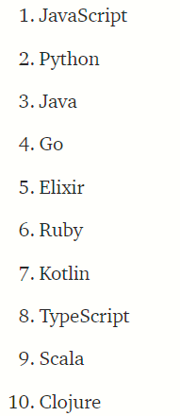
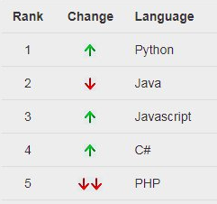
Is Python Popular?
Notes:
Job demand
Google search trend
Top programming language from 4 sites survey (based on the number of skilled engineers, courses, and third-party vendors identified worldwide via search-engine queries.)
RedMonk -> Github projects
4. Best languages to learn

Slide 3
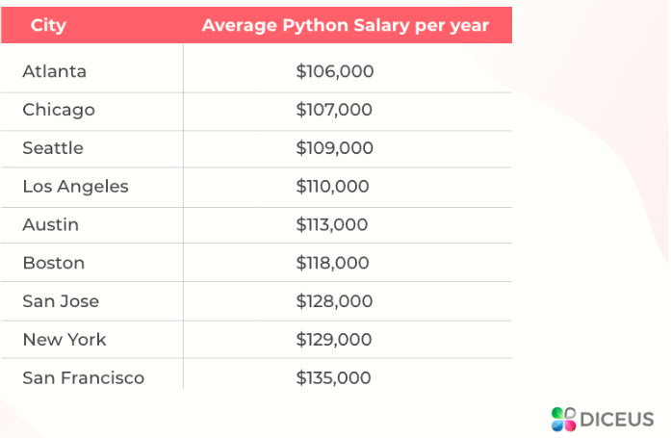
Average Python Salary per Year
Notes:
Job demand
Google search trend
Top programming language from 4 sites survey (based on the number of skilled engineers, courses, and third-party vendors identified worldwide via search-engine queries.)
RedMonk -> Github projects
4. Best languages to learn

Slide 4
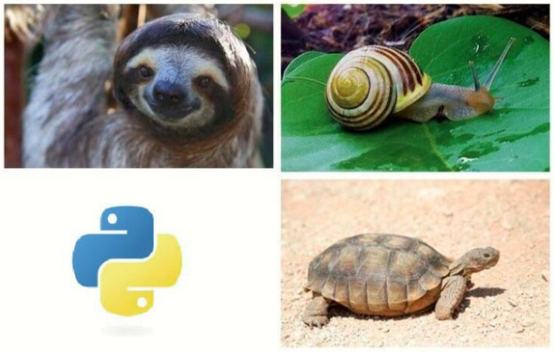
What is the common theme?
Notes:
https://medium.com/@trungluongquang/why-python-is-popular-despite-being-super-slow-83a8320412a9

Slide 5
Python is S L O W . . . .
Is not a compiler…
Is not a transpiler…
Is an interpreter
Is high-level programming language
Is dynamically typed
No multi-threading
Notes:
Job demand
Google search trend
Top programming language from 4 sites survey (based on the number of skilled engineers, courses, and third-party vendors identified worldwide via search-engine queries.)
RedMonk -> Github projects
4. Best languages to learn

Slide 6
Then why Python is so popular?
Python is a language for business applications
Proud of rapid development and faster innovation
Easy to learn, maintain (readability) thus more productive
Lots of free packages from the large community
May not be for real-time applications or gamming applications
Less platform dependent, easy for system integration
Fits well during the Agile Era
Notes:
# of lines 3-5 times fewer than Java
Its advantages outweigh its disadvantages

Slide 7
What types of application?
Big data
AI
Web FE and BE -> Fullstack
Notes:
# of lines 3-5 times fewer than Java
Its advantages outweigh its disadvantages

Slide 8
Python Basics
Interactive shell (Scripting) >>>
File organization (Running) % python your_file.py
Notes:
Different purposes
Quick check of statements or assignment or type conversion etc…in the testing env.
File Organization is the development env.

Slide 9
Data Types
Numbers
Integer
Floating-point numbers
Letter
String (enclosed by single or double or triple quotes): ‘string’, ‘ ‘c’ ’, ‘ ‘ ‘ This is a test’ ’ ’ …
Triple quote is useful when multi-line string
no Character but String Length of 1
combining string with integer or float numbers

Slide 10
Keywords
True, False, None,
and, assert, break, def, continue, class, if, else, elif, del, not, try, except, raise, import, lambda, return, in, global, non-local, …

Slide 11
Variables
Legality of variable names
One word (no spaces), temp var = 10 (x)
Alphanumeric and the underscore ( _ ), str_1 = “test” (o)
Cannot start with a number, 3temp = 10 (x)
The variable names are case-sensitive.
Self-explanatory
No magic numbers

Slide 12
Variables
A typed container to store a value
Legality of variable names
One word (no spaces), temp var = 10 (x)
Alphanumeric and the underscore ( _ ), str_1 = “test” (o)
Cannot start with a number, 3temp = 10 (x)
The variable names are case-sensitive.
Self-explanatory
No magic numbers

Slide 13
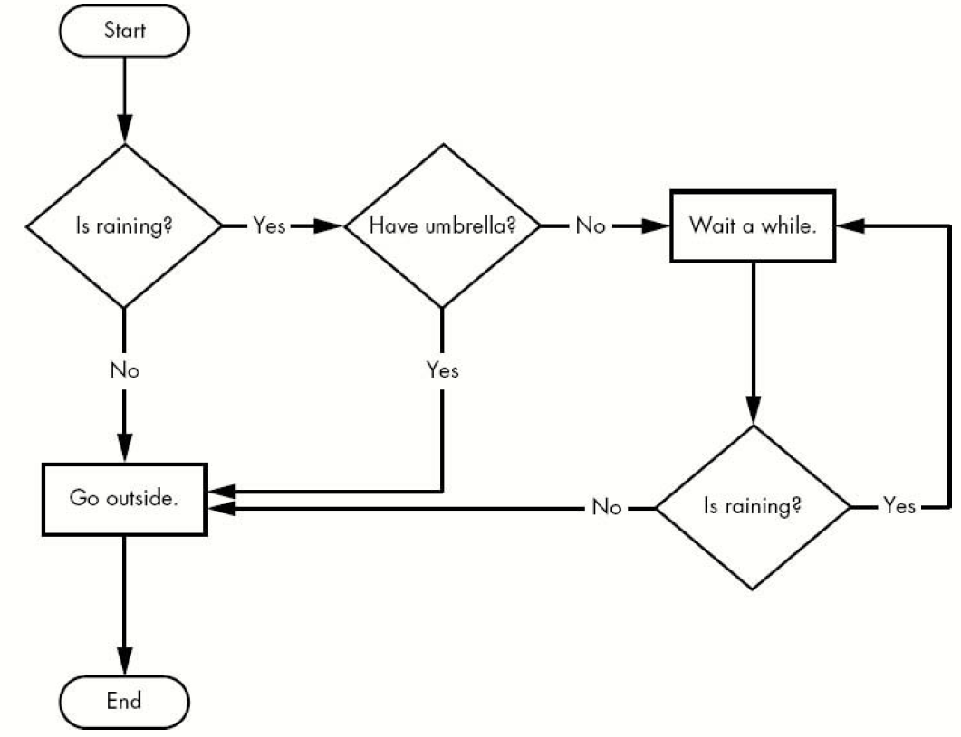
Flow Control
In order to manipulate data, a set of rules by design is required.
Condition check and iteration are often used to create a “flow of logic”
Notes:
Module1.py

Slide 14
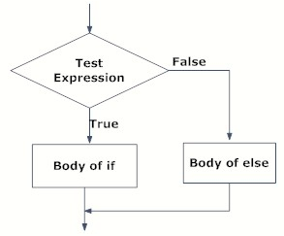
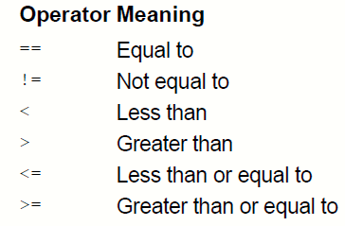
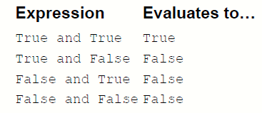
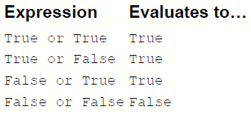

if …
if test_exp:
statements
Notes:
Module2.py
Indentation for if-block
https://www.programiz.com/python-programming/

Slide 15
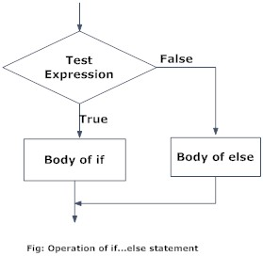
if … else
if test_exp:
body of if
else:
body of else
Notes:
https://www.programiz.com/python-programming/

Slide 16
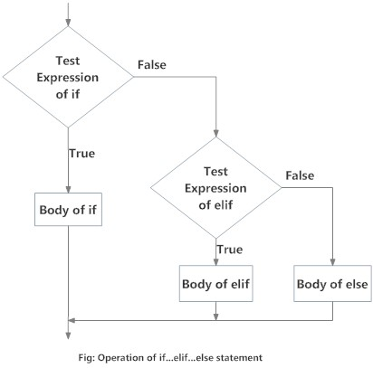
if … elif… else
if test_exp1:
body of if
elif test_exp2:
body of elif
else:
body of else
Notes:
https://www.programiz.com/python-programming/

Slide 17
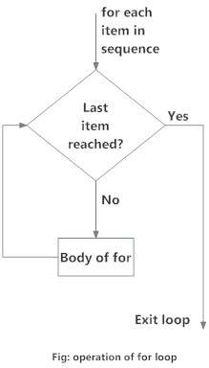
for loop
When iterative operations required, a sequence of repeated statements can be written in a loop, traversing a list or tuple, exhausting all the entries.
# init.
for val in sequence:
body of for
range() function is useful to traverse the
list of values
range(start,stop,step_size)

Slide 18
for … else loop
# init.
for val in sequence:
body of for
else: # note that this is outside for loop
# clean up after the loop exits

Slide 19
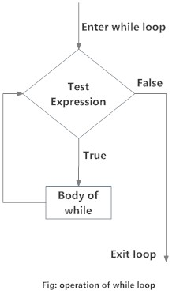
while loop
When iterating, certain condition needs to be check to access or calculate certain values, looping when certain conditions met, displaying a menu continuously until valid input is entered.
Loops only testing condition is True.
while test_expression:
body of while

Slide 20
while … else loop
# init.
while test_expression:
body of while
else: # note that this is outside while loop
# clean up after the loop exits

Slide 21
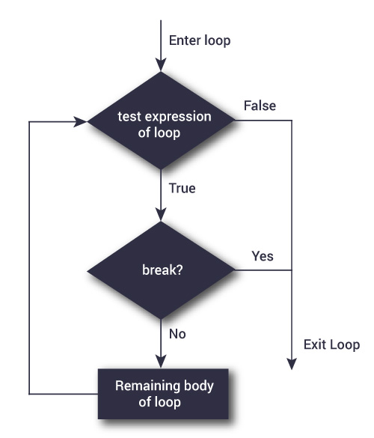
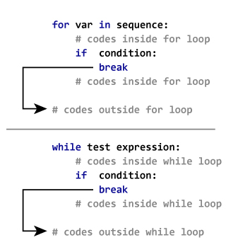
Other loop techniques
break is used when the loop needs to halt immediately since all the conditions are met.
Notes:
https://www.programiz.com/python-programming/break-continue
2 list with different sizes (len), once I get the last item of either of lists, I can break out of the loop.
Or
You have an infinite loop, and when you are done with all operations, you can quit out of the loop.

Slide 22
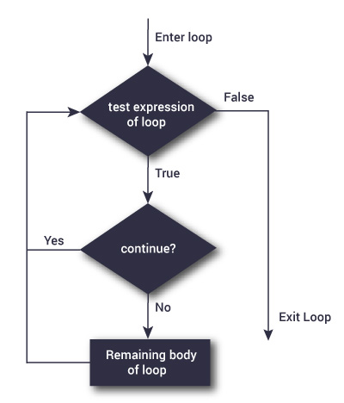
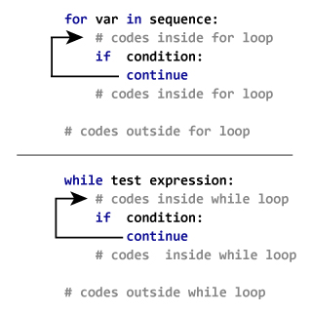
Other loop techniques
continue is used when the loop needs to start the next iteration ignoring the rest of loop statements.
Notes:
Two lists, I would like to add only if they are positive numbers then you can use continue if negative

