Slide 1

Dynamic DJ
Hessen Alahmed
Guadalupe Avalos
Gavin Frausto
Flor Gordivas
Rachel Lewis

Slide 2

“Music is your own experience, your thoughts, your wisdom. If you don't live it, it won't come out of your horn.” ~Charlie Parker
Experience the music!

Slide 3

Goals
Build a device that will detect the motions of a user
Write code to interpret the motions to change music settings
Feel free to dance and move however you like without being interrupted
Be your own DJ!

Slide 4

Why You Should Dance
Beyond the obvious physical benefits from cardio exercise…
Boosts happiness
Reduces stress
Prevents Alzheimer’s disease and dementia
Increases cognitive acuity through memorization and repetition

Slide 5

Implementation
Using two accelerometers, we mount one to each hand to detect hand motion
An MP3 shield will be attached to the Arduino Uno to play music
The Arduino, MP3 shield, speakers, and the rest of the equipment is currently strapped on to the user for mobility

Slide 6
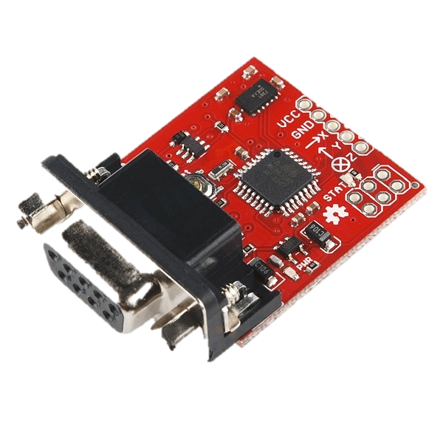
Accelerometer
Device that measures acceleration, specifically proper acceleration or “g-force”
Accelerometers in free fall measure zero

Slide 7

Dance Movement
Problem: We originally intended to change songs according to dance movements which is much more complicated than we anticipated
Proposed Solutions: A combination of rate gyros and accelerometers detects movement more accurately
Our Change: We decided to stick solely to accelerometers for the purpose of this project due to time and money constraints

Slide 8

Our Adjustment
Each accelerometer detects 5 orientations. When we use two in combination with each other we have a maximum of 25 states. We use the flat(parallel to ground) mode as the default setting
Now we are left with 4 options per hand since we will not use the flat setting for anything else, yielding 16 total commands

Slide 9
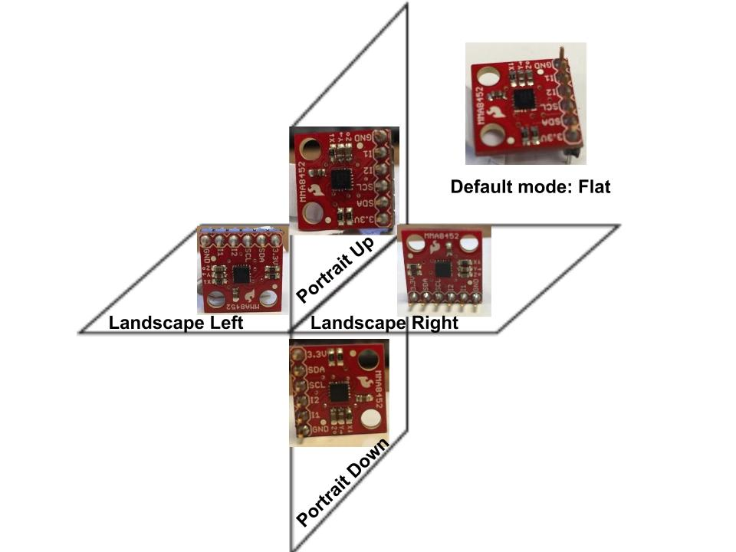

Slide 10

Sorting the Music
All MP3 files have metadata tags known as ID3
Metadata was originally in the card catalogs of libraries
ID3 tags allow for information such as title, artist, album, track number etc. to be stored in the file
There are 2 versions of ID3: ID3v1 and ID3v2

Slide 11

ID3v1 vs ID3v2
ID3v1
ID3v2
Created by Eric Kemp in 1996
128 bytes beginning with the string TAG
Tag is placed at the end of the file to maintain compatibility
30 bytes allocated for each title, artist, album, and comment; 4 bytes for the year; 1 byte for genre
Created in 1998 with multiple contributors
Variable size
Occur at the beginning of a file
Consists of frames, each contain a piece of metadata
Can define a new type of frame

Slide 12
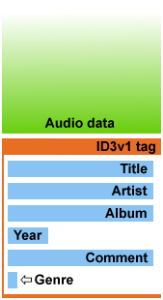
Coding with Metadata
Problem: Our given library was for ID3v1 metadata tags while our music has ID3v2 tags
Proposed Solution: Use software that converts ID3v2 into ID3v1 tags so that we can sort through any given music library and separate it into categories according to our settings

Slide 13
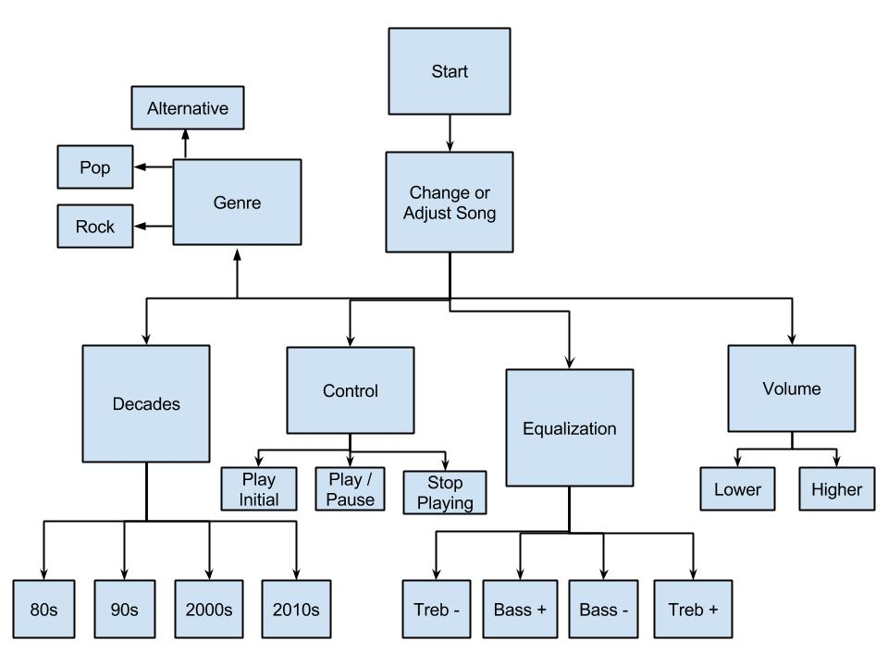

Slide 14
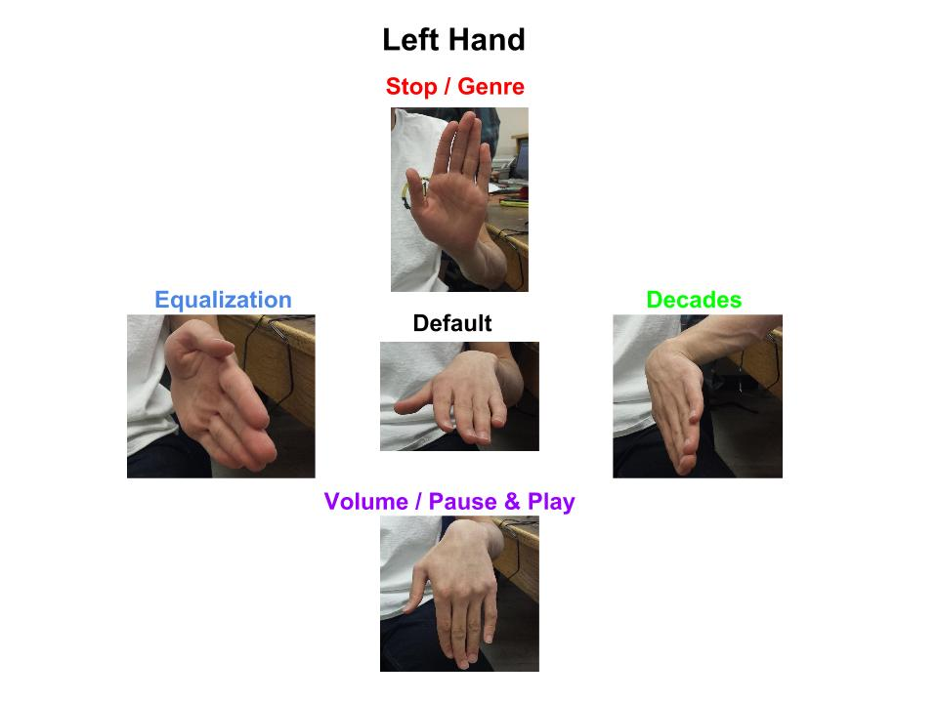
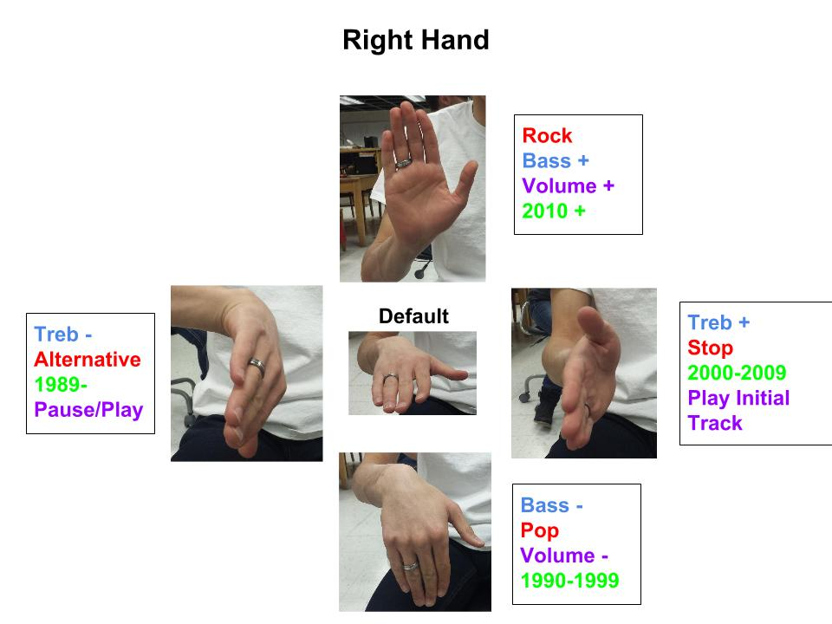
Hand Demonstration

Slide 15

Functional Decomposition
Microcontroller:
Arduino Uno -Red board
Communication:
SPI
I2C
Power:
Battery (9V)
Components:
2 triple axis accelerometers
MP3 shield
battery powered speakers

Slide 16
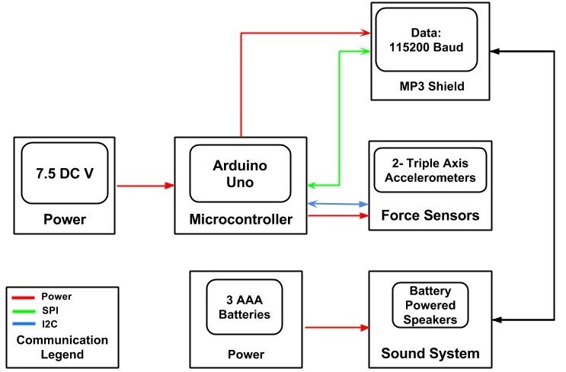
Communication Diagram

Slide 17

SPI Communication
Serial peripheral interface aka SPI bus is a type of communication that operates in full duplex mode
Master/slave communication
Master initiates data frame
Individual slave select lines

Slide 18


$I^{2}$C Communication
Inter-Integrated Circuit
Multi-master, multi-slave serial computer bus
Used to attach low-speed peripherals to computer motherboards and embedded systems

Slide 19

Results/Conclusion
We are able to change music based on specific settings
Coding the Metadata was surprisingly more difficult than coding the accelerometers
It is currently not as stylish as we had imagined but we can always put the user in an Iron Man suit

Slide 20

Future Ideas
We can use wire thread for increased flexibility
We can incorporate rate gyros to detect a wider range of movement allowing us to implement more settings to adjust the music
We’d like to be able to detect a wide range of movements and play songs accordingly

