Slide 1
AI DATA ANALYST INTERNSHIP
Credit Card
Customer Segmentation
Using K-Means Clustering & Machine Learning Analytics
Presented by: Alva Rachel Wilfred
USN: 4SO22AI009
College: St Joseph Engineering College
Organization: Rooman Technologies Pvt. Ltd.

Slide 2
Problem Statement & Objectives
❗ PROBLEM STATEMENT
🎯 PROJECT OBJECTIVES
Financial institutions lack a structured way to identify different customer behaviors based on credit card usage.
01
Analyze customer financial behavior patterns
02
Apply K-Means clustering to identify segments
One-size-fits-all approach leads to poor customer engagement
03
Generate business insights for marketing & risk
Ineffective marketing strategies reduce revenue potential
Higher credit risk with no early identification of risky customers
04
Build interactive Streamlit dashboard
Difficulty identifying high-value customers for retention
05
Enable data-driven decision making
8,950
18
K=3
0.2510
Customer Records
Behavioral Features
Optimal Clusters
Silhouette Score

Slide 3
Dataset Overview & Technologies Used
DATASET
TECH STACK
8,950
18
Python • Pandas • NumPy
Customer records
Financial features
BALANCE
PURCHASES
Scikit-learn • K-Means • PCA
Outstanding amount
Total spending
CASH_ADVANCE
CREDIT_LIMIT
Matplotlib • Seaborn
Cash withdrawals
Approved limit
PAYMENTS
MIN_PAYMENTS
Streamlit Dashboard
Amount paid
Minimum paid
Statistical Validation (ANOVA)

Slide 4
Project Workflow
01
Data Collection
02
Preprocessing
03
EDA
8,950 credit card holder records
Missing values, normalization, cleaning
Exploratory data analysis & correlation
04
Feature Engineering
05
K-Means Clustering
06
Validation
Utilization, payment, spending ratios
Elbow method, K=3, segmentation
Silhouette: 0.2510 | ANOVA p < 0.001
07
Visualization
08
Dashboard
09
Business Insights
PCA plot, heatmap, scatter charts
Interactive Streamlit analytics app
Targeted strategies per segment

Slide 5
Machine Learning Model — K-Means Clustering
🤖 K-MEANS CLUSTERING
📈 MODEL SELECTION — ELBOW METHOD
K-Means is an unsupervised clustering algorithm that groups data points into K clusters based on feature similarity by minimizing within-cluster variance.
+
Simple, interpretable, and efficient for large datasets
+
Works well with multi-feature customer behavioral data
K = 3
Optimal
+
Identifies hidden behavioral patterns without labels
+
Validated by Silhouette Score (0.2510) & ANOVA (p<0.001)
0.2510
p<0.001
K = 3
⚙️ FEATURE ENGINEERING
Silhouette Score
ANOVA F-Stat
Clusters
Credit Utilization Ratio
Payment Ratio
Spending Ratio
Cluster cohesion
All features distinct
Optimal by Elbow
Balance / Credit Limit
Payments / Purchases
Purchases / Credit Limit

Slide 6
Customer Segments Identified
*
Premium Spenders
~
Low Engagement
!
Cash Dependent
Cluster 0
LOW RISK
Cluster 1
MEDIUM RISK
Cluster 2
HIGH RISK
1,275
Customers (14.2%)
6,114
Customers (68.3%)
1,561
Customers (17.4%)
$4,187
Avg Purchases
$496
Avg Purchases
$3,917
Avg Cash Advance
$7,643
Avg Credit Limit
$3,267
Avg Credit Limit
$6,729
Avg Credit Limit
30%
Full Payment Rate
15%
Full Payment Rate
3%
Full Payment Rate
KEY TRAITS
KEY TRAITS
KEY TRAITS
Highest spending & credit limit
Majority segment — massive upside
Heavy cash advance reliance
Consistent payment behavior
Minimal card usage & activity
Near-zero purchase activity
Premium rewards engagement
Highest revenue opportunity
Default prevention priority
14.2% Premium Spenders
68.3% Low Engagement
17.4% Cash Dependent

Slide 7
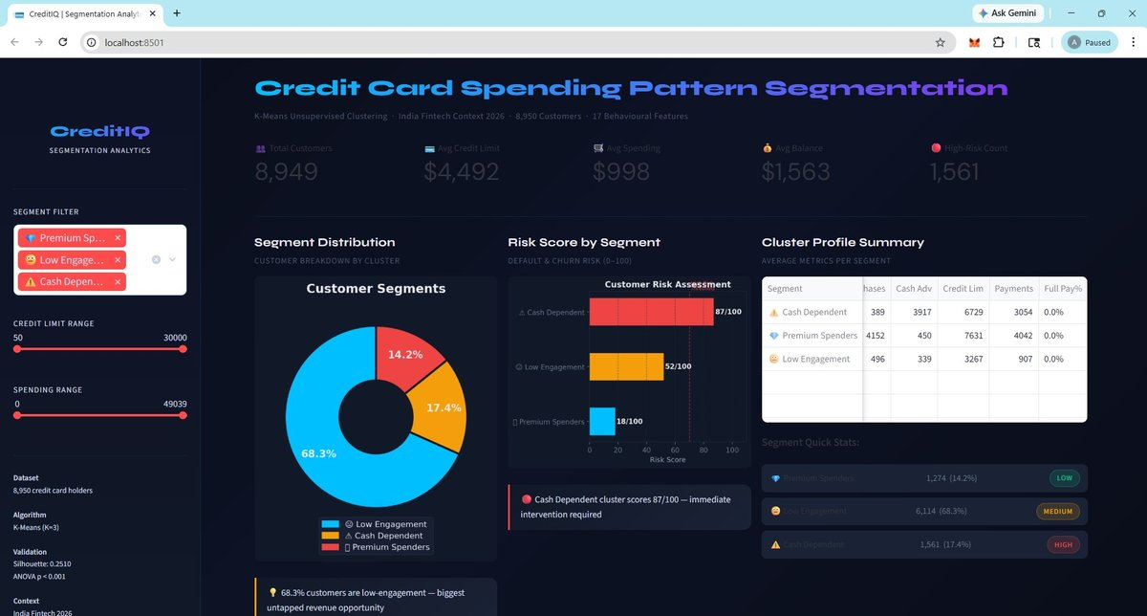
Interactive Dashboard — CreditIQ Analytics
DASHBOARD HIGHLIGHTS
KPI Cards
Live metrics: Customers, Avg Credit, Spending, Risk Count
Segment Distribution
Donut chart with cluster breakdown
Risk Score Panel
0-100 default & churn risk by segment
Cluster Profile Table
Purchases, Cash Advance, Credit Limit per segment
Interactive Filters
Segment, credit range & spending sliders
Smart Insights
Auto-generated actionable business recommendations

Slide 8
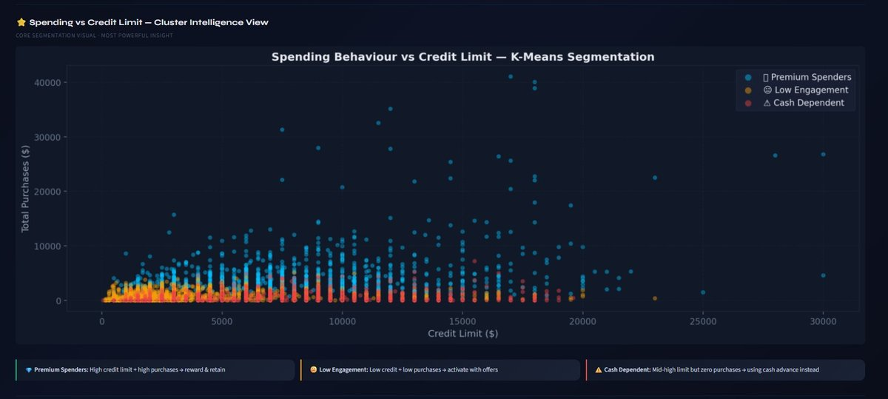
Cluster Intelligence — Spending Behaviour vs Credit Limit
CHART INSIGHTS
💎 Premium Spenders
High credit limit + high purchases. Top tier — reward and retain.
😐 Low Engagement
Low credit + very low purchases. Biggest activation opportunity.
⚠️ Cash Dependent
Mid-high limit but zero purchases — relying on cash advance only.
💡 KEY INSIGHT: 68.3% of customers are low-engagement — the biggest untapped revenue opportunity for the bank.

Slide 9
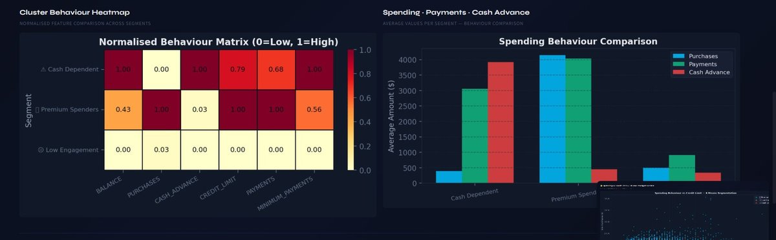
Cluster Behavior Analysis—Heatmap & Spending Comparison
Cash Dependent: Scores 1.0 on Balance, Cash Advance & Min Payments — highest financial risk
Premium Spenders: Top Purchases & Payments — strong repayment behavior
Low Engagement: Near-zero across all features — dormant customer group

Slide 10
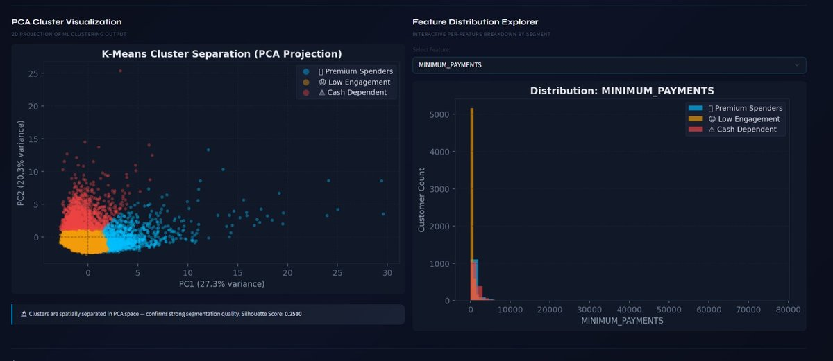
PCA Cluster Visualization & Feature Distribution Explorer
PC1 — 27.3% Variance
PC2 — 20.3% Variance
Silhouette: 0.2510
ANOVA p < 0.001
Primary separating dimension
Secondary cluster dimension
Acceptable for behavioral data
All clusters statistically distinct

Slide 11
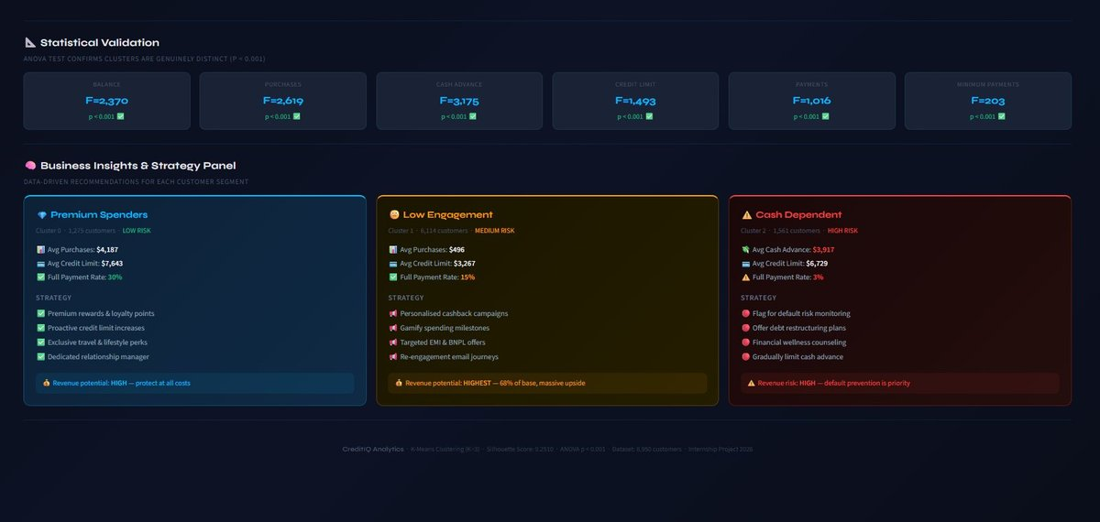
Business Insights & Strategy Panel

Slide 12
Key Insights & Statistical Validation
📐 ANOVA STATISTICAL VALIDATION (P < 0.001 FOR ALL FEATURES)
Balance
F=2,370
Credit Limit
F=1,493
Purchases
F=2,619
Payments
F=1,016
Cash Advance
F=3,175
Min Payments
F=203
💡 KEY FINDINGS
Premium Spenders (14.2%) contribute disproportionately to revenue — protect & reward this cohort.
Cash Dependent users (17.4%) show high default risk — 87/100 risk score; early intervention is critical.
Low Engagement customers (68.3%) represent the biggest untapped revenue opportunity.
Data-driven segmentation improves marketing ROI and enables personalized customer strategies.

Slide 13
Challenges Faced & Future Enhancements
⚡ CHALLENGES FACED
🚀 FUTURE ENHANCEMENTS
01
Missing Value Handling
Real-Time Segmentation
CREDIT_LIMIT and MINIMUM_PAYMENTS had null values requiring strategic imputation to preserve data integrity.
Live customer classification as new transactions occur using streaming pipelines.
02
Optimal Cluster Selection
Fraud Detection Integration
Balancing Elbow Method and Silhouette Score to determine K=3 as the most interpretable choice.
Combine segmentation with anomaly detection models to flag suspicious behavior.
03
Advanced Algorithms
Cluster Interpretation
Explore DBSCAN, Gaussian Mixture Models, or Hierarchical clustering for richer segments.
Translating mathematical cluster boundaries into meaningful, actionable business segment descriptions.
Cloud Deployment
04
Dashboard Integration
Deploy on AWS/GCP with auto-scaling for enterprise-level real-time analytics.
Building a real-time, interactive Streamlit UI that accurately reflects K-Means output with filtering.
Power BI / Tableau
Enhanced executive dashboards with drill-through, forecasting, and scheduled reports.

Slide 14
CONCLUSION
Summary & Impact
This project demonstrates how machine learning and data analytics can transform raw credit card data into meaningful business intelligence. The K-Means segmentation model (K=3, validated with Silhouette Score 0.2510, ANOVA p<0.001) enables financial institutions to move from one-size-fits-all to precision-driven customer strategies.
TGT
RIS
REV
DTA
Precision Marketing
Risk Reduction
Revenue Growth
Data-Driven Culture
Personalized campaigns for each segment
Early identification of high-risk customers
Activate 68.3% dormant customer base
Interactive dashboard for ongoing insights
Project developed as part of AI Data Analyst Internship at Rooman Technologies Pvt. Ltd.

Slide 15
Thank You
Questions & Discussion Welcome
Alva Rachel Wilfred
USN: 4SO22AI009 • St Joseph Engineering College
AI Data Analyst Intern • Rooman Technologies Pvt. Ltd.
K-Means Clustering
Customer Segmentation
Python
Streamlit
Machine Learning

