Slide 1
Synthetic card-dispute
resolution
Two agents challenge the proposal.
Code protects every simulated action.
bob the builder / Track 3: Reasoning Architecture
Notes:
All records and effects are fictional. T16 refresh, 27 October 2026. Separate Investigator and Reviewer calls may use the same model. Sources: https://github.com/rachelanneliew/Open-Agent-Hackathon/blob/codex/t14-t16-two-agent-reviewer/dispute-demo/docs/evidence/t16-live-accepted.json ; https://github.com/rachelanneliew/Open-Agent-Hackathon/blob/codex/t14-t16-two-agent-reviewer/docs/competition.md

Slide 2
A case needs more than a plausible answer
The user
The risk
The product
A dispute analyst checks evidence, existing refunds and the policy that applied when the case opened.
A plausible proposal can cite the wrong facts, credit too much or repeat an existing action.
The workbench exposes both agents, their feedback and the outcome that actually persisted.
Four policy outcomes: credit, evidence request, decline or saved human review. All effects are simulated.
Notes:
https://github.com/rachelanneliew/Open-Agent-Hackathon/blob/codex/t14-t16-two-agent-reviewer/context.md ; https://github.com/rachelanneliew/Open-Agent-Hackathon/blob/codex/t14-t16-two-agent-reviewer/dispute-demo/docs/analyst-ui.md

Slide 3
Two agents inside one bounded workflow
Stage | Responsibility
Zetaris + policy | Fresh source snapshot and deterministic rule ordering
Investigator | Structured recommendation and source citations
Deterministic critic | Check policy, amounts, citations and proposal binding
Independent Reviewer | Separate Nightshift call challenges evidence and omissions
Final gate + writer | Both accept same proposal; writer rechecks source atomically
One shared correction. Six total model calls and three reads by default. Recovery calls neither agent. Verified H-MEM stays advisory.
Notes:
https://github.com/rachelanneliew/Open-Agent-Hackathon/blob/codex/t14-t16-two-agent-reviewer/dispute-demo/docs/workflow.md ; https://github.com/rachelanneliew/Open-Agent-Hackathon/blob/codex/t14-t16-two-agent-reviewer/dispute-demo/docs/reviewer.md

Slide 4
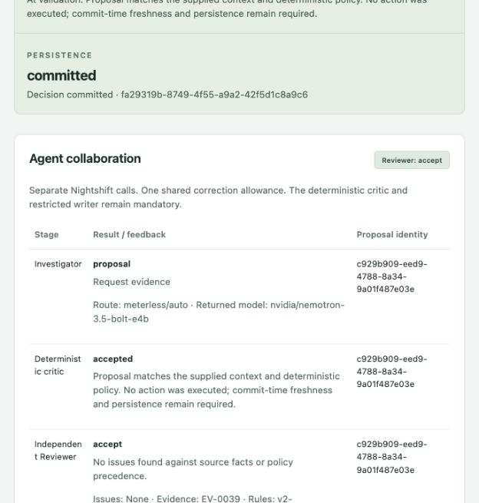
A real two-agent decision committed
DP-0020
Investigator: request evidence
Critic: accepted
Reviewer: accept
Persistence: committed
Two real Nightshift calls. Missing refund confirmation under policy v2. Zero credit effect.
The final gate binds both approvals to the same proposal.
Notes:
https://github.com/rachelanneliew/Open-Agent-Hackathon/blob/codex/t14-t16-two-agent-reviewer/dispute-demo/docs/evidence/t16-live-accepted.json ; actual UI capture 27 October 2026. No-memory mode for this live demonstration.

Slide 5
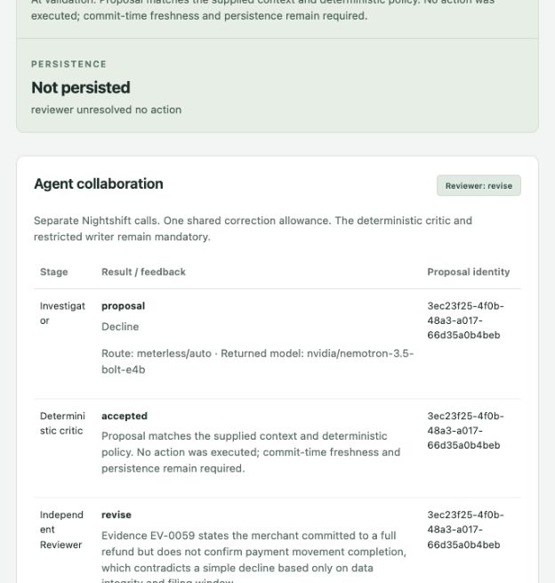
A real objection stopped the action
DP-0029
Reviewer requests revision.
Investigator revises once.
Reviewer objects again.
Controller stops without writing.
Four real calls. The objection appears overly conservative about the filing-window rule. We preserve the refusal.
No new decision, credit or review queue entry.
Notes:
https://github.com/rachelanneliew/Open-Agent-Hackathon/blob/codex/t14-t16-two-agent-reviewer/dispute-demo/docs/evidence/t16-live-refusal.json ; source policy v1. Reviewer objection is conservative and appears inconsistent with first-terminal policy precedence. No success or policy defect is inferred.

Slide 6
A reproducible correction handoff
DP-0020 rehearsal stage | Observed result
Initial Investigator + critic | Evidence request, accepted deterministic critique
Scripted Reviewer objection | Material omission; one correction token consumed
Revised Investigator + critic | New proposal identity, accepted deterministic critique
Reviewer recheck + final gate | Accept revised proposal, then guarded commit
Explicitly scripted models; real isolated PostgreSQL and H-MEM. Two fresh cycles each produced 8 decisions, 4 credits and 1 review.
Notes:
https://github.com/rachelanneliew/Open-Agent-Hackathon/blob/codex/t14-t16-two-agent-reviewer/dispute-demo/docs/evidence/t16-isolated-replay.json ; https://github.com/rachelanneliew/Open-Agent-Hackathon/blob/codex/t14-t16-two-agent-reviewer/dispute-demo/tests/test_reliability.py

Slide 7
Working technology, recorded evidence
Component | Contribution
Zetaris | Live JDBC source facts and source-linked prior receipts
Nightshift | Separate Investigator and Reviewer calls
H-MEM reference | Persistent verified summaries; mock embeddings
PostgreSQL + Python | Protected source recheck, atomic actions and exact recovery
298 application tests + 16 reference checks passed with zero skips. Recovery reuses the same saved decision with no model calls.
Both live roles returned nvidia/nemotron-3.5-bolt-e4b. Metadata, not independent provider attestation.
Notes:
https://github.com/rachelanneliew/Open-Agent-Hackathon/blob/codex/t14-t16-two-agent-reviewer/dispute-demo/docs/evidence/t16-verification.json ; https://github.com/rachelanneliew/Open-Agent-Hackathon/blob/codex/t14-t16-two-agent-reviewer/dispute-demo/docs/evidence/t16-live-accepted.json ; https://github.com/rachelanneliew/Open-Agent-Hackathon/blob/codex/t14-t16-two-agent-reviewer/dispute-demo/docs/evidence/t10-verified-memory.json

Slide 8
Current limits and delivery status
Implementation limits
Owner checks
Synthetic documents and canonical rationale
One PostgreSQL datasource, no USL
Reviewer can add conservative refusals
Local demo without production authentication
Leader must verify the actual submission form
Playable video hosting and portal preview
Contributor rights and earlier-work declaration
Final submission receipt remains unverified
Distinct live roles are demonstrated. Organizer acceptance and exact-reference endorsement remain unclaimed.
Notes:
https://github.com/rachelanneliew/Open-Agent-Hackathon/blob/codex/t14-t16-two-agent-reviewer/docs/competition.md ; https://github.com/rachelanneliew/Open-Agent-Hackathon/blob/codex/t14-t16-two-agent-reviewer/docs/submission/README.md

