Slide 1
Synthetic card-dispute
resolution
An analyst workbench for auditable decisions
bob the builder
Track 3: Reasoning Architecture
All records and financial effects are synthetic
01
Notes:
We are team bob the builder, presenting synthetic card dispute resolution for Track Three. The workbench helps analysts investigate disputes and record auditable outcomes. All records and financial effects are fictional.
Evidence mode: All records and financial effects are synthetic
Sources:
https://github.com/rachelanneliew/Open-Agent-Hackathon/blob/main/docs/submission/ARCHITECTURE.md
https://github.com/rachelanneliew/Open-Agent-Hackathon/blob/main/docs/competition.md

Slide 2
How a decision reaches the database
Stage | What it checks or produces
1 Zetaris + policy | Source facts and the applicable policy
2 Investigator | A structured proposal with citations
3 Deterministic critic | Policy, amounts and evidence references
4 Independent Reviewer | A separate challenge to the evidence
5 Protected database writer | Current facts, then an atomic decision
One correction allowance. Both checks accept the same final proposal.
Two separate Nightshift roles; deterministic code controls persistence
02
Notes:
Zetaris retrieves source facts. The Investigator proposes an outcome through Nightshift. A code based critic checks policy, amounts and citations. A separate Reviewer challenges the evidence. Both checks must accept the same proposal before the database writer rechecks current facts and commits.
Evidence mode: Two separate Nightshift roles; deterministic code controls persistence
Sources:
https://github.com/rachelanneliew/Open-Agent-Hackathon/blob/main/dispute-demo/docs/workflow.md
https://github.com/rachelanneliew/Open-Agent-Hackathon/blob/main/dispute-demo/docs/reviewer.md

Slide 3
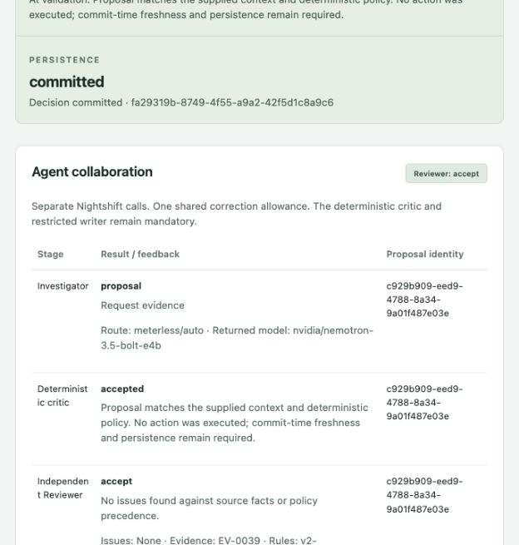
DP-0020: missing refund confirmation
SGD 114 captured
Missing: refund confirmation
A merchant promise does not
confirm a completed refund.
Evidence request committed
2 model calls, 0 credit effect
Exact recovery: same decision,
zero model calls
Recorded live run, 27 Oct 2026. Memory disabled
03
Notes:
Case D P twenty has a captured transaction of one hundred and fourteen Singapore dollars. A merchant promise is present, but the required refund confirmation is missing. In this recorded live run, the Investigator requested evidence and the critic and Reviewer accepted. Two Nightshift calls produced a saved evidence request with no credit effect. Recovery reused the same decision with zero model calls. Memory was disabled for this run.
Evidence mode: Recorded live run, 27 Oct 2026. Memory disabled
Sources:
https://github.com/rachelanneliew/Open-Agent-Hackathon/blob/main/dispute-demo/docs/evidence/t16-live-accepted.json
https://github.com/rachelanneliew/Open-Agent-Hackathon/blob/main/dispute-demo/docs/evidence/t16-recovery.json
https://github.com/rachelanneliew/Open-Agent-Hackathon/blob/main/docs/submission/assets/t16/live-accepted-trace.png

Slide 4
DP-0014: calculate the remaining amount
Source movement | Amount (SGD)
Completed capture | 100.00
Existing merchant refund | −40.00
Remaining eligible amount | 60.00
SGD 60 recorded as a separate simulated credit
Identical request: original decision reused
Fresh attempt: rejected because effective credit already exists
Scripted models, real isolated PostgreSQL. Recorded rehearsal, 27 Oct 2026
04
Notes:
Case D P fourteen makes the arithmetic clear. One hundred Singapore dollars was captured, and the merchant already refunded forty. The remaining amount is sixty dollars, recorded as a separate simulated credit. This rehearsal uses scripted models and a real isolated database. An identical request reuses the original decision. A fresh attempt is rejected, so processing the case again cannot create a second effective credit.
Evidence mode: Scripted models, real isolated PostgreSQL. Recorded rehearsal, 27 Oct 2026
Sources:
https://github.com/rachelanneliew/Open-Agent-Hackathon/blob/main/dispute-demo/docs/evidence/t16-isolated-replay.json
https://github.com/rachelanneliew/Open-Agent-Hackathon/blob/main/dispute-demo/tests/test_reliability.py
https://github.com/rachelanneliew/Open-Agent-Hackathon/blob/main/dispute-demo/data/synthetic/settlements.csv

Slide 5
DP-0003: reject one extra cent
SGD 200.01
SGD 200.00
Injected proposal
Allowed and corrected amount
Check | Observed result
Critic on the faulty proposal | Reject excess amount; request correction
One revised proposal | Critic accepted; Reviewer accepted
Protected write | Committed SGD 200.00
Injected fault in an isolated test. Scripted model responses
05
Notes:
For D P three, the allowed credit is two hundred Singapore dollars. The test deliberately proposes two hundred dollars and one cent. The critic rejects the extra cent and allows one correction. The corrected proposal passes the critic and Reviewer before the write. This is an injected test fault, not a spontaneous live model mistake.
Evidence mode: Injected fault in an isolated test. Scripted model responses
Sources:
https://github.com/rachelanneliew/Open-Agent-Hackathon/blob/main/dispute-demo/docs/evidence/t16-isolated-replay.json
https://github.com/rachelanneliew/Open-Agent-Hackathon/blob/main/dispute-demo/tests/test_reliability.py
https://github.com/rachelanneliew/Open-Agent-Hackathon/blob/main/dispute-demo/tests/test_orchestrator.py

Slide 6
DP-0017: verify remembered history
DP-0014
DP-0017
Earlier committed decision
Later case for the same customer
Memory step | Required verification
Recall | Find the source-linked earlier decision
Verify | Match receipt and customer ownership
Use | Advisory context; policy controls eligibility
Memory storage retry does not repeat the financial action.
Scripted-model rehearsal; real H-MEM reference with mock embeddings
06
Notes:
A later investigation, D P seventeen, recalls the earlier D P fourteen decision through H mem. The workflow verifies the committed receipt and customer ownership against source records. Memory supplies context, while policy determines eligibility. This rehearsal uses the real reference engine with mock embeddings and scripted models. Retrying memory storage never repeats the financial action.
Evidence mode: Scripted-model rehearsal; real H-MEM reference with mock embeddings
Sources:
https://github.com/rachelanneliew/Open-Agent-Hackathon/blob/main/dispute-demo/docs/evidence/t16-isolated-replay.json
https://github.com/rachelanneliew/Open-Agent-Hackathon/blob/main/dispute-demo/tests/test_reliability.py
https://github.com/rachelanneliew/Open-Agent-Hackathon/blob/main/dispute-demo/docs/memory.md

Slide 7
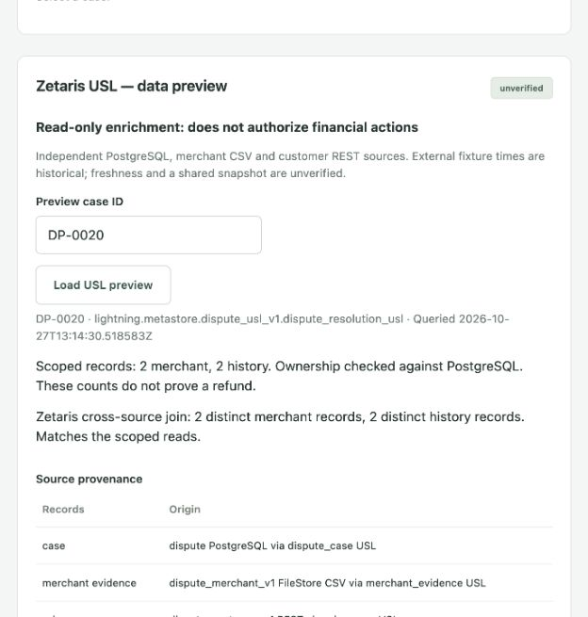
Zetaris joins three independent sources
Connector | Records
PostgreSQL | 40 cases
CSV FileStore | 4 merchant
REST JSON | 3 history
DP-0020 join
2 merchant + 2 history records
No action authority. Freshness and
cross-source snapshot unverified.
Recorded live Zetaris preview, 27 Oct 2026. Read-only enrichment
07
Notes:
The new Unified Semantic Layer joins three independent connectors: PostgreSQL with forty cases, a CSV file with four merchant records, and a REST source with three history records. For D P twenty, the join returns two merchant records and two history records. This optional preview cannot authorize financial actions. Source freshness and a shared cross-source snapshot remain unverified.
Evidence mode: Recorded live Zetaris preview, 27 Oct 2026. Read-only enrichment
Sources:
https://github.com/rachelanneliew/Open-Agent-Hackathon/blob/main/docs/zetaris-usl/evidence/parity.json
https://github.com/rachelanneliew/Open-Agent-Hackathon/blob/main/docs/zetaris-usl/evidence/preview-DP-0020.json
https://github.com/rachelanneliew/Open-Agent-Hackathon/blob/main/docs/zetaris-usl/sources.md
https://github.com/rachelanneliew/Open-Agent-Hackathon/blob/main/docs/zetaris-usl/evidence/dashboard-preview.png

Slide 8
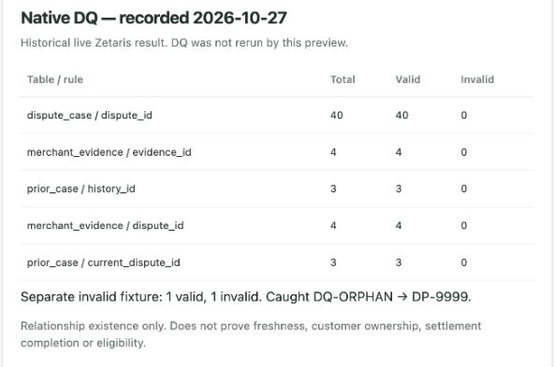
A quality check catches a broken reference
Fixture record | Case reference
DQ-VALID | DP-0020 exists
DQ-ORPHAN | DP-9999 absent
2 checked
1 valid
1 invalid
Checks relationship integrity.
Document truth and freshness
require other evidence.
Recorded native Zetaris DQ execution on a separate controlled fixture
08
Notes:
This separate quality test contains two records. One references an existing case. The orphan references a nonexistent case. Zetaris detects exactly one invalid record. The result proves that the foreign key check catches broken relationships. It does not prove document truth or source freshness.
Evidence mode: Recorded native Zetaris DQ execution on a separate controlled fixture
Sources:
https://github.com/rachelanneliew/Open-Agent-Hackathon/blob/main/docs/zetaris-usl/evidence/native-invalid-fixture.txt
https://github.com/rachelanneliew/Open-Agent-Hackathon/blob/main/docs/zetaris-usl/data-quality.md
https://github.com/rachelanneliew/Open-Agent-Hackathon/blob/main/docs/zetaris-usl/evidence/dashboard-dq.png

Slide 9
Test coverage and the current limit
328 application + 16 reference checks
344 passed, 0 failures, 0 skips
Isolated case | Recorded outcome
DP-0014 | Simulated provisional credit
DP-0020 | Request missing evidence
DP-0029 | Decline
DP-0008 | Human review
Live DP-0029: conservative Reviewer objections stopped the run.
No decision, credit or review queue entry was written.
Recorded 27 Oct 2026. Isolated suite uses scripted model responses
09
Notes:
The latest recorded suite passed three hundred and twenty eight application tests and sixteen reference checks, with no failures or skips. Rehearsals cover all four outcomes shown here. Real models still vary: the Reviewer appeared overly conservative on D P twenty nine and stopped without writing.
Evidence mode: Recorded 27 Oct 2026. Isolated suite uses scripted model responses
Sources:
https://github.com/rachelanneliew/Open-Agent-Hackathon/blob/main/docs/zetaris-usl/evidence/regression.json
https://github.com/rachelanneliew/Open-Agent-Hackathon/blob/main/dispute-demo/docs/evidence/t16-isolated-replay.json
https://github.com/rachelanneliew/Open-Agent-Hackathon/blob/main/dispute-demo/docs/evidence/t16-live-refusal.json

Slide 10
Evidence-backed decisions
with controlled actions
Observable collaboration. Duplicate prevention.
Verified memory. Inspectable source quality.
Next: broader documents and source-freshness metadata
github.com/rachelanneliew/Open-Agent-Hackathon
bob the builder / Track 3: Reasoning Architecture
10
Notes:
The contribution combines observable agent collaboration, duplicate prevention, verified memory and inspectable source quality. Next steps are broader document support and source freshness metadata.
Evidence mode: bob the builder / Track 3: Reasoning Architecture
Sources:
https://github.com/rachelanneliew/Open-Agent-Hackathon/blob/main/docs/submission/ARCHITECTURE.md
https://github.com/rachelanneliew/Open-Agent-Hackathon/blob/main/docs/submission/USL_ADDENDUM.md

