Slide 1
Synthetic card-dispute
resolution
Evidence, policy and verified memory
for auditable simulated decisions
bob the builder · Track 3: Reasoning Architecture
Notes:
All records and financial effects are synthetic. One Nightshift model investigator, deterministic critic and Python controller. Team name and track from authenticated HackOS. Sources: https://github.com/rachelanneliew/Open-Agent-Hackathon/blob/937b642d9f48c9f5a5a2e336a51f5f1938231210/context.md ; https://github.com/rachelanneliew/Open-Agent-Hackathon/blob/937b642d9f48c9f5a5a2e336a51f5f1938231210/docs/competition.md

Slide 2
A case needs more than a plausible answer
The user
The risk
The product
A dispute analyst checks evidence, existing refunds and the policy that applied when the case opened.
An unsupported proposal can cite the wrong facts, credit too much or repeat an existing action.
A visible record of source facts, policy, critique and the outcome that actually persisted.
Eligible credit, evidence request and decline run automatically. Policy exceptions enter a saved review queue.
Notes:
https://github.com/rachelanneliew/Open-Agent-Hackathon/blob/937b642d9f48c9f5a5a2e336a51f5f1938231210/context.md ; https://github.com/rachelanneliew/Open-Agent-Hackathon/blob/937b642d9f48c9f5a5a2e336a51f5f1938231210/dispute-demo/docs/analyst-ui.md

Slide 3
One bounded workflow
Zetaris reads
Policy + investigator
Deterministic critic
Verified H-MEM
Atomic PostgreSQL
Source recheck
One model investigator. One deterministic critic. One controller.
At most one correction. Up to four model calls, three reads and 300 seconds. Memory recall is verified before policy and proposal.
Notes:
https://github.com/rachelanneliew/Open-Agent-Hackathon/blob/937b642d9f48c9f5a5a2e336a51f5f1938231210/dispute-demo/docs/workflow.md ; https://github.com/rachelanneliew/Open-Agent-Hackathon/blob/937b642d9f48c9f5a5a2e336a51f5f1938231210/dispute-demo/docs/memory.md

Slide 4
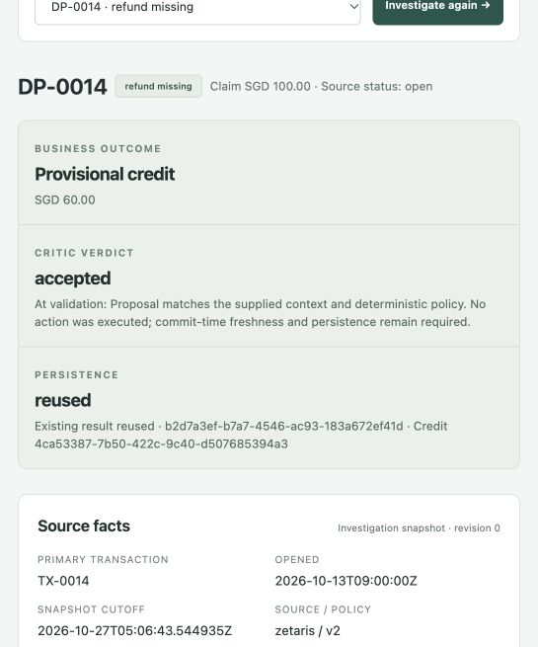
The analyst sees what actually happened
DP-0014
SGD 100.00 captured
SGD 40.00 already refunded
SGD 60.00 simulated credit
The pure critic accepted the proposal. Exact saved-request recovery returned the same decision and credit.
Dated live receipt and actual UI capture. All financial effects are synthetic.
Notes:
https://github.com/rachelanneliew/Open-Agent-Hackathon/blob/937b642d9f48c9f5a5a2e336a51f5f1938231210/dispute-demo/docs/evidence/t08-live-workflow.json ; https://github.com/rachelanneliew/Open-Agent-Hackathon/blob/937b642d9f48c9f5a5a2e336a51f5f1938231210/dispute-demo/docs/evidence/t11-analyst.json ; screenshot captured 27 October 2026 from the actual local UI. Existing result displayed, not a new model run.

Slide 5
Memory keeps its source references
DP-0014
DP-0017
Prior committed SGD 60.00 credit
Customer CUST-008
Saved source receipt
Recall candidate from H-MEM
Verify receipt through Zetaris
Commit SGD 57.60 under policy
The later live investigation verified the earlier case before its proposal. A fresh-process memory retry reused the summary without calling the action service.
Official pinned reference, mock embeddings. Advisory and partial history. No claim-count threshold.
Notes:
https://github.com/rachelanneliew/Open-Agent-Hackathon/blob/937b642d9f48c9f5a5a2e336a51f5f1938231210/dispute-demo/docs/evidence/t10-verified-memory.json ; https://github.com/rachelanneliew/Open-Agent-Hackathon/blob/937b642d9f48c9f5a5a2e336a51f5f1938231210/dispute-demo/docs/memory.md

Slide 6
Four outcomes, one persistence boundary
Case | Outcome | Evidence mode
DP-0014 | SGD 60.00 credit | Live receipt + isolated replay
DP-0020 | Request refund confirmation | Scripted isolated commit
DP-0029 | Decline: filing window | Scripted isolated commit
DP-0008 | Review with zero credit | Live UI + isolated replay
Two fresh replay cycles each produced 8 decisions, 4 credits and 1 review. DP-0003 corrects one injected +1 amount fault. DP-0033/34 verify policy versions.
Notes:
https://github.com/rachelanneliew/Open-Agent-Hackathon/blob/937b642d9f48c9f5a5a2e336a51f5f1938231210/dispute-demo/docs/evidence/t12-isolated-replay.json ; https://github.com/rachelanneliew/Open-Agent-Hackathon/blob/937b642d9f48c9f5a5a2e336a51f5f1938231210/dispute-demo/docs/evidence/t12-verification.json ; https://github.com/rachelanneliew/Open-Agent-Hackathon/blob/937b642d9f48c9f5a5a2e336a51f5f1938231210/dispute-demo/docs/evidence/t08-live-workflow.json

Slide 7
Working technology, recorded evidence
Component | Contribution
Zetaris | Fresh source and prior-receipt reads through JDBC
Nightshift | Primary model provider for structured investigation
H-MEM reference | Persistent source-linked summaries and verified recall
PostgreSQL + Python | Protected source recheck, atomic actions and recovery
267 main tests + 16 reference/compatibility checks passed with zero skips in T12. Tests separate live evidence from scripted responses.
Returned live model label: nvidia/nemotron-3.5-bolt-e4b. Metadata, not independent attestation.
Notes:
https://github.com/rachelanneliew/Open-Agent-Hackathon/blob/937b642d9f48c9f5a5a2e336a51f5f1938231210/dispute-demo/docs/evidence/t08-live-workflow.json ; https://github.com/rachelanneliew/Open-Agent-Hackathon/blob/937b642d9f48c9f5a5a2e336a51f5f1938231210/dispute-demo/docs/evidence/t10-verified-memory.json ; https://github.com/rachelanneliew/Open-Agent-Hackathon/blob/937b642d9f48c9f5a5a2e336a51f5f1938231210/dispute-demo/docs/evidence/t12-verification.json

Slide 8
Current limits and next work
Today
Next
Synthetic document templates and canonical rationale
One PostgreSQL datasource, no USL
One model plus a deterministic critic
Local demo with occasional model schema refusals
Broader evidence interpretation and production controls
Separately scoped three-source USL work
Organizer clarification on two-agent wording
Leader verification of final submission and access
External platform, model and reference work is credited. Team confirmation of pre-event contributions remains required.
Notes:
https://github.com/rachelanneliew/Open-Agent-Hackathon/blob/937b642d9f48c9f5a5a2e336a51f5f1938231210/docs/competition.md ; https://github.com/rachelanneliew/Open-Agent-Hackathon/blob/937b642d9f48c9f5a5a2e336a51f5f1938231210/dispute-demo/docs/memory.md ; project Git history begins 24 October 2026, earlier work requires team confirmation.

