Slide 1


Artificial Intelligence Reinforcement learning with OpenAI Gym Msc. in Computational Data Science A.Y. 2021/2022, Summer Semester
Blue Team
Ceol Samuele
Fanti Coelho Lima Rachel
Hooshyar Hosna

Slide 2
Code Structure – Game Environment class
Keeps track of the (useful) information related to the current game:
Agent location
Agent orientation
Wumpus killed (i.e. the arrow has been used and a scream has been heard)
Gold taken (i.e. grab action has been performed on a glitter location)
Agent climbed out

Slide 3
Code Structure – Gym Custom Player
Contains the Q-Table and the logic to populate it (i.e. the train method)
Initialized with:
A gym environment. In this case, gym.make('wumpus-v0’)
A value for the enum BinaryStates, defining what constitutes a Q-Table state
A value for the enum ExplorationApproach, controlling the exploration-exploitation tradeoff
A value for the Boolean grab_reward, determining whether grabbing the gold grants a additional (mid-game) reward

Slide 4
Q-Table states
A state (Q-Table row) always accounts for:
The agent location (x and y coordinates)
The agent orientation
Additionally the BinaryStates parameter can be set to:
BASIC, adding the gold_taken variable to the state values
ADVANCED, adding the gold_taken and wumpus_killed variables to the state values
COMPLETE, adding the gold_taken, wumpus_killed and climbed_out variables to the state values

Slide 5
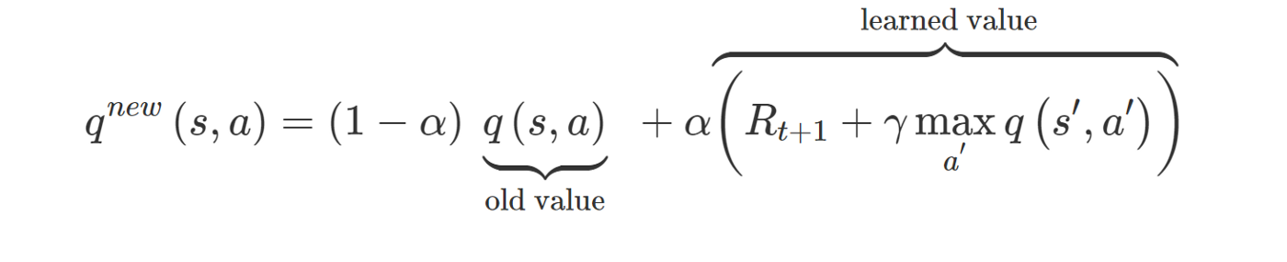
Training
The train method of the GymCustomPlayer updates the Q-Table values.
The method accepts as input parameters the values of: alpha, gamma, epsilon, epsilon_decay and epsilon_min and updates a given Q-value using the following formula:

Slide 6
Exploration vs Exploitation
Exploration vs Exploitation trade-off during training is determined by the ExplorationApproach parameter, which can take the following values:
RANDOM: The agent only takes random actions (exploration only)
GREEDY: The agent only takes the action with the highest q-value (exploitation only)
EPSILON_GREEDY: Epsilon value determines the trade-off
DECAYING_EPSILON_GREEDY: Epsilon value determines the trade-off. Epsilon is decreased after every episode as long as it is bigger than epsilon_min
EPSILON_JUMP: Epsilon value determines the trade-off. Epsilon value remains constant for a set percentage of episodes (default 80%) and is drastically lowered for the remaining ones.

Slide 7




Default world
Game is solvable
Kill is not mandatory
Q-table state:
BinaryStates.BASIC
Agent location, orientation, gold taken

Slide 8
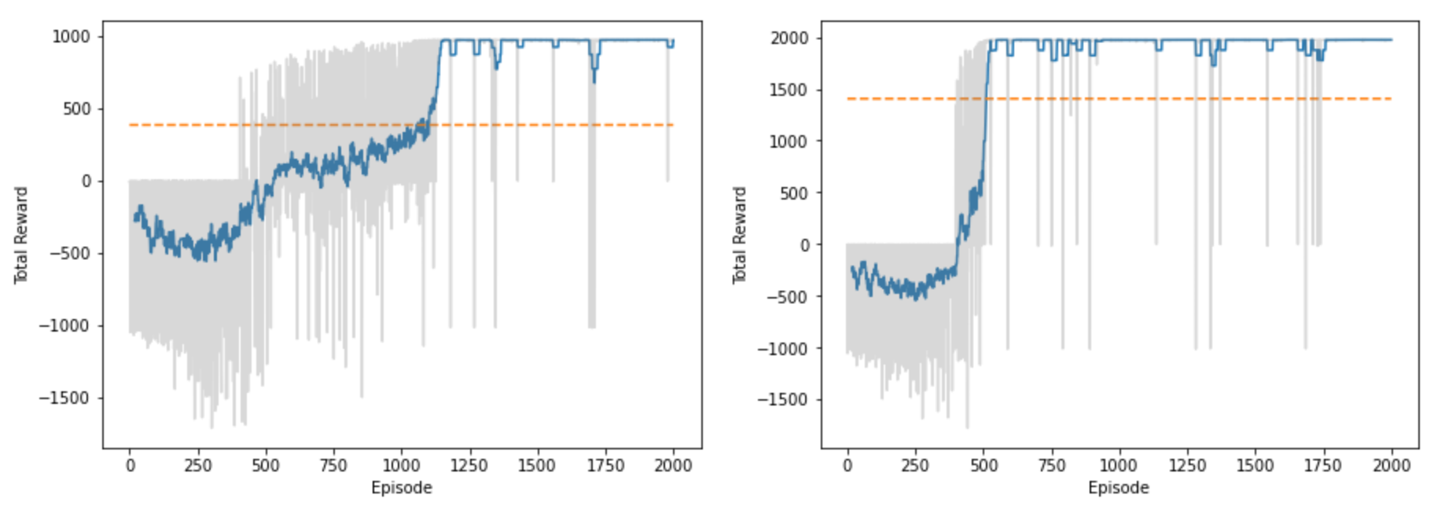
Results – Default world
With: BinaryStates.BASIC and ExplorationApproach.DECAYING_EPSILON_GREEDY
grab_reward = False grab_reward = True
epsilon=0.9
decay=0.01
min=0.01

Slide 9
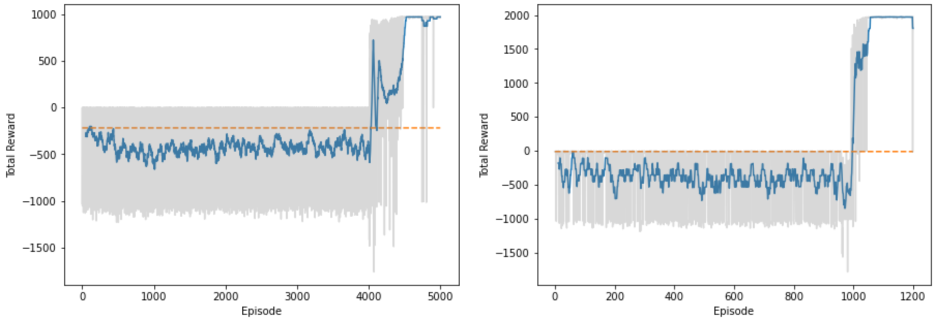
Results – Default world
With: BinaryStates.BASIC and ExplorationApproach.EPSILON_JUMP
grab_reward = False grab_reward = True
Jump point = 80%
From epsilon = 0.9
To epsilon = 0.01

Slide 10
Final reward – Default world
RL player
Nr of steps: 23
Final reward: 973
Online player
Nr of steps: 53
Final reward: -54

Slide 11
Mandatory kill world
Game is solvable
Kill is mandatory
Q-table state:
BinaryStates.ADVANCED
Agent location, orientation, gold taken, wumpus killed

Slide 12
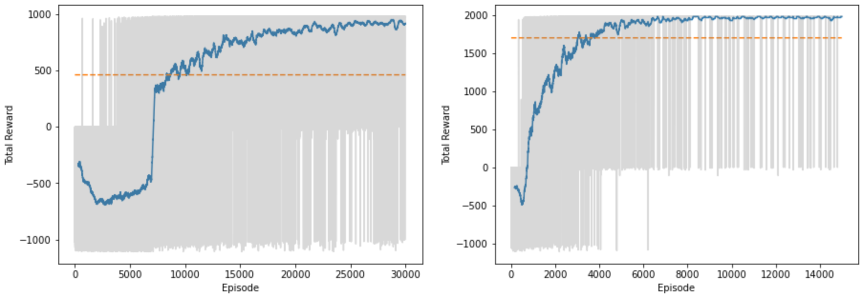
Results – Mandatory kill world
With: BinaryStates.ADVANCED and ExplorationApproach.DECAYING_EPSILON_GREEDY
grab_reward = False grab_reward = True
epsilon=0.9
decay=0.0001/0.0005
min=0.01

Slide 13
Final reward – Default world
RL player
Nr of steps: 12
Final reward: 979
Online player
Nr of steps: 59
Final reward: 931

Slide 14
Non-solvable world
Game is not solvable
Q-table state:
BinaryStates.COMPLETE
Agent location, orientation, gold taken, wumpus killed, climbed out

Slide 15
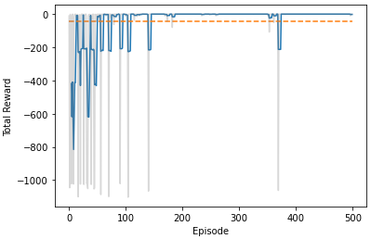
Results – Non-solvable world
With: BinaryStates.COMPLETE and ExplorationApproach.DECAYING_EPSILON_GREEDY
epsilon=0.9
decay=0.01
min=0.01

Slide 16
Final reward – Non-solvable world
RL player
Nr of steps: 1
Final reward: -1
Online player
Nr of steps: 51
Final reward: -52

Slide 17
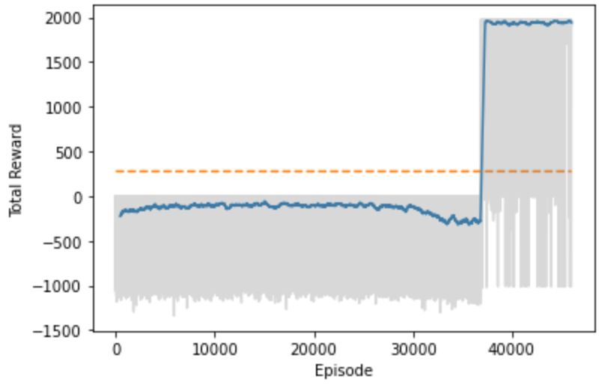
Complete state on the default world
With: ExplorationApproach.EPSILON_JUMP
BinaryStates.BASIC BinaryStates.COMPLETE

Slide 18
Key takeaway
Having a more granular state representation:
Might be a requirement for convergence in certain environments
Affects Q-Table size and nr of required training episodes
For a 8x8 world:
(pos_x, pos_y, orientation, gold_taken) = 512 entries
(pos_x, pos_y, orientation, gold_taken, wumpus_killed, climbed_out) = 2048 entries

Slide 19
Thank you for your attention

