Slide 1
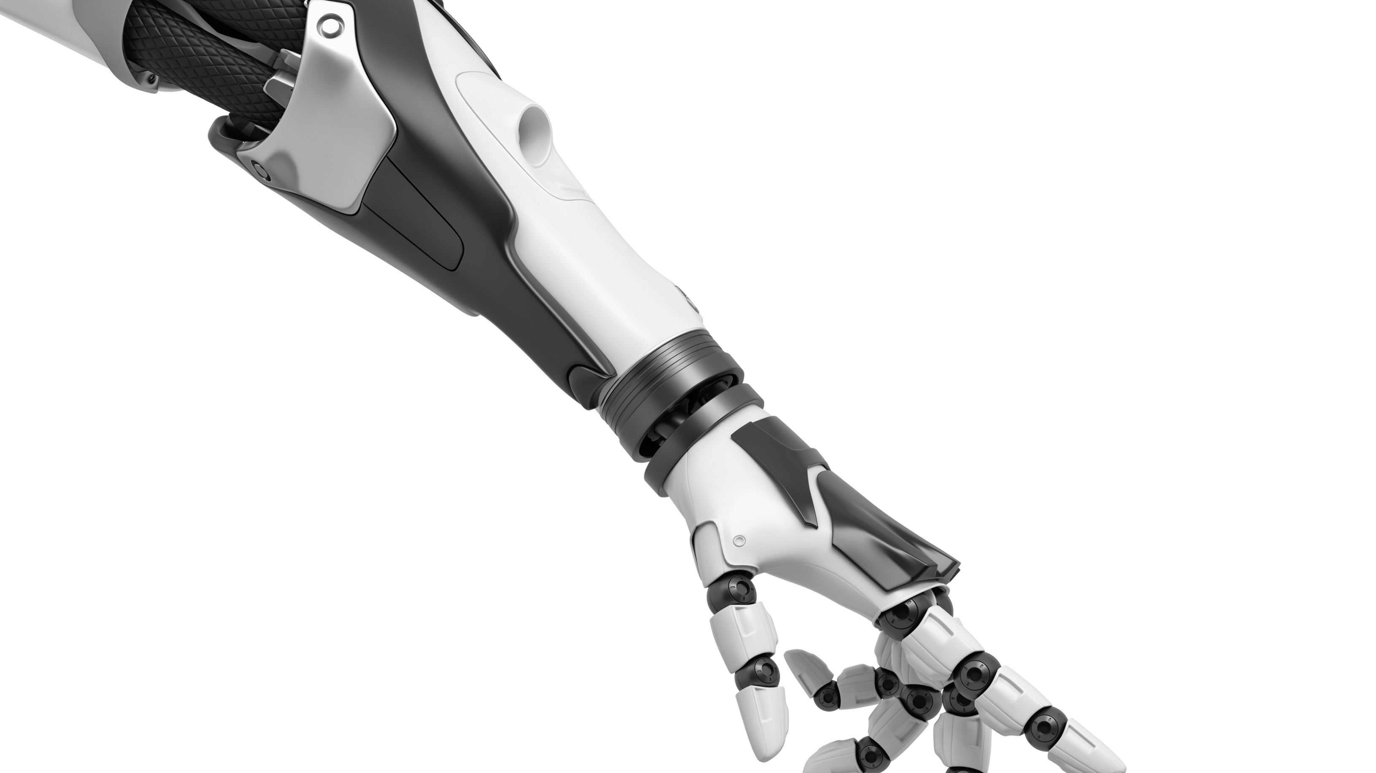

Artificial Intelligence Wumpus Online Msc. in Computational Data Science A.Y. 2021/2022, Summer Semester
Blue Team
Ceol Samuele
Fanti Coelho Lima Rachel
Hooshyar Hosna

Slide 2
Code Structure – Overview
Main components:
CustomPlayer (custom_player.py)
GameEnvironment (game_env.py)
Modules:
AStar (a_star_module.py)
SMT module (smt_module.py)
Bayesian module (bayesian_module.py)

Slide 3
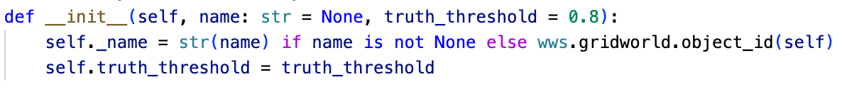
Custom Player
Extension of OnlinePlayer
Initialized with a truth_threshold value
How much risk will the agent take?
start_episode initializes a GameEnvironment object
get_action is called from the play method

Slide 4
Game Environment - Overview
Keeps track of the collected world information:
Free/Breeze/Stench locs
Pits/Wumpus candidates
Pending locs
(Known) world size
Computes next (set of) agent action(s) given:
The current percept
The stored world information

Slide 5



Game Environment – Updating the environment
At each step, the update_env method is called:
Adds the current location to the appropriate list(s)
If required, updates the world size
Updates the set of pending locations
Calls the SMT module

Slide 6
Game Environment – Building the action list
When building the action list (build_action_list), we first look at pending locations:
Priority is given to direct neighbours of current agent location
Otherwise, A-Star module computes the path to the closest p.l.
An empty pending location list will either:
Trigger a kill attempt (attempt_kill) if at least one stench location has been found
Call the Bayesian module
Head towards the location with highest prob. of being safe
If no location is above the set threshold, head out

Slide 7
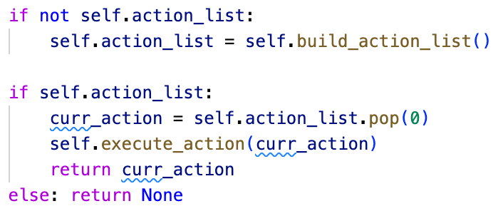
Game Environment – Executing an action
With the action list built, action are passed one by one to the agent until the list is fully consumed
execute_action allows to keep track of the current agent location and orientation

Slide 8

Simulation
World size = (1, 1)
Final size known = False
Percepts = []
Free = [(0,0)]
Pending = []
Breeze = []
Stench = []
Wumpus candidates = []
Pits candidates = []

Slide 9
Simulation
World size = (1, 1)
Final size known = False
Percepts = []
Free = [(0,0)]
Pending = [(1,0), (0,1)]
Breeze = []
Stench = []
Wumpus candidates = []
Pits candidates = []

Slide 10

Simulation
New breeze location is found
SMT module is called to update the pit locations

Slide 11
Simulation
World size = (2, 2)
Final size known = False
Percepts = [Breeze]
Free = [(0,0)]
Pending = [(1,0)]
Breeze = [(0,1)]
Stench = []
Wumpus candidates = []
Pit candidates = [(1,1), (0,2)]

Slide 12
Simulation
No adjacent locations to explore
A-Star module is called to reach closest pending location
Path: [LEFT, LEFT, MOVE, RIGHT, MOVE]

Slide 13
Simulation
World size = (2, 2)
Final size known = False
Percepts = [Breeze]
Free = [(0,0)]
Pending = [(1,0)]
Breeze = [(0,1)]
Stench = []
Wumpus candidates = []
Pit candidates = [(1,1), (0,2)]

Slide 14
Simulation
World size = (2, 2)
Final size known = False
Percepts = [Breeze]
Free = [(0,0)]
Pending = [(1,0)]
Breeze = [(0,1)]
Stench = []
Wumpus candidates = []
Pit candidates = [(1,1), (0,2)]

Slide 15
Simulation
World size = (2, 2)
Final size known = False
Percepts = []
Free = [(0,0)]
Pending = [(1,0)]
Breeze = [(0,1)]
Stench = []
Wumpus candidates = []
Pit candidates = [(1,1), (0,2)]

Slide 16
Simulation
World size = (2, 2)
Final size known = False
Percepts = []
Free = [(0,0)]
Pending = [(1,0)]
Breeze = [(0,1)]
Stench = []
Wumpus candidates = []
Pit candidates = [(1,1), (0,2)]

Slide 17

Simulation
World size = (2, 2)
Final size known = False
Percepts = []
Free = [(0,0), (1,0)]
Pending = [(2,0), (1,1)]
Breeze = [(0,1)]
Stench = []
Wumpus candidates = []
Pit candidates = [(0,2)]

Slide 18

Simulation
World size = (3, 3)
Final size known = False
Percepts = [Stench]
Free = [(0,0), (1,0)]
Pending = [(1,1)]
Breeze = [(0,1)]
Stench = [(2,0)]
Wumpus candidates = [(3,0), (1,2)]
Pit candidates = [(0,2)]

Slide 19
Simulation
World size = (3, 3)
Final size known = False
Percepts = [Stench]
Free = [(0,0), (1,0)]
Pending = [(1,1)]
Breeze = [(0,1)]
Stench = [(2,0)]
Wumpus candidates = [(3,0), (1,2)]
Pit candidates = [(0,2)]

Slide 20
Simulation
World size = (3, 3)
Final size known = False
Percepts = [Stench]
Free = [(0,0), (1,0)]
Pending = [(1,1)]
Breeze = [(0,1)]
Stench = [(2,0)]
Wumpus candidates = [(3,0), (1,2)]
Pit candidates = [(0,2)]

Slide 21
Simulation
World size = (3, 3)
Final size known = False
Percepts = []
Free = [(0,0), (1,0)]
Pending = [(1,1)]
Breeze = [(0,1)]
Stench = [(2,0)]
Wumpus candidates = [(3,0), (1,2)]
Pit candidates = [(0,2)]

Slide 22
Simulation
World size = (3, 3)
Final size known = False
Percepts = []
Free = [(0,0), (1,0)]
Pending = [(1,1)]
Breeze = [(0,1)]
Stench = [(2,0)]
Wumpus candidates = [(3,0), (1,2)]
Pit candidates = [(0,2)]

Slide 23

Simulation
World size = (3, 3)
Final size known = False
Percepts = [Stench]
Free = [(0,0), (1,0)]
Pending = [(3,0), (1,2)]
Breeze = [(0,1)]
Stench = [(2,0), (1,1)]
Wumpus candidates = [(1,2)]
Pit candidates = [(0,2)]

Slide 24
Simulation
World size = (3, 3)
Final size known = False
Percepts = [Breeze]
Free = [(0,0), (1,0)]
Pending = [(3,0)]
Breeze = [(0,1), (1,2)]
Stench = [(2,0), (1,1)]
Wumpus candidates = [(1,2)]
Pit candidates = [(0,2), (2,2), (1,3)]

Slide 25
Simulation
World size = (3, 3)
Final size known = False
Percepts = [Breeze]
Free = [(0,0), (1,0)]
Pending = [(3,0)]
Breeze = [(0,1), (1,2)]
Stench = [(2,0), (1,1)]
Wumpus candidates = [(1,2)]
Pit candidates = [(0,2), (2,2), (1,3)]

Slide 26
Simulation
World size = (3, 3)
Final size known = False
Percepts = [Breeze]
Free = [(0,0), (1,0)]
Pending = [(3,0)]
Breeze = [(0,1), (1,2)]
Stench = [(2,0), (1,1)]
Wumpus candidates = [(1,2)]
Pit candidates = [(0,2), (2,2), (1,3)]

Slide 27
Simulation
World size = (3, 3)
Final size known = False
Percepts = [Stench]
Free = [(0,0), (1,0)]
Pending = [(3,0)]
Breeze = [(0,1), (1,2)]
Stench = [(2,0), (1,1)]
Wumpus candidates = [(1,2)]
Pit candidates = [(0,2), (2,2), (1,3)]

Slide 28
Simulation
World size = (3, 3)
Final size known = False
Percepts = []
Free = [(0,0), (1,0)]
Pending = [(3,0)]
Breeze = [(0,1), (1,2)]
Stench = [(2,0), (1,1)]
Wumpus candidates = [(1,2)]
Pit candidates = [(0,2), (2,2), (1,3)]

Slide 29
Simulation
World size = (3, 3)
Final size known = False
Percepts = []
Free = [(0,0), (1,0)]
Pending = [(3,0)]
Breeze = [(0,1), (1,2)]
Stench = [(2,0), (1,1)]
Wumpus candidates = [(1,2)]
Pit candidates = [(0,2), (2,2), (1,3)]

Slide 30
Simulation
World size = (3, 3)
Final size known = False
Percepts = [Stench]
Free = [(0,0), (1,0)]
Pending = [(3,0)]
Breeze = [(0,1), (1,2)]
Stench = [(2,0), (1,1)]
Wumpus candidates = [(1,2)]
Pit candidates = [(0,2), (2,2), (1,3)]

Slide 31
Simulation
World size = (4, 4)
Final size known = False
Percepts = []
Free = [(0,0), (1,0), (3,0)]
Pending = [(4,0), (3,1)]
Breeze = [(0,1), (1,2)]
Stench = [(2,0), (1,1)]
Wumpus candidates = [(1,2)]
Pit candidates = [(0,2), (2,2), (1,3)]

Slide 32
Simulation
World size = (5, 5)
Final size known = False
Percepts = [Breeze]
Free = [(0,0), (1,0), (3,0)]
Pending = [(3,1)]
Breeze = [(4,0), (0,1), (1,2)]
Stench = [(2,0), (1,1)]
Wumpus candidates = [(1,2)]
Pit candidates = [(5,0), (4,1), (0,2), (2,2), (1,3)]

Slide 33
Simulation
World size = (5, 5)
Final size known = False
Percepts = [Breeze]
Free = [(0,0), (1,0), (3,0)]
Pending = [(3,1)]
Breeze = [(4,0), (0,1), (1,2)]
Stench = [(2,0), (1,1)]
Wumpus candidates = [(1,2)]
Pit candidates = [(5,0), (4,1), (0,2), (2,2), (1,3)]

Slide 34
Simulation
World size = (5, 5)
Final size known = False
Percepts = [Breeze]
Free = [(0,0), (1,0), (3,0)]
Pending = [(3,1)]
Breeze = [(4,0), (0,1), (1,2)]
Stench = [(2,0), (1,1)]
Wumpus candidates = [(1,2)]
Pit candidates = [(5,0), (4,1), (0,2), (2,2), (1,3)]

Slide 35
Simulation
World size = (5, 5)
Final size known = False
Percepts = []
Free = [(0,0), (1,0), (3,0)]
Pending = [(3,1)]
Breeze = [(4,0), (0,1), (1,2)]
Stench = [(2,0), (1,1)]
Wumpus candidates = [(1,2)]
Pit candidates = [(5,0), (4,1), (0,2), (2,2), (1,3)]

Slide 36
Simulation
World size = (5, 5)
Final size known = False
Percepts = []
Free = [(0,0), (1,0), (3,0)]
Pending = [(3,1)]
Breeze = [(4,0), (0,1), (1,2)]
Stench = [(2,0), (1,1)]
Wumpus candidates = [(1,2)]
Pit candidates = [(5,0), (4,1), (0,2), (2,2), (1,3)]

Slide 37


Simulation
World size = (5, 5)
Final size known = False
Percepts = [Breeze, Stench]
Free = [(0,0), (1,0), (3,0)]
Pending = []
Breeze = [(4,0), (0,1), (3,1), (1,2)]
Stench = [(2,0), (1,1), (3,1)]
Wumpus candidates = [(1,2)]
Pit candidates = [(5,0), (4,1), (0,2), (2,2), (3,2), (1,3)]

Slide 38
Simulation
No location left to safely explore
Since we have found stench locations, a kill is attempted instead of calling the Bayesian module

Slide 39
Simulation
World size = (5, 5)
Final size known = False
Percepts = [Breeze, Stench]
Free = [(0,0), (1,0), (3,0)]
Pending = []
Breeze = [(4,0), (0,1), (3,1), (1,2)]
Stench = [(2,0), (1,1), (3,1)]
Wumpus candidates = [(1,2)]
Pit candidates = [(5,0), (4,1), (0,2), (2,2), (3,2), (1,3)]

Slide 40
Simulation
World size = (5, 5)
Final size known = False
Percepts = [Breeze, Scream]
Free = [(0,0), (1,0), (2,0), (3,0), (1,1)]
Pending = [(2,1)]
Breeze = [(4,0), (0,1), (3,1), (1,2)]
Stench = []
Wumpus candidates = []
Pit candidates = [(5,0), (4,1), (0,2), (2,2), (3,2), (1,3)]

Slide 41
Simulation
World size = (5, 5)
Final size known = False
Percepts = []
Free = [(0,0), (1,0), (2,0), (3,0), (1,1), (2,1)]
Pending = [(2,2)]
Breeze = [(4,0), (0,1), (3,1), (1,2)]
Stench = []
Wumpus candidates = []
Pit candidates = [(5,0), (4,1), (0,2), (3,2), (1,3)]

Slide 42
Simulation
World size = (5, 5)
Final size known = False
Percepts = []
Free = [(0,0), (1,0), (2,0), (3,0), (1,1), (2,1)]
Pending = [(2,2)]
Breeze = [(4,0), (0,1), (3,1), (1,2)]
Stench = []
Wumpus candidates = []
Pit candidates = [(5,0), (4,1), (0,2), (3,2), (1,3)]

Slide 43
Simulation
World size = (5, 5)
Final size known = False
Percepts = []
Free = [(0,0), (1,0), (2,0), (3,0), (1,1), (2,1), (2,2)]
Pending = [(3,2), (2,3)]
Breeze = [(4,0), (0,1), (3,1), (1,2)]
Stench = []
Wumpus candidates = []
Pit candidates = [(5,0), (4,1), (0,2), (1,3)]

Slide 44
Simulation
World size = (5, 5)
Final size known = False
Percepts = []
Free = [(0,0), (1,0), (2,0), (3,0), (1,1), (2,1), (2,2), (2,3)]
Pending = [(3,2), (1,3), (3,3), (2,4)]
Breeze = [(4,0), (0,1), (3,1), (1,2)]
Stench = []
Wumpus candidates = []
Pit candidates = [(5,0), (4,1), (0,2)]

Slide 45
Simulation
World size = (5, 5)
Final size known = False
Percepts = []
Free = [(0,0), (1,0), (2,0), (3,0), (1,1), (2,1), (2,2), (2,3), (2,4)]
Pending = [(3,2), (1,3), (3,3), (1,4), (3,4)]
Breeze = [(4,0), (0,1), (3,1), (1,2)]
Stench = []
Wumpus candidates = []
Pit candidates = [(5,0), (4,1), (0,2)]

Slide 46
Simulation
Bumping against the wall reveals the true size of the world
World size is now fixed

Slide 47
Simulation
World size = (5, 5)
Final size known = True
Percepts = [Bump]
Free = [(0,0), (1,0), (2,0), (3,0), (1,1), (2,1), (2,2), (2,3), (2,4)]
Pending = [(3,2), (1,3), (3,3), (1,4), (3,4)]
Breeze = [(4,0), (0,1), (3,1), (1,2)]
Stench = []
Wumpus candidates = []
Pit candidates = [(4,1), (0,2)]

Slide 48
Simulation
World size = (5, 5)
Final size known = True
Percepts = []
Free = [(0,0), (1,0), (2,0), (3,0), (1,1), (2,1), (2,2), (2,3), (2,4)]
Pending = [(3,2), (1,3), (3,3), (1,4), (3,4)]
Breeze = [(4,0), (0,1), (3,1), (1,2)]
Stench = []
Wumpus candidates = []
Pit candidates = [(4,1), (0,2)]

Slide 49
Simulation
World size = (5, 5)
Final size known = True
Percepts = []
Free = [(0,0), (1,0), (2,0), (3,0), (1,1), (2,1), (2,2), (2,3), (2,4), (3,4)]
Pending = [(3,2), (1,3), (3,3), (1,4), (4,4)]
Breeze = [(4,0), (0,1), (3,1), (1,2)]
Stench = []
Wumpus candidates = []
Pit candidates = [(4,1), (0,2)]

Slide 50

Simulation
World size = (5, 5)
Final size known = True
Percepts = [Glitter, Breeze]
Free = [(0,0), (1,0), (2,0), (3,0), (1,1), (2,1), (2,2), (2,3), (2,4), (3,4)]
Pending = [(3,2), (1,3), (3,3), (1,4)]
Breeze = [(4,0), (0,1), (3,1), (1,2), (4,4)]
Stench = []
Wumpus candidates = []
Pit candidates = [(4,1), (0,2), (4,3)]

Slide 51
Simulation
The glitter percept triggers the grab action
A-Star module is called to get back to start
Path: [G, R, R, M, M, L, M, M, M, M, R, M, M, C]

Slide 52
Simulation
World size = (5, 5)
Final size known = True
Percepts = [Breeze]
Free = [(0,0), (1,0), (2,0), (3,0), (1,1), (2,1), (2,2), (2,3), (2,4), (3,4)]
Pending = [(3,2), (1,3), (3,3), (1,4)]
Breeze = [(4,0), (0,1), (3,1), (1,2), (4,4)]
Stench = []
Wumpus candidates = []
Pit candidates = [(4,1), (0,2), (4,3)]

Slide 53
Simulation
World size = (5, 5)
Final size known = True
Percepts = [Breeze]
Free = [(0,0), (1,0), (2,0), (3,0), (1,1), (2,1), (2,2), (2,3), (2,4), (3,4)]
Pending = [(3,2), (1,3), (3,3), (1,4)]
Breeze = [(4,0), (0,1), (3,1), (1,2), (4,4)]
Stench = []
Wumpus candidates = []
Pit candidates = [(4,1), (0,2), (4,3)]

Slide 54
Simulation
World size = (5, 5)
Final size known = True
Percepts = []
Free = [(0,0), (1,0), (2,0), (3,0), (1,1), (2,1), (2,2), (2,3), (2,4), (3,4)]
Pending = [(3,2), (1,3), (3,3), (1,4)]
Breeze = [(4,0), (0,1), (3,1), (1,2), (4,4)]
Stench = []
Wumpus candidates = []
Pit candidates = [(4,1), (0,2), (4,3)]

Slide 55
Simulation
World size = (5, 5)
Final size known = True
Percepts = []
Free = [(0,0), (1,0), (2,0), (3,0), (1,1), (2,1), (2,2), (2,3), (2,4), (3,4)]
Pending = [(3,2), (1,3), (3,3), (1,4)]
Breeze = [(4,0), (0,1), (3,1), (1,2), (4,4)]
Stench = []
Wumpus candidates = []
Pit candidates = [(4,1), (0,2), (4,3)]

Slide 56
Simulation
World size = (5, 5)
Final size known = True
Percepts = []
Free = [(0,0), (1,0), (2,0), (3,0), (1,1), (2,1), (2,2), (2,3), (2,4), (3,4)]
Pending = [(3,2), (1,3), (3,3), (1,4)]
Breeze = [(4,0), (0,1), (3,1), (1,2), (4,4)]
Stench = []
Wumpus candidates = []
Pit candidates = [(4,1), (0,2), (4,3)]

Slide 57
Simulation
World size = (5, 5)
Final size known = True
Percepts = []
Free = [(0,0), (1,0), (2,0), (3,0), (1,1), (2,1), (2,2), (2,3), (2,4), (3,4)]
Pending = [(3,2), (1,3), (3,3), (1,4)]
Breeze = [(4,0), (0,1), (3,1), (1,2), (4,4)]
Stench = []
Wumpus candidates = []
Pit candidates = [(4,1), (0,2), (4,3)]

Slide 58
Simulation
World size = (5, 5)
Final size known = True
Percepts = []
Free = [(0,0), (1,0), (2,0), (3,0), (1,1), (2,1), (2,2), (2,3), (2,4), (3,4)]
Pending = [(3,2), (1,3), (3,3), (1,4)]
Breeze = [(4,0), (0,1), (3,1), (1,2), (4,4)]
Stench = []
Wumpus candidates = []
Pit candidates = [(4,1), (0,2), (4,3)]

Slide 59
Simulation
World size = (5, 5)
Final size known = True
Percepts = []
Free = [(0,0), (1,0), (2,0), (3,0), (1,1), (2,1), (2,2), (2,3), (2,4), (3,4)]
Pending = [(3,2), (1,3), (3,3), (1,4)]
Breeze = [(4,0), (0,1), (3,1), (1,2), (4,4)]
Stench = []
Wumpus candidates = []
Pit candidates = [(4,1), (0,2), (4,3)]

Slide 60
Simulation
World size = (5, 5)
Final size known = True
Percepts = []
Free = [(0,0), (1,0), (2,0), (3,0), (1,1), (2,1), (2,2), (2,3), (2,4), (3,4)]
Pending = [(3,2), (1,3), (3,3), (1,4)]
Breeze = [(4,0), (0,1), (3,1), (1,2), (4,4)]
Stench = []
Wumpus candidates = []
Pit candidates = [(4,1), (0,2), (4,3)]

Slide 61
Simulation
World size = (5, 5)
Final size known = True
Percepts = []
Free = [(0,0), (1,0), (2,0), (3,0), (1,1), (2,1), (2,2), (2,3), (2,4), (3,4)]
Pending = [(3,2), (1,3), (3,3), (1,4)]
Breeze = [(4,0), (0,1), (3,1), (1,2), (4,4)]
Stench = []
Wumpus candidates = []
Pit candidates = [(4,1), (0,2), (4,3)]

Slide 62
Simulation
World size = (5, 5)
Final size known = True
Percepts = []
Free = [(0,0), (1,0), (2,0), (3,0), (1,1), (2,1), (2,2), (2,3), (2,4), (3,4)]
Pending = [(3,2), (1,3), (3,3), (1,4)]
Breeze = [(4,0), (0,1), (3,1), (1,2), (4,4)]
Stench = []
Wumpus candidates = []
Pit candidates = [(4,1), (0,2), (4,3)]

Slide 63
Simulation
World size = (5, 5)
Final size known = True
Percepts = []
Free = [(0,0), (1,0), (2,0), (3,0), (1,1), (2,1), (2,2), (2,3), (2,4), (3,4)]
Pending = [(3,2), (1,3), (3,3), (1,4)]
Breeze = [(4,0), (0,1), (3,1), (1,2), (4,4)]
Stench = []
Wumpus candidates = []
Pit candidates = [(4,1), (0,2), (4,3)]

Slide 64

Simulation (Bayes)
A slightly different world configuration could require a call to the Bayesian module

Slide 65
Simulation (Bayes)
How much risk is the agent willing to take?
The truth threshold defines the value above which a module prediction is taken as ground truth
In this case:
Truth threshold >= 0.8 → The agent heads out
Truth threshold < 0.8 → The agent heads to (1,3)
 | 80%
0% |  | 0% | 69%
 |  |  |  | 14%
69%

Slide 66
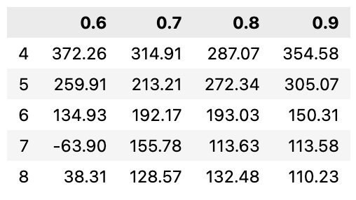
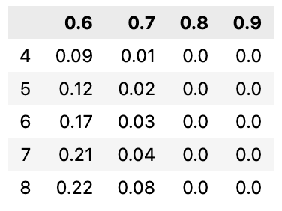
Some truth threshold tests
We collected results obtained using different truth thresholds:
Thresholds: [0.6, 0.7, 0.8, 0.9]
World sizes: [4x4, 5x5, 6x6, 7x7, 8x8]
Tests per configuration: 100
Avg final reward:
Death %:

Slide 67
Thank you for your attention

