Slide 1

KUMC Microbiome Symposium Analysis Workshop June 25, 2026
Rachel Griffard-Smith
Bioinformatician
Department of Biostatistics & Data Science
University of Kansas Medical Center

Slide 2
Overview
16S rRNA-sequencing
Quality control
Diversity metrics & results
Case study
Resources at KUMC
Questions

Slide 3
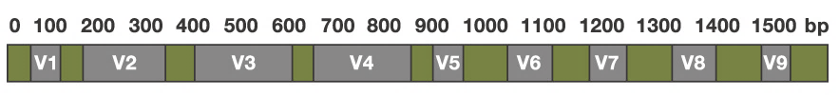
16S rRNA sequencing
One of most widely used methods for profiling bacterial communities
16S rRNA gene found in all bacteria and archaea
Cost-effective, high throughput characterization at varying levels of taxonomic resolution
Robust ecological insights for large cohorts of samples
Paired or single end
16S gene
V3
V4
V5
https://biology.stackexchange.com/questions/54823/what-causes-the-variable-conserved-structure-in-the-16s-rrna-gene

Slide 4
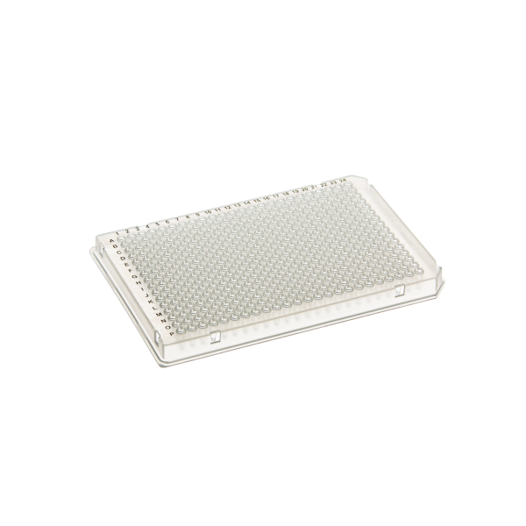
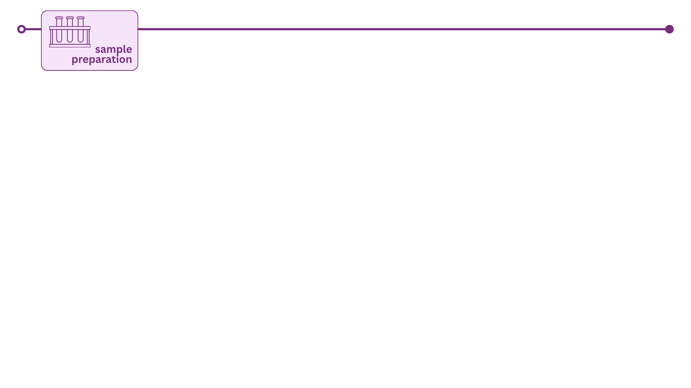

Slide 5


Slide 6
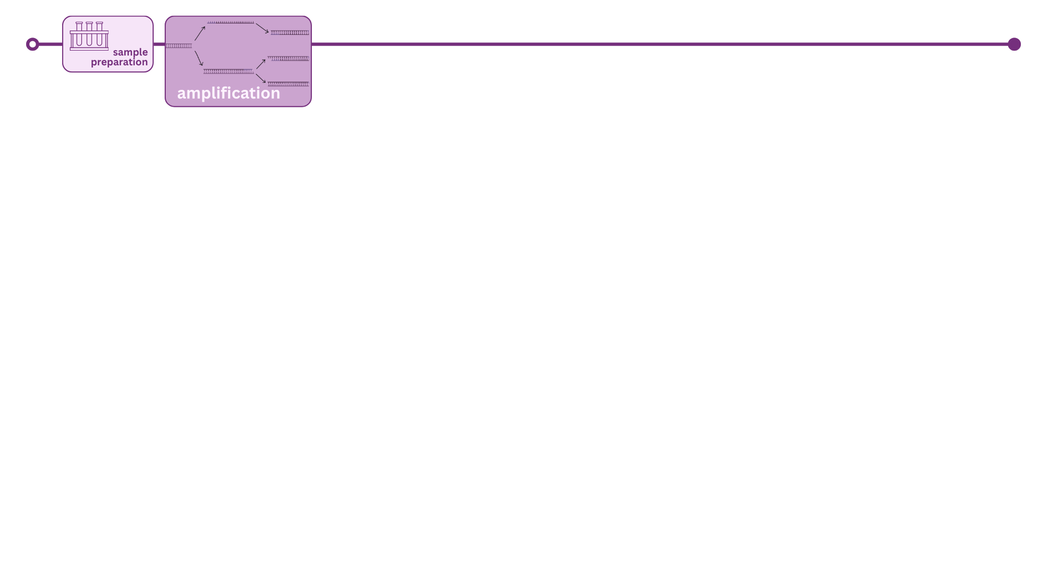
16S rRNA-sequencing
Quality control
Diversity metrics & results
Case study
Resources at KUMC
Questions

Slide 7


Slide 8
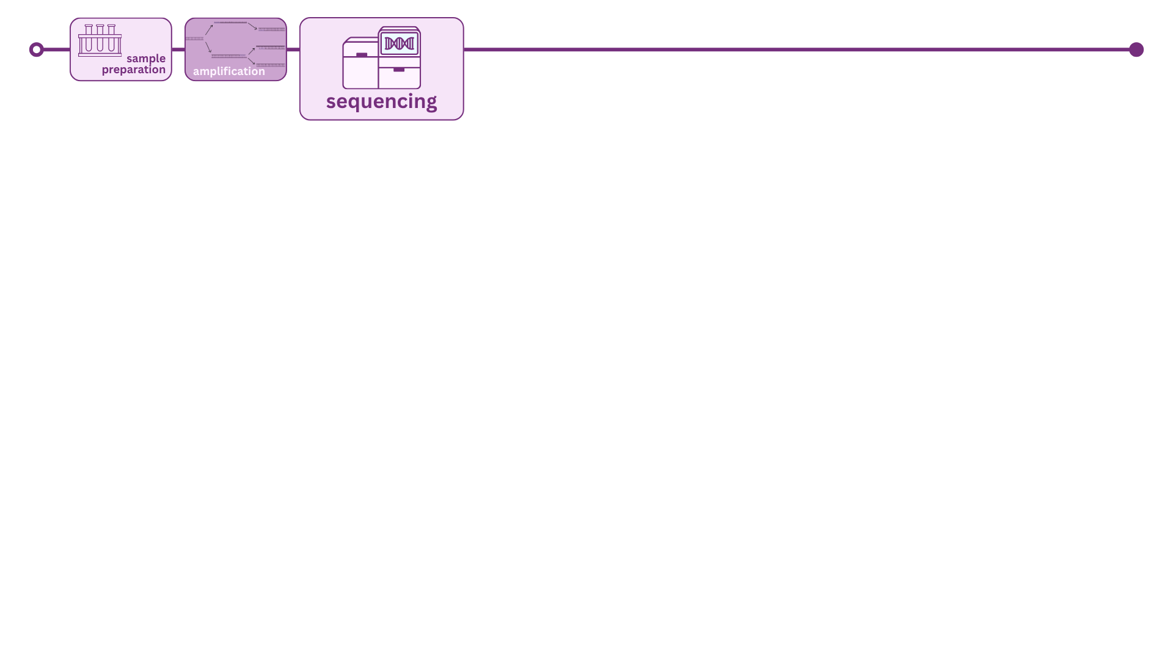

Slide 9
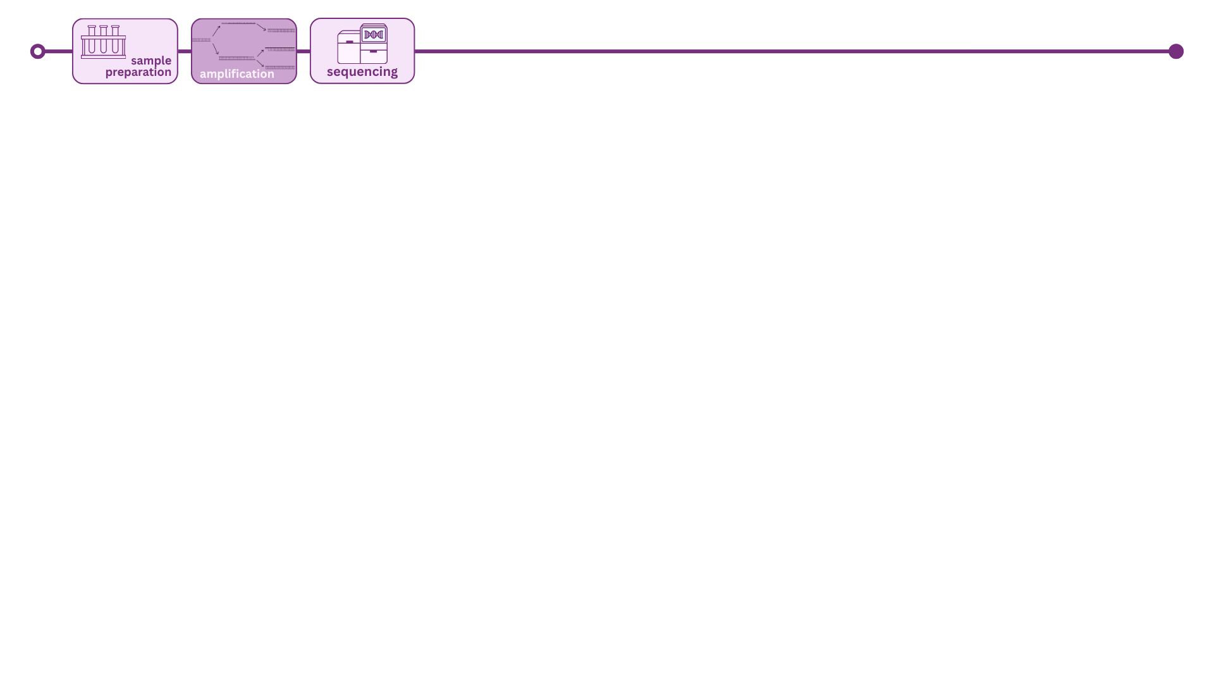

Slide 10
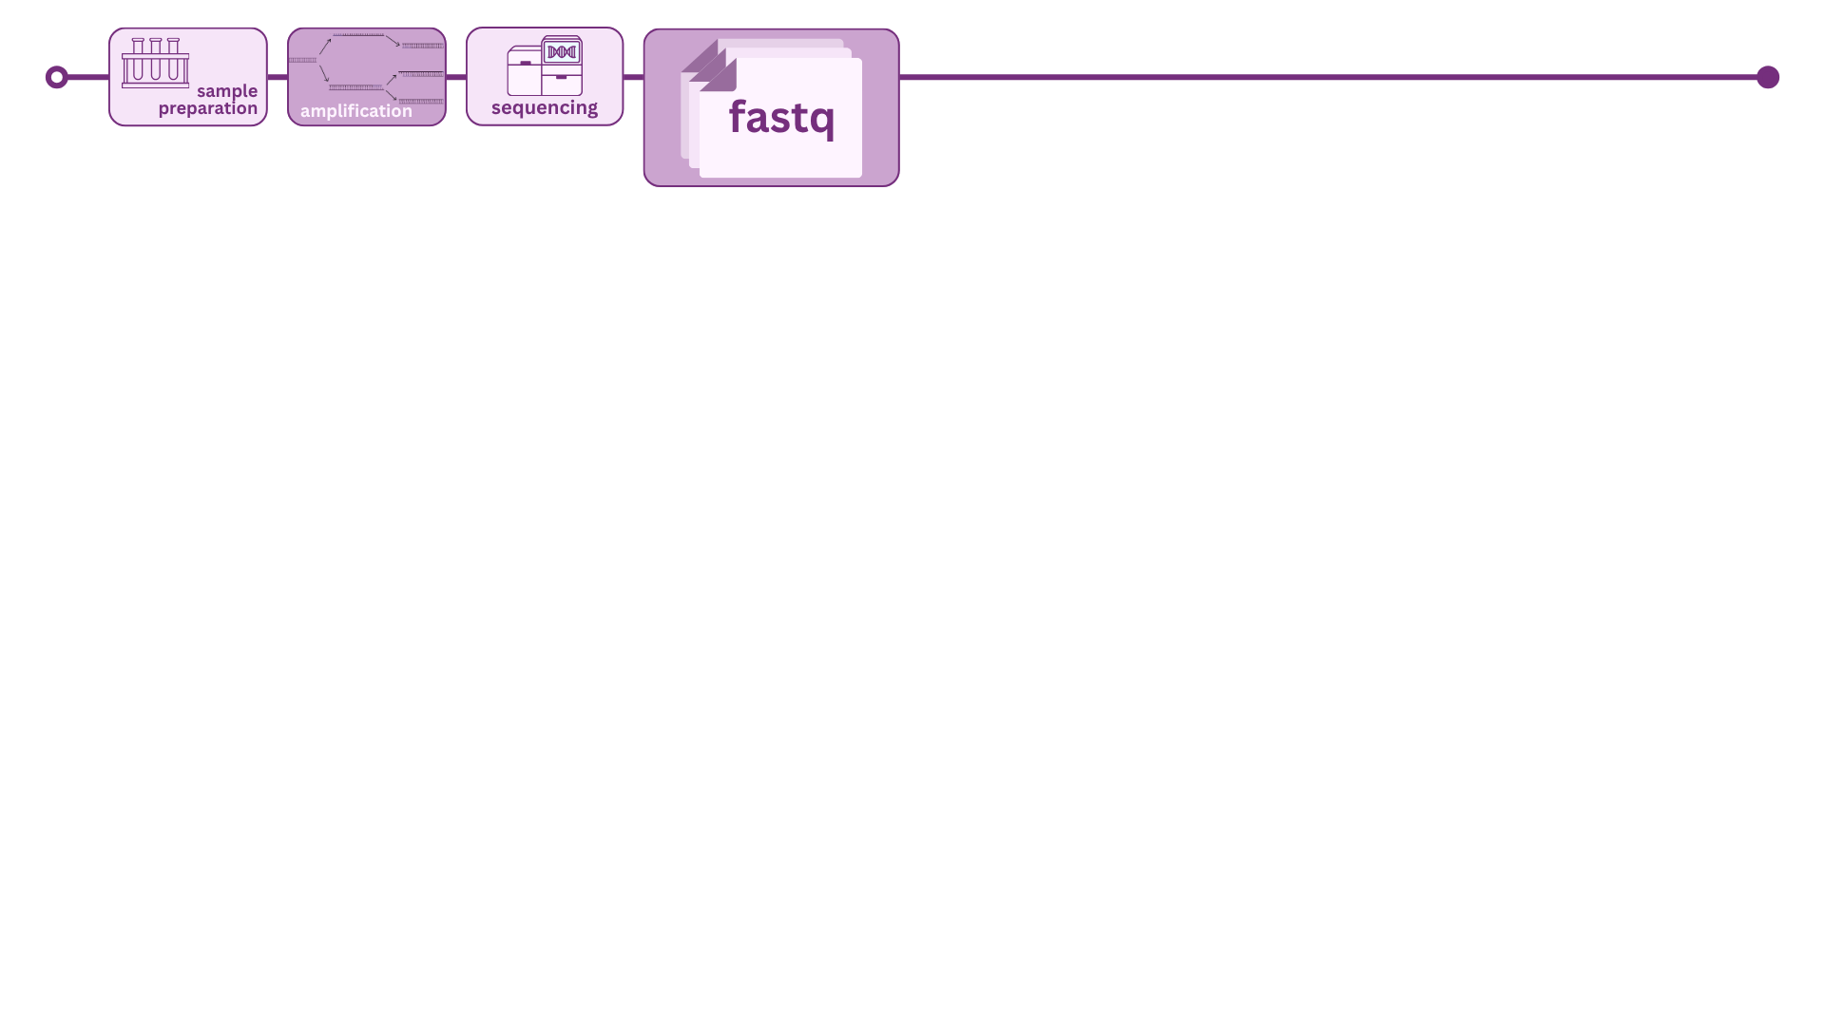

Slide 11
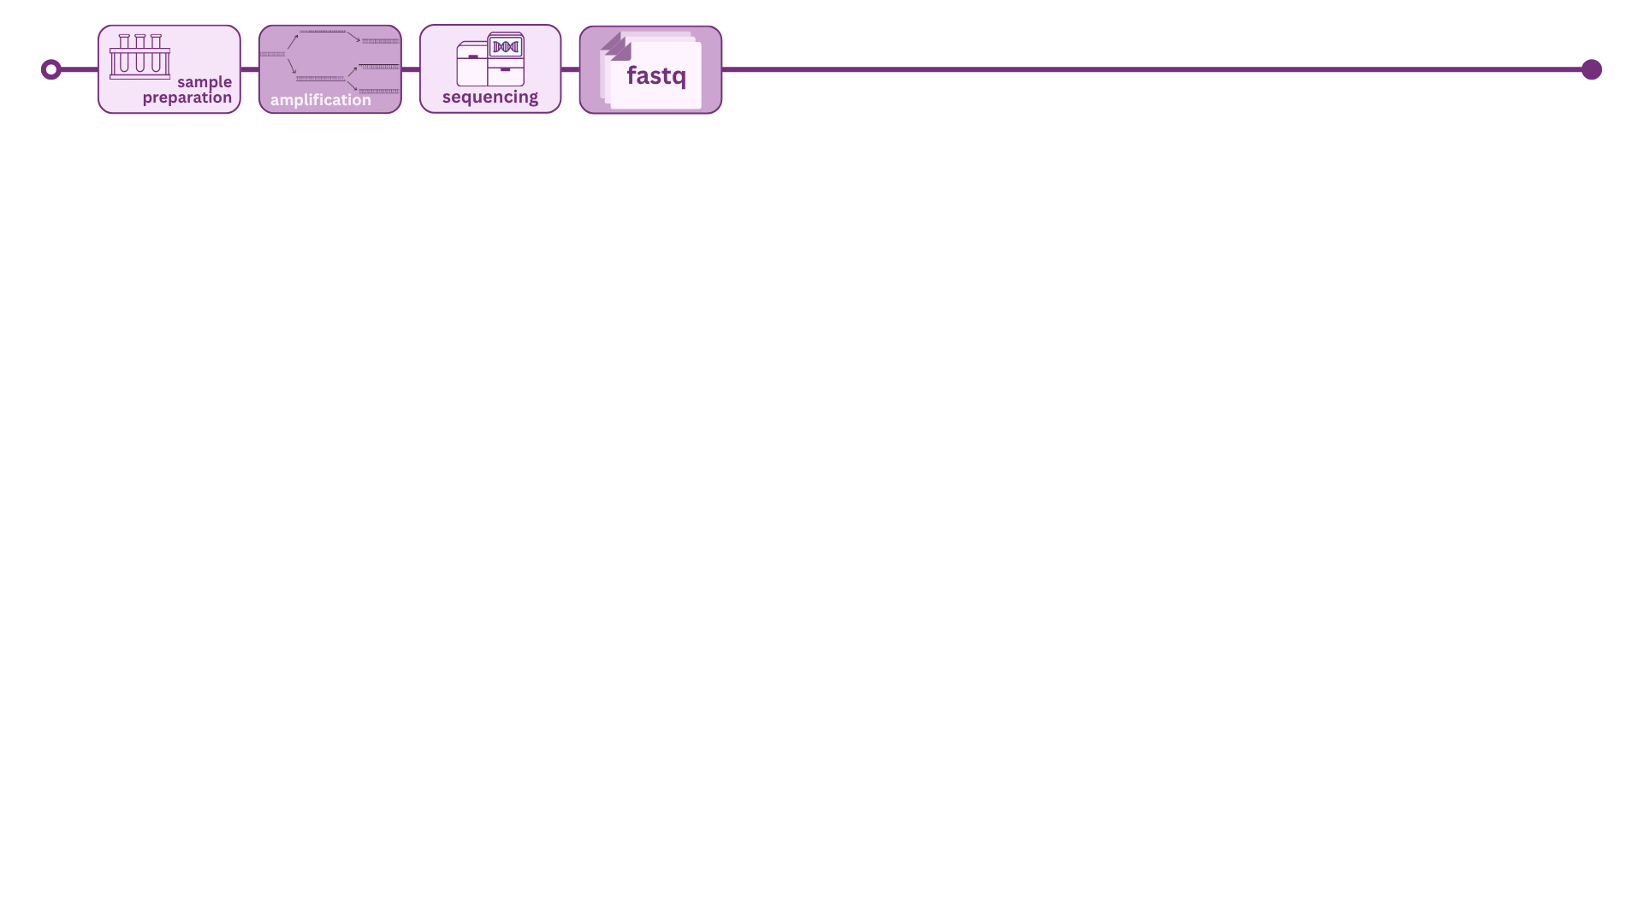

Slide 12
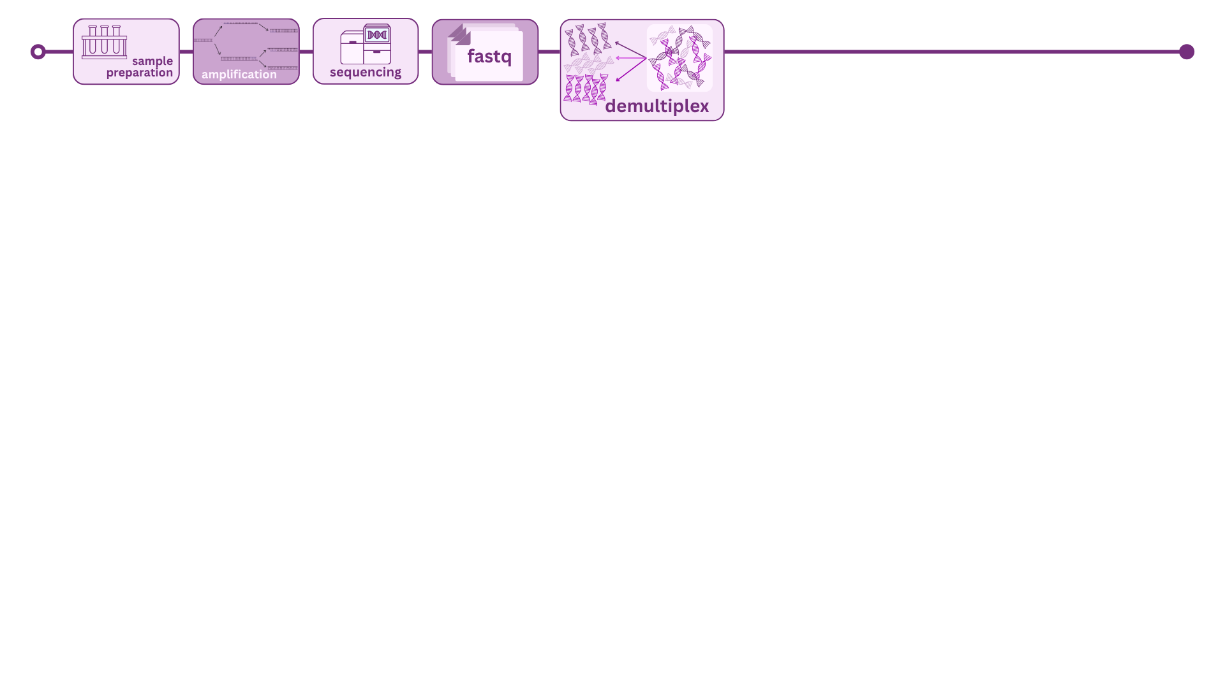

Slide 13
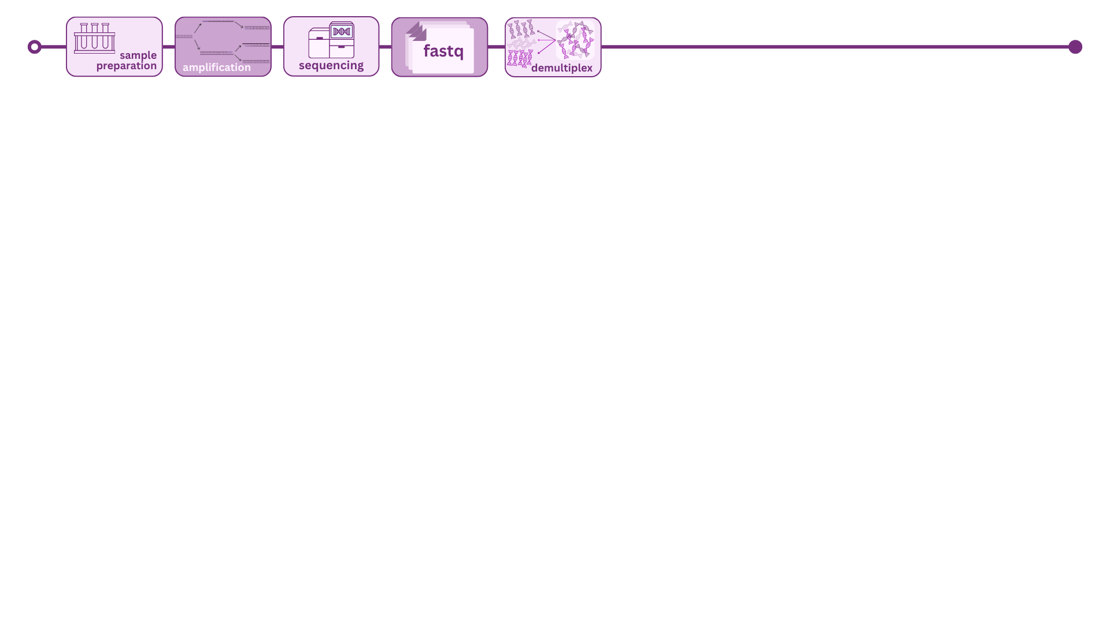

Slide 14
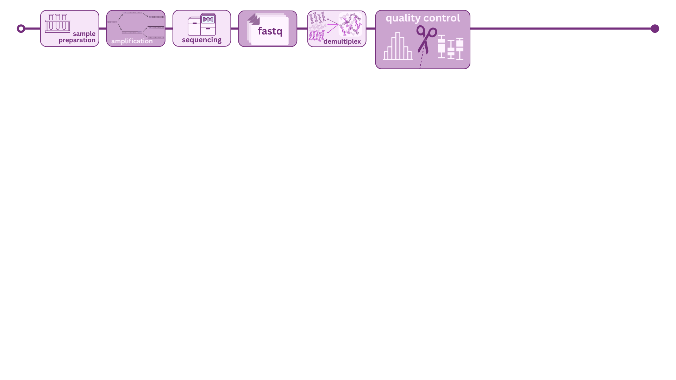

Slide 15
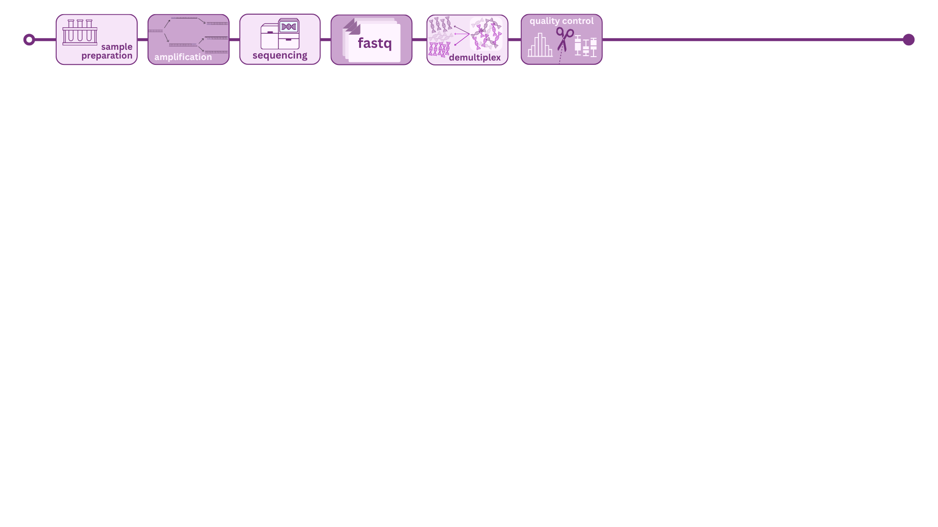

Slide 16
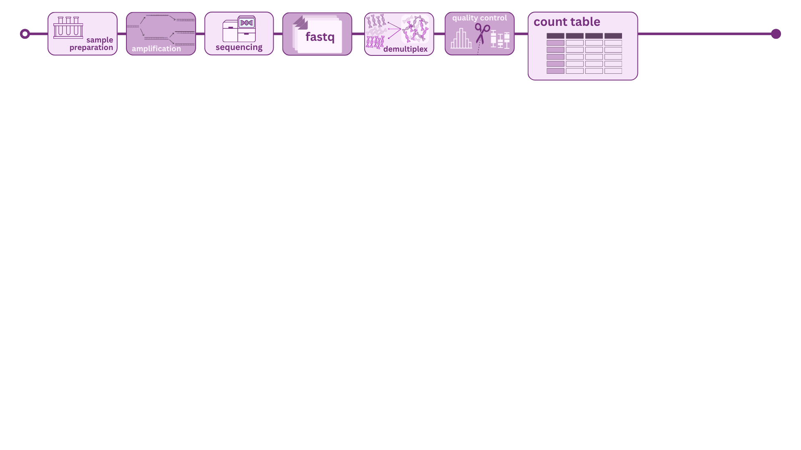

Slide 17
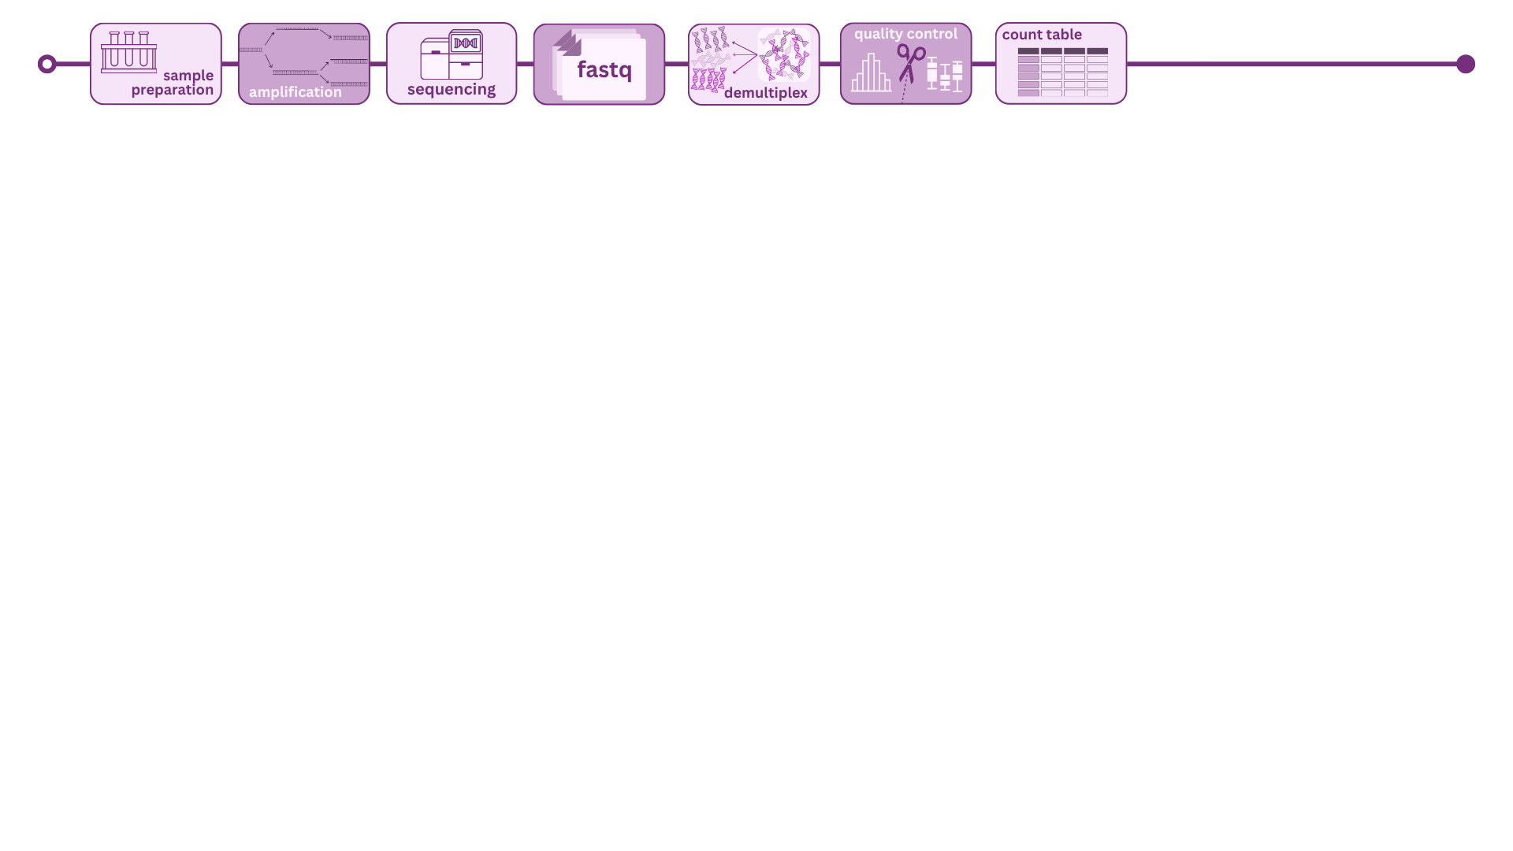

Slide 22
 | Amplicon sequencing | Metagenomics | Metatrascriptomics | Metabolomics
Extracted | DNA | DNA | RNA | Small molecules
Targeted | Marker gene (16S; ITS) | All DNA | Active mRNA transcripts | All metabolites or targeted specific compounds
Core question | Who is there? | Who is there? | What are they actively doing? | What has been produced?
Output | Counts table with assigned taxonomy to genus or family level | Counts table with species level taxonomy | Counts table of genes | Counts table to metabolite profiles
Limitations | Limited taxonomic resolution No functional information Primer bias | Computationally intensive Host DNA contamination Deep sequencing | Captures snapshot in time | Can be difficult to link metabolites back to specific organisms
Best for | Large cohort studies | Strain-level research Novel organisms | Host-microbiome interaction studies Disease state comparisons | Functional outcomes Multi-omics
Notes:
Add quick summary – what would a researcher pick based on specific research questions
Maybe split this into four slides? Have this in a notes handout?
City metaphor: 16S is a census to tell us roughly who is living in this city; metagenomics tells you everyone in the city and their job title and skill set; metatranscriptomics shows us what is being done at work for those who showed up to work today; and metabolomics shows us everything the city has manufactured and sent out into the world

Slide 23
Amplicon sequencing
Who is there?
Does the gut microbiome composition differ between patients with IBD and healthy controls?
Are there differences in soil bacterial communities across agricultural land use types?
Notes:
Add quick summary – what would a researcher pick based on specific research questions

Slide 24
Metagenomics
Who is there? What can they do?
Are there novel or uncultured organisms in a deep-sea hydrothermal vent community?
What metabolic pathways are encoded in the oral microbiome of people with periodontitis?
Notes:
Add quick summary – what would a researcher pick based on specific research questions

Slide 25
Metatranscriptomics
What are they actively doing?
How does the gene expression of the microbiome change in response to a dietary intervention?
Which microbes are most metabolically active in the tumor microenvironment?
Notes:
Add quick summary – what would a researcher pick based on specific research questions

Slide 26
Metabolomics
What have they produced?
Does a probiotic intervention change the metabolite profile of breast milk?
What serum metabolites distinguish patients who respond to immunotherapy from those who do not?
Multi-omics: Does the shift in gut microbiome composition (amplicon sequencing) correspond to measurable increases in metabolomic profiles (metabolomics) after a high-fiber diet intervention?
Notes:
Add quick summary – what would a researcher pick based on specific research questions

