Slide 1
ENGI 301 Halloween Animatronic Proposal
12/13/2022
Rachel Lee

Slide 2
Background Information
I want to make a Halloween candy bowl with an animatronic hand attached that moves when it detects motion. Additionally, the system would vibrate, flash LED lights, and play an audio file. After rescoping the project for this semester, only the software portion of this project was completed.
I am a huge fan of Halloween and one of my favorite parts about celebrating the holiday is getting to see all the cool animatronics fellow Halloween junkies create.
This would be my first project so I thought it would be fitting to start simple and add to the more important element of Halloween: scaring trick or treaters

Slide 3

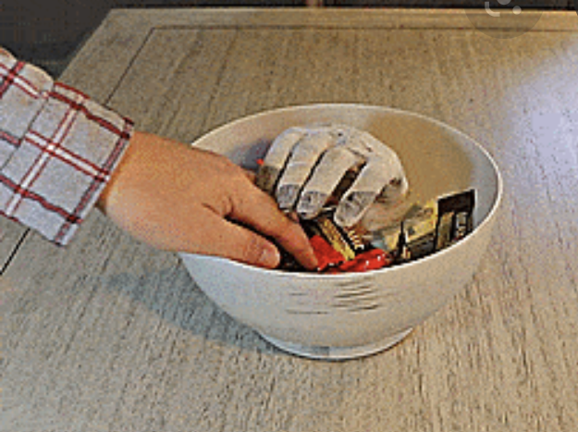
Existing Projects
I want to leverage the existing code
and redesign the hardware to have a
simpler motion, while making the
finger joints in the hands move freely
GitHub Code for Motion Sensor
Sensor Youtube Video
SparkFun Halloween Candy Bowl Teardown
Candy Bowl Surprise
Notes:
Add usb speaker for sound
LEDs?
Piazzo buzzer → for vibration
On/off switch
Extra button for different sounds or to turn off the sound → mp4 or wave files

Slide 4
System Block Diagram
USB Battery
PIR Motion sensor
PocketBeagle
USB0
GPIO
GPIO
LED Strip
USB Speaker
Host adaptor
Piezo vibration motor
USB1
GPIO
PWM
Servo motor
Notes:
Need power input → 5V USB battery plug into usb0 port
Usb1 → host port / host adaptor
Speaker connected through usb to host port
Motion sensor →
Piezo vibration motor → PWM output
Lights → gpio
Servo → pwm output
What are the things that I want to happen?
Song playing continuously → motion detected → different sound
When do you want the vibration to occur
Sequences for lights

Slide 5
System Block Diagram
USB Battery
PIR Motion sensor
5 Volts
PocketBeagle
5 Volts
VIN_USB
SYSVOUT
5 Volts
SYSVOUT
LED Strip
USB Speaker
Host adaptor
5 Volts
Piezo vibration motor
SYSVOUT
SYSVOUT
5 Volts
SYSVOUT
Servo motor
5 Volts
Notes:
Need power input → 5V USB battery plug into usb0 port
Usb1 → host port / host adaptor
Speaker connected through usb to host port
Motion sensor →
Piezo vibration motor → PWM output
Lights → gpio
Servo → pwm output
What are the things that I want to happen?
Song playing continuously → motion detected → different sound
When do you want the vibration to occur
Sequences for lights

Slide 6
Components / Budget
Component | Need to Buy | Cost
PIR Motion Sensor | 1 | 9.95
USB Cable with Switch | 1 | 2.95
USB Battery Pack | 1 | 14.95
Vibration Motor | 1 | 10.69
Servo Motors | 1 | 19.99
USB Speaker | 1 | 12.99

