Slide 1
Friction Force Explorers
Don Zheng, Neil Jassal, Rachel Holladay

Slide 2
Metrics Used

Slide 3


Metric #1: Mechanical Complexity

Slide 4


Metric #2: Algorithmic Interest

Slide 5


Metric #3: Time

Slide 6


Metric #4: Usability

Slide 7


Metric #5: Durability

Slide 8
Robots to Be Evaluated

Slide 9
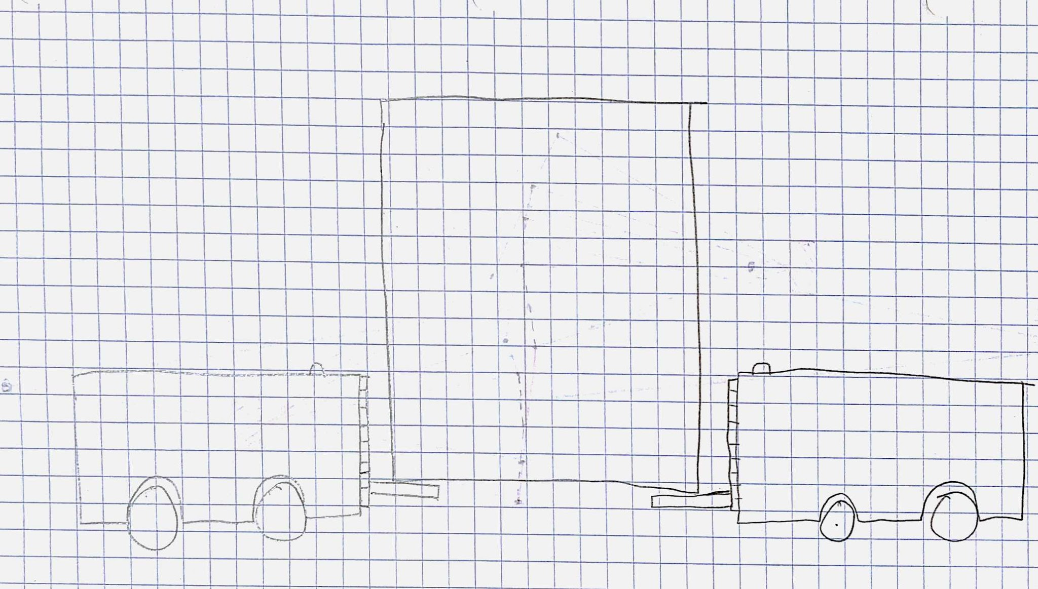
Robot #1: Multirobot Movers

Slide 10
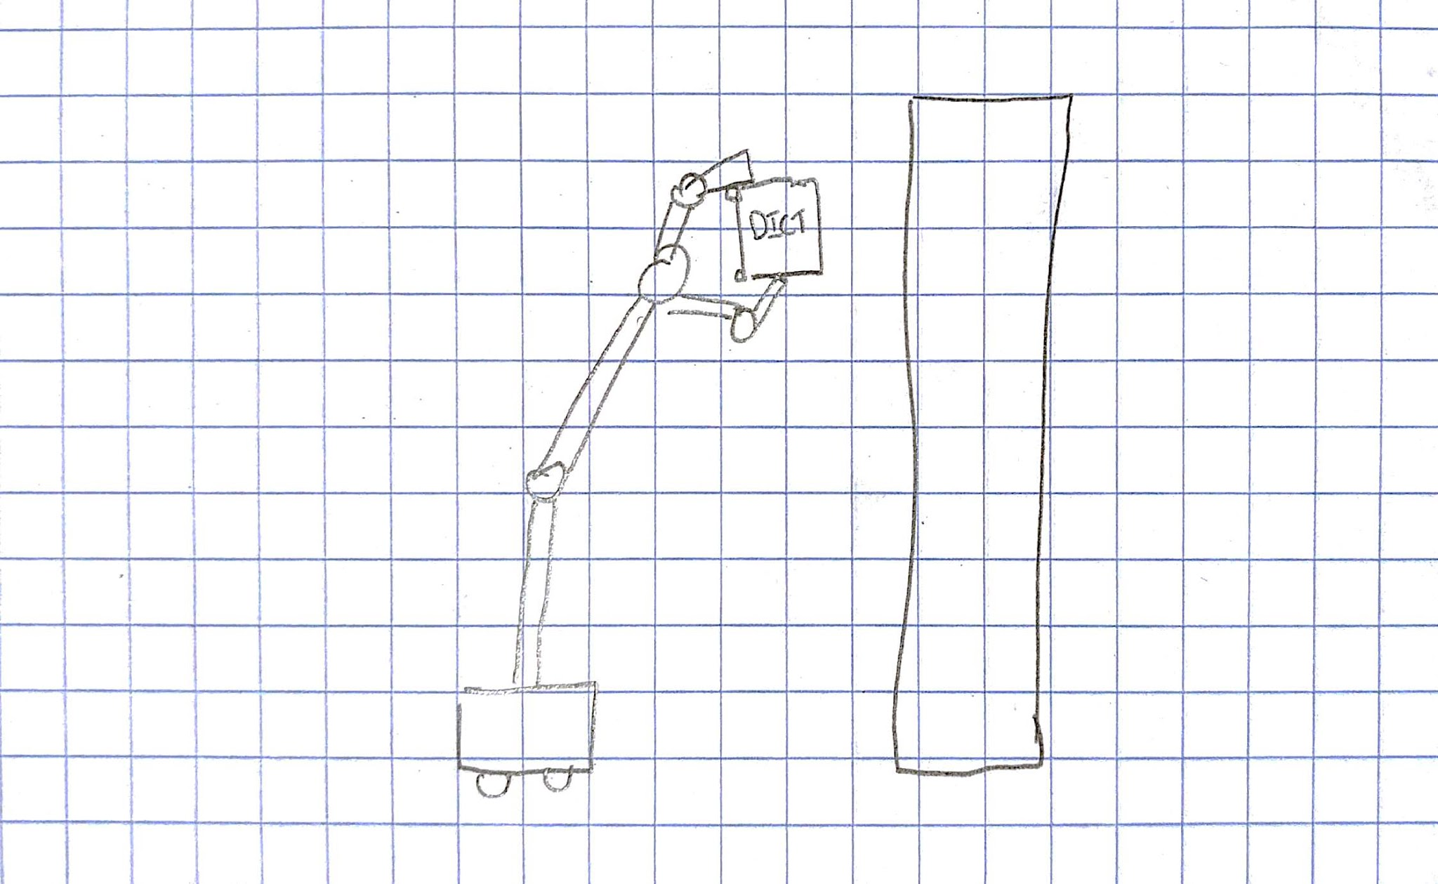
Robot #2: Robot Librarian

Slide 11
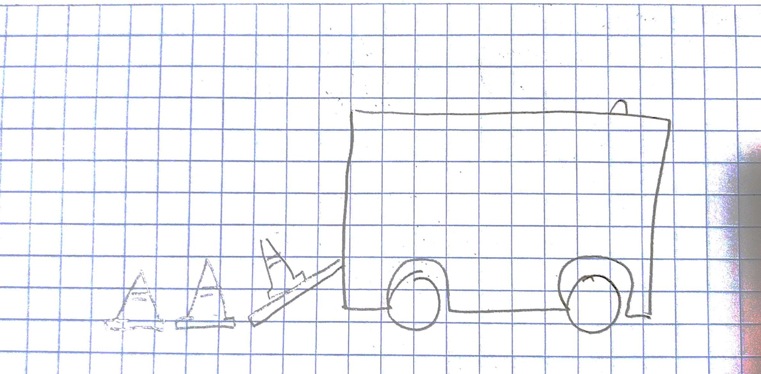
Robot #3: Cone Laying Robot

Slide 12
Alternatives Evaluation

Slide 13
 |  |  | Multi-Robot Movers |  | Robot Librarian |  | Cone Laying Robot
Evaluation Criteria | Priority (1-5) | System Attributes (Relevant Feature) | Metric Score (1-5) | Weighted Score | Metric Score (1-5) | Weighted Score | Metric Score (1-5) | Weighted Score
Mechanical Complexity | -5 | # of mechanically significant parts | 2 | -10 | 4 | -20 | 3 | -15
Algorithmic Interest | 3 | # of interesting problems | 4 | 12 | 2 | 6 | 3 | 9
Time to build | -4 | Schedule predictability | 3 | -12 | 3 | -12 | 4 | -16
Usability | 1 | Startup potential | 3 | 3 | 2 | 2 | 5 | 5
Durability | -2 | # of fragile mechanical components | 1 | -2 | 3 | -6 | 2 | -4
 |  |  |  | -9 |  | -30 |  | -21

