Slide 1

Lead Score Case Study Using Logistic Regression

Slide 2
Problem Statement
X Education is an online education company that provides online courses for industry professionals
The Sales team gets Leads through various channels such as Google, email, SMS, advertisement, referrals, etc
To boost sales efficiency, X Education aims to identify 'Hot Leads' with high conversion potential, enhancing the conversion rate

Slide 3
Goals of the Case Study
Build a logistic regression model to assign a lead score between 0 and 100 to each of the leads which can be used by the company to target potential leads
A higher score would mean that the lead is hot, i.e. is most likely to convert whereas a lower score would mean that the lead is cold and will mostly not get converted
There are some more problems presented by the company which your model should be able to adjust to if the company's requirement changes in the future so you will need to handle these as well

Slide 4
Business Goal
The business goal of X Education is to enhance its lead conversion rate and overall efficiency in order to achieve a higher level of growth and success in the online education industry
This goal is driven by the aim to identify and prioritize high-potential leads, often referred to as 'Hot Leads,' who are more likely to convert into paying customers
This elevated conversion rate would contribute significantly to the company's expansion and market prominence, aligning with its vision of providing online courses to industry professionals and further establishing itself as a key player in the online education sector

Slide 5
Strategy
Import Data and Understand the Data
Data Sanitization
Exploratory Data Analysis
Data Preparation for Modeling
Scaling features
Build a logistic Regression Model
Test the model on the train set
Evaluate the model with different metrics and measures
Test the model on test set
Measure the accuracy and other metrics

Slide 6

Exploratory Data Analysis

Slide 7
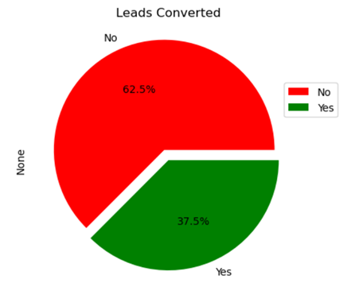
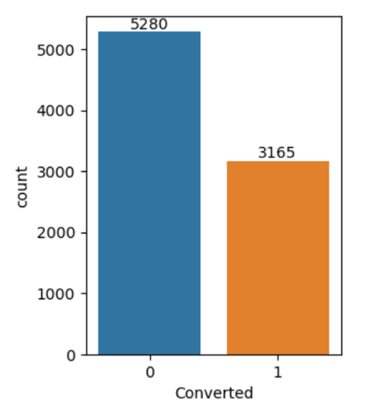
Converted
The lead convertion success rate is 37.5%. Around 62.5% of the leads are not converted.

Slide 8
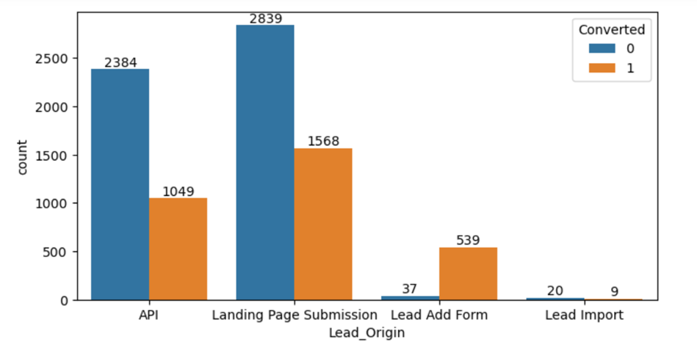
Lead Origin
The leads coming from the landing page and the API has the highest conversion rate of 35.5% and 30.5% respectively. The lead Add Form has the highest conversion rate of 93% The lead import is not successful for lead conversion.

Slide 9
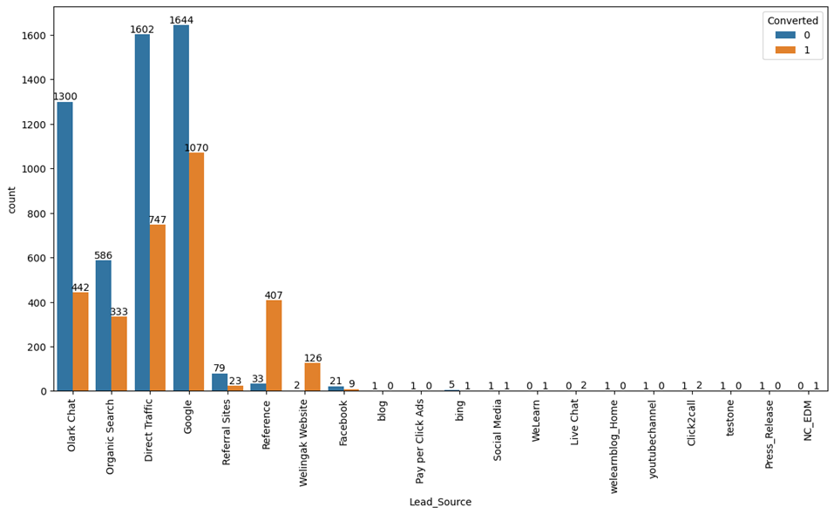
Lead_Origin
Google traffic has the highest lead_Source followed by Direct_Traffic of 39%. Reference has the highest convertion rate of 92.5% Direct Traffic has 31% Olark Chat 25% Organic Search 36%.

Slide 10
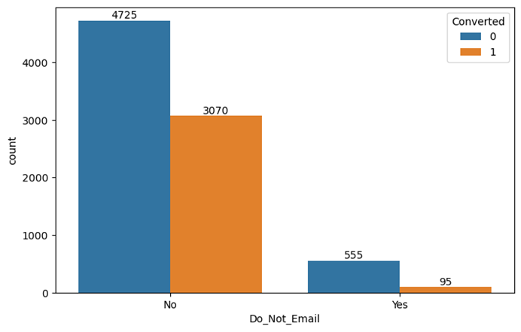
Do Not Email
Though 'Do_Not_Email' has been selected by the customers, there seems a high conversion rate of 40% compared to the customers who has a conversion rate of 15% said 'Yes'

Slide 11
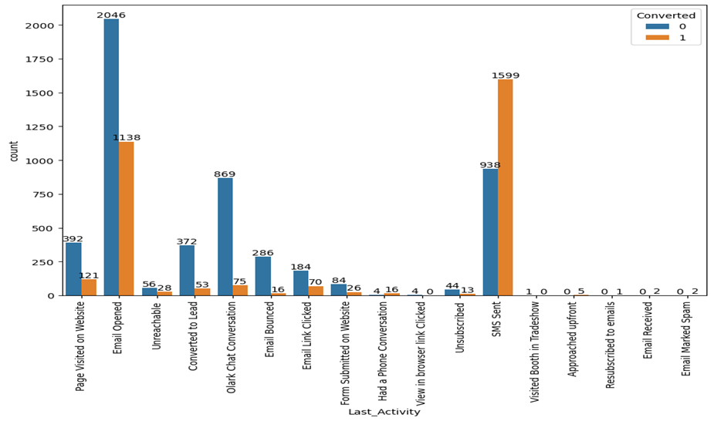
Last Activity
SMS has the highest convertion rate of 80% followed by Email opened of 43.5 Page visited on website has a convertion rate of 23.5%.

Slide 12
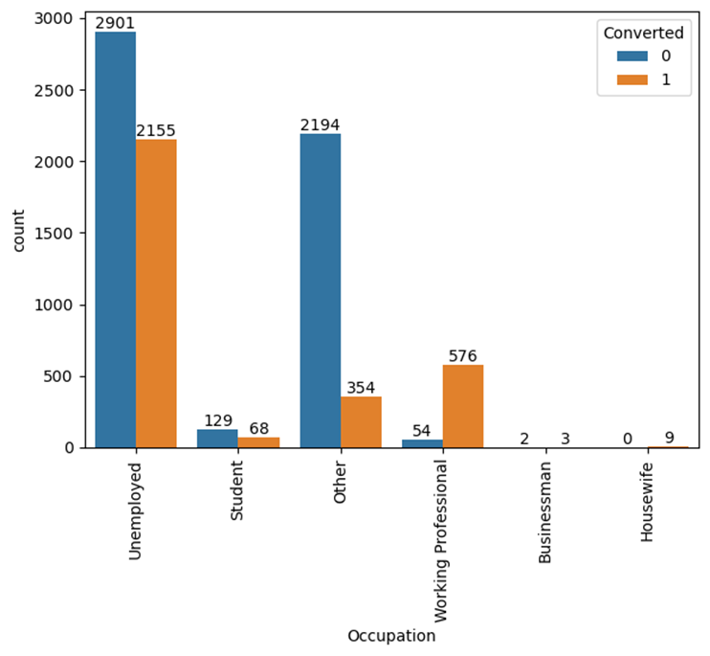
Occupation
Unemployed people shows highest convertion rate of 42.6% followed by working professionals with a convertion rate of 91%.

Slide 13
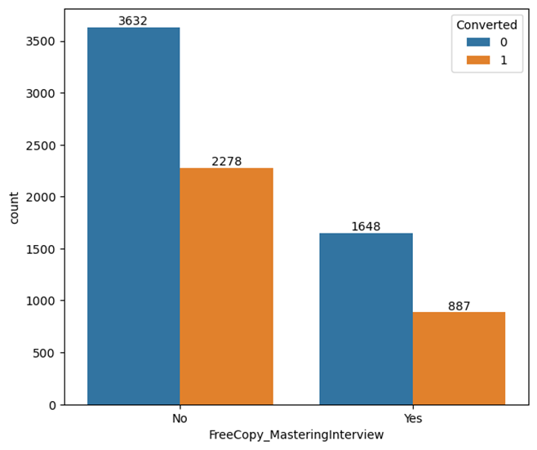
Free Copy Mastering Interview
Irrespective of downloading the Free Copy for Mastering Interview, the convertion rate is almost equal with 38.5% and 35% respectively.

Slide 14
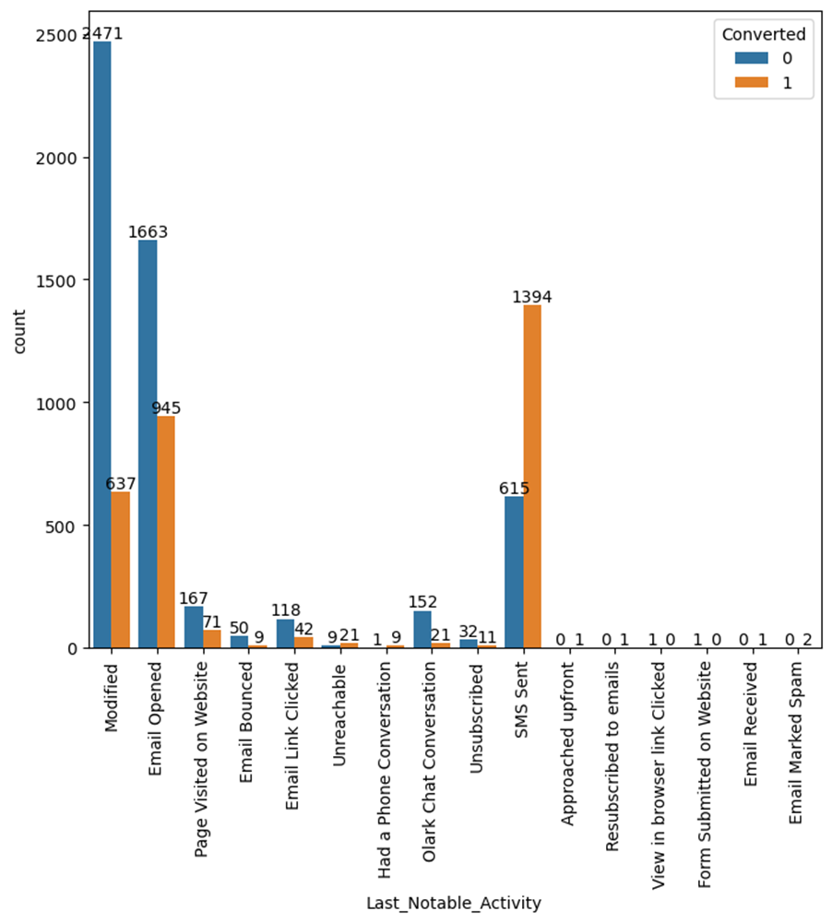
Last Notable Activity
The effective lead convertion is through SMS (69%) ,Email_opened (36%) and Email modified (57%)

Slide 15

Model Building Steps
Splitting the data frame into test and train data
Scale variables in the train set
Build the initial model
Use RFE to eliminate the less relevant variables
Build the second model
Eliminate the variables having high p-value
Check VIF score < 5
Predict using train set
Repeat model building until VIF score < 5 and p_value is 0.
Evaluate accuracy and other metrics
Predict using test set
Accuracy and other metrics

Slide 16
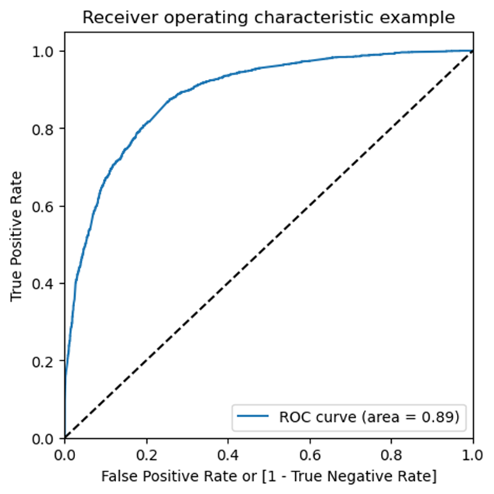
ROC Curve
It shows the tradeoff between sensitivity and specificity (any increase in sensitivity will be accompanied by a decrease in specificity).
The closer the curve follows the left-hand border and then the top border of the ROC space, the more accurate the test. The closer the curve comes to the 45-degree diagonal of the ROC space, the less accurate the test.

Slide 17
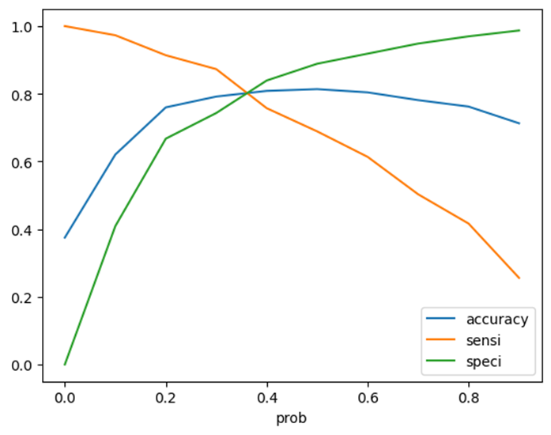
Finding Optimal Cutoff Point
Optimal cutoff probability is that prob where we get balanced sensitivity and specificity
From the curve above, 0.37 is the optimum point to take it as a cutoff probability

Slide 18

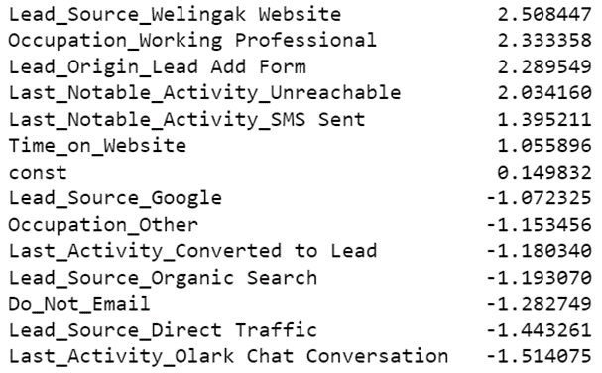
Hot Leads

Slide 19
Accuracy and other metrics
Train Data:
Accuracy:0.81
sensitivity: 0.80
specificity:0.81
1
Test Data:
Accuracy: 0.82
sensitivity: 0.78
specificity:0.84
2
Precision and Recall
Precision: 0.787
Recall: 0.688
3

Slide 20
Recommendation Based on EDA
EDA:
Enhance the overall lead conversion rate by directing attention towards improving the conversion rates for API and Landing Page Submission. Additionally, prioritize generating a greater influx of leads through the Lead Add Form.
To bolster the overall lead conversion rate, the client should place emphasis on elevating the conversion rates of leads originating from Google and Direct Traffic sources. Furthermore, increasing lead generation from references and the Welingak website is paramount.
It's noteworthy that customers or leads with higher visit frequency and prolonged time spent on the website exhibit a greater likelihood of conversion.
Logistic Regression Model:
The model seems to predict the conversion rate more accurately and this will ensure the CEO with a good conversion rate.
Conversion rate on the final predicted model is around 78%
There are strongly funneled 490 Hot Leads. They should be targeted as they have a high chance of getting converted.
We have determined the following features that have the highest positive coefﬁcients, and these features should be given priority in our marketing and sales efforts to increase lead conversion.
Lead_Source_Welingak Website : 2.508447
Occupation_Working Professional : 2.333358
Lead_Origin_Lead Add Form : 2.289549

Slide 21
THANK YOU!

