Slide 1
Income Prediction Using Census Data
Xiangmin Kong (Rachel)

Slide 2
Agenda
Problem description
Data Exploration
Data Cleaning
Data Normalization
Handling Imbalanced Data
Model Evaluation
Feature Selection
Model Prediction

Slide 3
Problem Description
The aim is to build models to determine the income level of the people in U.S.
It’s a binary classification problem to predict if an individual has an income higher than $50k/year
Which of the variables(age, occupation, race, etc.) are the most decisive for determining the income of a person
Which model have the best performance

Slide 4
Data Exploration
Source:https://archive.ics.uci.edu/ml/datasets/Census-Income+(KDD)
Steps:
Check Data shape
Check Data types for all the columns and change if required
Check target column data levels
Explore and visualize the patterns in data

Slide 5
a) Check Data shape
We downloaded the dataset and separated into train and test dataset. Following are the observations:
Total:299285 rows and 41 columns
 | TRAIN DATASET | TEST DATASET
Rows | 199523 | 99762
Columns | 41 | 41

Slide 6
b) Check Data types for all the columns and change if required
On checking the dataset we identified the Numerical Columns and Categorical Columns changed their datatypes:
Categorical Columns identified: #34/41 Cols
factorCols = ['class_of_worker','industry_code','occupation_code','education','enrolled_in_edu_inst_lastwk', 'marital_status', 'major_industry_code', 'major_occupation_code','race', 'hispanic_origin','sex’, 'member_of_labor_union', 'reason_for_unemployment', 'full_parttime_employment_stat', 'tax_filer_status', 'region_of_previous_residence', 'state_of_previous_residence', 'd_household_family_stat', 'd_household_summary', 'migration_msa', 'migration_reg', 'migration_within_reg', 'live_1_year_ago', 'migration_sunbelt', 'family_members_under_18', 'country_father', 'country_mother', 'country_self', 'citizenship', 'business_or_self_employed', 'fill_questionnaire_veteran_admin', 'year','veterans_benefits','income_level']
Numerical Columns identified: #7/41 Cols
numCols = ['age','wage_per_hour','capital_gains','capital_losses','dividend_from_Stocks','num_person_Worked_employer','weeks_worked_in_year']

Slide 7
Features & Response Variable:
Response Variable:
income_level of below 50K or above 50K
Features:
Age, industry_code, occupation_code, education
marital_status, race, sex...

Slide 8
c) Check target column data levels
The target column is income_level
On checking initial rows identified that the target column has different denominations ie:
In TrainData we have -50000 & +50000 for income_level
In TestData we have -50000 & 50000+ for income_level

Slide 9
d) Explore and visualize the patterns in data
For further data exploration we separated the dataset in Numerical and Categorical Dataset. We analyzed the columns to find patterns. Below the observations we found:
Observations on Numerical Data
Observations on Numerical Data with Target Variable
Observations on Categorical Data

Slide 10
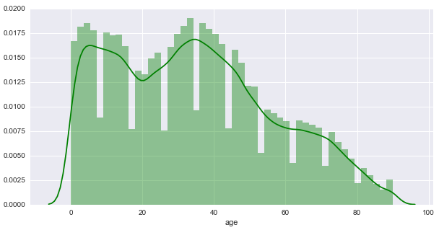
Observations on Numerical Data
Distribution Pattern of some numerical columns on the Graph:
Age
Conclusion: Earning class is from 0-90

Slide 11
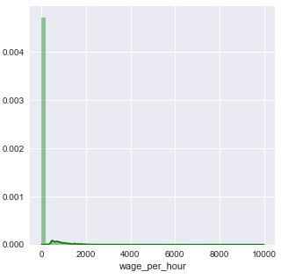
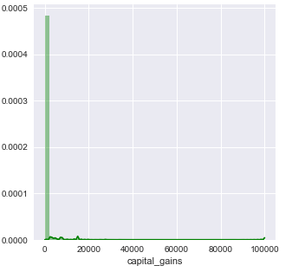
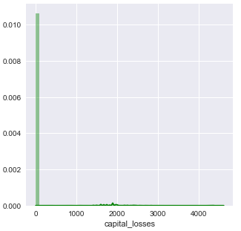
2. capital_Losses , capital_gains, wage_per_hour
Conclusion: : Highly skewed graph, We can check for unique values and may need to normalize if unique values are less.

Slide 12
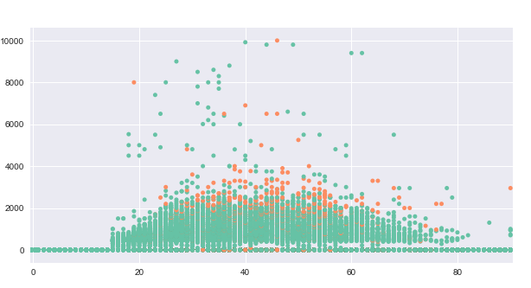
Observations on Numerical Data with Target Variable
Checked the age, wage_per_hour and income_level
Conclusion:
Majority of income_level 1 fall in 25-65 age group.
Age group 0-20 have income level as 0.
Income_level 0
Income_level 1
Wage_per_hour
age

Slide 13
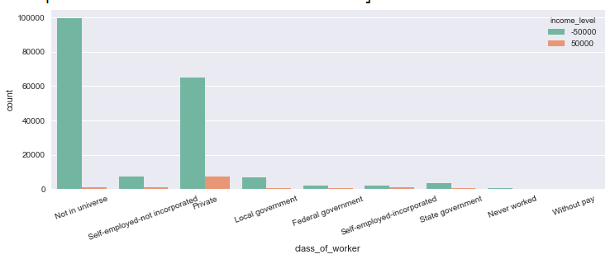
Observations on Categorical Data
Class_of_worker
Conclusion:
Majority dominant in only two categories ‘Not in Universe’ and ‘Private’ rest all are very less and can be combined together to new category ‘Others’

Slide 14
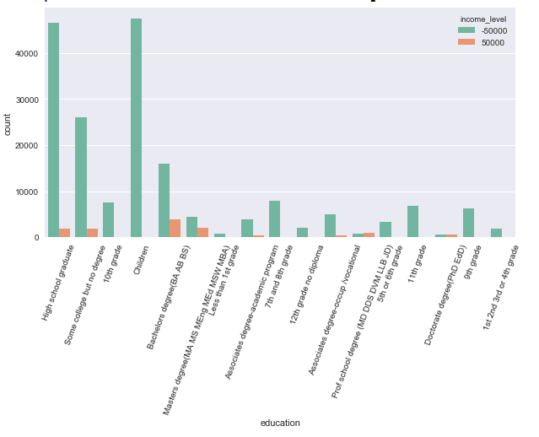
2. Education
Conclusion:
People with the Bachelor’s degree are the highest earning class with income_level 1 whereas children have no earnings and all have income_level 0.

Slide 15
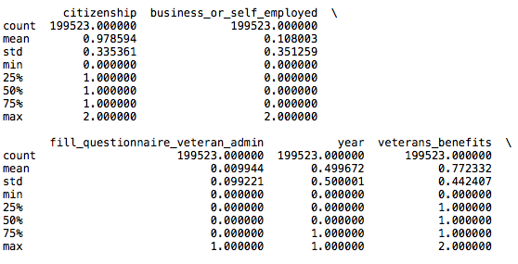
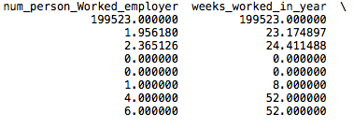
Descriptive Statistics

Slide 16
Data Cleaning
Steps
Check for missing values
Delete columns with >5% missing values
Set missing data as ‘Unavailable’ in columns with <5%
Encode categorical values to numerical
Bin columns with high % of zero values to Zero and Non-Zero
Bin age variable into age groups

Slide 17
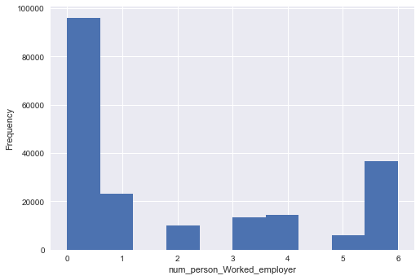
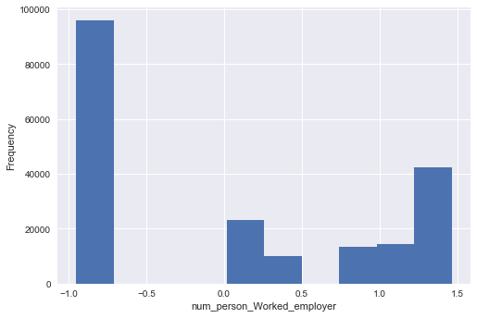
Data Normalisation
2 highly skewed numerical columns
num_person_Worked_employer
weeks_worked_in_year
Before Normalization
After Normalization

Slide 18
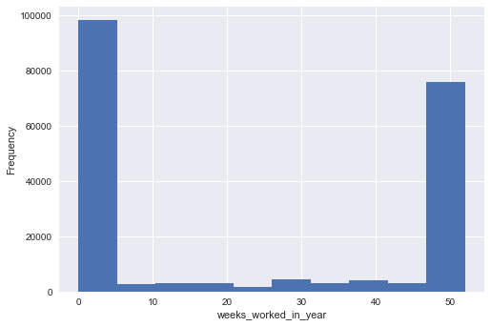
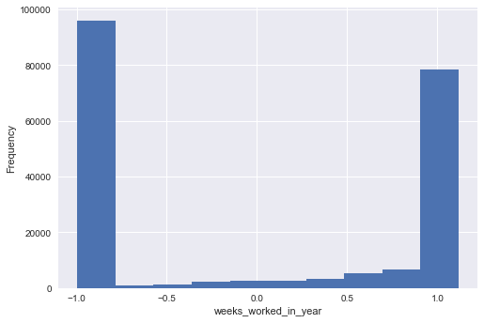
Data Normalisation
Before Normalization
After Normalization

Slide 19
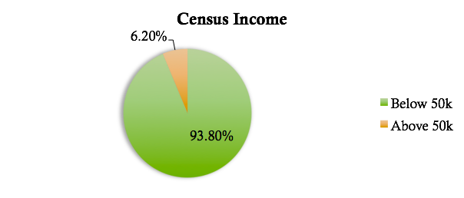
The Data is Imbalanced
The dependent variable has imbalanced proportion of the classes.

Slide 20
Danger of Imbalanced Classes
ML algorithms struggle with accuracy because of the unequal distribution of dependent variable
This cause the performance of existing classifier to get biased towards majority class.
Accuracy is very high while AUC is very low
Accuracy 0.94 VS AUC 0.58

Slide 21
Handling Imbalanced Data
Down-sampling Majority Class – lose information
Up-sample Minority Class – over-fitting
Synthetic Data Generation(SMOTE)

Slide 22
Model Evaluation
k-fold Cross Validation
Bootstrap
Imbalanced vs Balanced Data

Slide 23
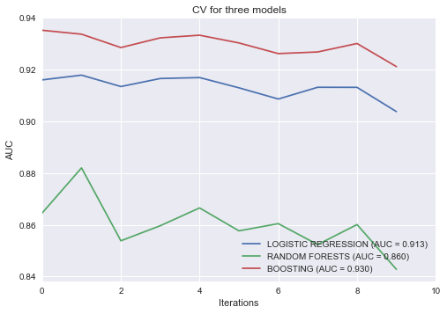
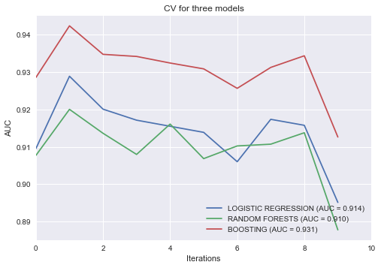
Model Evaluation
K-fold Cross Validation

Slide 24
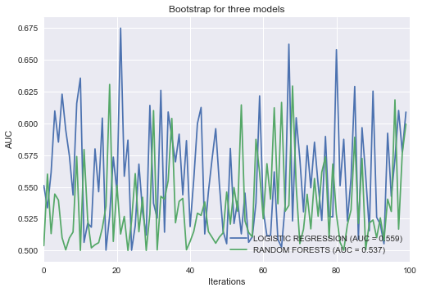
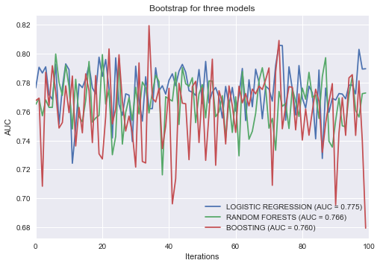
Model Evaluation
Bootstrap
Accuracy:0.93
Accuracy:0.91

Slide 25
Feature Selection
Forward Stepwise Feature Selection
Backward Stepwise Feature Selection
Random Forest for Feature Selection
Boosting for Feature Selection

Slide 26
Feature Selection
Sometimes, feature subsets giving better results than complete set of feature for the same algorithm.

Slide 27
Feature Selection
Reasons to use feature selection:
It enables the machine learning algorithm to train faster.
It reduces the complexity of a model and makes it easier to interpret.
It improves the accuracy of a model if the right subset is chosen.
It reduces overfitting.

Slide 28
Forward Stepwise
After applying forward selection, the best set of features obtained are :
['weeks_worked_in_year', 'dividend_from_Stocks', 'sex', 'age', 'capital_gains', 'capital_losses', 'num_person_Worked_employer']

Slide 29
Backward Stepwise
After applying backward elimination, the best set of features obtained are :
['sex', 'age', 'capital_gains', 'capital_losses', 'dividend_from_Stocks', 'weeks_worked_in_year']

Slide 30
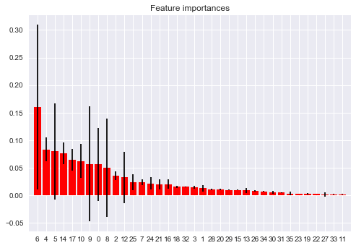
Random Forest for Feature Selection
Feature ranking:
weeks_worked_in_year 0.16
dividend_from_Stocks 0.08
num_person_Worked_employer 0.08
major_occupation_code 0.08
sex 0.06
education 0.06
occupation_code 0.06
age 0.06
industry_code 0.05

Slide 31
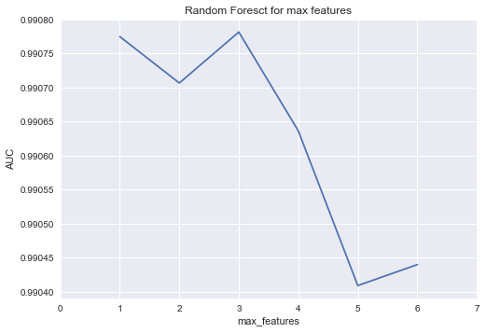
Maximum Features
The max number of features for Random Forests is 3

Slide 32
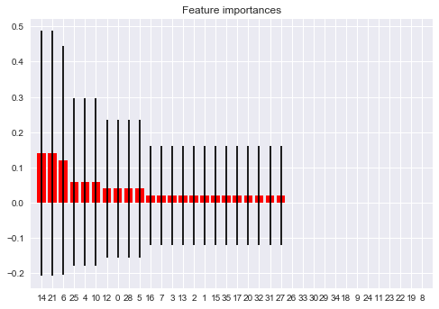
Boosting for Feature Selection
Feature ranking:
major_occupation_code: 0.14
tax_filer_status: 0.14
weeks_worked_in_year: 0.12
d_household_summary: 0.06
dividend_from_Stocks: 0.06
education: 0.06
marital_status: 0.04
age: 0.04
country_father: 0.04

Slide 33
Significant Features
weeks_worked_in_year
dividend_from_Stocks
major_occupation_code , education
Backward stepwise | Forward stepwise | Random forest | Boosting
weeks_worked_in_year | weeks_worked_in_year | weeks_worked_in_year | major_occupation_code
dividend_from_Stocks | dividend_from_Stocks | dividend_from_Stocks | tax_filer_status
num_person_Worked_employer | sex | num_person_Worked_employer | weeks_worked_in_year
major_occupation_code | age | major_occupation_code | d_household_summary
sex | capital_gains | sex | dividend_from_Stocks
education | capital_losses | education | education
occupation_code | num_person_Worked_employer | occupation_code | marital_status

Slide 34
Model Prediction
Logistic Regression
Random Forest
Boosting
Support Vector Machine(SVM)

Slide 35
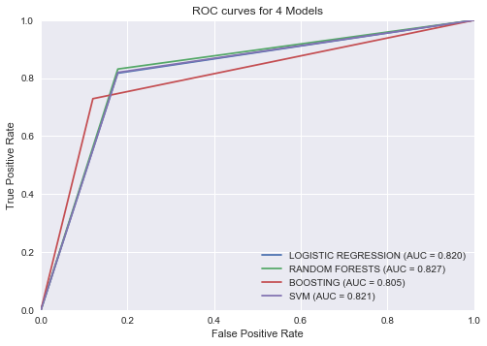
Summary
ROC Curve and AUC for Balanced Dataset
Based on Down-Sampling:
Total Computational Time: 1 hour

Slide 36
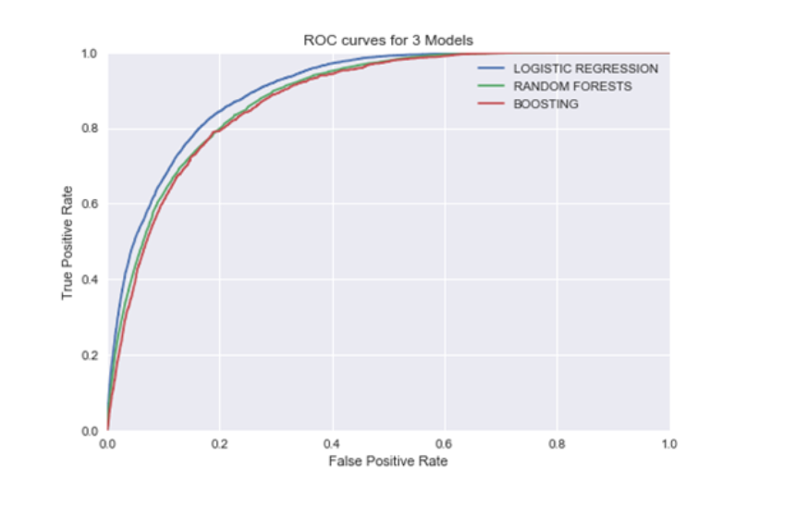
Summary
Based on SMOTE up-sampling:
Total Computational Time for Logistic Regression, Random Forests and Boosting: 2 hours

Slide 37
Summary
Based on SMOTE up-sampling:
Computational Time for SVM : 11+ hours
Accuracy: 0.87
Recall / TPR: 0.69996766893
Precision / FPR: 0.277332991738
AUC Score: 0.90
Classification Report:
precision recall f1-score support
0 0.98 0.88 0.93 93576
1 0.28 0.70 0.40 6186
avg / total 0.93 0.87 0.89 99762

Slide 38
Summary
Balanced Dataset Comparison Results:
Best Model: Boosting
MODEL | ACCURACY | AUC
Logistic regression | 0.87 | 0.90
Random forest | 0.94 | 0.89
SVM | 0.87 | 0.90
Boosting | 0.94 | 0.91

Slide 39
Conclusion
Work years, dividends, company size, age, education, occupation, and marital status (or relationship kind) are good for predicting income (above a certain threshold).
Boosting has the best performance with a AUC of 0.91 and Accuracy of 0.94

Slide 40
Thank you

