Slide 1
UpTake Case Study
Rachelle Du
1/3/2016

Slide 2
Executive Summary
A historical data set from an insurance company was used to build predictive model for marketing selection to maximize profit
Logistic regression was used to show all the modeling steps
A tree model was also built for comparison

Slide 3
Data set statistics
Historical marketing data
8238 obs and 24 variables
Target variable: responded (no missing)
The goal is to maximize profit
Marking response model and risk model (pricing model)
Responded = no for profit < =30 (cost of marketing is $30 per contact)
Findings:
‘poutcome’ and ‘responded’: there are 109 obs with ‘poutcome’ = failure and ‘responded’ = yes
‘default’: only one default
pday and p month are correlated (coefficient = 0.999; scatter plot is attached in appendix)
‘campaign’ and ‘previous’: unclear definitions
Regroup some variables
Training/validation: 70%/30%

Slide 4
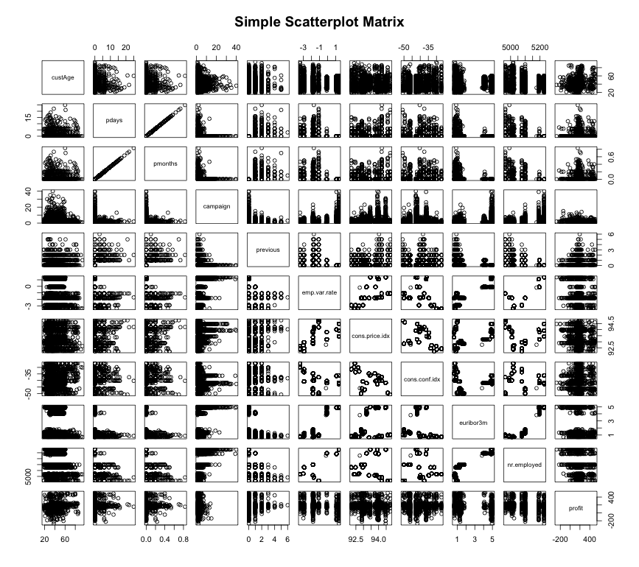
Data sanity check

Slide 5
Logistic Regression with R

Slide 6
Variable selection using AIC
Df Deviance AIC
<none> 1147.7 1213.7
- pmonths 1 1150.2 1214.2
- pastEmail 1 1150.2 1214.2
- loan 2 1153.0 1215.0
- month 9 1168.1 1216.1
- profession 11 1182.7 1226.7
- cons.conf.idx 1 1162.7 1226.7
- poutcome 2 1170.7 1232.7
- default 2 1174.8 1236.8
- contact 1 1180.1 1244.1
- cons.price.idx 1 1199.9 1263.9
- emp.var.rate 1 1234.2 1298.2
 |  | Train |  | Test
 |  | 0 | 1 | 0 | 1
Model | 1 | 82 | 159 | 31 | 58
 | 0 | 5136 | 388 | 2178 | 205
 |  | 91.85% |  | 91.46%

Slide 7
Variable selection using AIC

Slide 8
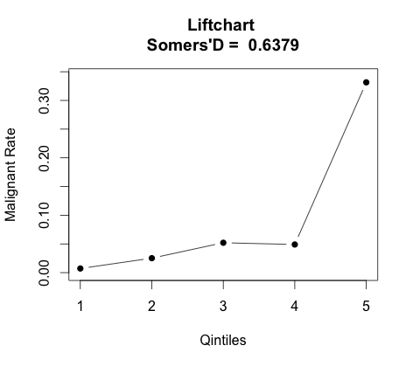
Liftchart of logistic regression model
While Somers’D show strong sloping power, the liftchart shows that we did not segment group 1-4 very well

Slide 9
Tree Model

Slide 10
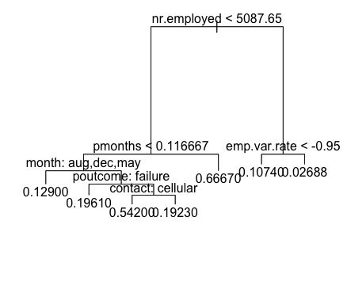
Decision Tree
 |  | Train |  | Test
 |  | 0 | 1 | 0 | 1
Model | 1 | 194 | 220 | 58 | 87
 | 0 | 5025 | 327 | 2151 | 176
 |  | 90.96% |  | 90.53%

Slide 11
Appendix

Slide 12
Prediction on testing data

Slide 13
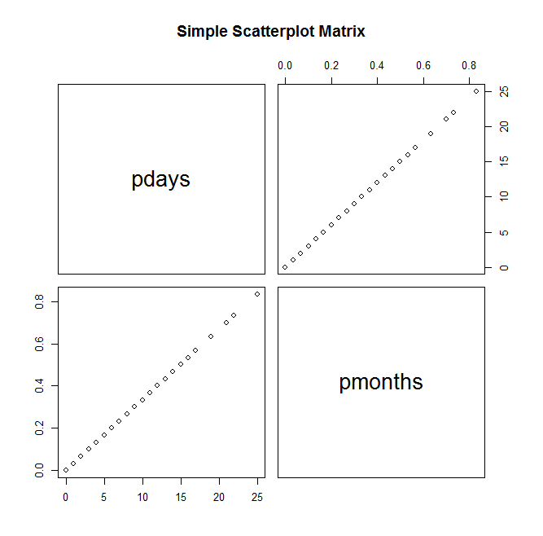
Data set statistics

