Slide 1

AN ANALYSIS OF CURRENT INVENTORY IN:
NEW YORK CITY

Slide 2
SCOPE OF PROJECT
DATA POINTS
Listing ID
Name
Host ID
Host Name
Borough (Neighborhood Group)
Neighborhood
Latitude
Longitude
Room Type
Price
Minimum Nights
Number of Reviews
Last Review Date
Reviews Per Month
Number of Listings per Host
Availability (Last 365 Days)
Spreadsheet with 48,895 Listings
16 Data Points Per Listing
TASK: Exploratory Analysis
Formulate questions & hypotheses
Answer these with multiple tools
Visualizations
Statistical Analysis (including p-value tests)
Query-based insights (SQL)
Identify trends & areas of concern
Establish relationships between variables
Notes:
TALKING POINTS
Almost 50K Listings
16 Data Points for Each
Tasked me with: Exploring Data
TO DO
- Highlight which ones focused on.

Slide 3
AVAILABILITY
Do we really have 48,895 listings in New York City?
Are these claims supported?
The majority of listings (75%) are available
Of the Active Listings, 50% of them are available at least 183 days (50% of Year)
Notes:
Do we really have almost 50K listings in NYC?
Hypothesis Test:

Slide 4
ACTIVE VS. INACTIVE
CLAIM 1: Majority of Listings (75%) are Available
Result of Hypothesis Test: Claim rejected with 95% confidence
Unexpectedly, a higher proportion of listings are not available.
What IS available?
Status | Number of Listings | % of Total
Active (Available 1+ Days) | 31,362 | 64%
Inactive (Available 0 Days) | 17,533 | 36%
TOTAL | 48,895 | 100%
Notes:
NOTE on CLAIM: p-value was a whole bunch of 0000.

Slide 5
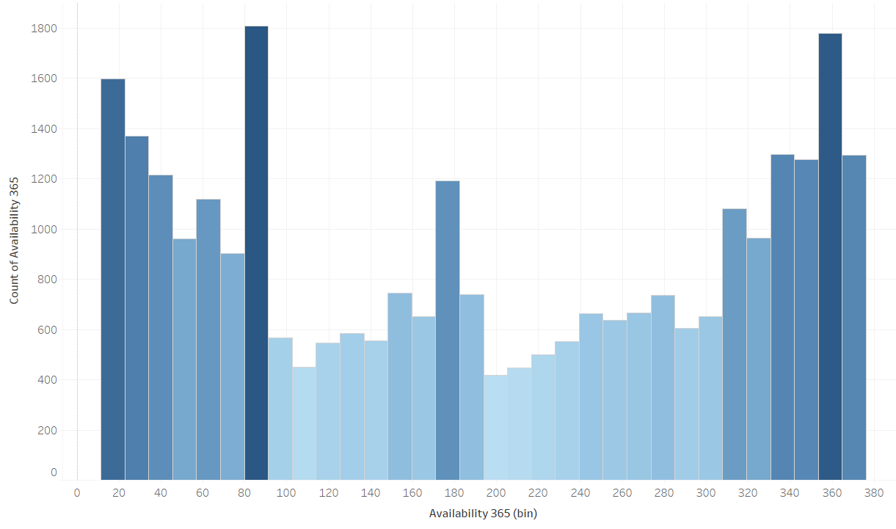
HOW AVAILABLE IS A LISTING?
CLAIM 2: 50% of active are available 50+% of Year (183 days )
Result of Hypothesis Test: Claim rejected with 95% confidence
Less than 50% of active listings are available half the year
Availability | Listing Count | % of Total
Less Than Half the Year (1-182) | 17,052 | 54%
More Than Half The year (183-365) | 14,310 | 46%
TOTAL ACTIVE | 31,362 | 100%
Notes:
Histogram shows that the distribution is pretty even, but with higher density bins on the first half of the graph

Slide 6
COMPARING LEVELS OF AVAILABILITY
Define Attribute: Availability Level
Availability (Days) | Attribute: Availability Level
0 | Inactive
1 -182 (Less than 50% Year) | Low Availability
183 - 365 (More than 50% Year) | High Availability
Proportion of Total Listings
Attribute: Availability Level | Listing Count (Source: SQL) | % of Total
Inactive | 17,533 | 36%
Low Availability | 17,052 | 35%
High Availability | 14,310 | 29%
TOTAL | 48,895 | 100%
Notes:
Let’s define attribute: Availability level as follows

Slide 7
YES, ONLY 29% OF OUR TOTAL LISTINGS ARE AVAILABLE AT LEAST HALF THE YEAR.
Notes:
Let’s define attribute: Availability level as follows
LET’S KEEP THIS IN MIND LATER!
MOVING FORWARD --- UNLESS OTHERWISE SAID, ANY NUMBERS WILL BE BASED ON ACTIVE LISTINGS ONLY

Slide 8
LOCATION
Do we have listings in all 5 boroughs?
Are these claims supported?
Manhattan has a higher average price, listing count, and neighborhoods represented than any other borough. It is the preferred borough for hosts.
Is the most popular neighborhood in each outer borough next to Manhattan?

Slide 9
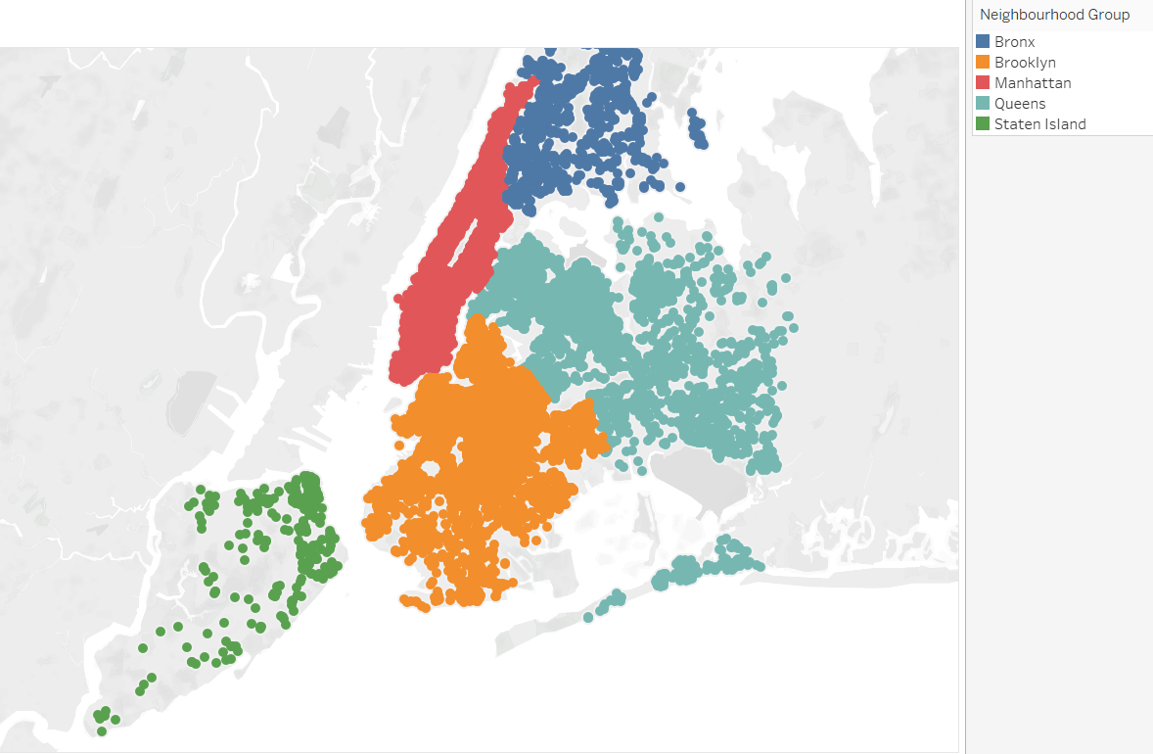
ARE ALL 5 BOROUGHS REPRESENTED?
YES
Notes:
Are all 5 boroughs represented? Yes!
NOTE – Inactive removed.

Slide 10
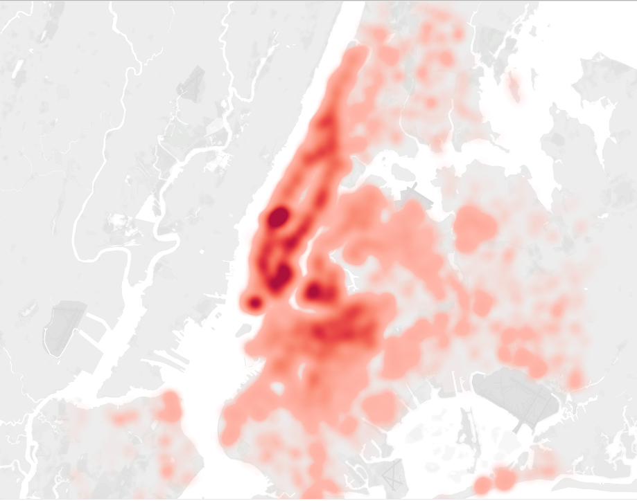
ARE BOROUGHS REPRESENTED EVENLY?
NO
Notes:
BUT… If the darker red areas have a more dense listing count, clearly Manhattan is more saturated.

Slide 11
DISTRIBUTION OF BOROUGHS
What is the proportion of each borough to total active listings?
Borough | Number of Listings (Source: SQL) | % of Total
Manhattan | 13559 | 43%
Brooklyn | 12260 | 39%
Queens | 4298 | 14%
Bronx | 914 | 3%
Staten Island | 331 | 1%
TOTAL | 31362 | 100%
Manhattan has 43% of all active listings, despite being the smallest borough, and 82% are in Manhattan or Brooklyn. Queens is the largest and only holds 14%.
Notes:
Manhattan is clearly the most saturated. Should we be concerned with changing that or do we accept and move on?

Slide 12
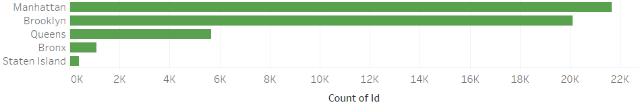
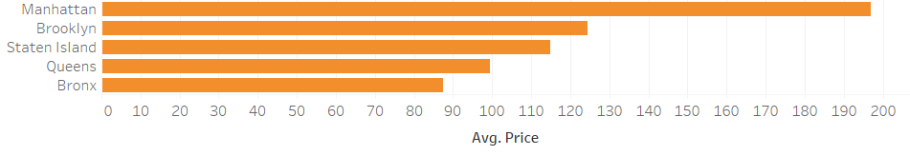
MANHATTAN VS. OUTER BOROUGHS
Does Manhattan have more listings than other boroughs?
YES
CLAIM: Manhattan has a higher average price
Result of Hypothesis Tests: Testing supports the alternative claim that Manhattan’s average price is higher than each borough with 95% confidence.

Slide 13
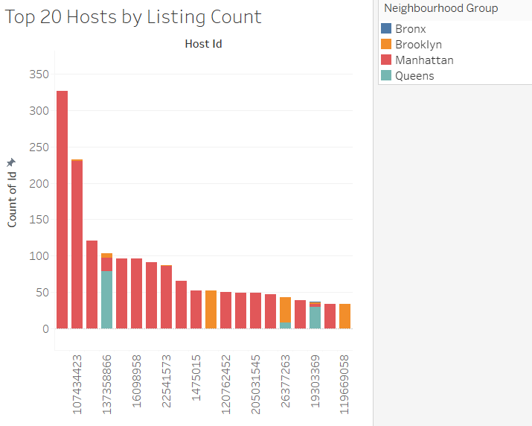
IS IT PREFERRED BY HOSTS?
YES, but note the following:
The top hosts by listing count tend to specialize in a borough
That borough is not always Manhattan.
Notes:
Note – Includes inactive!

Slide 14
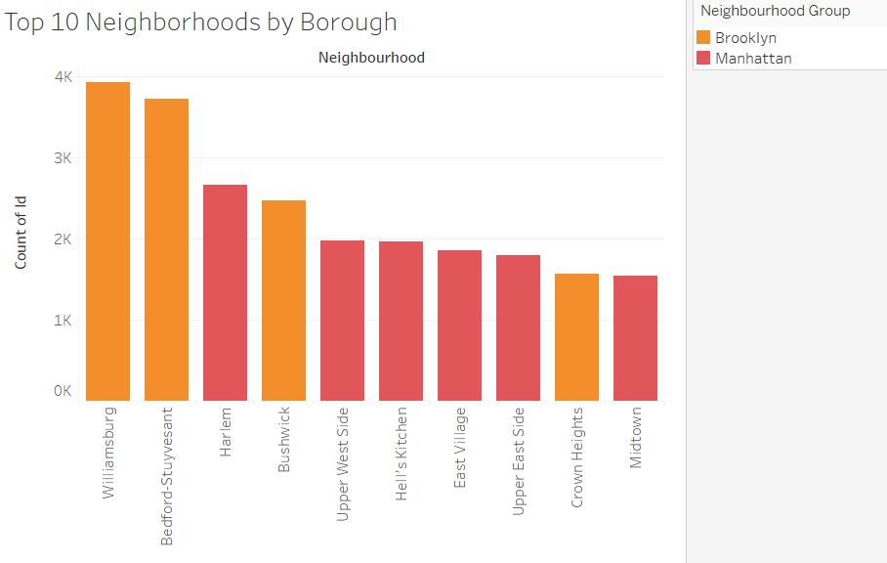
ARE MANHATTAN NEIGHBORHOODS MORE POPULAR?
YES, but not by much.
4 of the Top 10 most popular neighborhoods are in Brooklyn, including the Top 2

Slide 15
IS A BOROUGH’S MOST POPULAR NEIGHBORHOOD BY MANHATTAN?
Borough | Top Neighborhood (Source: SQL) | Next to Manhattan?
Brooklyn | Williamsburg | YES
Queens | Astoria | YES
Staten Island | St. George | YES
Bronx | Kingsbridge | NO
YES, for the most part. We can infer there is a correlation between neighborhood popularity and proximity to Manhattan.
Exception: Bronx is the only borough where its most popular neighborhood is not by Manhattan.

Slide 16
ROOM TYPE
What is the distribution of room types?
Are these claims supported?
Entire home/apt listings are more expensive than Private Room
Private Room listings are more expensive than Shared Room

Slide 17
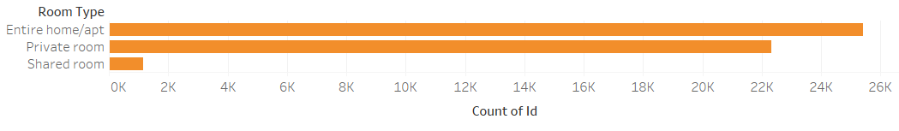
ROOM TYPE DISTRIBUTION
What room type is more popular? Entire Home / Apt
What is the proportion of each room type to active listings?
Room Type | Number of Listings (Source: SQL) | % of Total
Entire home / apt | 16533 | 53%
Private Room | 13965 | 45%
Shared Room | 864 | 3%
TOTAL | 31362 | 100%
Notes:
POSSIBLE HYPOTHESIS TEST – PROPORTION OF ENTIRE HOMES WILL BE MORE THAN 50%

Slide 18
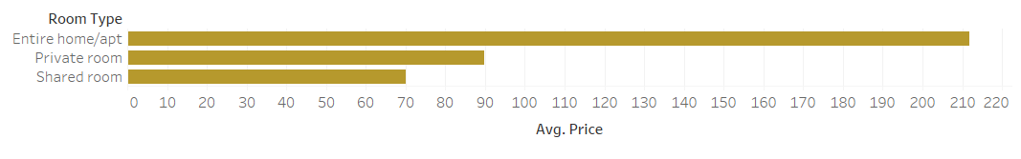
ROOM TYPE + PRICES
CLAIM 1: Entire Home / Apt has a higher average price than Private Room
CLAIM 2: Private Room has a higher average price than Shared Room
Result from Hypothesis Test:
First test supports the alternative claim that average price of Entire Home / Apt is greater than Private Room.
Second test supports the alternative claim that average price of Private Room is higher than the one for Shared Room
Both with 95% confidence

Slide 19
AVAILABILITY + LOCATION + ROOM TYPE
Are there are relationships to between availability, location, and room type?

Slide 20
NUMBER OF LISTINGS
Count of id | Column Labels
Row Labels | Entire home/apt | Private room | Shared room | Grand Total
High Availability | 7674 | 6155 | 481 | 14310
Bronx | 149 | 270 | 21 | 440
Brooklyn | 2458 | 2486 | 190 | 5134
Manhattan | 4293 | 2054 | 174 | 6521
Queens | 689 | 1230 | 95 | 2014
Staten Island | 85 | 115 | 1 | 201
Inactive | 8876 | 8361 | 296 | 17533
Bronx | 61 | 106 | 10 | 177
Brooklyn | 3487 | 4252 | 105 | 7844
Manhattan | 4758 | 3200 | 144 | 8102
Queens | 546 | 786 | 36 | 1368
Staten Island | 24 | 17 | 1 | 42
Low Availability | 8859 | 7810 | 383 | 17052
Bronx | 169 | 276 | 29 | 474
Brooklyn | 3614 | 3394 | 118 | 7126
Manhattan | 4148 | 2728 | 162 | 7038
Queens | 861 | 1356 | 67 | 2284
Staten Island | 67 | 56 | 7 | 130
Grand Total | 25409 | 22326 | 1160 | 48895
Notes:
Should we do something about X,Y,Z

Slide 21
PROPORTION - NUMBER OF LISTINGS
Count of id | Column Labels
Row Labels | Entire home/apt | Private room | Shared room | Grand Total
High Availability | 30.20% | 27.57% | 41.47% | 29.27%
Bronx | 1.94% | 4.39% | 4.37% | 3.07%
Brooklyn | 32.03% | 40.39% | 39.50% | 35.88%
Manhattan | 55.94% | 33.37% | 36.17% | 45.57%
Queens | 8.98% | 19.98% | 19.75% | 14.07%
Staten Island | 1.11% | 1.87% | 0.21% | 1.40%
Inactive | 34.93% | 37.45% | 25.52% | 35.86%
Bronx | 0.69% | 1.27% | 3.38% | 1.01%
Brooklyn | 39.29% | 50.86% | 35.47% | 44.74%
Manhattan | 53.61% | 38.27% | 48.65% | 46.21%
Queens | 6.15% | 9.40% | 12.16% | 7.80%
Staten Island | 0.27% | 0.20% | 0.34% | 0.24%
Low Availability | 34.87% | 34.98% | 33.02% | 34.87%
Bronx | 1.91% | 3.53% | 7.57% | 2.78%
Brooklyn | 40.79% | 43.46% | 30.81% | 41.79%
Manhattan | 46.82% | 34.93% | 42.30% | 41.27%
Queens | 9.72% | 17.36% | 17.49% | 13.39%
Staten Island | 0.76% | 0.72% | 1.83% | 0.76%
Grand Total | 100.00% | 100.00% | 100.00% | 100.00%

Slide 22
PRICE DISTRIBUTION
Average of price | Column Labels
Row Labels | Entire home/apt | Private room | Shared room | Grand Total
High Availability | $ 249.22 | $ 100.07 | $ 56.85 | $ 178.60
Bronx | $ 138.91 | $ 66.53 | $ 87.52 | $ 92.04
Brooklyn | $ 202.52 | $ 82.34 | $ 44.33 | $ 138.47
Manhattan | $ 291.50 | $ 145.94 | $ 73.44 | $ 239.83
Queens | $ 181.55 | $ 70.40 | $ 43.77 | $ 107.17
Staten Island | $ 206.68 | $ 59.97 | $ 150.00 | $ 122.46
Inactive | $ 187.94 | $ 82.83 | $ 82.20 | $ 136.03
Bronx | $ 105.74 | $ 67.25 | $ 52.80 | $ 79.69
Brooklyn | $ 161.99 | $ 70.69 | $ 60.98 | $ 111.15
Manhattan | $ 215.57 | $ 100.05 | $ 99.38 | $ 167.88
Queens | $ 123.51 | $ 80.71 | $ 85.22 | $ 97.91
Staten Island | $ 155.29 | $ 74.59 | $ 20.00 | $ 119.40
Low Availability | $ 203.27 | $ 89.11 | $ 77.47 | $ 148.16
Bronx | $ 125.31 | $ 66.87 | $ 42.14 | $ 86.19
Brooklyn | $ 177.64 | $ 79.50 | $ 51.20 | $ 128.80
Manhattan | $ 244.12 | $ 114.44 | $ 96.42 | $ 190.46
Queens | $ 134.38 | $ 67.81 | $ 96.12 | $ 93.73
Staten Island | $ 138.84 | $ 63.32 | $ 49.57 | $ 101.50
Grand Total | $ 211.79 | $ 89.78 | $ 70.13 | $ 152.72

Slide 23
QUESTIONS?
Notes:
Should we do something about X,Y,Z

Slide 24
RESOURCES
LINK TO GITHUB REPOSITORY
LINK TO TABLEAU PUBLIC
Notes:
https://public.tableau.com/profile/rachelle.perez#!/vizhome/airbnb_nyc_15729029642910/Top10NeighborhoodsbyBorough?publish=yes

