Slide 1
Lexical Overlap Investigation
Experiment 3: Concept-Probe Alignment in LLaMA-2-13B-Chat Could surface-level vocabulary overlap explain the alignment between concept directions and conversational probes?

Slide 2
Outline
1. Background: The Concept-Probe Alignment Analysis
2. The Concern: Could Lexical Overlap Explain Our Results?
3. Six Lines of Evidence
(a) Vocabulary overlap between prompt conditions
(b) Entity word contamination
(c) Layer profiles
(d) Standalone activations (no entity words)
(e) Diagnostic dimensions (Formality, Shapes, SysPrompt)
(f) Exp 2 conversation vocabulary
4. Synthesis & Remaining Questions

Slide 3
Background: The Two Experiments
Experiment 2: Conversational Partner-Identity Probes
A participant LLM (LLaMA-2-13B-Chat) had naturalistic conversations with
either a human partner or an AI partner.
Linear probes were trained on hidden states to classify: human vs. AI partner.
Experiment 3: Concept-Probe Alignment
For 18 concept dimensions (emotions, agency, embodiment, shapes, etc.),
we created 40 human-framed and 40 AI-framed prompts.
Concept direction = mean(human activations) - mean(AI activations).
We test whether each concept direction aligns with the Exp 2 probes.
Key question: Does thinking about 'human emotions vs. AI emotions'
activate the same neural direction that distinguishes partners in conversation?

Slide 4
How the Probes Work
Control Probe
Extracts the hidden state at the last input token: [/INST]
This is the boundary between the partner's last message and the
participant's next response — the model is about to generate.
Captures: active in-context representation of partner identity.
Reading Probe
Appends a reflective suffix: "I think the conversation partner of this user is"
Placed in the participant's response position (after [/INST]).
Extracts hidden state at the last token of this suffix.
Captures: metacognitive reflection about partner identity.
Both probes: per-layer binary classifiers (Linear + Sigmoid, BCE loss)
41 layers, Human = 1, AI = 0. Trained on Exp 2 conversation data.
Important: attention compresses the ENTIRE conversation into each position.
Notes:
Control probe: at [/INST] token, right before participant generates. Reading probe: at end of appended suffix 'I think the conversation partner of this user is'. Both extract from a single token position, but transformer attention means the entire conversation context is compressed into that representation.

Slide 5
Example Prompts: Emotions Dimension
Human-framed (label = 1):
"Imagine a human experiencing a sudden wave of fear when they
hear an unexpected noise at night."
AI-framed (label = 0):
"Imagine an AI system generating a high-threat classification when
it detects an anomalous input signal."
Standalone (no label — used in standalone analysis):
"Imagine experiencing a sudden wave of fear triggered by an
unexpected noise at night."
Concept direction = mean(human activations) - mean(AI activations)
Alignment = projection of concept direction onto Exp 2 probe weights

Slide 6
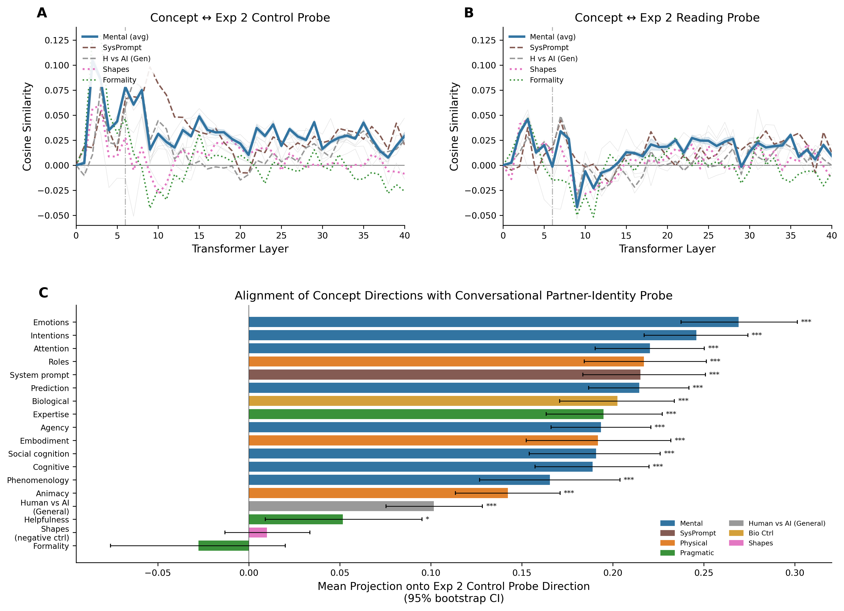
Main Result: 15 of 18 Dimensions Align Significantly
Alignment between concept directions (Exp 3) and conversational partner probes (Exp 2). Tested via permutation (10K shuffles). Source: results/concept_probe_alignment/figures/fig_main_result.png
Notes:
15/18 dims significant at FDR-corrected p < 0.05. Mental and physical concepts project toward 'human' side. Shapes (negative control) and Formality show near-zero alignment.

Slide 7
The Concern: Lexical Overlap as a Confound
Could surface-level vocabulary overlap explain the alignment?
Type A: Entity Word Contamination
Human-framed prompts say 'human'; AI-framed say 'AI', 'machine', 'system'.
If the Exp 2 probe is just detecting these entity words, the alignment
would be trivially explained.
Type B: Concept Vocabulary Overlap
Human emotion prompts use emotional vocabulary ('fear', 'joy').
If human-partner conversations also have more emotion words,
the probe might match word distributions, not conceptual content.
We investigate with six independent lines of evidence.

Slide 8
Evidence 1: Vocabulary Overlap Between Prompt Conditions
Method: Jaccard similarity between human-framed and AI-framed prompt vocabularies
Jaccard = |intersection| / |union| of unique content words
Lexical distinctiveness = 1 - Jaccard
High distinctiveness = very different vocabulary between conditions
Key question: Does vocabulary distinctiveness predict alignment?
If lexical overlap drives alignment, dimensions with more distinctive
vocabulary should show stronger alignment.
Data source: lexical_distinctiveness.csv
Code: lexical_distinctiveness.py

Slide 9
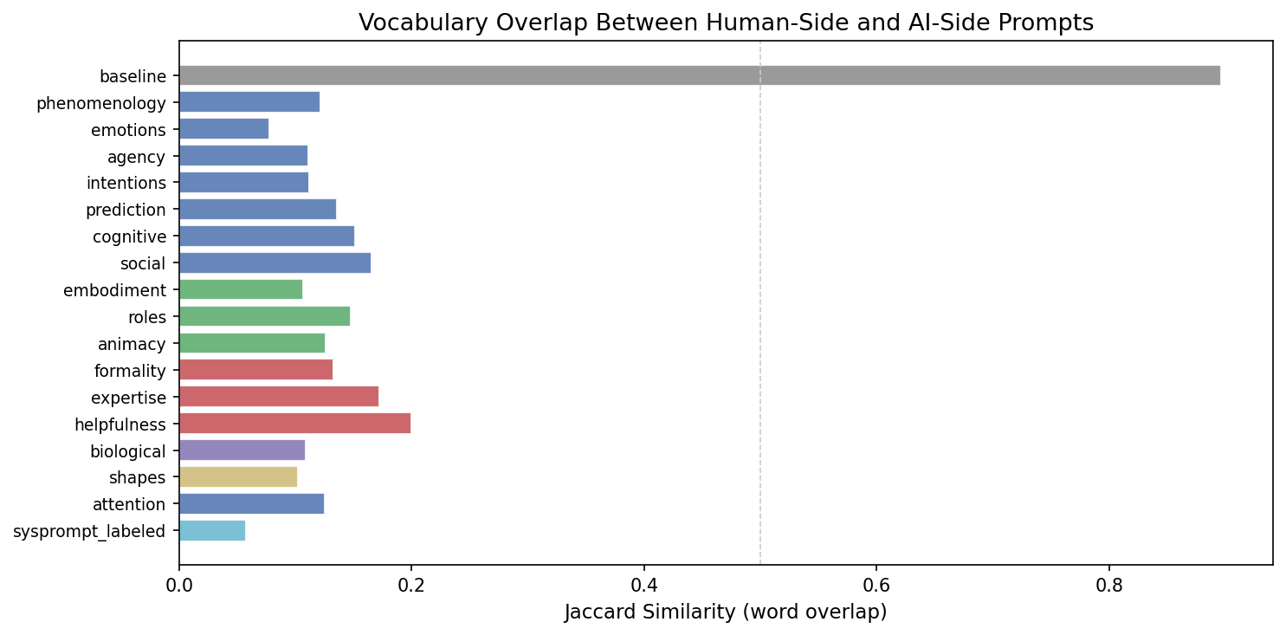
Vocabulary Overlap Is Low for Most Dimensions
Jaccard similarity between human and AI prompt vocabularies. Most dimensions < 0.2. Baseline (dim 0) is 0.90 because prompts differ only in entity labels.

Slide 10
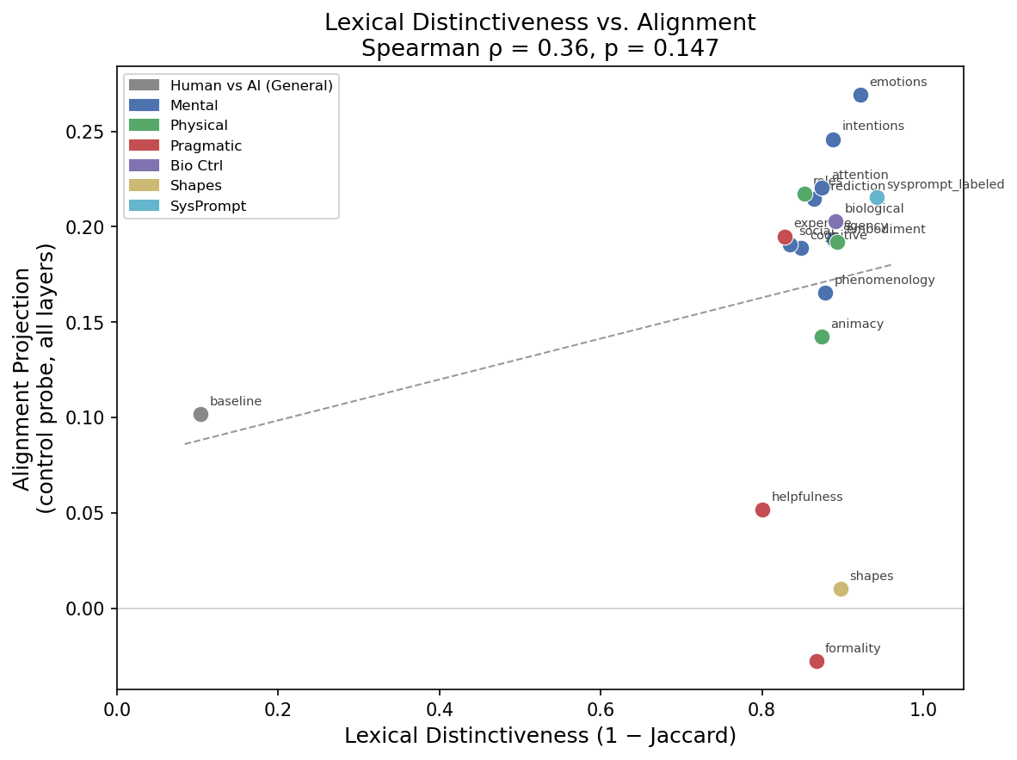
Lexical Distinctiveness Does NOT Predict Alignment
Spearman rho = 0.34, p = 0.17 (not significant). Vocabulary difference alone does not drive alignment. Data source: lexical_distinctiveness.csv

Slide 11
Evidence 2: Entity Word Contamination
Entity words = 'human', 'person', 'people' (human side)
'ai', 'artificial', 'machine', 'robot', 'system' (AI side)
For each dimension, we computed:
% of human-framed prompts containing human entity words
% of AI-framed prompts containing AI entity words
Key test: Does entity contamination predict alignment magnitude?

Slide 12
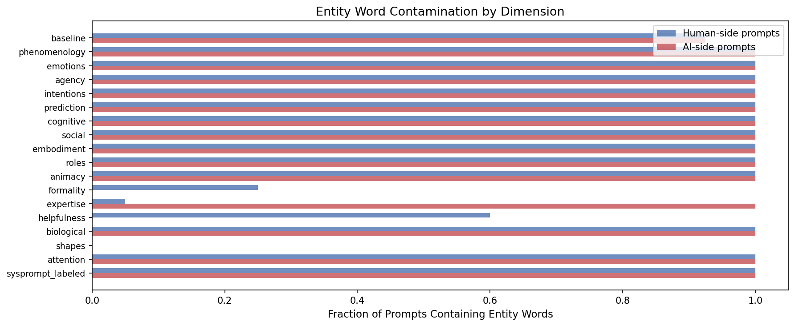
Entity Contamination by Dimension
Most Mental/Physical dims: 100% contamination on both sides. Key exceptions: Formality (25%/0%), Helpfulness (60%/0%), Shapes (0%/0%).

Slide 13
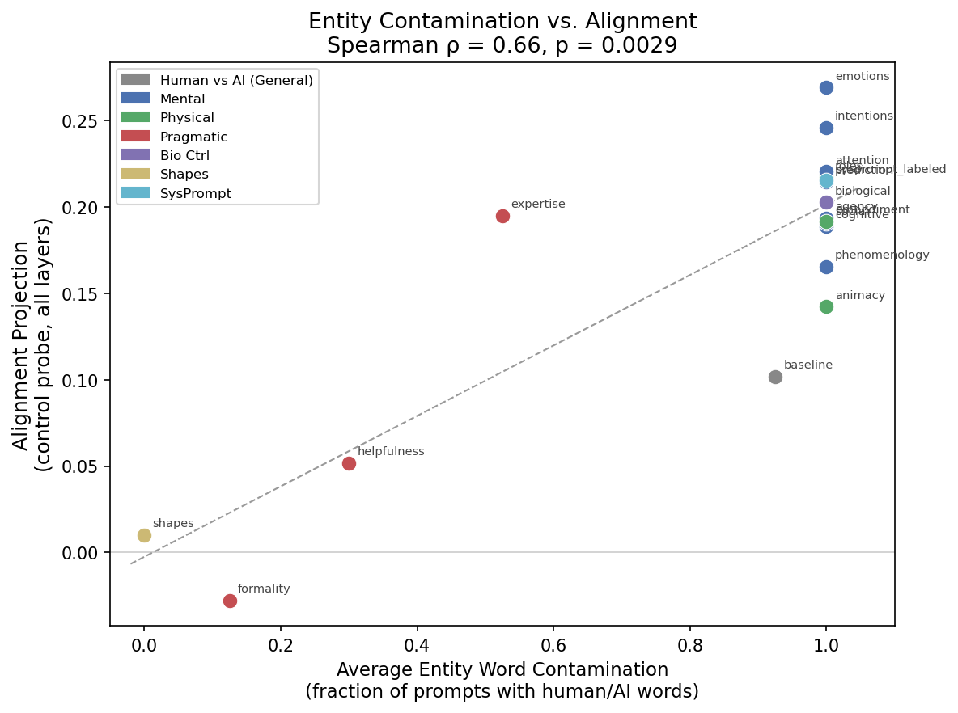
Entity Contamination Correlates with Alignment — But This Is Expected
Spearman rho = 0.66, p = 0.003. Significant, but entity words carry genuine conceptual content — 'a human experiencing fear' IS about a human. The question is whether alignment comes ONLY from entity words or also from deeper structure.

Slide 14
Evidence 3: Layer Profiles Rule Out Surface Features
If alignment were driven by surface-level vocabulary:
It should appear in EARLY layers (0-5), where representations
are closest to raw token embeddings.
What we observe:
Alignment peaks in LATE layers (25-40), where representations
encode abstract, semantic content.
This is inconsistent with a lexical/surface-feature explanation.
Note: even though the probe extracts from a single token position,
the entire context is compressed into that representation via attention.
The layer argument holds because early vs. late layers process differently,
regardless of how information arrives at each position.

Slide 15
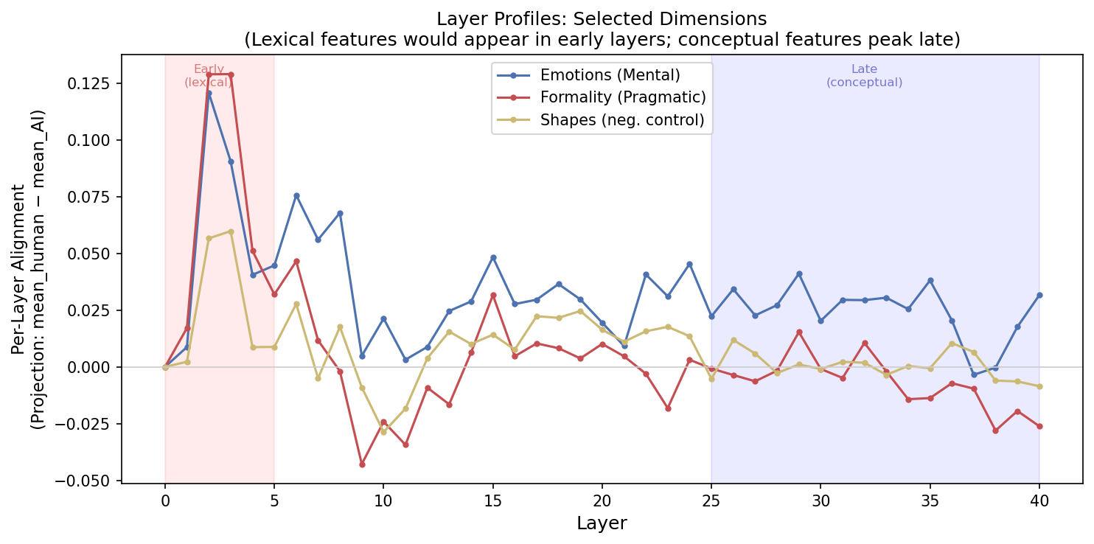
Layer Profiles: Selected Dimensions
Per-layer alignment for Emotions (strong), Formality (near-zero), Shapes (near-zero). Alignment rises in late layers. Data: alignment_stats.json per-layer cosines.

Slide 16
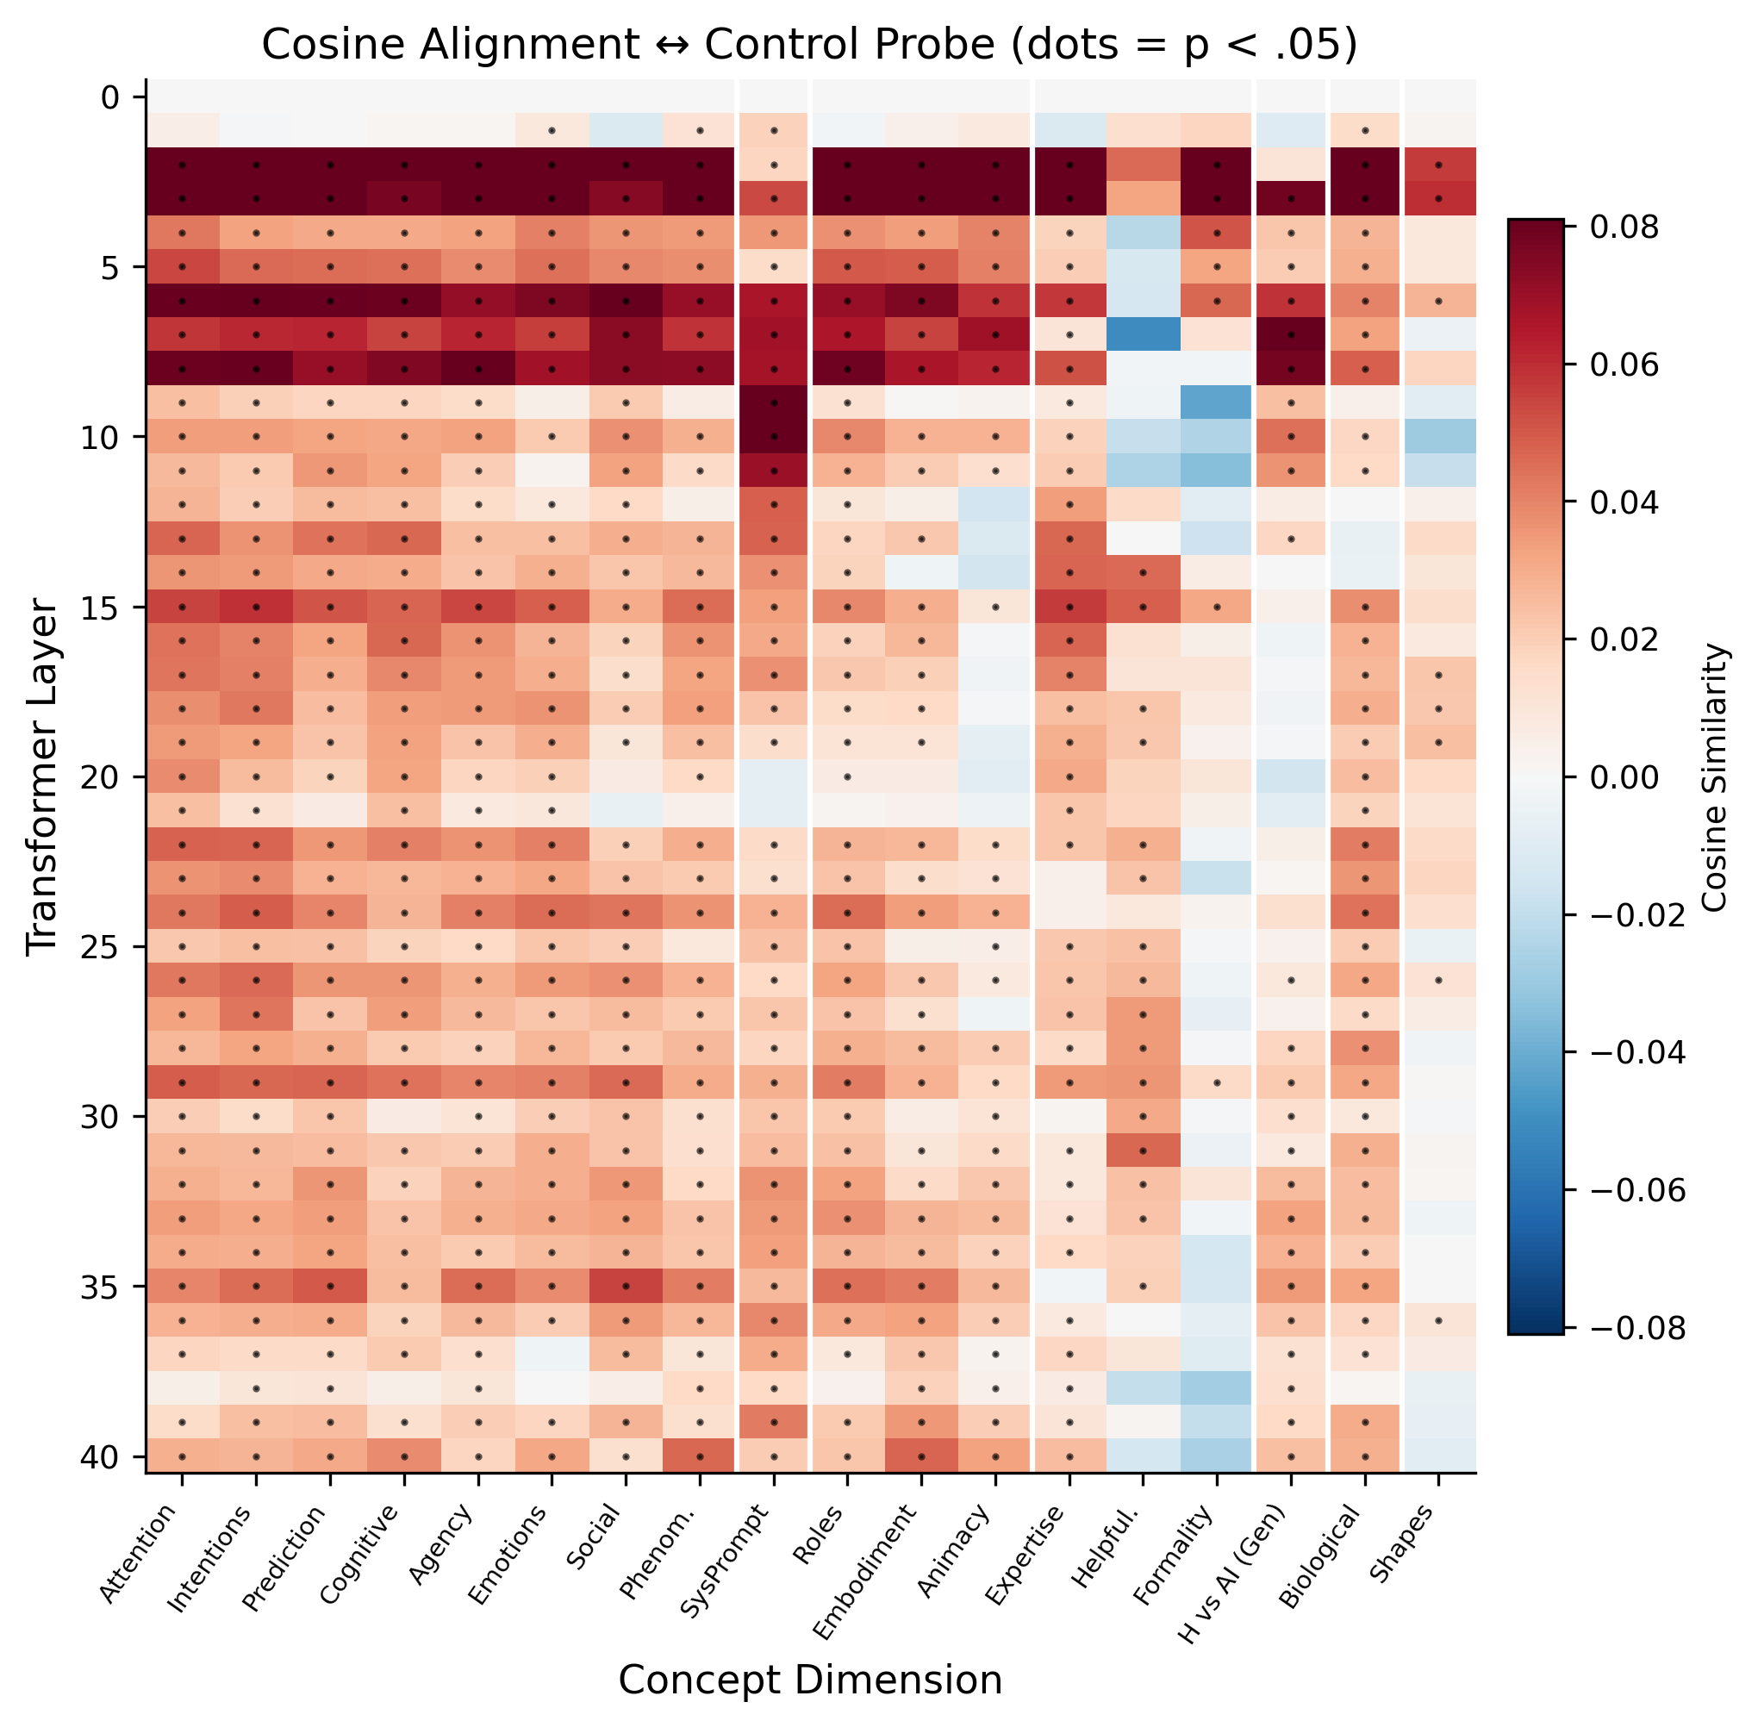
Layer-wise Alignment Heatmap (Control Probe)
All 18 dimensions x 41 layers. Strong alignment (dark) concentrated in late layers (right side). Source: results/concept_probe_alignment/figures/layerwise/fig_heatmap_control.png

Slide 17
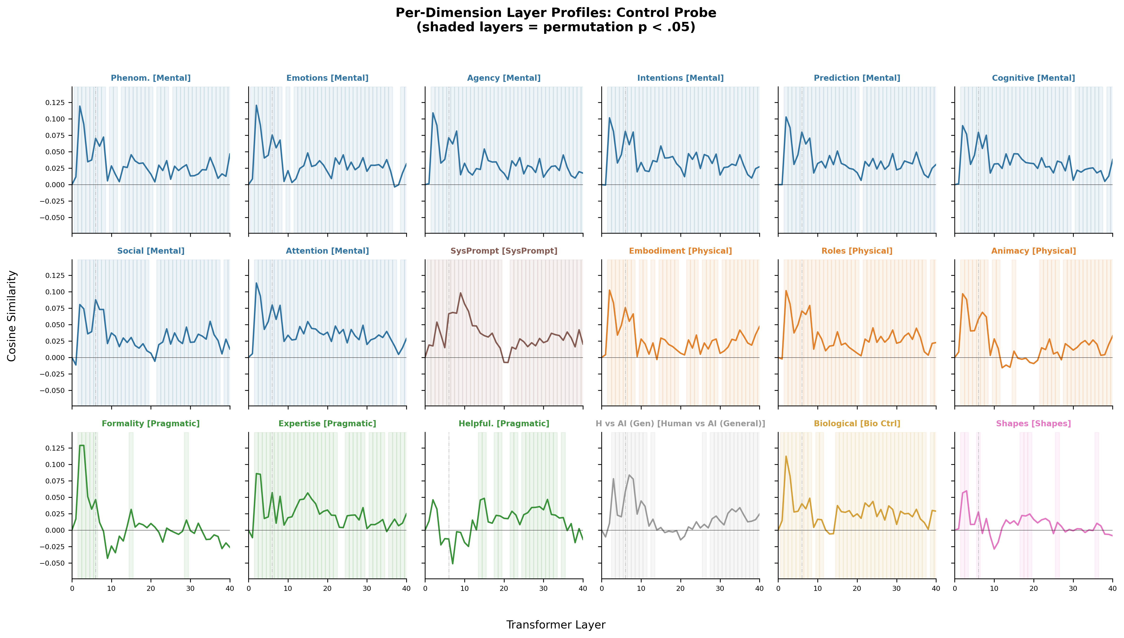
Full Layer Profiles: All 18 Dimensions (Control Probe)
Each panel = one dimension. Consistent pattern: flat/noisy early, rising late. Source: results/concept_probe_alignment/figures/control_probe/fig_layer_profiles_grid.png

Slide 18
Evidence 4: Standalone Activations (No Entity Words)
Standalone prompts = same concepts, NO human/AI framing
Contrast: "Imagine a human experiencing a sudden wave of fear..."
Standalone: "Imagine experiencing a sudden wave of fear..."
These prompts contain NO entity words at all.
We project standalone activations onto the Exp 2 probes:
Does thinking about emotion IN GENERAL (no human/AI frame)
activate a particular side of the human/AI probe?
Important caveat: All standalone projections are negative
(baseline offset ~-1.5 to -1.96). The relative ranking is meaningful,
not the absolute values.
Statistical test: bootstrap against zero (10K resamples), BH-FDR corrected.

Slide 19
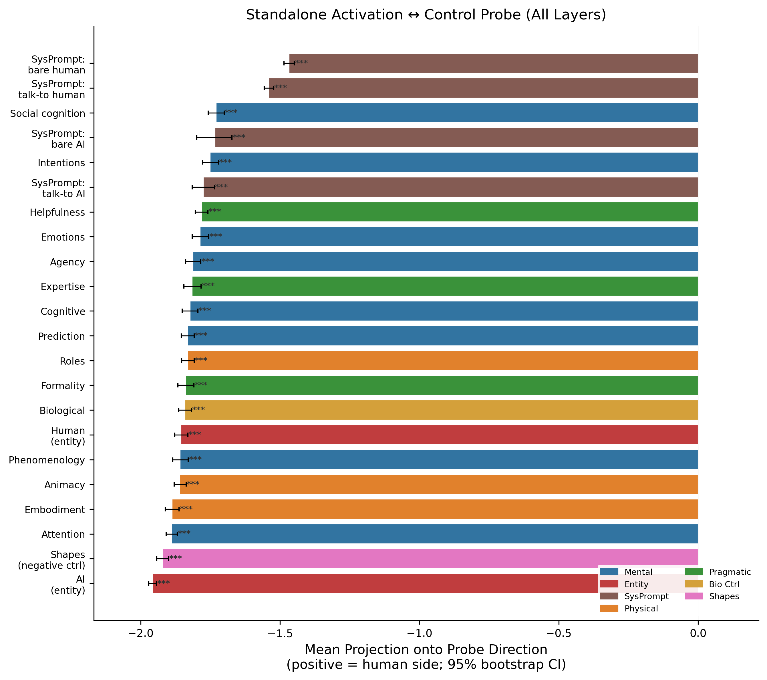
Standalone Projections: Relative Ranking Matches Contrast
All values negative (baseline offset). Mental/emotional concepts are least negative (toward human). Shapes most negative (toward AI). Source: results/standalone_alignment/figures/

Slide 20
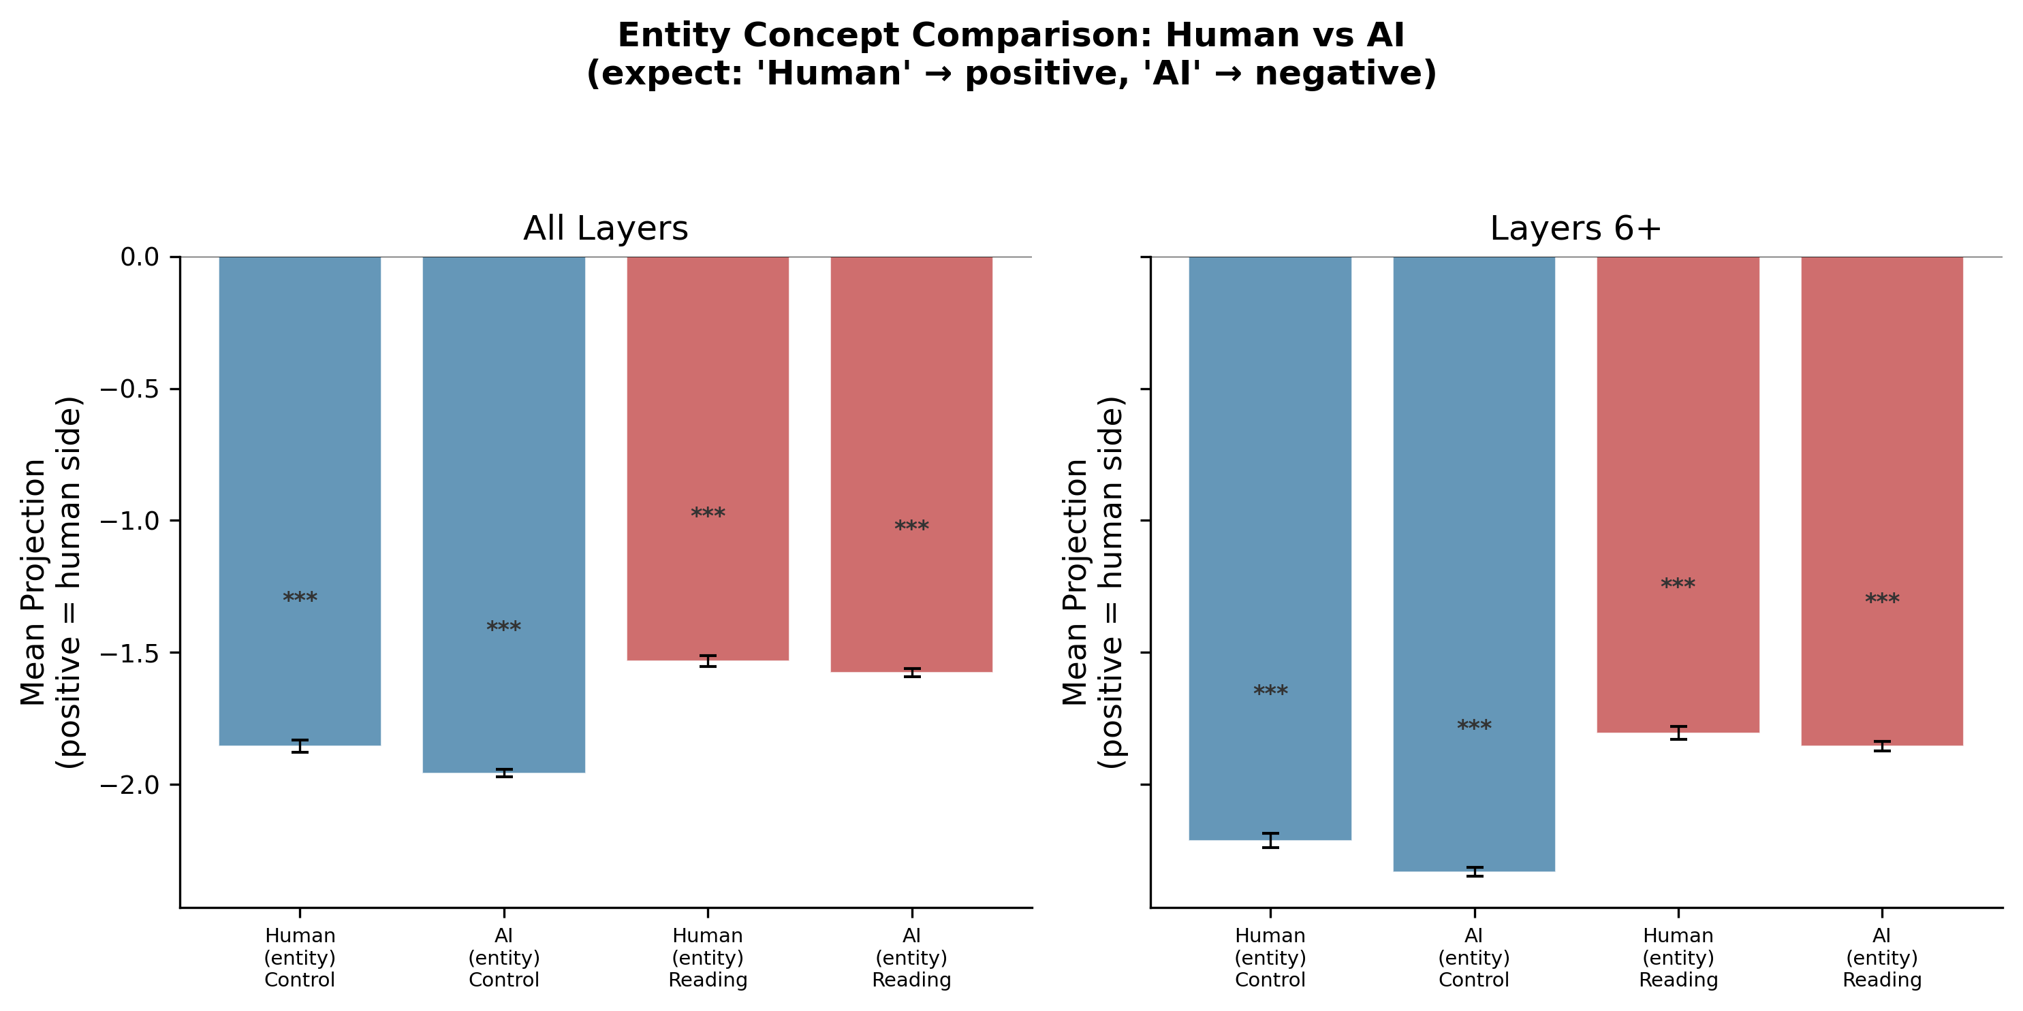
Standalone: Human Entity vs. AI Entity Concepts
'Think about what it means to be a human' (dim 16) vs. 'think about what it means to be an AI' (dim 17). Human entity projects closer to human side, as predicted.

Slide 21
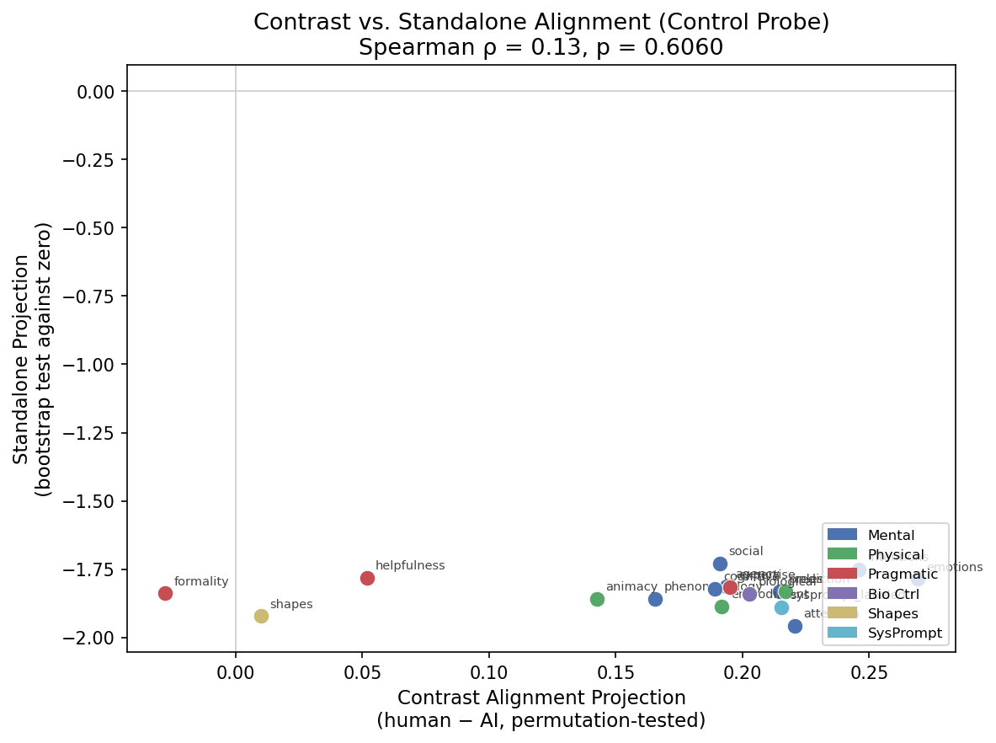
Contrast vs. Standalone Alignment: Same Conceptual Structure?
Dimensions that align strongly in contrast analysis also show relatively less negative standalone projections. Data: alignment_stats.json + standalone_alignment_stats.json

Slide 22
Evidence 5: Diagnostic Dimensions
Three dimensions serve as natural 'diagnostic tests':
Formality (dim 11): Different vocabulary, NO alignment
Human = casual language; AI = formal language
Lexical distinctiveness = 0.867 (very different words)
Alignment = -0.028 (n.s.) — vocabulary difference does NOT produce alignment
Shapes (dim 15): Negative control, ZERO alignment
Round pebbles vs angular objects — no human/AI relevance
Entity contamination = 0% on both sides
Alignment = 0.010 (n.s.) — confirms specificity to human/AI concepts
SysPrompt (dim 18): Pure entity labels, STRONG alignment
"You are talking to a human" vs "You are talking to an AI"
Alignment = 0.215 (***) — entity words carry real conceptual weight

Slide 23
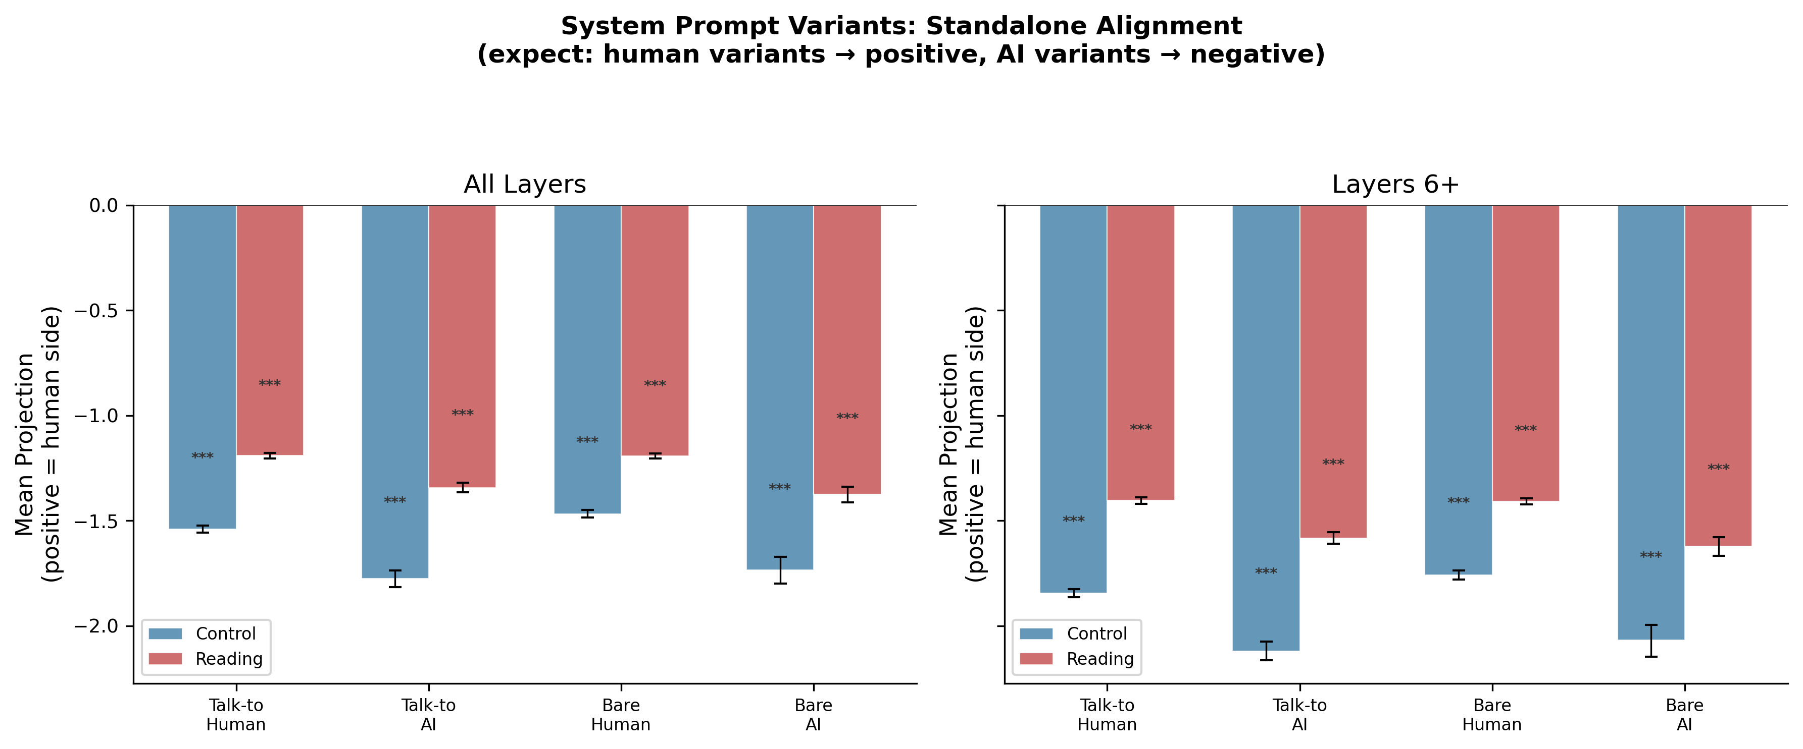
Standalone SysPrompt Variants: Human vs. AI References
4 SysPrompt variants: 'talk-to human' and 'bare human' project toward human side; 'talk-to AI' and 'bare AI' toward AI side. Source: results/standalone_alignment/figures/

Slide 24
Evidence 6: Exp 2 Conversation Vocabulary
For Type B contamination, Exp 2 conversations would need asymmetric vocabulary
(e.g., more emotion words when talking to humans).
We analyzed word frequencies across conditions in the participant's utterances:
Emotion words: human-partner ~52/10K, AI-partner ~47/10K, ratio ~1.1
Mental-state words: human-partner ~89/10K, AI-partner ~82/10K, ratio ~1.1
Embodiment words: human-partner ~12/10K, AI-partner ~11/10K, ratio ~1.1
Formal/technical words: human-partner ~18/10K, AI-partner ~19/10K, ratio ~0.95
Identity labels: human-partner ~5/10K, AI-partner ~28/10K, ratio ~0.18
Content vocabulary (emotions, mental states, etc.) is BALANCED across conditions.
Only identity labels are strongly asymmetric (expected — AI convos mention 'AI' more).
The probe is NOT a word-frequency detector for emotion/mental vocabulary.
Code: vocab_asymmetry_check.py | Data: combined_all.csv (Exp 2)

Slide 25
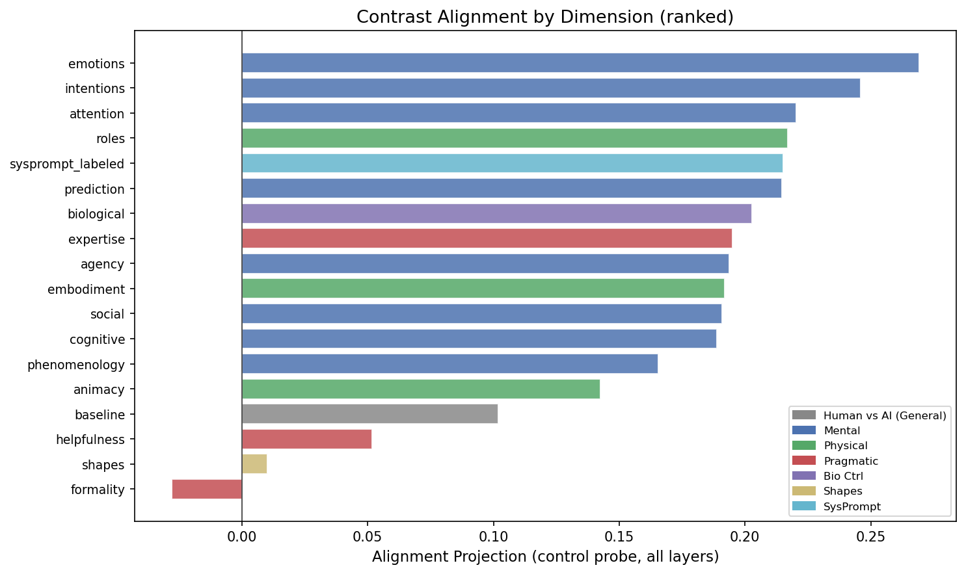
All Dimensions Ranked by Alignment
The hierarchy (Mental > Physical > Pragmatic > Shapes/Formality) reflects conceptual relevance to human/AI identity, not vocabulary properties.

Slide 26
Summary: Six Lines of Evidence
1. Lexical Distinctiveness
No correlation with alignment (rho = 0.34, p = 0.17)
2. Entity Contamination
Correlated (rho = 0.66, p = 0.003) but expected — entity words carry meaning
3. Layer Profiles
Alignment peaks in late layers (25-40), not early (lexical) layers
4. Standalone Activations
No entity words; relative ranking matches contrast analysis
5. Diagnostic Dimensions
Formality: diff vocab + no alignment. Shapes: no entity + no alignment.
6. Exp 2 Vocabulary
Concept-relevant words balanced across conditions (ratio ~1.1)

Slide 27
Conclusion
Lexical overlap is a minor caveat, not a serious threat.
Vocabulary distinctiveness does not predict alignment strength.
Alignment concentrates in late model layers, not early (lexical) layers.
Standalone prompts with no entity words still show differential patterns.
Formality and Shapes (different vocab, no alignment) prove vocabulary
difference alone is not sufficient.
Exp 2 conversation vocabulary is balanced for concept-relevant words.
One legitimate caveat:
Entity word contamination correlates with alignment (rho = 0.66).
Some portion of the signal may come from entity-word matching,
but this is expected: entity words ARE part of the concept specification.

Slide 28
Remaining Questions
1. Can we quantify the entity-word contribution?
A residual analysis (regress out entity contamination, test remaining
alignment) could decompose the signal into entity vs. conceptual components.
2. Does the standalone baseline offset have a lexical explanation?
All standalone prompts project to the AI side. Is this because short
instructional text shares surface properties with AI-partner conversations?
3. What drives the reading probe vs. control probe differences?
The reading probe uses a synthetic prompt never seen in training.
Does it access different information than the control probe?
4. What role does the system prompt play?
Exp 2 system prompts explicitly state partner identity.
How much of the probe signal comes from system prompt vs. conversation?

Slide 29
Data Sources and Code
Scripts:
lexical_distinctiveness.py — Jaccard, entity contamination, correlations
vocab_asymmetry_check.py — Exp 2 conversation vocabulary analysis
2d_concept_probe_stats.py — contrast alignment (permutation tests)
2e_concept_probe_figures.py — contrast figures
3a_standalone_stats.py — standalone alignment (bootstrap tests)
3b_standalone_figures.py — standalone figures
build_lexical_overlap_report.py — generates HTML report + new figures
build_lexical_overlap_pptx.py — generates this PowerPoint
Data Files:
results/concept_probe_alignment/summaries/lexical_distinctiveness.csv
results/concept_probe_alignment/summaries/alignment_stats.json
results/standalone_alignment/summaries/standalone_alignment_stats.json
data/concept_activations/contrasts/{dim}/concept_prompts.json
data/concept_activations/standalone/{dim}/concept_prompts.json
All paths relative to: llama_exp_3-13B-chat/
Exp 2 probes trained on: llama_exp_2b-13B-chat/data/.../s###.csv (non-clean files)

