Slide 1
Learning about
Fitness Lifestyles
Team 5 — VR/AR x Edu

Slide 2
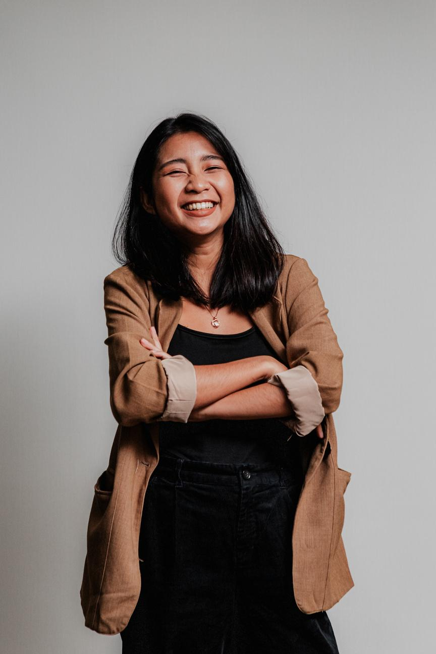
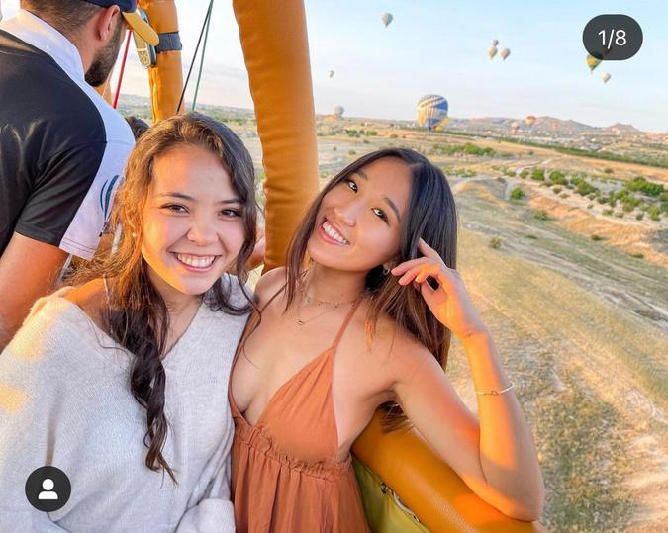
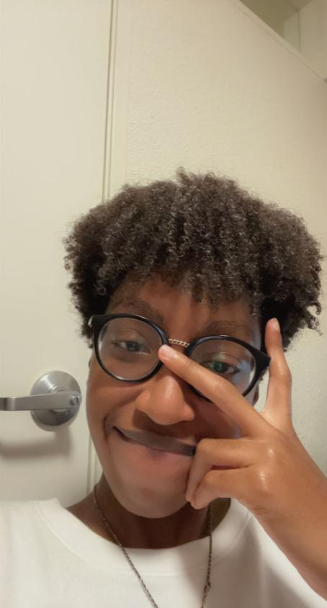
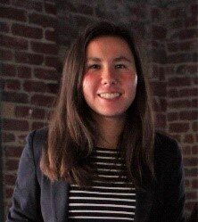
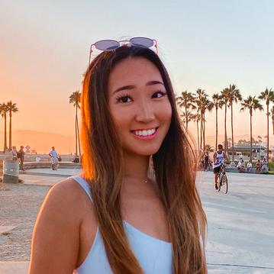
Our Team
Rachel
Melinda
Chloe
Shimea
Computer Science
Junior
Fairfax, VA
Computer Science
Sophomore
Atlanta, GA
Product Design
Senior
Los Angeles, CA
Computer Science
Junior
Long Island, NY

Slide 3
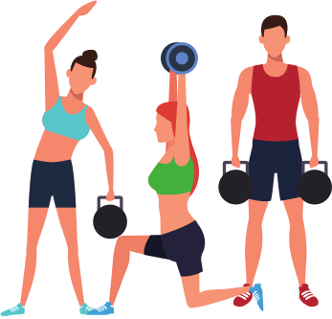
Our Focus:
Fitness

Slide 4
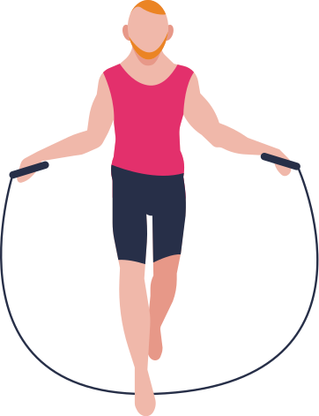
Through our interviews, we seek to...
Explore the POVs of people who come from varying experience & commitment levels

Slide 5
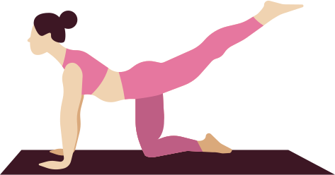
Interviewee Selection
College students
College triathlete who has run competitively
Workout beginner
Areas of improvement:
Age, Gender
Frequents spin classes and loves to workout
Values workout regimen but travels a lot

Slide 6
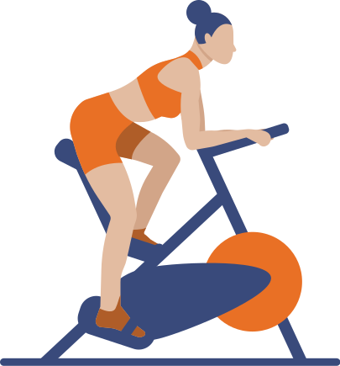

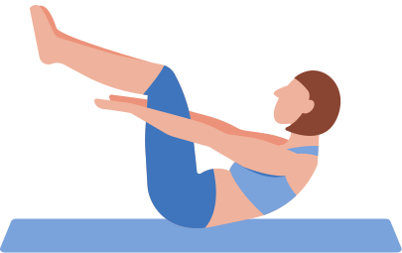

Meet Our Interviewees
Amanda
Khalil
Nikki
Kenza
21 year old asian female
@ Dartmouth
College triathelete
Sunnyvale, CA
19 year old black male
@ Howard University
Workout beginner
Queens, NY
19 year old hispanic female
@ UC San Diego
Loves spin classes and loves to workout
Palo Alto, CA
21 year old white female @London College of Fashion
Loves workout classes & travels a lot
Germany

Slide 7
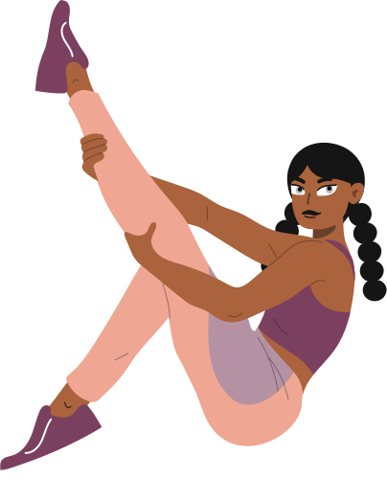
Guiding Questions
What is your workout regimen?
How do you hold yourself accountable with your fitness routine?
If you had a magic wand, what would you wish for?
Any frustrations with fitness?
How long have you been working out?
What was it like when you went to the gym by yourself for the first time? What did you do?
Do you use any tools, tricks, or apps to help you work out?

Slide 8
"In high school, there were never any moments where I gained the willpower to go to practice and there was no one there."
Amanda

Slide 9
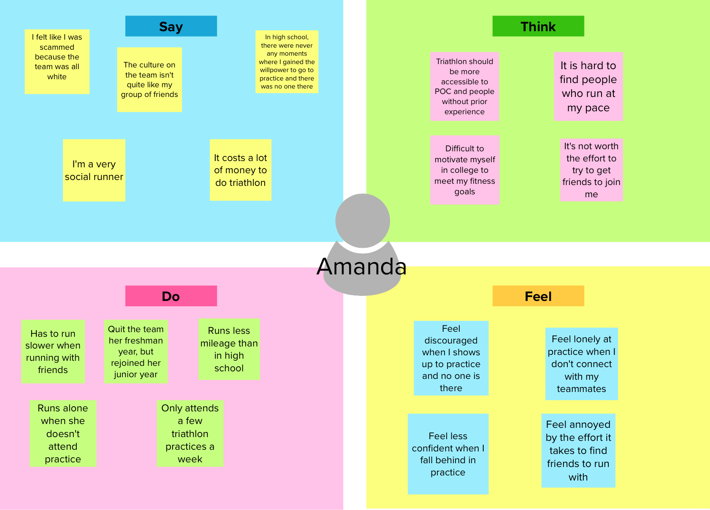

Slide 10
“My motivation definitely takes a hit while I keep waiting for results. I'll always feel more motivated for things that provide you with that level of instant gratification.”
Khalil

Slide 11
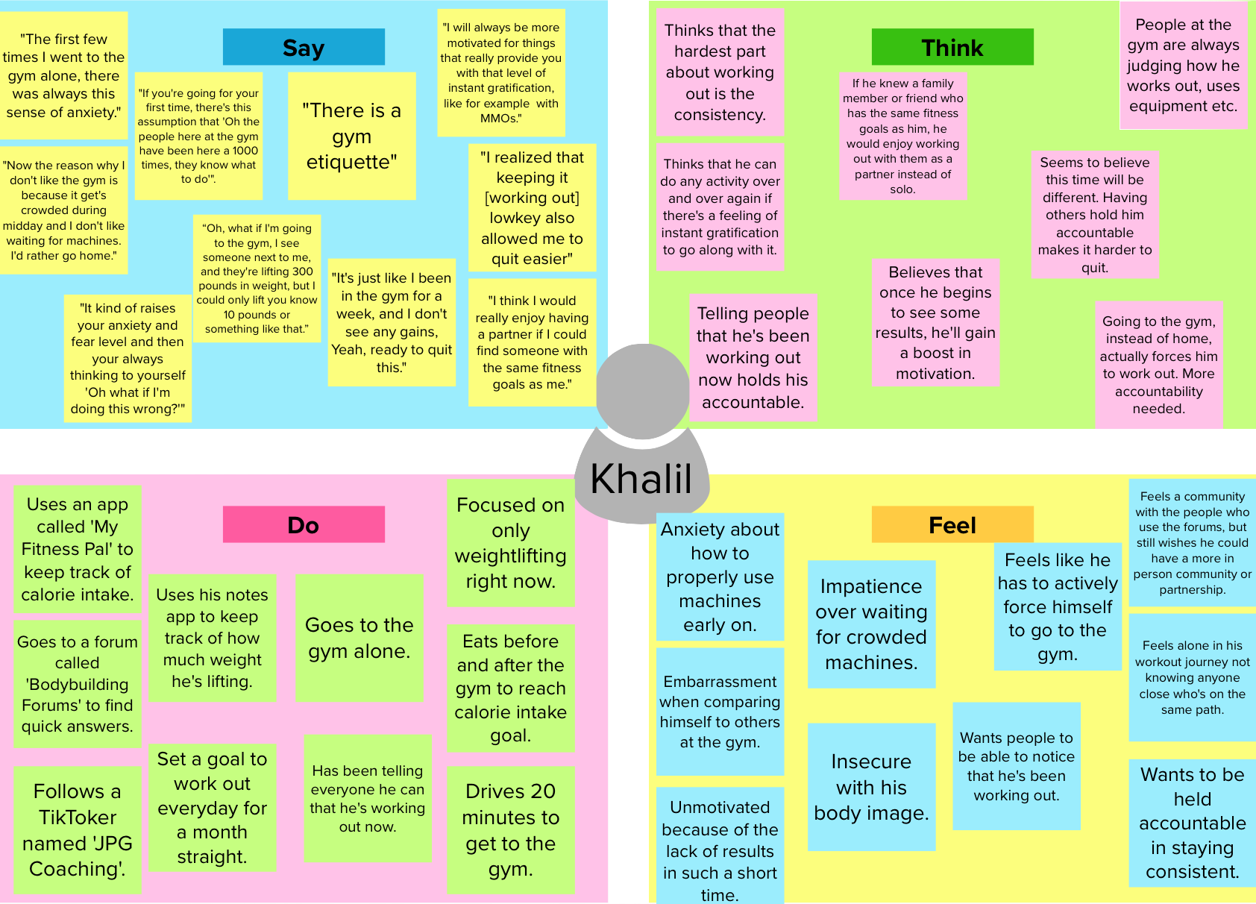

Slide 12
Nikki
"I've taken a lot of SoulCycle classes and sometimes I see some riders crying because they get really in the zone, emotional, and vulnerable."

Slide 13
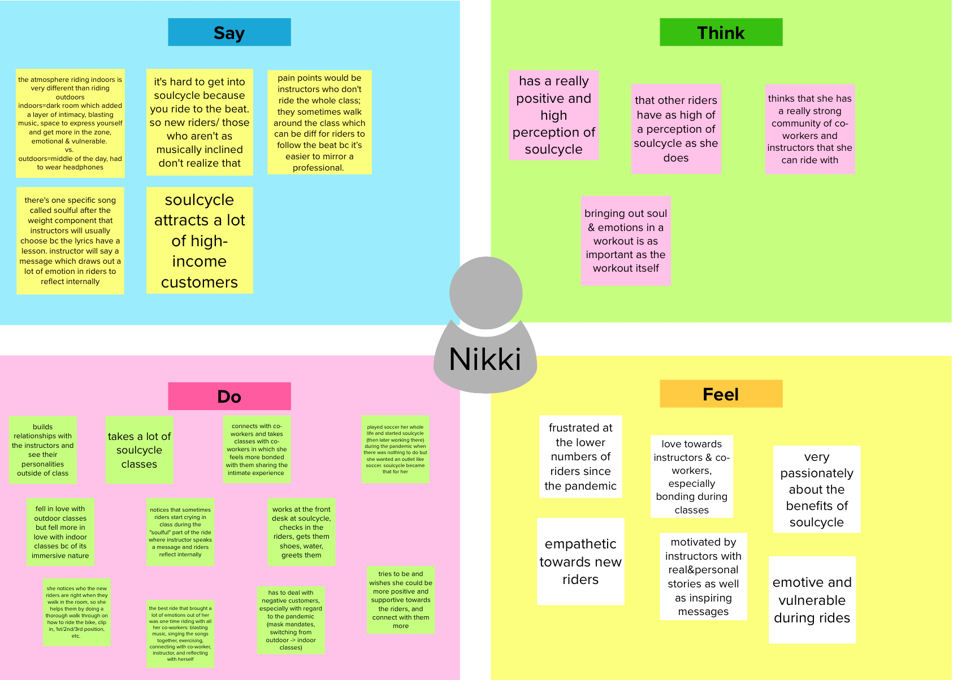

Slide 14

Kenza
“It’s impossible for me to have a regular routine when I’m traveling because I don’t have equipment, access to my gym, and am with my family”

Slide 15
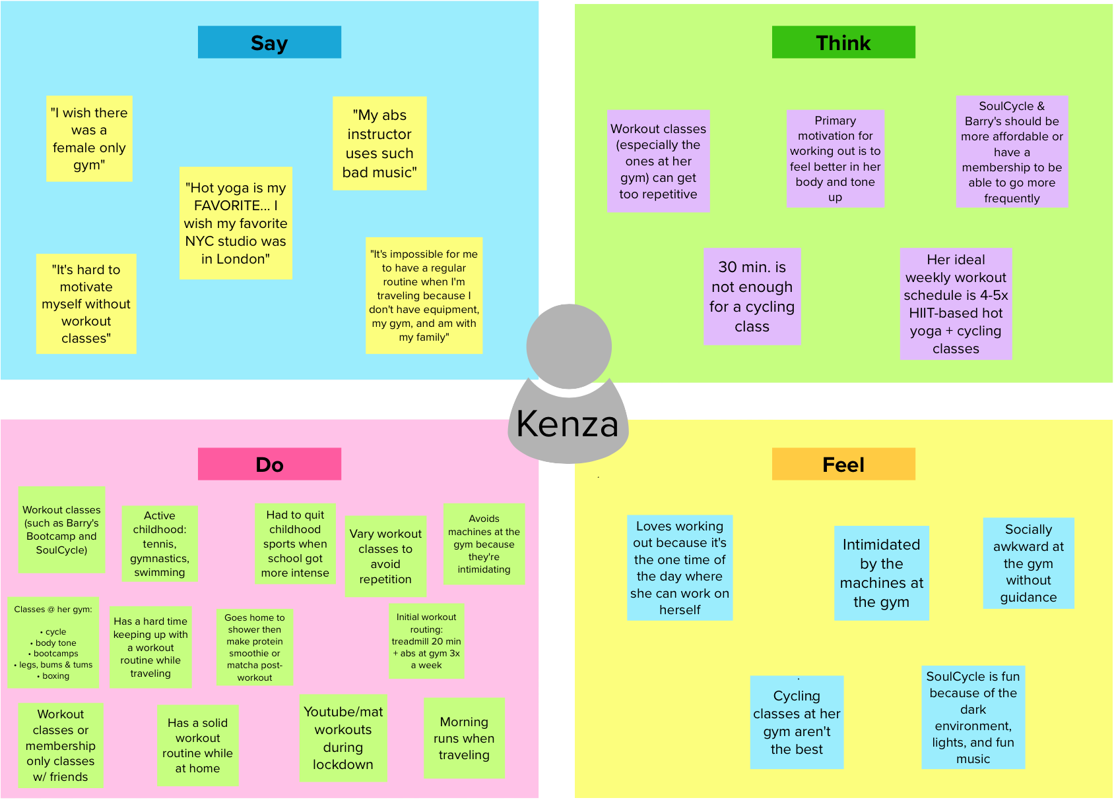

Slide 16
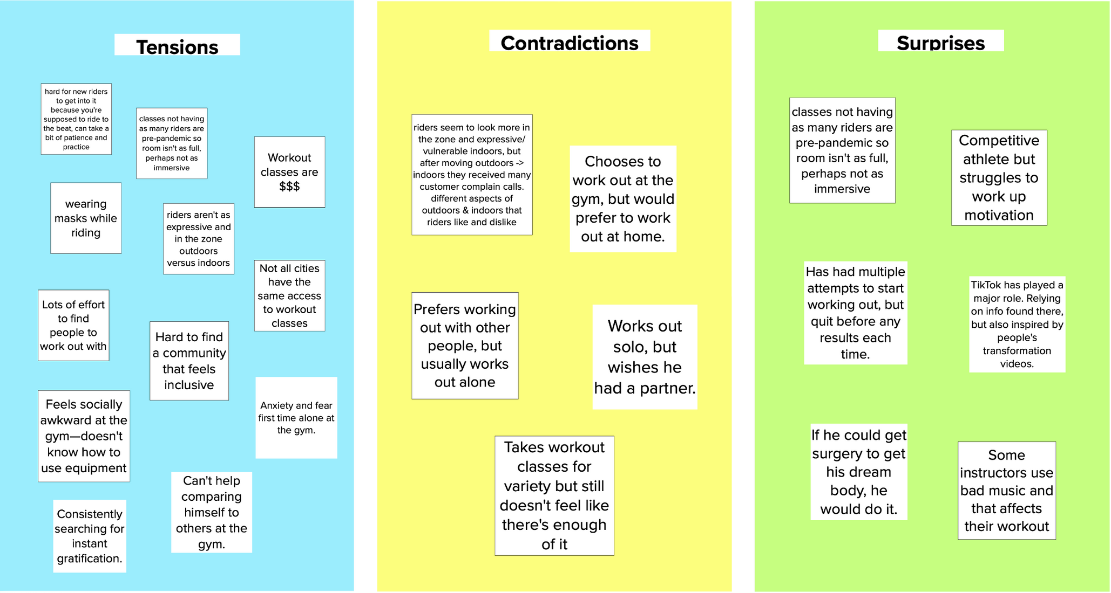
Tensions, Contradictions, Surprises

Slide 17
Insights: Key Themes
Regimen Accountability

Slide 18
Insights: Key Themes
Regimen Accountability
Social/Community

Slide 19
Insights: Key Themes
Regimen Accountability
Social/Community
Economic Accessibility

Slide 20
Insights: Key Themes
Regimen Accountability
Social/Community
Economic Accessibility
Locational Accessibility

Slide 21
Moving Forward
How might we...
mimic community-based fitness without the high fees?
How might we...
help people stay committed to their workout regimen no matter where they are in the world?
How might we...
replicate community through digital and immersive experiences?

Slide 22
Summary
Next Steps
We talked to 4 interviewees of varying experience levels about their workout habits
A commonality that we discovered among the interviewees was that they all appreciate the social aspects of working out.
POVs
Generating more HMW statements
Diversify participant age & gender with additional interviews
Brainstorm

Slide 23
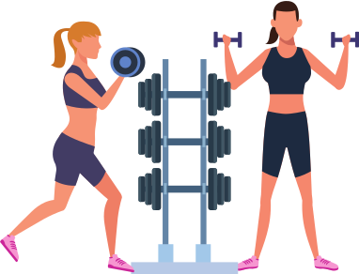
Thank You!

