Slide 1

Get fit with anyone, anywhere

Slide 2
Market Research
Supernatural
VR on-demand single-player fitness program
4 different modes: Boxing workouts, flow workouts, meditation, and stretching in VR on Oculus Quest
Pre-recorded instructors demonstrate body movements during warmup/cooldown and give motivational commentary during workout
Leaderboard with friends
Well-known songs play during workout
Scenic real-life camera captured locations all around the world
FitXR
VR on-demand rhythm fitness game
3 different modes: Boxing, Dancing, and HIIT
3D avatars appear during dance workouts to demonstrate movements and instructors give motivational commentary
Can see avatars of previously recorded players and their scores while working out
Includes multiplayer of up to 7 people total
Not well-known songs play during workout
Only a few human-made locations
Mirror
The invisible at-home gym. A smart mirror with an embedded screen, speakers, and webcam that displays the fitness instructor
Build into wall (permanent) or stand (can move around)
Have to use app to jump into a workout because there is no touch screen
Can buy additional weights or
Can track body metrics, track heartbeat, variety of classes
Relatively costly (~$2,000 installation, excluding classes)
Installations rose during the pandemic because it is entirely at-home friendly, and takes up no physical space (besides a wall)
Users can see their orm while working out and tracking progress
Tonal
At-home workout with adjustable arms with cables inside for strength training
Built into the wall and takes up no floor space except workout bench + mat
Can jump into a workout directly through the Tonal device
Includes initial strength training
Music of different genres or use you own music from Apple Music account
Recorded instructors demonstrate movements, and on-screen cues help stay on track with reps, sets, and weight
Cost is similarly costly compared to MIrror

Slide 3
Tasks
Simple: Receive workout instructions
Moderate: Build motivation and community with others
Complex: Browse and plan future workouts

Slide 4
Values in Design
Our project’s values include health, community, inclusion, and accessibility. We wish to provide users the ability to have engaging workout classes regardless of their location or starting ability. By providing both live and on-demand classes users will be able to attend classes whenever they want.
Our values of community and accessibility may come into conflict. We hope to provide the best community experience with VR technology that allows for people to feel connected, but VR headsets may not be affordable for everyone. We believe that with the falling prices of VR headsets in recent years and by not requiring additional expensive hardware, we best balance the need for strong community and being as accessible as possible.

Slide 5
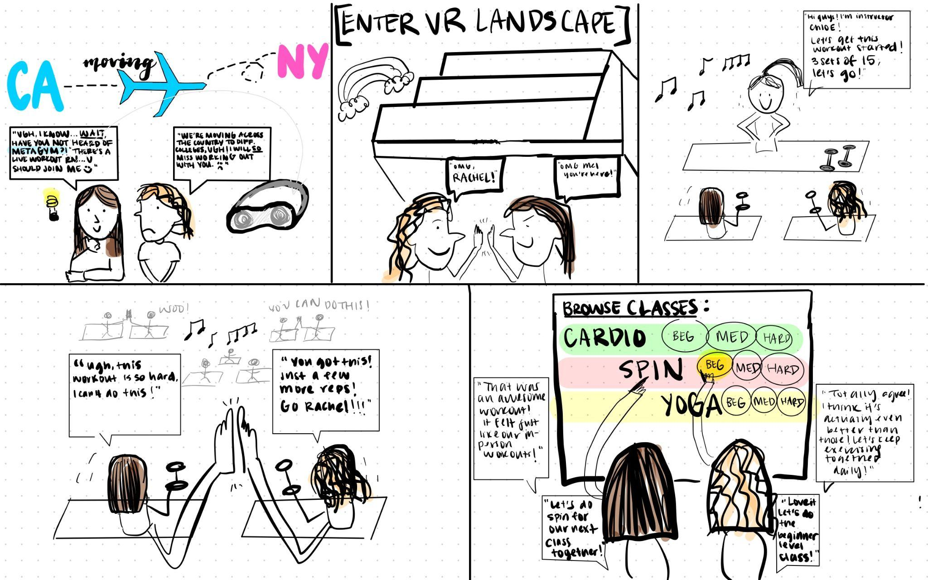
Storyboard

