Slide 1
Assignment 2 –Creation & Analysis of COVID Charts
File created on: 10-10-2021 16:59:47

Slide 2
Overview OF Data
The data in the dataset is based on different date ranges over the WORLD for COVID Vaccines. The data is primarily captured on the following points:
Total Vaccines
People Vaccinated
People Fully Vaccinated
Daily Vaccinations

Slide 3
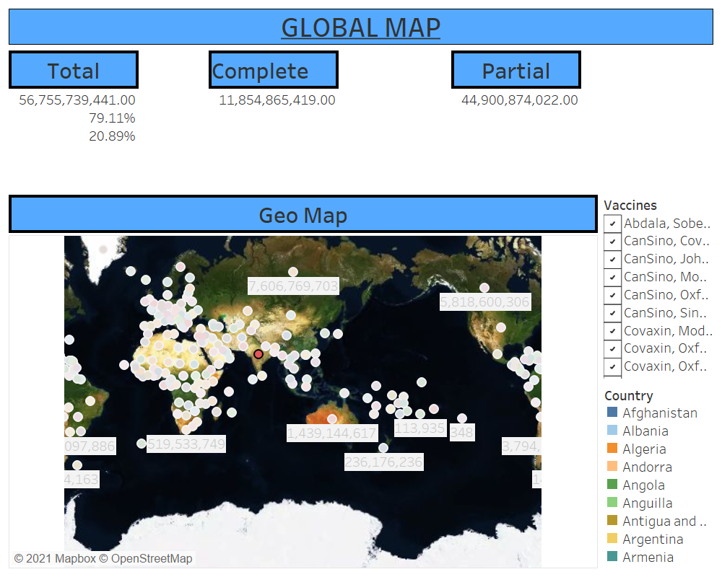
Dashboard Overview
This dashboard gives an overall count of vaccinations taken by people all over the world.
Without any selection the total count for all the countries in the World is shown.
Selecting a single county or multiple counties changes the 3 KPIs of total (vaccinations done ), complete and partial
The countries filtered in Geo Map are carried over to the next page.

Slide 4
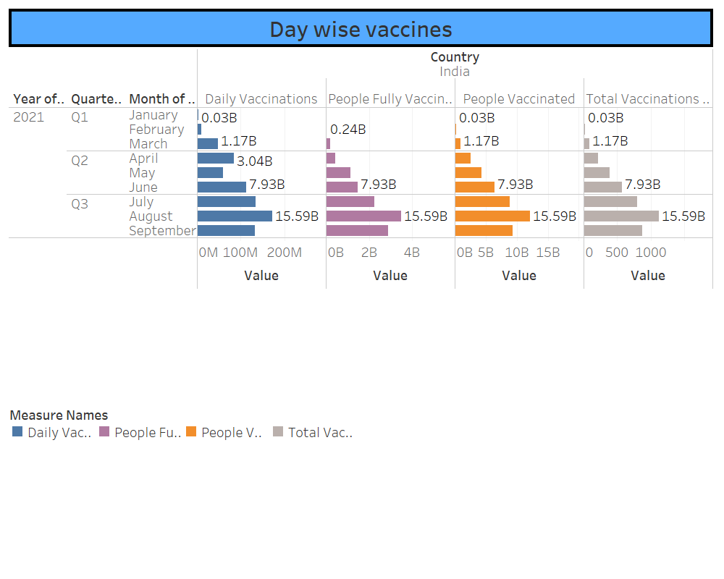
Vaccines Administered Over Time
This dashboard gives break of vaccine administered over time.
It is a one shot view in terms of year, quarter ,month and day. Data can be rolled up or rolled down based on the analysis to be done.

Slide 5
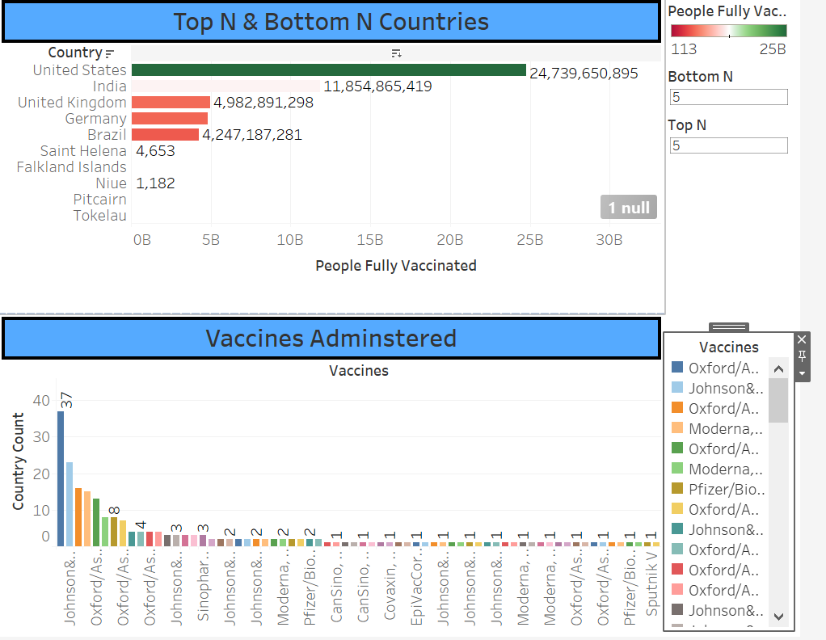
TOP N Countries & Vaccines
Administered
Based on the people completely vaccinated TOP and BOTTOM N countries can be found.
Vaccines administered shows the vaccines that are mostly used overall the World. For eg Sputnik V is used only in 1 country.

Slide 6
References – Data obtained
https://www.kaggle.com/gpreda/covid-world-vaccination-progress -Medical - COVID 19 Vaccination Progress

Slide 7

Prepared By – Rachel REGO

