Slide 1
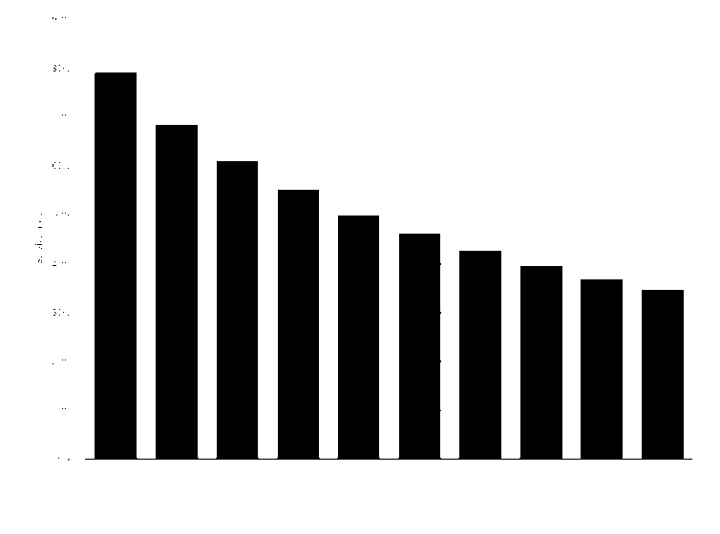
Case Study: LA Business Profitability
Analysis of Business Data And Predictors of Sales Growth
Rachel Pham, Herat Devisha, Diego Estuar, Yannick Angouo Lopes, Andrew Morris, and Riley Nickel

Slide 2
Starting a business is challenging …
>20%
of all new businesses will fail within the first year after opening.
*https://www.statista.com/statistics/725044/survival-rate-new-business-united-states/

Slide 3
… and maintaining profitable growth over time is even more difficult.
>65%
will fail within the first 10 years of operation.
*https://www.statista.com/statistics/725044/survival-rate-new-business-united-states/

Slide 4
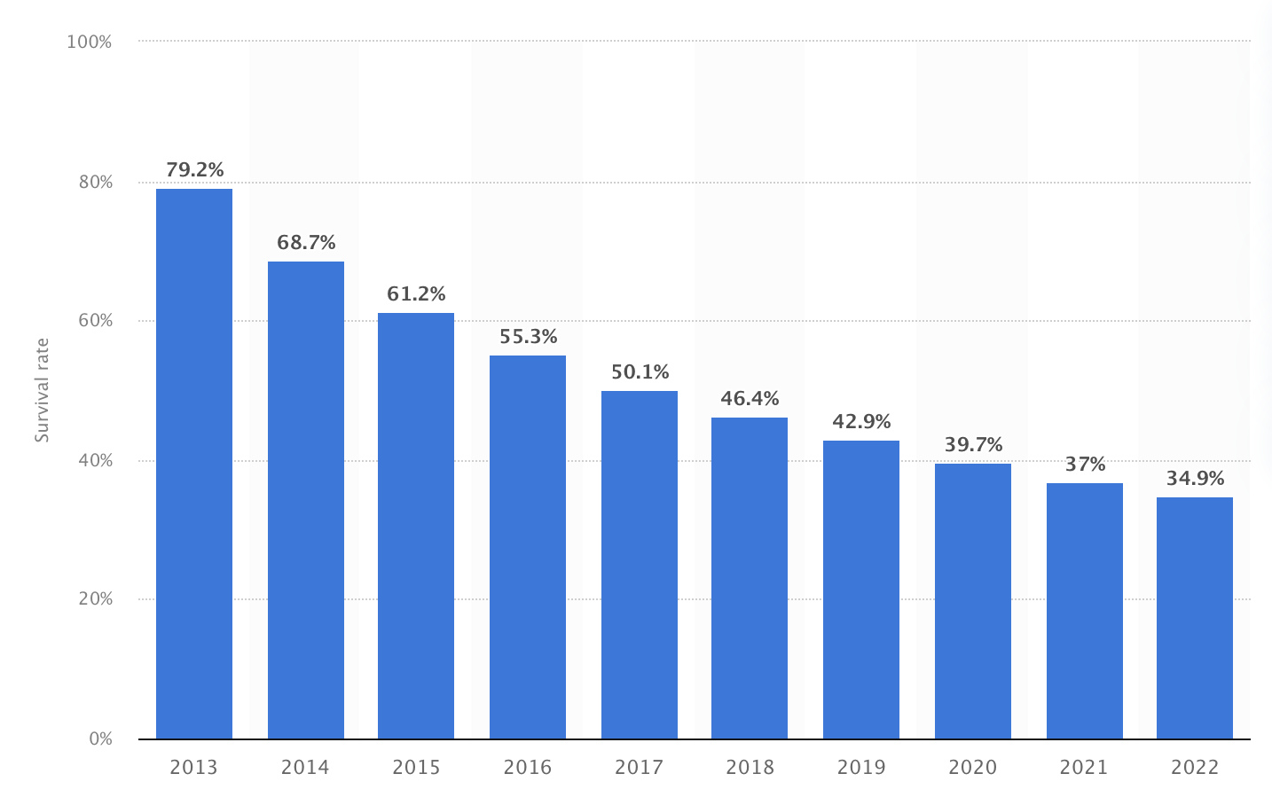
Business Survival Rate (in the United States founded between April 2012 to March 2022)
*https://www.statista.com/statistics/725044/survival-rate-new-business-united-states/

Slide 5
Introduction
There are a number of factors that play a determining role in the profitability of any given business.
Focal Industry
Location (ZIP code)
Sales Growth
Demographic factors
Out of the variables present in the data available to us, we decided to take two approaches to optimize potential sales growth for new businesses.
*Cegiełka, M. (2020). Factors Determining the Survival of New Companies.Central European Economic Journal, 7(54), 300-315.

Slide 6

Research Question
For a given business type and target customer, what location (ZIP code) will result in the highest sales growth?

Slide 7
Data Processing & Method
2020 National Establishment Time-Series (NETS) Database
Los Angeles
Information on over 500,000 businesses
Filtered merged data by ‘Relocated’
Location Census Data
California
Demographic data by ZIP Code
Filtered for 2020 data
Notes:
Started with National Establishment Time-Series Data in Los Angeles from 2020
Dataset included over 500,000 data points with information on individual businesses in Los Angeles
Some of the variables in the NETS data include previous year sales, the quartile of sales growth, demographics of owner, and business type
The second dataset we used was from the US Census Bureau
It included demographic data at the ZIP code level such as income, ethnicity, and poverty rates
This data was for all of California, not just Los Angeles
This dataset included data for years 2011 to 2020 but we kept the 2020 data as we felt that was the most relevant to the cluster analysis and regression we wanted to run.
Once we removed the non-2020 years from the census data we did a left merge of the two datasets where the NETS data was our left dataset
We did this because we wanted to preserve each business in the dataset.
Once the dataset was merged, we did further cleaning.
There was a variable named ‘Relocated’ that indicated whether a business had changed locations. We removed any rows where this variable was 1 because we only wanted to look at businesses that had stayed in place.

Slide 8
Cluster Analysis
We applied k-means clustering to location census data, focusing on demographic variables like population composition by race, median age, income, and educational attainment.
This method effectively segmented the data into
06 distinct clusters, each representing unique demographic characteristics.
We used the following columns for cluster analysis:
pop_black
pop_asian
pop_white_all
pop_hispanic
median_age
per_capita_income
edu_highschool_percent
edu_bachelor_percent

Slide 9
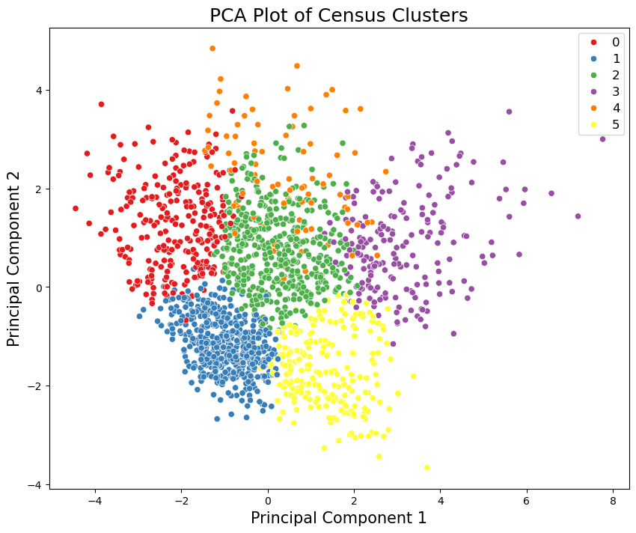
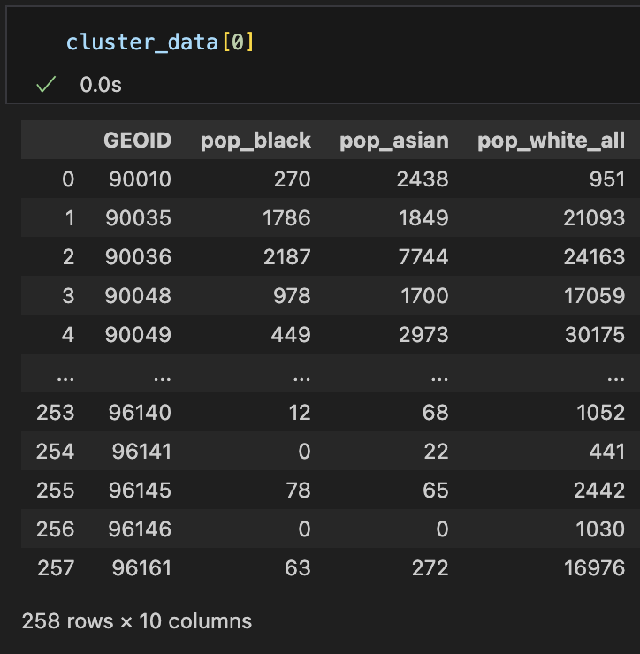
Cluster Analysis
Each cluster consists of a list of locations with unique zip codes that share common demographic characteristics.

Slide 10
Cluster Analysis
Cluster 0 - Affluent and Educated
Marked by the highest incomes and educational levels.
Significant proportion of Asian and White individuals.
The median age in the late 30s suggests a mix of young professionals and established adults.
Cluster 3 - Working-Class, Hispanic Dominant
Characterized by lower incomes and educational levels
Substantial Hispanic demographic.
It might represent working-class neighborhoods.
Cluster 1 - Mid-Income, Diverse Population
Moderate incomes and varied educational attainment
Demographic diversity, including notable Black, Asian, and Hispanic populations.
The age group skews a bit older.
Cluster 4 - Middle-Aged, Diverse Middle Class
With mid-level incomes and education
Notable Asian and White population
The median age indicates a mix of middle-aged residents.
Cluster 2 - Young and Multicultural
This group has a younger median age and is diverse
Significant Hispanic presence.
The lower income levels and varied education suggest it might include students and early-career individuals.
Cluster 5 - Economically Disadvantaged, Youthful Diversity
The lowest income levels and educational attainment
The diverse demographic, significant Hispanic and Asian
Younger median age, suggests neighborhoods with younger families or individuals in starter careers.
Notes:
After clustering, we look closely at each cluster and provide a name as well as interpretation for each cluster.

Slide 11
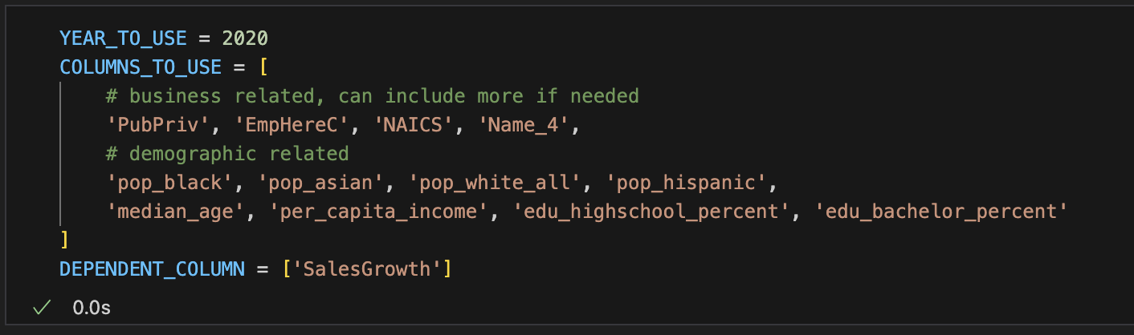
Linear Regression Model
This linear model allows us to determine the best zipcode to open a new business in each certain cluster (or demographic groups)
Notes:
The second part of pipeline is a linear regression model. This model predict the sales growth of a business based on business related variables shown in the slides and also the demographics information. As we will show later, this linear model allows us to determine the best zipcode to open a new business in a certain cluster (or demographic groups)

Slide 12
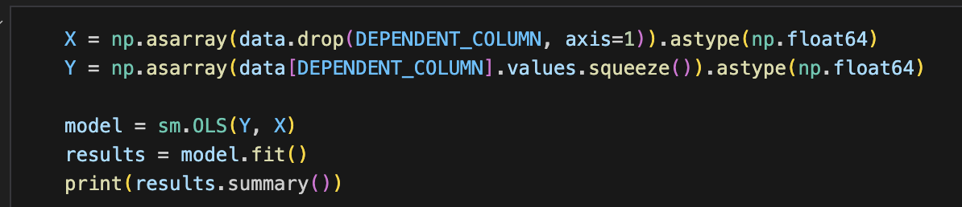
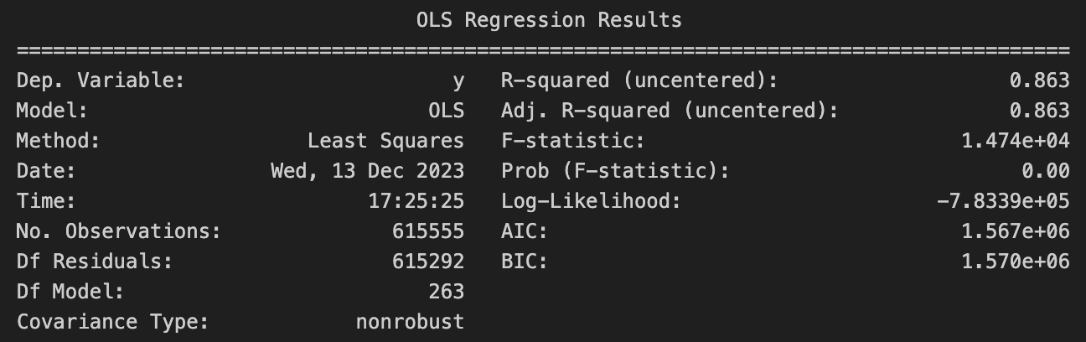
Linear Regression Model
Notes:
This slide shows the python code that we use for building the linear regression model and the results of the model.

Slide 13
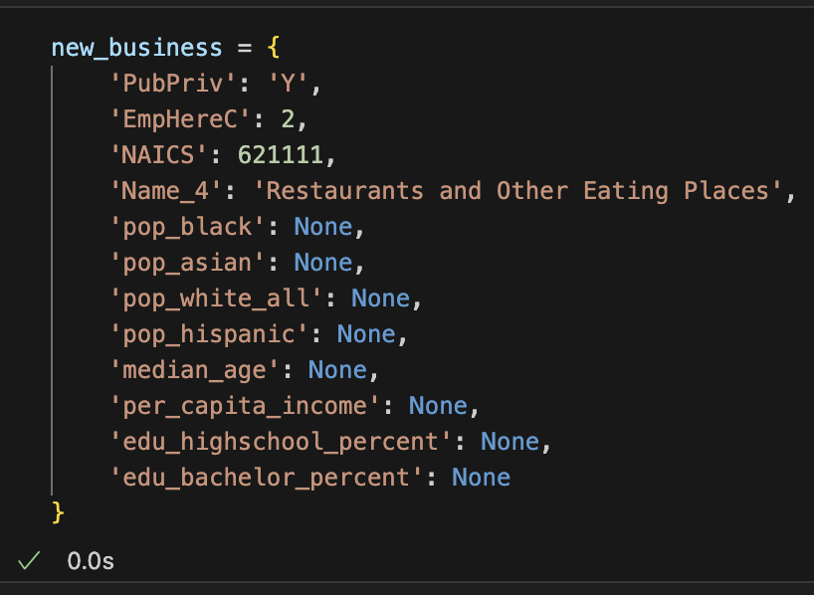
Determining the best zip code
To determine the best zip code for a new business, we first decide some important business information.
For example: We want to open a Restaurant business.

Slide 14
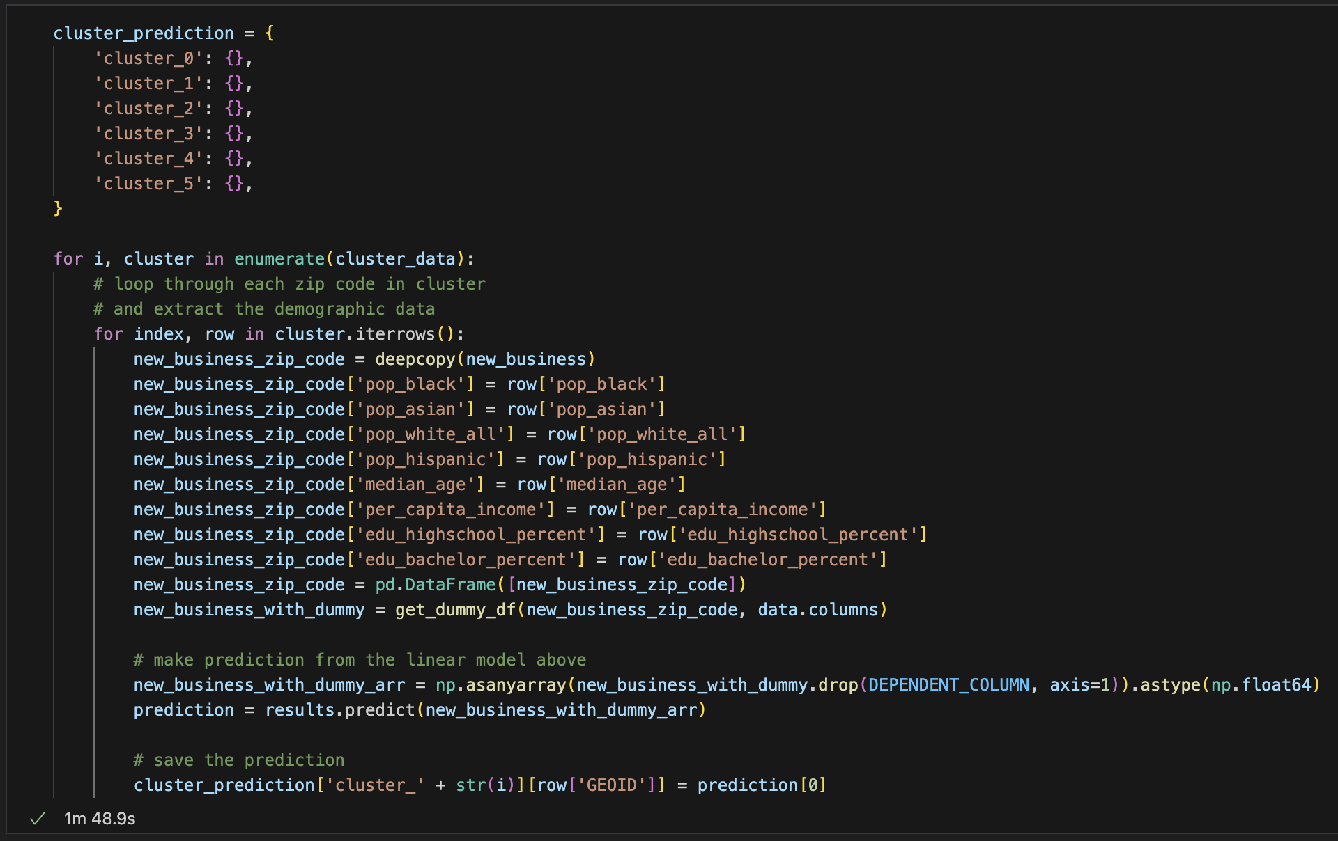
Determining the best zip code
Loop over the 6 clusters and the zip codes
Notes:
Next, we loop over the 6 clusters, and the zip codes in each cluster

Slide 15
Determining the best zip code
Extract Demographic information from the zip codes
Notes:
For each zip code, we extract the corresponding demographic information, and run the linear model using both the business information before and the current demographic information.

Slide 16
Determining the best zip code
The prediction of the model indicates the sales growth if we open this business in this zip code
Notes:
The prediction of the model indicates the sales growth if we open this business in this zip code.

Slide 17
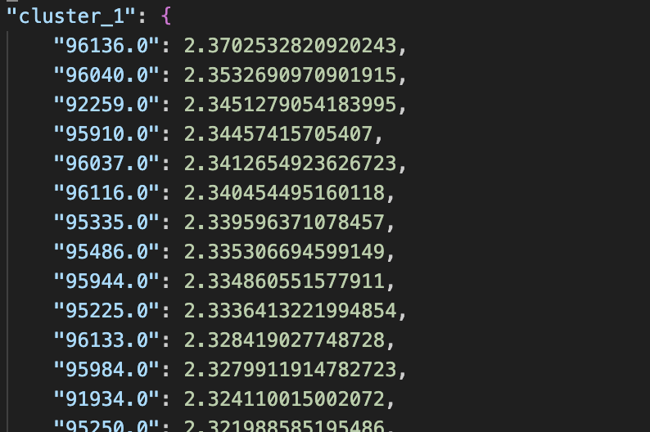
Determining the best zip code
Each zip code in each cluster will have a corresponding predicted sales growth.
We then sort the zip codes based on their predictions.
Notes:
After running the linear model, we saved the prediction which is the sales growth of the business for all clusters and all zip codes in a JSON file. We also sort the predictions for each cluster.

Slide 18
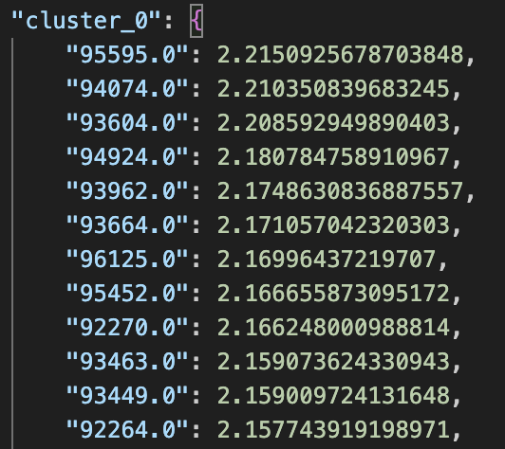
Determining the best zip code
For Cluster 0 - Affluent and Educated
95595 is the best zipcode to open a restaurant
For Cluster 1 - Mid-Income, Diverse Population
96136 is the best zipcode to open a restaurant

Slide 19
Conclusion and Future Research
Through our analysis we have:
Conducted a cluster analysis to highlight key customer groups with demographic and business variables.
Analyzed a linear regression model to locate zip codes with the highest sales growth within each target customer group for a given business.
Future research should look to expand on this subject by including additional relevant business variables, analyzing the clusters and linear regression for each business type, and applying the predictive model to a larger or more robust dataset to improve accuracy.

