Slide 1
Git Training Rachel Player Jordy Gennissen Nathan Rutherford + you! Royal Holloway University of London 9 April 2021
Notes:
3/5/21
1
1
TODO: Change the date and potential names

Slide 2
Motivation
Imagine a bunch of researchers want to write a paper together
They are sitting in different offices (all over the world)
They want to work together on one/more documents
They want to edit the documents at the same time
Under pressure, mistakes happen
Also when not under pressure
Solution: Office 365?
Disagreements fought over the editor
Who wrote that monstrosity / brilliant quote?
And who deleted my section, and why?
Notes:
3/5/21
2
2

Slide 3

Git: The cloud before it was cool

Slide 4
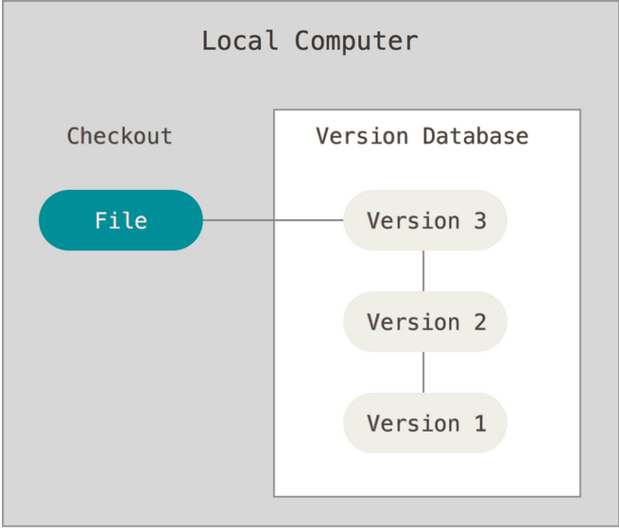
About Version Control (1)
Retain a database of all previous versions
All changes have a record of who did what
Notes:
3/5/21
4
4

Slide 5
Free backups for everyone!
About Version Control (2)
Notes:
3/5/21
5
5

Slide 6
Disclaimer
This workshop does not tell you:
Good coding collaborative practice
How to be a “git master”
But does tell you:
How to use git well when collaborating on a paper
How to use it practically

Slide 7
Terminal Interrupt
~$

Slide 8
How do we navigate in a black box?
Black box is called a shell/terminal
Open it now!
You’re always in a directory (folder)
Which one? Type pwd [enter]
Changing Directory: cd [path]
Reset directory to your home: cd without a path

Slide 9
More terminal
Show what files are in the directory
ls (stands for list)
Make a new folder / directory
mkdir (make directory)
Edit a file
nano [filename]
From last slide
cd; cd [path]; pwd

Slide 10
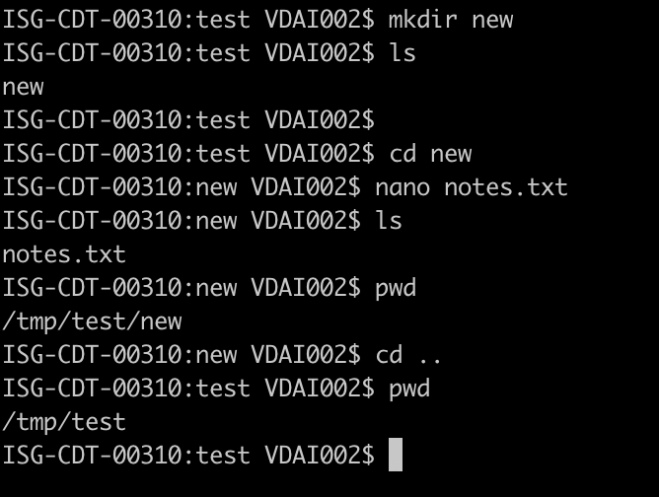
Change Directory
Need to specify a path
Usually done as a relative path

Slide 11
Essential terminal commands
Mkdir
Cd
Ls
pwd
nano (for mac)
nano or gedit (for linux)

Slide 12
Installing git
Linux:
$ sudo apt install git
Mac OS:
Download from: https://git-scm.com/download/mac
Or use brew: brew install git
Windows:
https://git-scm.com/download/windows
Notes:
3/5/21
12
12

Slide 13
First-Time Git Setup
Configure name
$ git config --global user.name “John Doe”
Configure email address
$ git config --global user.email “johndoe@example.com”
Configure editor for commit messages
$ git config --global core.editor nano
Check settings
$ git config --list
user.name=John Doe user.email=johndoe@example.com ...
Notes:
3/5/21
13
13
Or vim

Slide 14
Basic Commands

Slide 15
git clone
Get a copy of an existing remote repository on your local machine
The typical way to start any project

Slide 16
git status
Lists the files which have been modified since the last commit
Lists the untracked files in your local directory

Slide 17
git add
Puts a file in the ‘staging area’ ready for a commit
You can add several files ready for one commit
Adds a new file called test.txt to the staging area (which can then be uploaded to the server)
$ git add test.txt

Slide 18
git commit
Commits the files in the staging area (that have been added with the previous command)
Add a meaningful commit message so you/other people understand the change
Commits are labelled by a hash value (SHA-1)
This means ‘Commit the file[s] that have been added to the local repository, with the message given after the symbol -m’.
$ git commit –m “refer to [XYZ17] in introduction”

Slide 19
git push
Upload the committed local changes to the remote repository
$ git push

Slide 20
git pull
Download the latest remote change to the local repository
$ git pull

Slide 21
git log
Shows the history of commits (author/date/commit message)
or
$ git log
$ git log --graph

Slide 22
Exercise ☺

Slide 23
Exercises
Setup
Create Github account (FYI: you already should’ve done this)
Tell us your username (FYI: you already should’ve done this)
Start Exercises (FYI: This is not something you should’ve done already )

Slide 24
Breakout rooms
Room 1: Dan, Stephanie, Sofia
Room 2: Kyra, James, Emma
Room 3: Giuseppe, Elle

Slide 25
Exercise 0
Type ‘cd’ to be in the home directory
Make a new directory called git
Make a subdirectory called test
Make a file called test.txt
Change directory to the git directory ready for the next exercises

Slide 26
Exercise 1
Create a new repository on Github
Create a file named “test.txt” inside the repo
Write your name in the text document
Upload the text file to the repository

Slide 27
Exercise 2
Clone the following repository:
https://github.com/rachelplayer/isg-playground.git
Create a file “<your_firstname>.txt”
Upload your file to the repository
Download the files of the other people

Slide 28
Collaborating 2.0
What if we edit the same file?
git will automatically try to understand how to merge two updates
If git doesn’t know how: you get a merge conflict and will need to resolve it manually

Slide 29
When all goes wrong
Two commands to reset everything
git reset --hard
Reset all git files to the latest commit
Also reset the files that git doesn’t track:
git clean --fd

Slide 30
Exercise 3
Use the repository from previous exercise
Write your name in the text document “names.txt”
Upload the changes in names.txt
Overall goal: Everyone’s name should be in the file names.txt

Slide 31
Advanced Commands
(slightly)

Slide 32
Git IDs
Every git commit has a unique ID
If you want to go back to a commit, use the ID!
To find the ID, use the website or
Git log example:
$ git log
commit 0cb46a492bd91e0b4389dfeacd83ed2701701222
Author: Rachel Player <rachelplayer@gmail.com>
Date: Fri Jan 18 15:06:41 2019 +0000
added the file rachel.txt
Notes:
You can use a short version too

Slide 33
git checkout
Revert a file to a version of the file from a previous commit
$ git checkout test.txt
This restores the file test.txt to the last uploaded version
$ git checkout 397344c2 test.txt
This restores the file test.txt to the version with commit id 397344c2

Slide 34
git diff
Shows the differences between your version and the latest commit
$ git diff
Notes:
3/5/21
34
34

Slide 35
.gitignore
One can create a file and list all files that should be ignored by git
For example, intermediate files from LaTeX including:
*.bbl
*.blg
*.aux
*.out
*.log
Notes:
3/5/21
35
35

Slide 36
git mv
Move/Rename a file
$ git mv test.txt introduction.txt
This renames the file test.txt to introduction.txt

Slide 37
git rm
Deletes a file from the git repository
If you delete the local file, but don’t commit the deletion, it still exists in the repo
To delete it in the repo, use
Note that you can still recover the file if necessary, even after deleting!
$ git rm test.txt

Slide 38
Forgot to pull? And already made changes?
Commit and merge, or:
$ git stash // save for later
$ git pull // get the latest version
$ git stash pop // retrieve your changes

Slide 39
Exercise ☺

Slide 40
Exercise 4
Go back to your own repo
Add 2 files: “test2.txt, oops.txt”.
Commit
Revert the changes using only git
Commit
Recover these files using only git
Remove oops.txt again

Slide 41
Pairs for Exercise 5
Pair 1: Sofia & Kyra
Pair 2: Dan & Elle
Pair 3: James & Giuseppe
Pair 4: Stephanie & Emma
(Each person is in a separate breakout room to the other person in their pair)

Slide 42
Exercise 5
In pairs, invite someone to join your repo
Add a file “review.txt” and push
Both collaboratively write a review about this workshop. Push regularly, and resolve conflicts. Hint:
Git diff
Git log (also verify their useful commit messages!)

Slide 43
Exercise 6
Copy the review into the shared repo
isg-playground
add it, commit and push!

Slide 44
Useful Stuff for Paper Writing

Slide 45
Github / Gitlab / Bitbucket
Web-based git/version control repositories
Distributed version control
Source code management
Millions of users
Offers public and private repositories
Free repositories (with an academic email address) on all three

Slide 46
CryptoBib
CryptoBib is a BibTeX database containing papers related to Cryptography, with manually checked entries and uniform BibTeX data.
https://cryptobib.di.ens.fr
Notes:
3/5/21
46
46

Slide 47
Note from fire safety: don’t actually do this

Slide 48
Advanced Commands

Slide 49
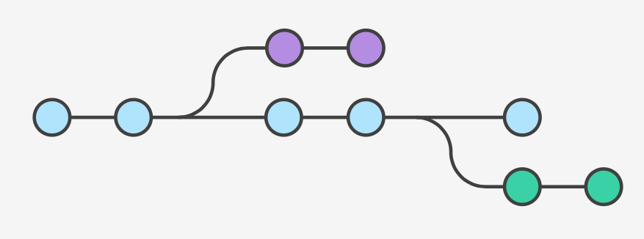
Git Branches
A branch represents a independent line of development
There are local and remote branches
Notes:
3/5/21
49
49

Slide 50
Git Branches
List all branches in your repository:
$ git branch
Create a new branch:
$ git branch <branch>
Delete a branch:
$ git branch -d <branch>
Switch to /checkout a branch:
$ git checkout <branch>
Notes:
3/5/21
50
50

Slide 51
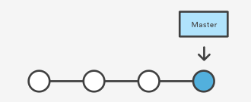
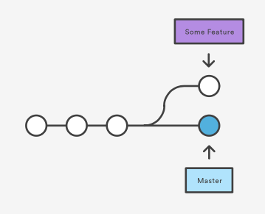
Git Branches - Example
$ git branch <some feature>
Notes:
3/5/21
51
51

Slide 52
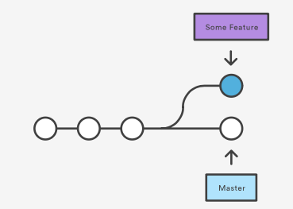
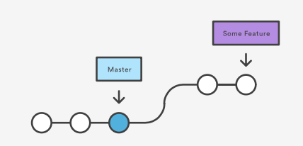
Git Branches - Example
$ git checkout <some feature>
$ touch test.txt
$ git add test.txt
$ git commit test.txt –m “add test.txt”
Notes:
3/5/21
52
52

Slide 53
Git Branches - Merge
Merge branch back to current branch:
$ git merge <branch>
Merge branch (but always create a merge commit):
$ git merge --no-ff <branch>
Several types of possible merges
Fast-forward merge
3-way merge
Notes:
3/5/21
53
53

Slide 54
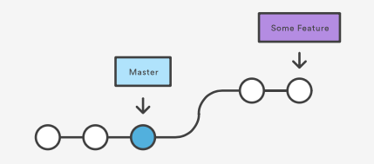
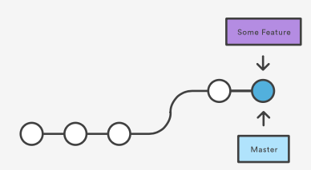
Git Branches – Fast-Forward Merge
$ git checkout master
$ git merge <some feature>
Before merging:
After merging:
Notes:
3/5/21
54
54

Slide 55
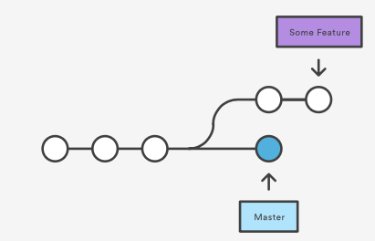
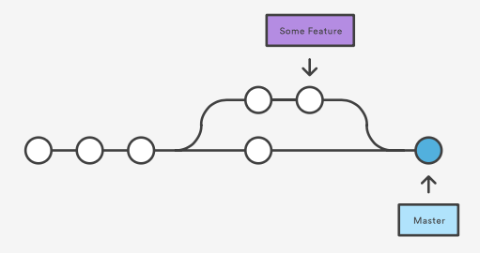
Git Branches – 3-way Merge
$ git checkout master
$ git merge <some feature>
Before merging:
After merging:
Notes:
3/5/21
55
55

Slide 56
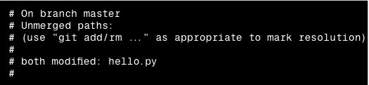
Git Branches – Merge conflicts
If two branches change the same part of the same file, git can’t handle the conflict
Resolve conflict manually
Commit resolved conflict
Notes:
3/5/21
56
56

Slide 57
Git Branches – Remote branches
Publish/Push a local branch:
$ git push origin <branch>
Pull a remote branch:
$ git checkout –b <localbranch> origin/<remotebranch>
List all branches (local and remote):
$ git branch -a
Delete remote branch
$ git push origin --delete <remotebranch>
Notes:
3/5/21
57
57

Slide 58
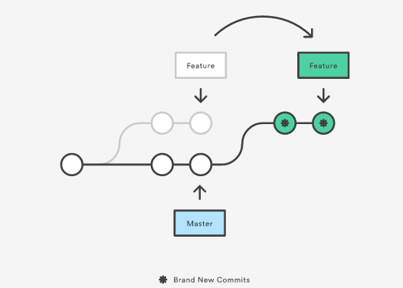
Git Branches – Rebasing
Move a branch to a new base commit
Maintain linear project history
Don’t loose history from a branch
Notes:
3/5/21
58
58

Slide 59
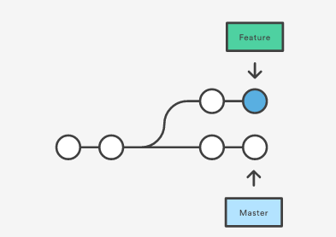
Git Branches – Rebasing
Master branch has progressed since the start of a feature
The feature depends on some commits of the master branch
Notes:
3/5/21
59
59

Slide 60
Git Branches – Rebasing
Solution 1: Merge directly with a 3-way merge and a merge commit
Notes:
3/5/21
60
60

Slide 61
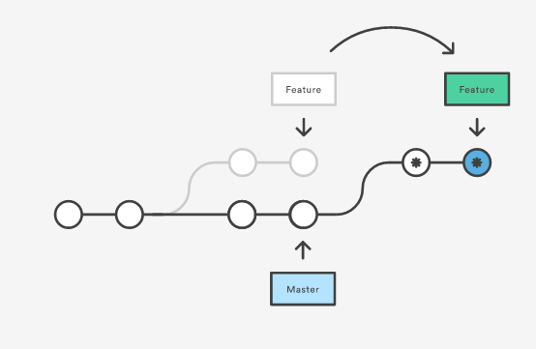
Git Branches – Rebasing
Solution 2: Rebase
Notes:
3/5/21
61
61

Slide 62
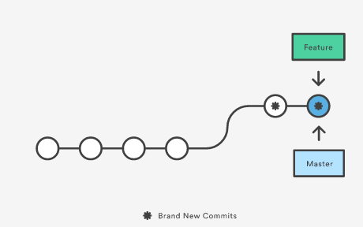
Git Branches – Rebasing
Solution 2: fast-forward merge
Notes:
3/5/21
62
62

Slide 63
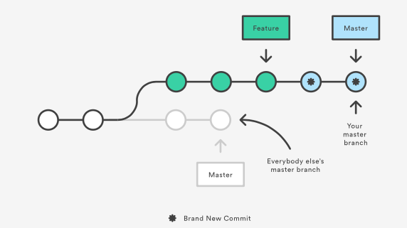
Git Branches – Rebasing
Golden Rule of Rebasing: Don’t rebase public branches
Example: Rebase the master branch onto your feature branch
Notes:
3/5/21
63
63

Slide 64
Git Branches – Rebasing
This only happens in your repository
Everyone else will work on the old master
Rebase creates new commits – git thinks that your master branches diverge from the other master
Merging them together will results in a merge commit with two different histories
Notes:
3/5/21
64
64

Slide 65
Git Submodules
Use other git repository in your git repository
Use external libraries managed in a git repository
Create a new submodule:
$ git submodule add <link to repository> <directory>
Clone a git repository with submodules:
$ git clone -- recursive <link to repository>
Update a submodule:
$ git submodule update --init
Notes:
3/5/21
65
65

Slide 66
Exercise ☺

Slide 67
Exercises 7
Go back to your own repo
Create a branch with your name
Edit the file ”test.txt” in your branch and write your name in it
Upload your branch to the repository
Checkout the master branch again

Slide 68
Exercise 8
Merge your branch to the master branch
Add CryptoBib as a submodule

Slide 69
Further Tutorials
https://git-scm.com/book/en/v2
https://www.atlassian.com/git/tutorials
https://www.git-tower.com/blog/git-cheat-sheet/

