Slide 1

Git Training Rachel Player Nathan Rutherford + you! Royal Holloway University of London 19 May 2022
shorturl.at/adgrQ
Notes:
5/19/22
1
1
TODO: Change the date and potential names

Slide 2
Learning Outcomes
Basic Git commands
Collaboration using Github
Using Github to create a personal website
shorturl.at/adgrQ

Slide 3
Motivation
Imagine a bunch of researchers want to write a paper together
They are sitting in different offices (all over the world)
They want to work together on one/more documents
They want to edit the documents at the same time
Under pressure, mistakes happen
Also when not under pressure
Solution: Office 365?
Disagreements fought over the editor
Who wrote that monstrosity / brilliant quote?
And who deleted my section, and why?
shorturl.at/adgrQ
Notes:
5/19/22
3
3

Slide 4

Git: The cloud before it was cool
shorturl.at/adgrQ

Slide 5
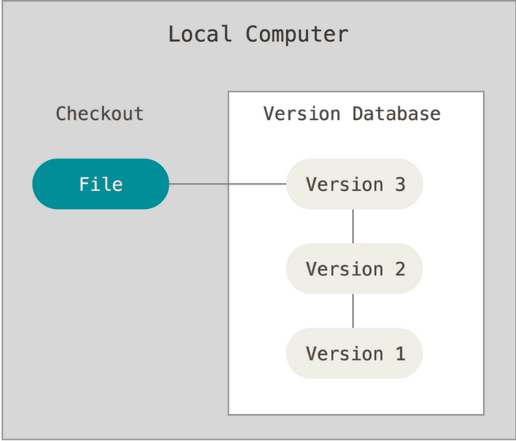
About Version Control (1)
Retain a database of all previous versions
All changes have a record of who did what
shorturl.at/adgrQ
Notes:
5/19/22
5
5

Slide 6
Free backups for everyone!
About Version Control (2)
shorturl.at/adgrQ
Notes:
5/19/22
6
6

Slide 7
Setup
shorturl.at/adgrQ

Slide 8
Create an account on Github
Recommend using a professional user
E.g., John Smith -> JSmith, JohnS
Will be used as the first part of your website address
Github Website
shorturl.at/adgrQ

Slide 9
Authentication using SSH
Written Guidance
shorturl.at/adgrQ

Slide 10
Visual Studio Code
Lightweight text editor with terminal integration
Download for your operating system
shorturl.at/adgrQ

Slide 11
Using the Terminal (CLI)
You can find your terminal in VS Code:
Terminal -> New Terminal (Opens a new terminal at the bottom)
mkdir git-workshop # creates a new folder called git-workshop
cd git-workshop # open the git-workshop folder
ls # list all the files and folders in git-workshop
touch hello.txt # create a new file called hello.txt
ls # list of files should now include hello.txt
rm hello.txt # delete hello.txt
shorturl.at/adgrQ

Slide 12
Installing git
Linux:
$ sudo apt install git
Mac OS:
Download from: https://git-scm.com/download/mac
Or use brew: brew install git
Windows:
https://git-scm.com/download/windows
shorturl.at/adgrQ
Notes:
5/19/22
12
12

Slide 13
First-Time Git Setup
Configure name
$ git config --global user.name “John Doe”
Configure email address
$ git config --global user.email “johndoe@example.com”
Configure editor for commit messages
$ git config --global core.editor nano
Check settings
$ git config --list
user.name=John Doe user.email=johndoe@example.com ...
shorturl.at/adgrQ
Notes:
5/19/22
13
13
Or vim

Slide 14
Github 101
Basic commands for usings Git
shorturl.at/adgrQ

Slide 15
Repository (Repo)
A repo is the storage area for all your files
Basically, a folder with all your sources
shorturl.at/adgrQ

Slide 16
Creating a New Repo
You can create a new repo:
Using the Github Website
Using your terminal
git clone <url>
Downloads the repo to your machine
git init
Create a new, empty repo
shorturl.at/adgrQ

Slide 17
File Management (add and remove)
git status
View new changes to the repo
git add <file(s)>
Add new file for git to track
git rm <file(s)>
Remove a file from git and local machine
shorturl.at/adgrQ

Slide 18
Saving Changes
git commit -m <message>
Save changes made using add or rm
Can include an optional message
Commits are labelled as hashes when you view then online or via the log
shorturl.at/adgrQ

Slide 19
Updating your repo
git push
Send your changes to the main repo stored on Github (everyone else can now see your changes)
git pull
Update your local repo with any new changes
shorturl.at/adgrQ

Slide 20
Keeping up to date
git log --graph
Show the commit history and any messages
Add optional graph argument to get a visual representation
shorturl.at/adgrQ

Slide 21
Git 101 Summary
git clone || git init
git pull
git add file.txt
git commit -m “add a new file that is useful”
git push
shorturl.at/adgrQ

Slide 22
Exercise 0 – Create a new repo using the terminal
Create a folder called ‘hello-world’ and create a new empty repo inside (use git init).
Add a new file called “hello.txt” and add it to your repo
Commit your changes and leave a message
Hints:
Using the Terminal (CLI)
File Management (add and remove)
shorturl.at/adgrQ

Slide 23
Exercise 1 – Create a new Repo using Github
Create a new repository on Github
Create a file named “test.txt” inside the repo
Write your name in the text document
Upload the text file to the repository
Hints:
Creating a New Repo
Updating your repo
shorturl.at/adgrQ

Slide 24
Exercise 2 – Update an existing Repo
Clone the isg-playground repository
Create a file “<your_firstname>.txt”
Upload your file to the repository
Download the files of the other people
Hints:
Creating a New Repo
File Management (add and remove)
Saving Changes
Keeping up to date
shorturl.at/adgrQ

Slide 25
Collaboration with Git
shorturl.at/adgrQ

Slide 26
Merge conflicts
When your repo has changed a file (or files) and the central repo is unaware
It will automatically try and resolve it if possible
You may have to open the file and manually fix the conflicts
shorturl.at/adgrQ

Slide 27
Introduction to Web Development
Three primary languages:
HTML -> Website content and Structure
CSS -> Website style
Javascript -> Website behaviour
All three work together to give users a positive experience
shorturl.at/adgrQ

Slide 28
Hypertext Markup Language
Defined by an opening and closing tag:
• <html> </html>
• <head> </head>
• <body> </body>
More information:
MDN HTML Docs
shorturl.at/adgrQ

Slide 29
HTML Example
^{<!DOCTYPE html>}
^{<html lang="en">}
^{<head>}
^{<meta charset="UTF-8">}
<meta http-equiv="X-UA-Compatible" content="IE=edge">
<meta name="viewport" content="width=device -width , initial -scale=1.0">
^{<title>Hello World!</title>}
^{</head>}
^{<body>}
<!-- This is a HTML comment -->
^{<h1>My Website</h1>}
^{</body>}
^{</html>}
shorturl.at/adgrQ

Slide 30
Cascading Style Sheets
Define the looks of your website
Colour, fonts, size, hidden
More information:
MDN CSS Docs
shorturl.at/adgrQ

Slide 31
CSS Example
^{<!DOCTYPE html>}
^{<html>}
^{<head>}
^{<style>}
^{p {}
^{color: red;}
^{text-align: center;}
}
^{</style>}
^{</head>}
^{<body>}
^{<p>Hello World!</p>}
<p>These paragraphs are styled with CSS.</p>
^{</body>}
^{</html>}
shorturl.at/adgrQ

Slide 32
Javascript (JS)
Defines the behaviour of your website
Typically runs client-side (in the browser)
More information:
MDN Javascript Docs
shorturl.at/adgrQ

Slide 33
Javascript Example
^{<!DOCTYPE html>}
^{<html>}
^{<body>}
<h2>Demo JavaScript in Body</h2>
^{<p id="demo">A Paragraph.</p>}
<button type="button" onclick="myFunction()">Try it</button>
^{<script>}
function myFunction() {
document.getElementById("demo").innerHTML = "Paragraph changed .";
}
^{</script>}
^{</body>}
^{</html>}
shorturl.at/adgrQ

Slide 34
Challenge – Create a new website for the ISG
As a group create a new website for the ISG
Using the basic HTML, CSS, and Javascript shown today
Create a new folder in ISG-Playground
Add a “home.html” page
Resolve any merge conflicts that will occur
Tips:
git pull
shorturl.at/adgrQ

Slide 35
Advanced Github for creating your own personal website
shorturl.at/adgrQ

Slide 36
Why might you want a personal website?
Showcase your work / publications
Share notes
Why use Github?
Provides a FREE github.io page for accounts
Github actions can automate a lot of the maintenance
shorturl.at/adgrQ

Slide 37
Static Sites (Jekyll)
No server-side processing
All content is pre-rendered HTML/CSS/JS
Only require store: Github Pages, AWS S3
Jekyll
Static Site Generator
Configure website settings using YAML (.yml)
Write content in Markdown (.md)
Use Themes (templates) to define the look
shorturl.at/adgrQ

Slide 38
Using a Github Template
git fork
Copy the repo into a new repo owned by your account
Creates a new repo on your account
Clones the current contents of the source repo
Allows you to create you own version of someone else’s repo
shorturl.at/adgrQ

Slide 39
Create you own Website using git fork
Template provided for this workshop
Select “Use this template” button to create your own fork
Follow the README with instructions for setting it up
shorturl.at/adgrQ

Slide 40
Continuous Integrate, Continuous Deployment (CI/CD)
CI
Testing changes before they are saved to the central repository
CD
Any successful push should immediately be deployed to the product
shorturl.at/adgrQ

Slide 41
CI/CD for your website
Github Actions allow you to update your website continuously
Anytime you push a new commit to your repo, Jekyll will re-generate your website and make it available online
shorturl.at/adgrQ

Slide 42
Updating your details (using CLI or Github Website GUI)
Open the ‘gh-pages’ branch of your repo
Edit _config.yml
Give your website a name
Edit your details
Save you changes and push them back to your site
shorturl.at/adgrQ

Slide 43
Wrapping Up
shorturl.at/adgrQ

Slide 44
Summary
Github 101:
git clone
git add
git commit
git push
Creating you own website with Github Pages
shorturl.at/adgrQ

Slide 45
Next Steps and Resources
Choose a new theme for your Jekyll website
Custom Domain Name
Register using a Domain Registrar e.g. Google Domains
Create A and CName records that point to Github
Hugo Academic
My preference, but a little harder to setup
Can use same principles shown today for setting one up on Github
shorturl.at/adgrQ

Slide 46
Note from fire safety: don’t actually do this

Slide 47
Useful Stuff for Paper Writing

Slide 48
Github / Gitlab / Bitbucket
Web-based git/version control repositories
Distributed version control
Source code management
Millions of users
Offers public and private repositories
Free repositories (with an academic email address) on all three

Slide 49
CryptoBib
CryptoBib is a BibTeX database containing papers related to Cryptography, with manually checked entries and uniform BibTeX data.
https://cryptobib.di.ens.fr
Notes:
5/19/22
49
49

Slide 50
Further Tutorials
https://git-scm.com/book/en/v2
https://www.atlassian.com/git/tutorials
https://www.git-tower.com/blog/git-cheat-sheet/

