Slide 1
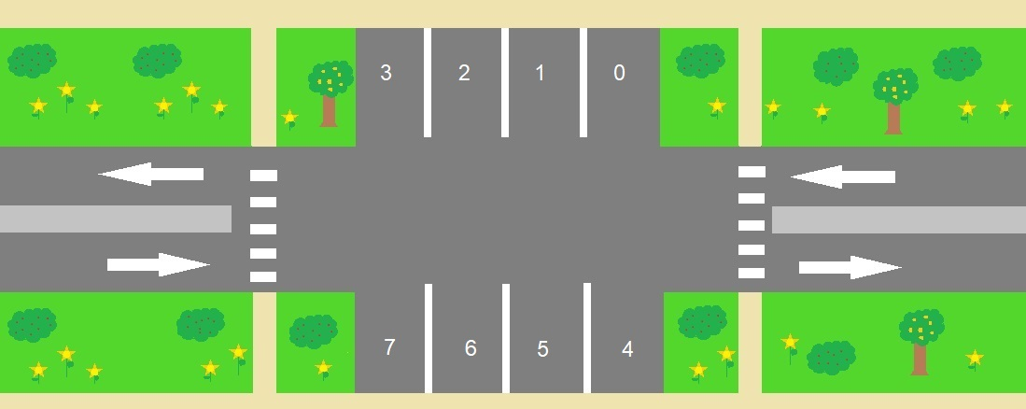
Smart Parking Lot
Group name: 1920aGroup3 – ParkingLot1
Prof. Shahar Maoz Workshop
School of Computer Science
Tel Aviv University, Israel

Slide 2



Introduction – Smart Parking Lot
Purpose:
Allow vehicles enter and exit the parking lot while supporting all complex situations
Support pedestrian mechanism
Complex situations:
Spot maintenance
Parking lot maintenance
Prioritizing VIP cars over regular cars
Pedestrian crossing

Slide 3
Specrta - Parameterization
We used macros:
define
numOfSpots := 7;
numOfSpotsPlusOne := numOfSpots + 1;
numOfSpotsPlusTwo := numOfSpots + 2;
define killAll := 4;

Slide 4
Specrta - Statistics
numOfSpots | 7 | 15 | 15 | 30 | 30
killAll | 4 | 4 | 10 | 10 | 15
Sythesize symbolic controller time | 20643ms | 46888ms | 99594ms | 170913ms | Over an hour… ☹

Slide 5
Specrta - Environment
Main variables:
env boolean carEntrance (also for VIP)
env boolean carExit (also for VIP)
env boolean pedestrianRight (and Left)
env boolean carInSpot[numOfSpotsPlusOne]
env boolean enableMain
Main assumptions:
At the beginning the parking lot is empty
asm G ((carVipEntrance & freeSpot != numOfSpotsPlusOne & !pedetrianLeftLight)-> !(next(carVipEntrance)));

Slide 6
Specrta - System
Main variables:
sys boolean gateEntrance (also for VIP)
sys boolean gateExit (also for VIP)
sys boolean [numOfSpotsPlusTwo] spotMaintenance
sys boolean parkingLotMaintenance
sys boolean [numOfSpotsPlusTwo]spotlight
sys boolean freeSpot
Main guarantees:
gar G exists i in Int(0..numOfSpotsPlusOne).forall j in Int(0..numOfSpotsPlusOne).(j<i->(spotLight[j]=true | spotMaintenance[j] = true)) &spotMaintenance[i] = false & spotLight[i]=false & freeSpot=i;
gar pRespondsToS(pedestrianRight, pedetrianRightLight)

Slide 7
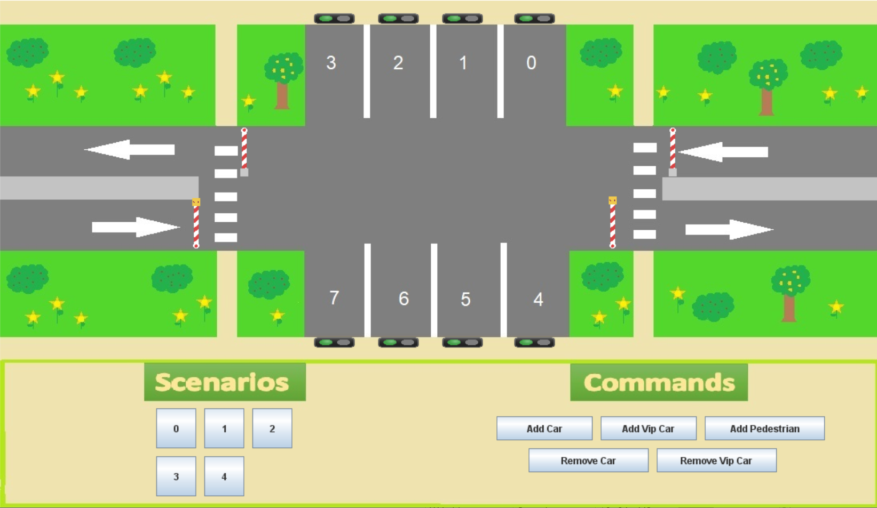
GUI

Slide 8
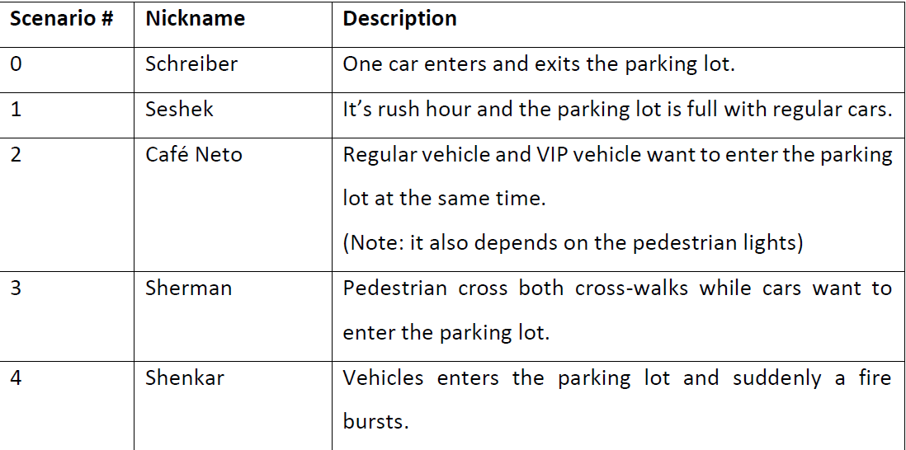
Scenarios

Slide 9
Conclusion
Difficulties:
Using triggers for maintenance
Counters has caused problems with realizability (Solved thanks to Ilia)
It was hard to think “spectra”
Useful features:
forall/exists
pRespodsToS
Features to add:
Regular for

Slide 10

Enjoy Playing

Slide 11
FORMAT

Slide 12
Slide title Arial 28 black, only first word caps
Slide title single line
Main bullet uses Arial 24 black
Sub bullet uses Arial 20 or 22 black
Font size never smaller than 18
Emphasize by using colors, this blue and this red
At most 4-5 bullet points per slide
At most 7-10 words per bullet point, no longer than two lines of text

Slide 13
Example slide with Spectra statements
Type definitions allow introduction of type aliases for reuse
A type definition consists of a name and type
Example definition:
type MotorCmd = {LEFT, OFF, RIGHT};
Example use:
sys MotorCmd telMot;

Slide 14
Example: Guarantees and Assumptions
asm
telPos=1;
asm moveLeft:
G (telMot=LEFT & !P1 -> next(telPos)=telPos-1);
gar
G (P1 -> telMot!=LEFT) & (P2 -> telMot!=RIGHT);
gar surveilP1:
GF P1;
initial assumption (no temporal operator)
optional name
safety assumption/guarantee (temporal operator G)
liveness guarantee (temporal operator GF)

Slide 15
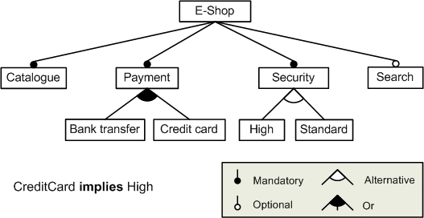
An example slide with a large image

Slide 16
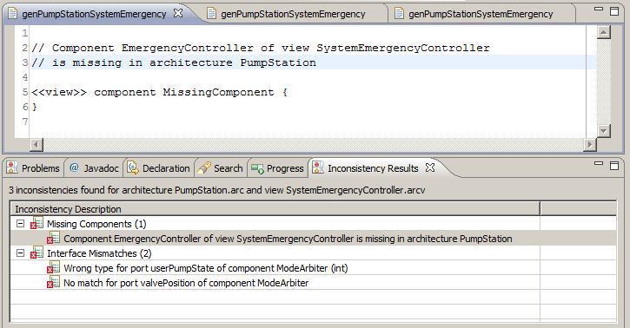
Example slide with image and text
Point to important parts on the image using a red / blue circle as in the example below
More text here

Slide 17
Example slide with a diagram and comments
Use this kind of textbox for comments about the diagram that are not part of it
DiagramName
ModeArbiter
boolean emsPumpState
ValvePosition
userValvePosition
boolean desiredPumpState
boolean userPumpState
ValvePosition desiredValvePosition
ValvePosition emsValvePosition
A note which is part of the diagram
Another external comment which points to a specific part of the diagram

Slide 18
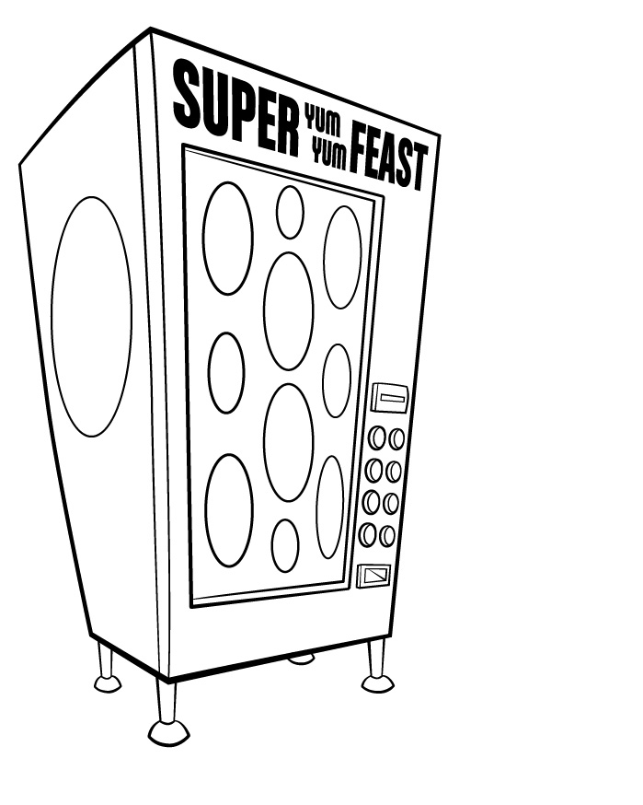
Example slide with a picture
System controlled entities
panel
Boolean enabled
dispenser
cashier
Number coins
Environment controlled entities
User
Heater
6 scenarios

