Slide 1
DataFest 2024
C.R.A.K.ing the Code to Improve Student Learning
Team R-sonists

Slide 2
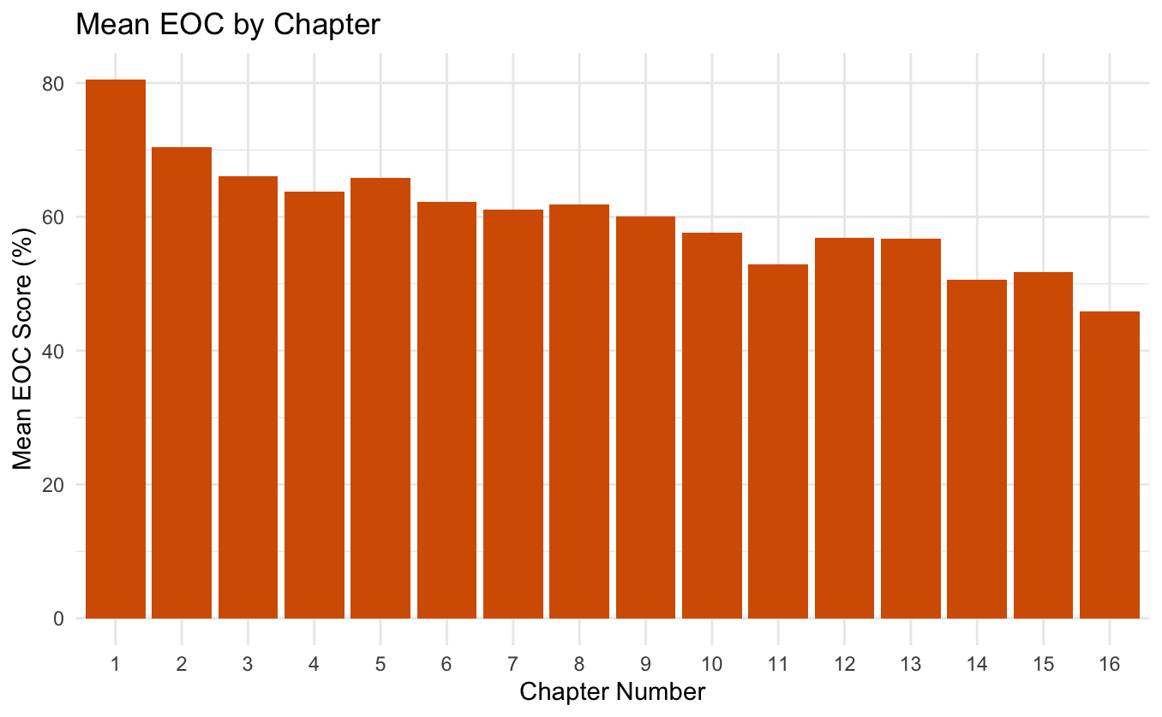
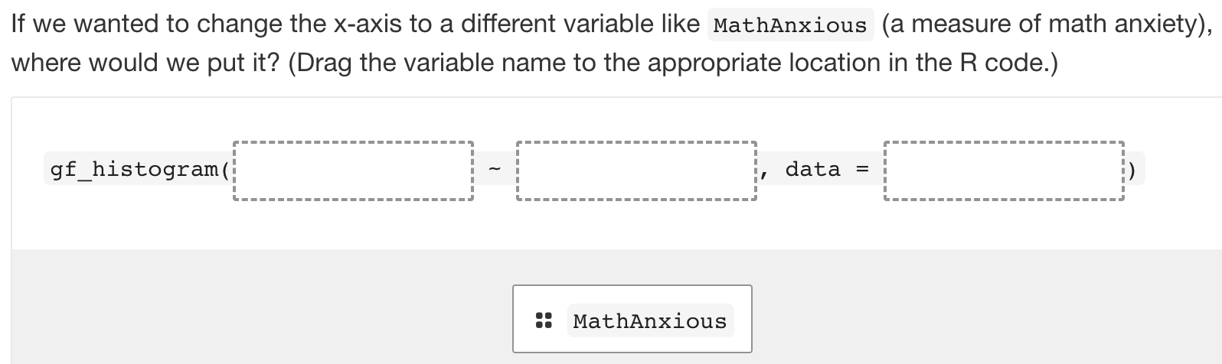
Motivation
Recommendations
Later chapters → more difficult
Impact of non-review questions
Newest Version (5.2)
Add more:
Non-review items in later chapters
Cloze with drag and drop questions
Notes:
Preliminary Analysis:
Later chapter
Version 5.2
Non-Review items
Interested in finding out what are specific things that we can recommend to the teachers in order to improve student learning experience
Why looking at EOC/Engagement:
Educators should focus on students scores and engagement to see how they are
Recommendation
Understanding the effects of learning types and number of non-review questions on both EOC scores and engagement levels is crucial for designing effective textbooks
Educators should consider these findings when selecting or designing learning activities to optimize both student engagement and scores.
We recommend to instructors to include more non-review items toward the later chapters
Because later chapters have more difficult material so it requires more engagement to understand
And more cloze with drag and drop questions because engagement tends to increase

Slide 3
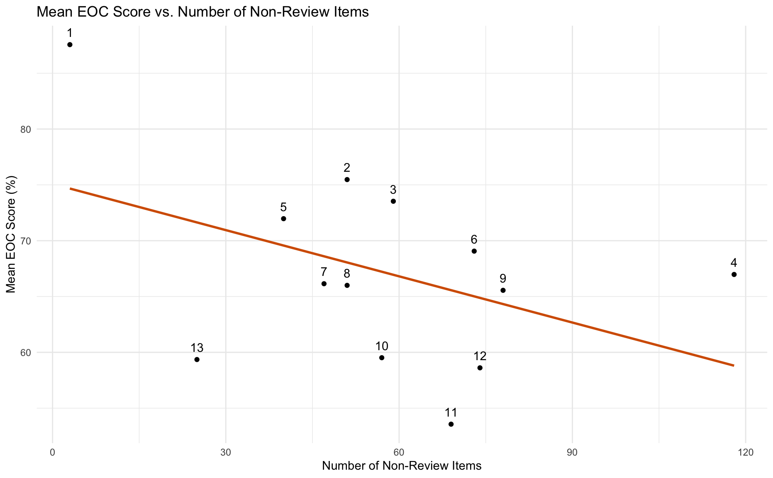
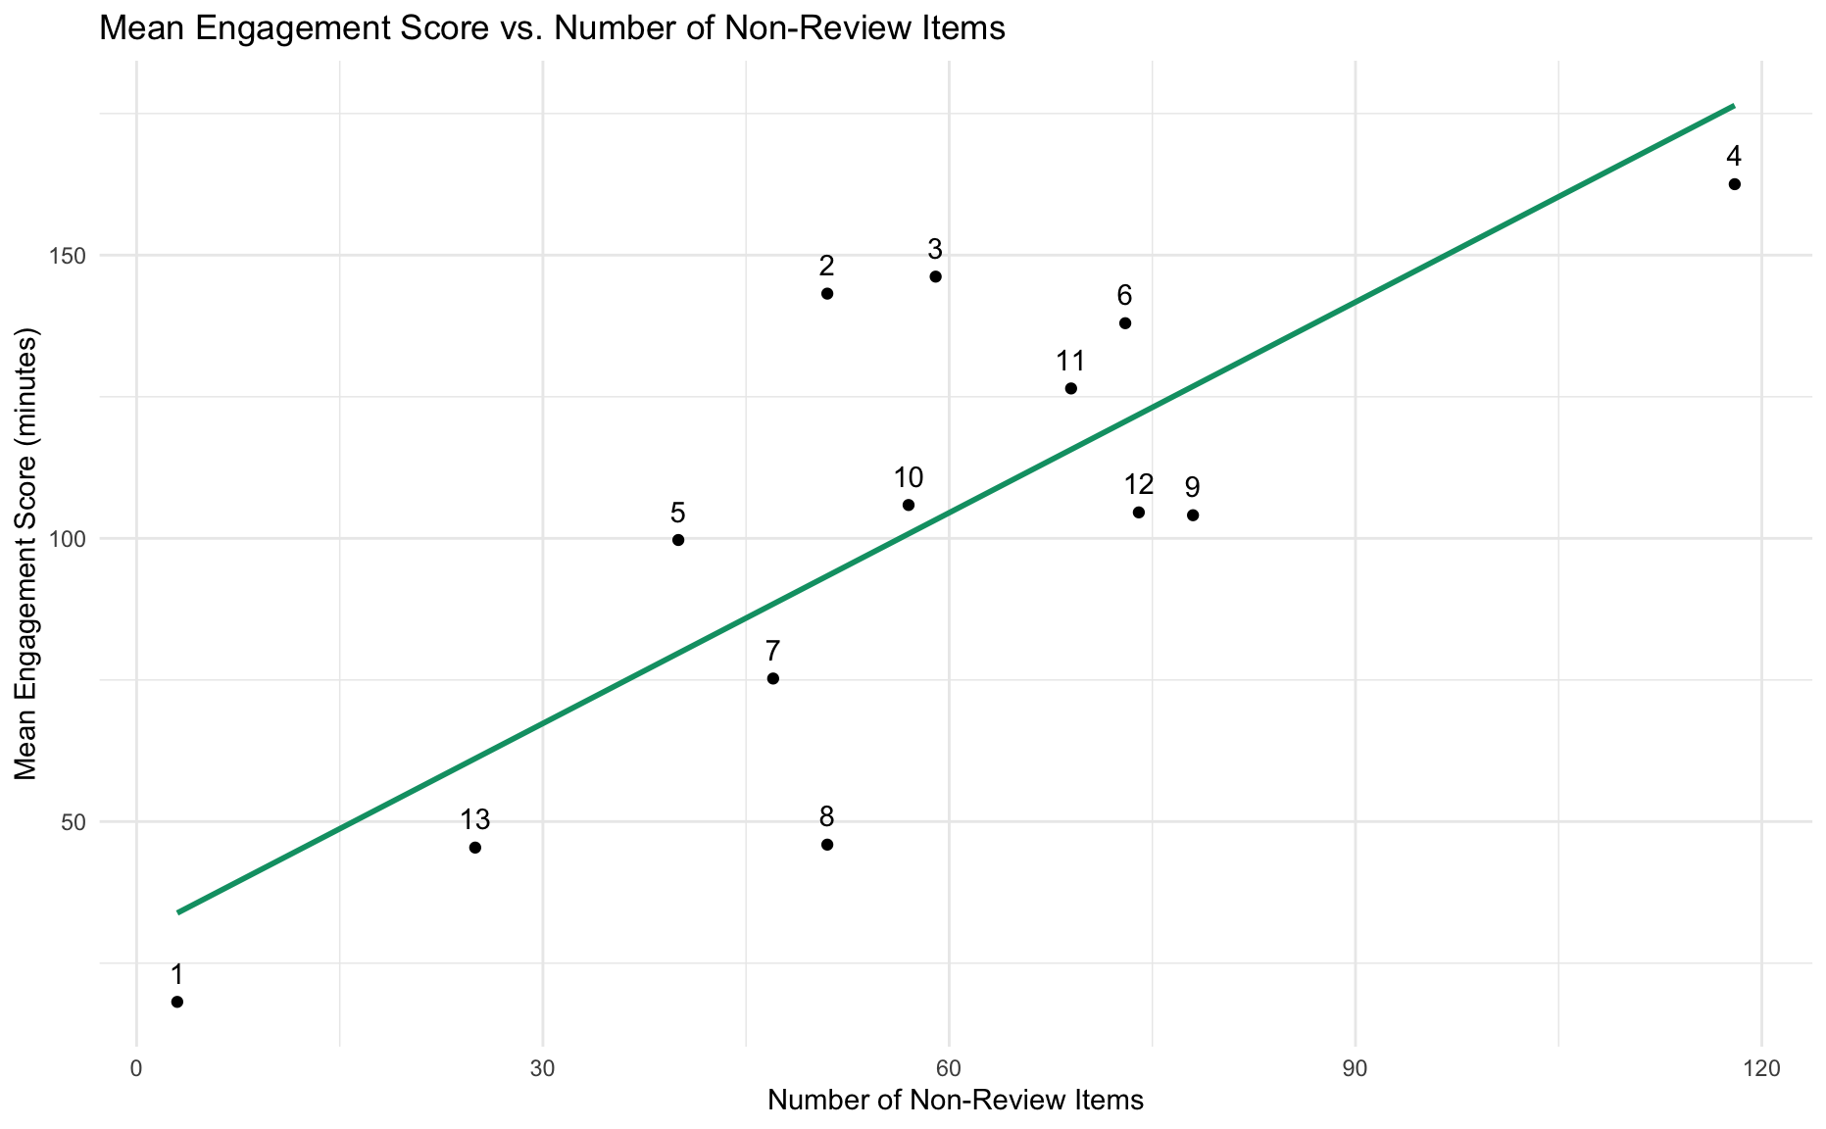
p-value = 0.00162
p-value > 0.1
Multivariate Regression
Response: EOC & Engagement
Explanatory: Non-Review Items
Notes:
First we performed a multivariate regression model measuring EOC and engagement on the number of non-review questions
Mean EOC vs # Non-Review
Each point on the graph is a chapter
We found a non-significant negative relationship between mean eoc and # of non-review questions
1 and 4 are heavy outliers →1 is introductory if they were removed slight positive association
Need further investigation or additional variables to understand the factors influencing EOC performance better
Mean Engagement vs # Non-Review
The linear regression model shows a significant positive relationship between the number of non-review pages and the mean engagement score (p = 0.00162)
Students tend to engage more with the material as the number of non-review pages increases
(having more interactive items before the End of Chapter Assesment leads to higher engagement)
Conclusions suggest that while the depth of engagement may increase with more non-review pages, it may not necessarily translate to improved EOC performance.

Slide 4
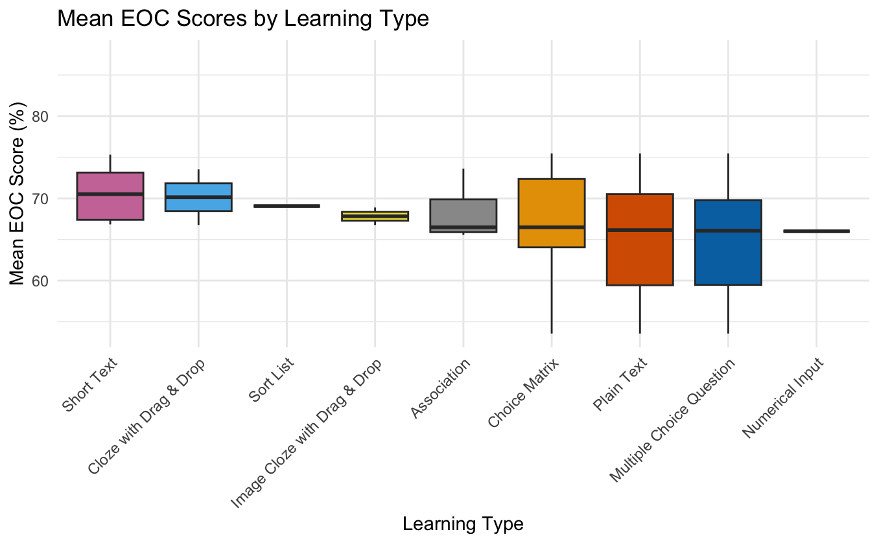
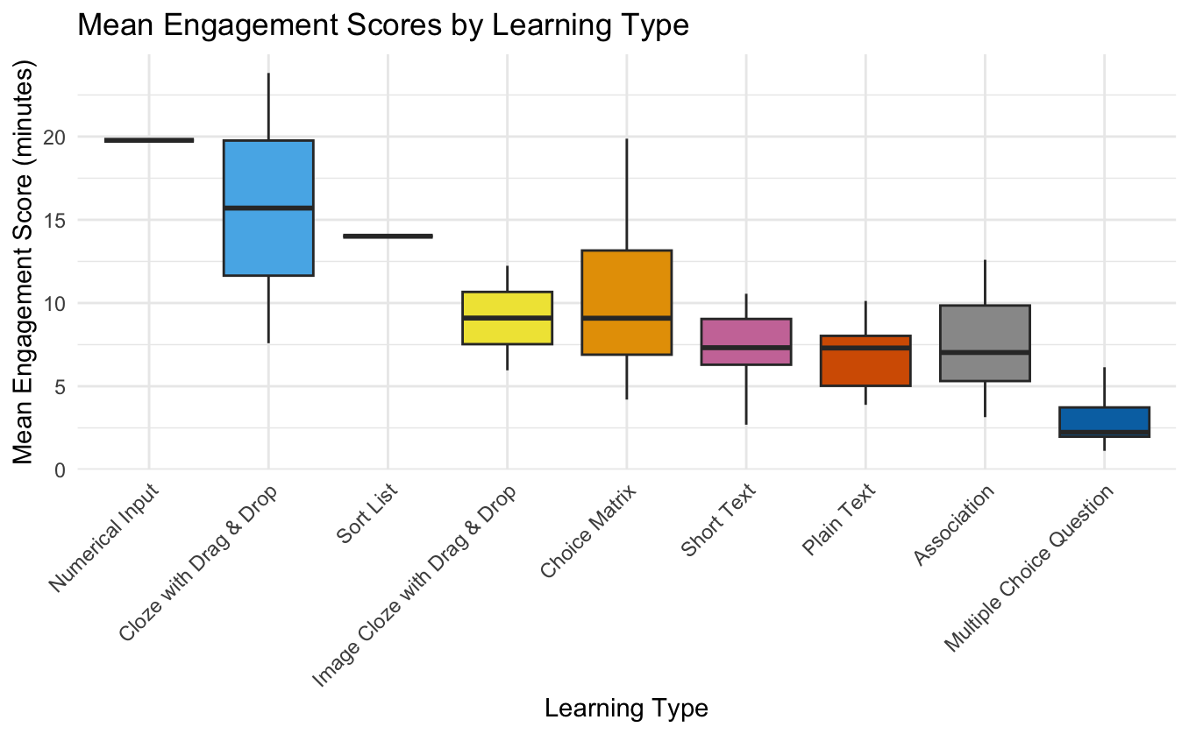
One-Way MANOVA
Response: EOC & Engagement
Explanatory: Type of Question
Multiple Tukey pairwise comparisons yielded significant results for engagement scores
Notes:
One-Way MANOVA to compare the mean vectors -> sees if at least two mu vectors are different
One eigenvalue is substantially larger than the other -> collinear (mean vectors lie close to line) -> Roy's (most powerful) -> Roy's has unreliable p-value in R -> Hotelling-Lawley
After rejecting the MANOVA null hypotheses, we conducted Tukey Comparisons to find the pairwise differences for EOC and engagement across types of questions
We made sure to normalize the number of questions for each learning type
There is a significant difference in engagement levels and different learning types
Overall, we suggest that the type of learning activity significantly impacts student engagement, with certain types leading to higher levels of engagement than others.

