Slide 1
Behavior Changes During COVID-19: Who People Are and How That Affects Their Activity Level
Rachel Rowe and Frederick Sell

Slide 2
Data!
UMD National Center for Smart Growth (NCSG) created a survey
How did habits change?
Distributed
Social media
Email lists
Two international airports

Slide 3


Respondents by the Numbers
557 individuals surveyed
403 zip codes represented
Notes:
Dataset we received originally included 564 individuals, but after data cleaning [how DID we clean] we noticed repeat identical responses and other invalid data that we removed

Slide 4
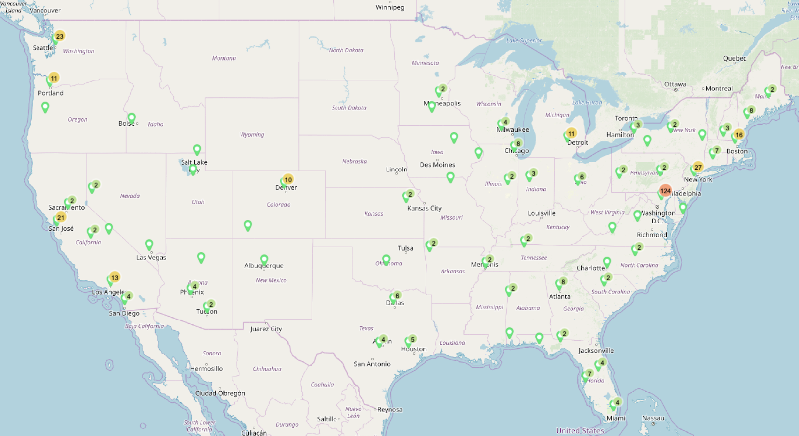
Notes:
Discuss concentrations in DC and WA because of survey distribution at international airports there

Slide 5
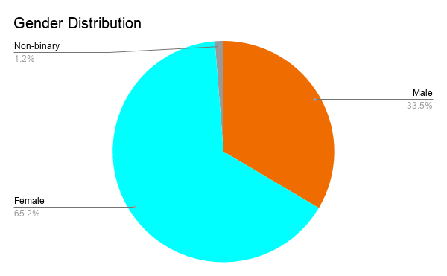
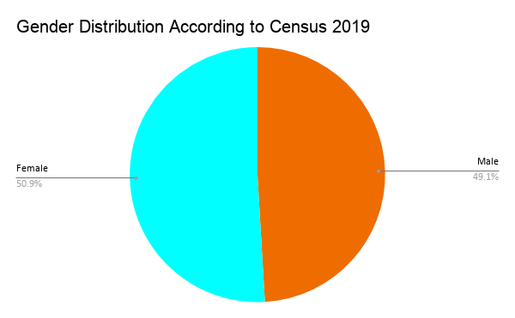
Who Is in Our Dataset?
SOURCE: U.S. Census Bureau, Current Population Survey, Annual Social and Economic Supplement, 2019.

Slide 6
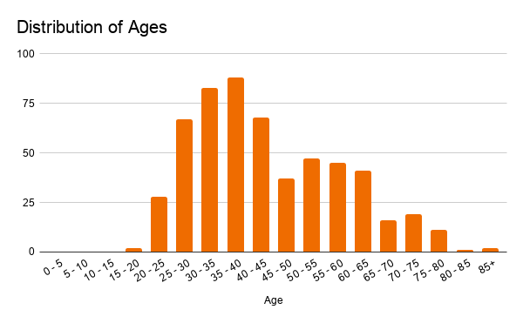
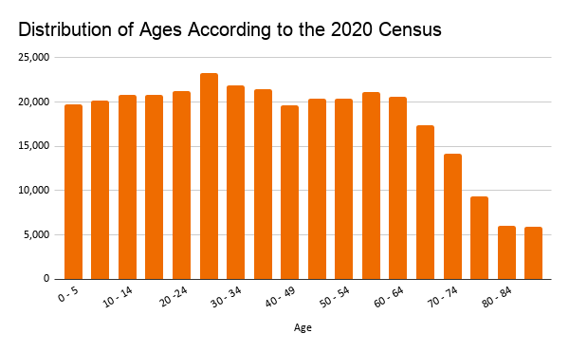
Who Is in Our Dataset?
Mean: 43.3 years
Median: 40 years
SOURCE: U.S. Census Bureau, Current Population Survey, Annual Social and Economic Supplement, 2019.

Slide 7
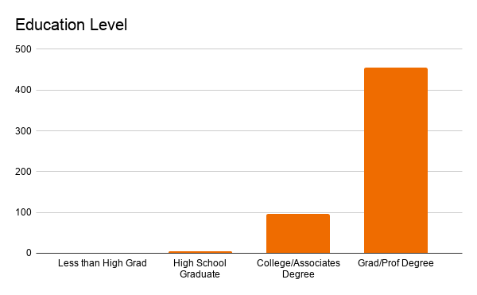
Who Is in Our Dataset?

Slide 8
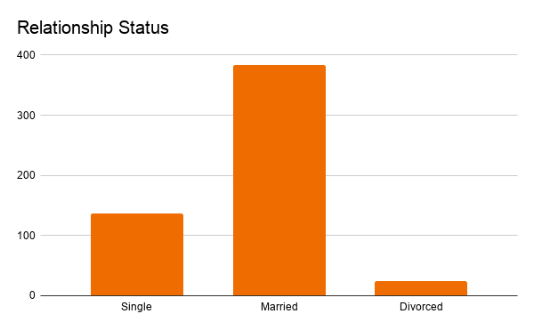
Who Is in Our Dataset?

Slide 9
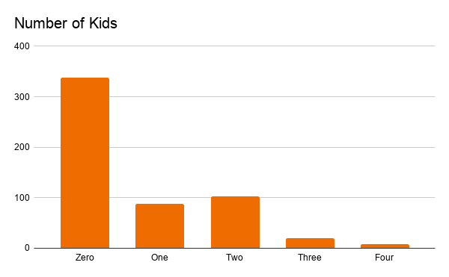
Who Is in Our Dataset?
Mean: 0.6 Kids
Median: 0 Kids

Slide 10
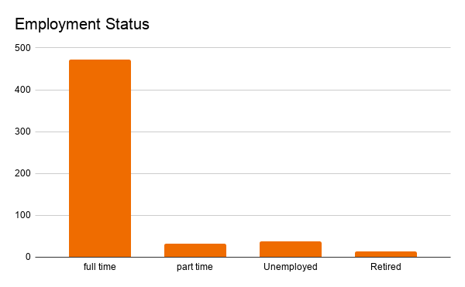
Who Is in Our Dataset?

Slide 11
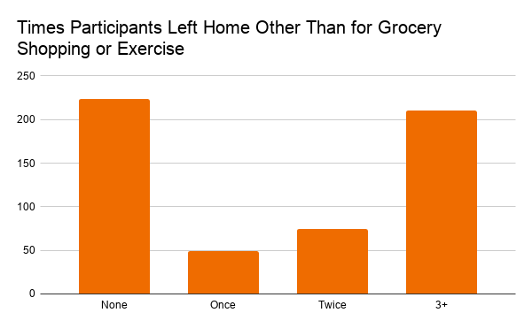
Who Is in Our Dataset?

Slide 12
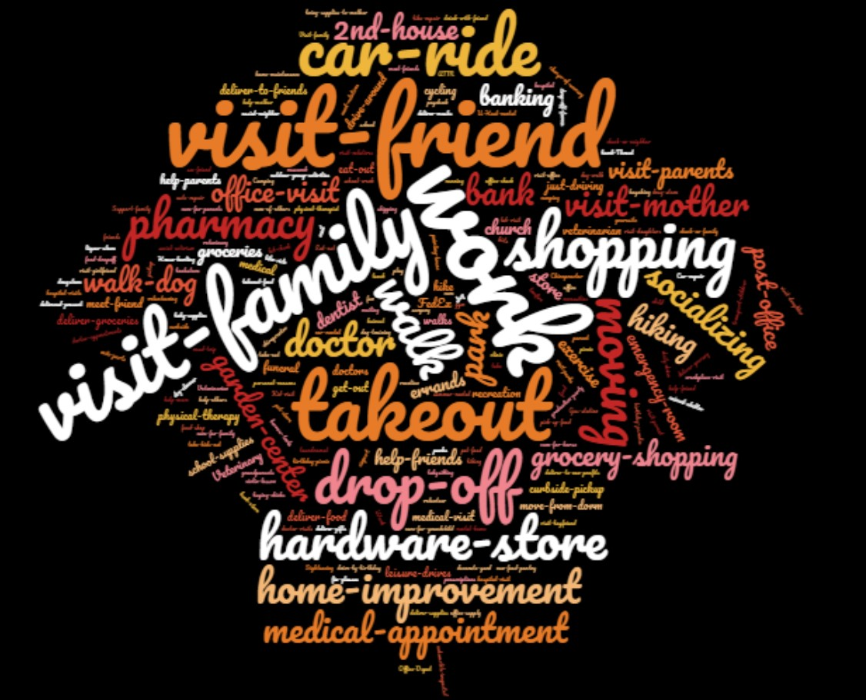

Slide 13
Who Is in Our Dataset?
Interesting notes:
Majority women
Age Skew
Very Educated

Slide 14
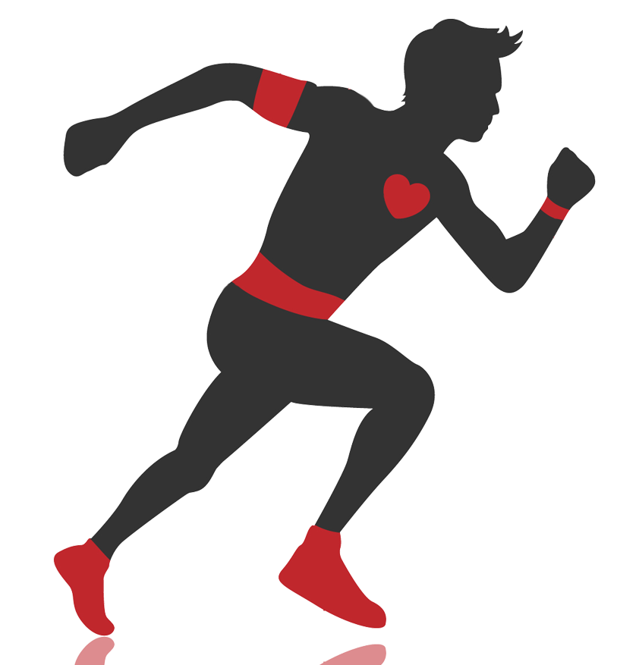
What Factors are Related to Exercise Change?
The WHO: “Physical activity...
Has significant health benefits
Reduces depression and anxiety
Helps improve quality of life”
SOURCE: The World Health Organization, Fact Sheet on Physical Activity

Slide 15
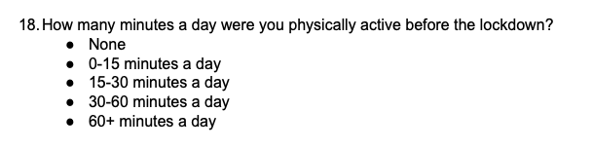
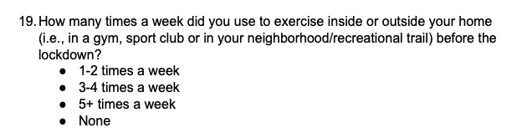
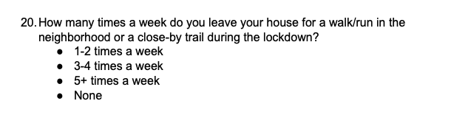
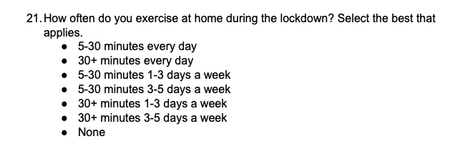
Mild
Mild
Hardcore
None
Mild
Mild
Hardcore
None
Hardcore
Hardcore
Mild
Mild
Mild
Mild
None

Slide 16
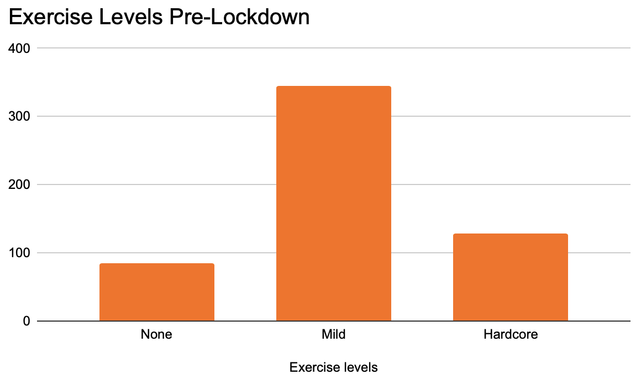
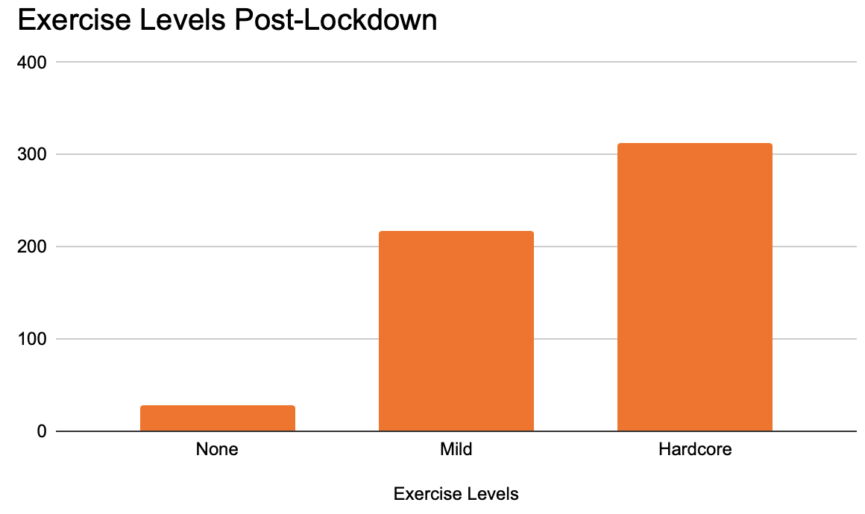
Exercise Levels

Slide 17
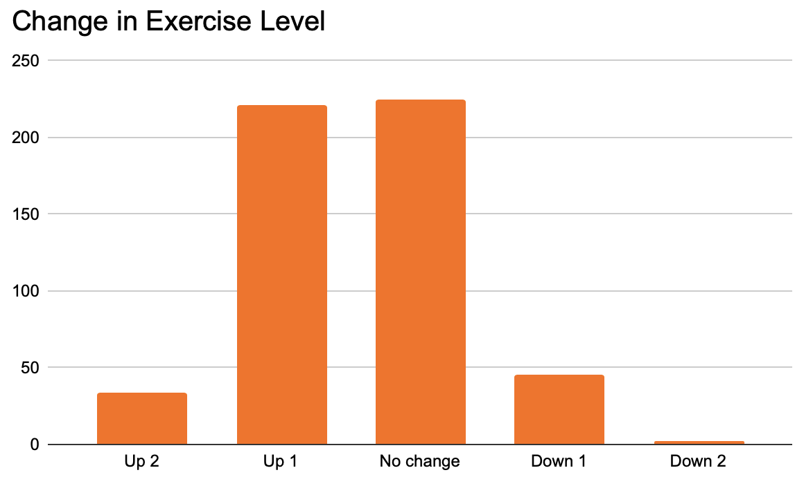
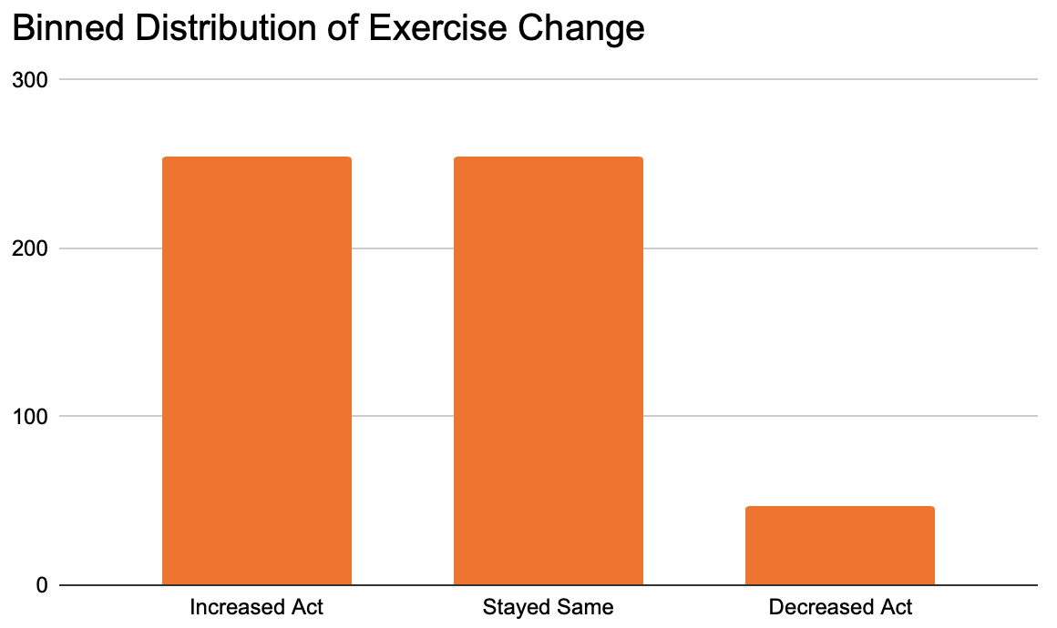
Two Perspectives on the Change in Exercise

Slide 18
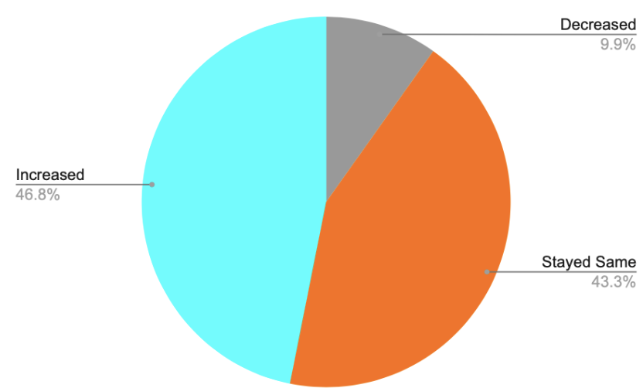
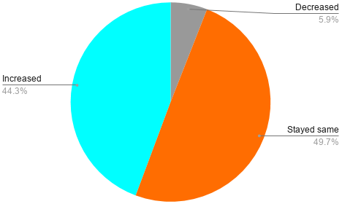
Gender and Exercise
Females
Males
* Note: 65.2% of respondents were female
Notes:
Little evidence to suggest gender affects exercise level
Num females: 365
Num males: 185

Slide 19
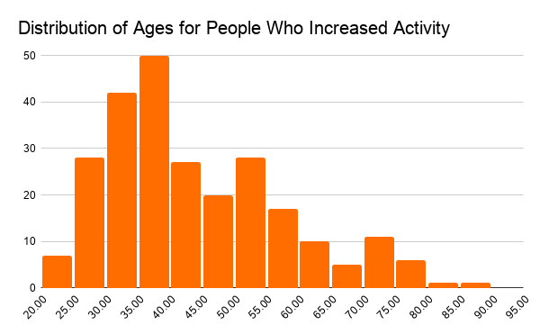
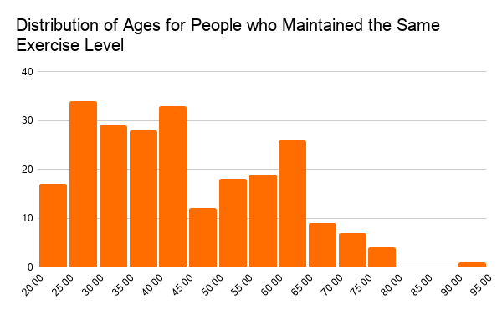
Age and Exercise
Mean: 43.2 years
Median: 39 years
Mean: 39.6 years
Median: 38 years
* Note: The percentage of respondents who reported decreased activity (47) was too small to produce relevant results, so we omitted that distribution here
Notes:
Shape of left distribution is similar to age distribution, older people are overrepresented among those maintaining the same exercise level

Slide 20
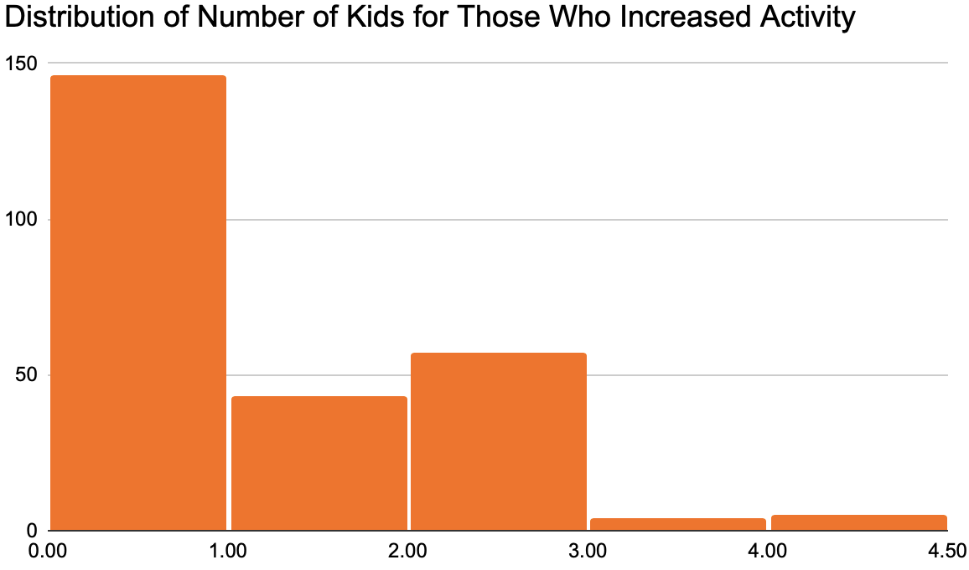
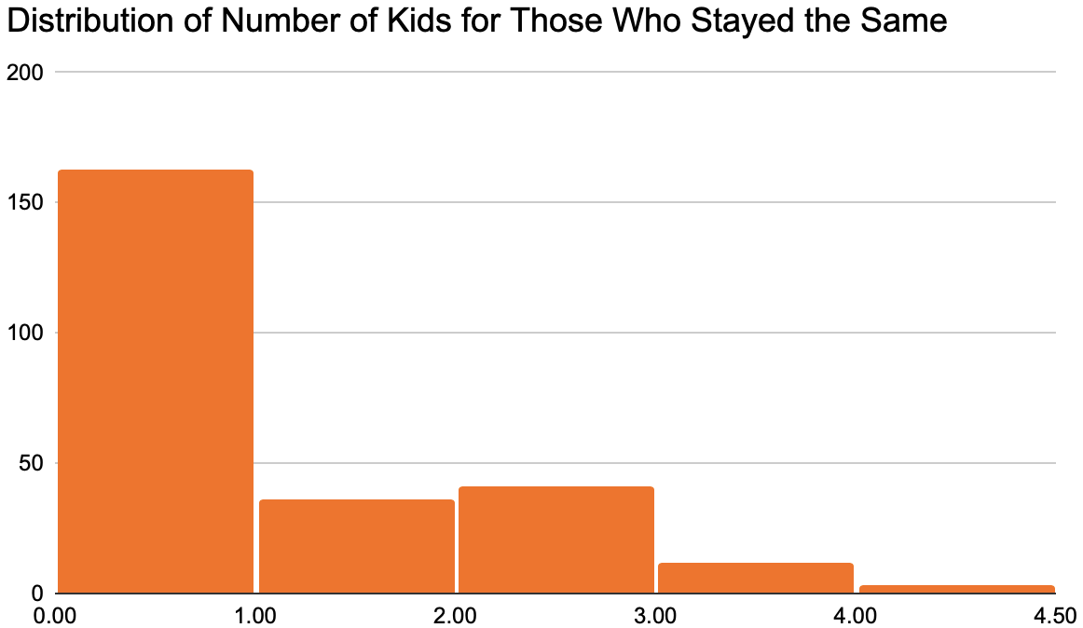
Number of Kids and Exercise
Mean: 0.7 kids
Median: 0 kids
Mean: 0.6 kids
Median: 0 kids
* Note: The percentage of respondents who reported decreased activity (47) was too small to produce relevant results, so we omitted that distribution here
Notes:
Num increased in activity: 255, Num stayed the same: 255

Slide 21
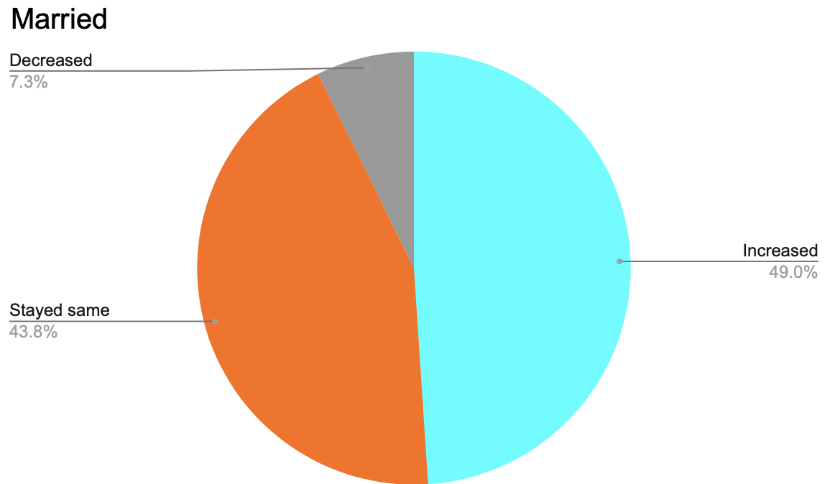
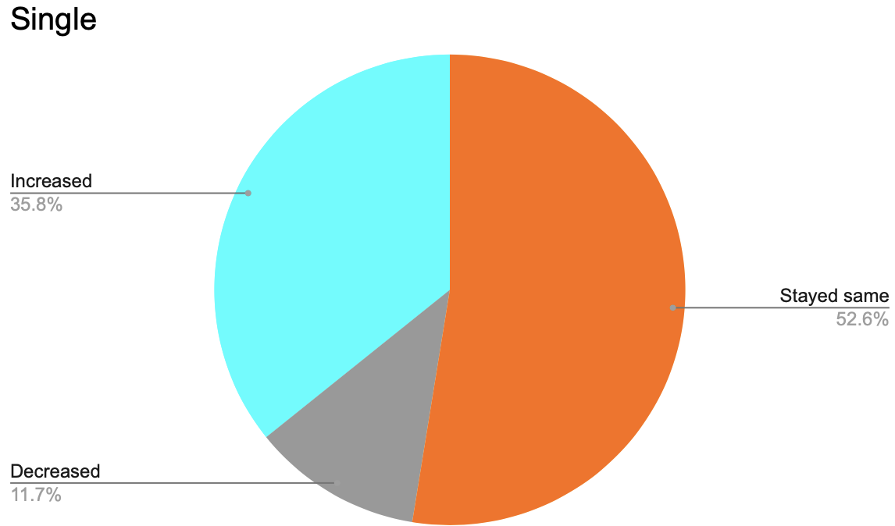
Marriage and Exercise
* Note: Omitted divorced/separated (25) due to limited representation in the data set
Notes:
Sample size of married: 384, those who are single: 137

Slide 22
Observations
Increase in exercise
Gender, number of kids: little correlation
50+ years old: overrepresented for stayed same
Married people were more likely to increase
Notes:
CORRELATION = APPROPRIATE WORD?

Slide 23
Conclusions
Female, highly educated, employed, married, 30s-40s
More socially, financially stable
Stability
Companionship
Notes:
overrepresented, which suggests that the respondents were likely to be more socially and financial stable than the general US population
stability appears to contribute to ability to one’s increase exercise level
benefits physical and mental wellbeing and potentially mitigates increased anxiety and depression caused by the lockdowns
Relating this to the WHO’s measurement of quality of life, the stability suggested by the data indicates

Slide 24
Thank You!
Any Questions?

